Slide 1
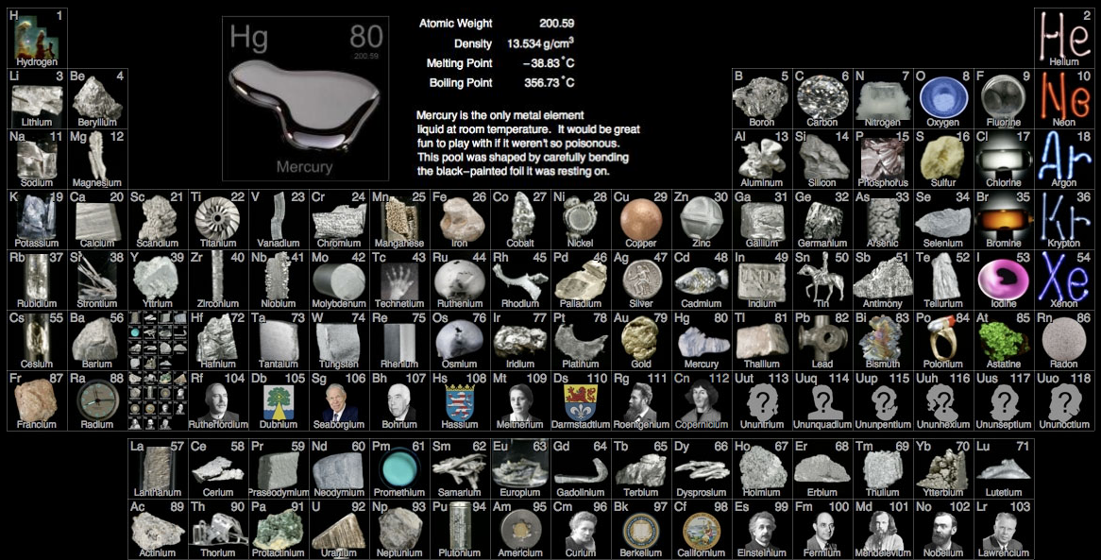
PART 3: Oxides and chorides of the third period (sodium → argon)

Slide 2
Oxides of Period 3 Elements

Slide 3
Formula | Na₂O | MgO | Al₂O₃ | SiO₂ | P₄O₁₀ (P₄O₆) | SO₃ (SO₂) | Cl₂O₇ (Cl₂O)
State at 25°C
Melting pt. (°C)
Boiling pt. (°C)
Electrical conductivity in molten state
Structure
Rxn w/ H₂O
Nature of oxide

Slide 4
Formula | Na₂O | MgO | Al₂O₃ | SiO₂ | P₄O₁₀ (P₄O₆) | SO₃ (SO₂) | Cl₂O₇ (Cl₂O)
State at 25°C
Melting pt. (°C)
Boiling pt. (°C)
Electrical conductivity in molten state
Structure
Rxn w/ H₂O
Nature of oxide
solid
liquid
liquid
solid
solid
solid
solid
(solid)
(gas)
(gas)
1275
2852
2027
1610
24
17
-92
-
3600
2980
2230
175
45
80

Slide 5
Formula | Na₂O | MgO | Al₂O₃ | SiO₂ | P₄O₁₀ (P₄O₆) | SO₃ (SO₂) | Cl₂O₇ (Cl₂O)
State at 25°C
Melting pt. (°C)
Boiling pt. (°C)
Electrical conductivity in molten state
Structure
Rxn w/ H₂O
Nature of oxide
solid
liquid
liquid
solid
solid
solid
solid
(solid)
(gas)
(gas)
1275
2852
2027
1610
24
17
-92
-
3600
2980
2230
175
45
80
very poor
good
none

Slide 6
Formula | Na₂O | MgO | Al₂O₃ | SiO₂ | P₄O₁₀ (P₄O₆) | SO₃ (SO₂) | Cl₂O₇ (Cl₂O)
State at 25°C
Melting pt. (°C)
Boiling pt. (°C)
Electrical conductivity in molten state
Structure
Rxn w/ H₂O
Nature of oxide
solid
liquid
liquid
solid
solid
solid
solid
(solid)
(gas)
(gas)
1275
2852
2027
1610
24
17
-92
-
3600
2980
2230
175
45
80
very poor
good
none
covalent
macro-
molecular
simple covalent molecular
ionic

Slide 7
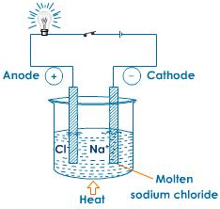
Physical properties - melting points, boiling points & conductivity: (from left → right)
Left side of PT: oxides of Na, Mg and Al
ionic (metal + nonmetal… large difference in electronegativity)
Ionic solids have high melting points
Ionic solids are capable of conducting electricity in molten state (moving charge = electricity)

Slide 8
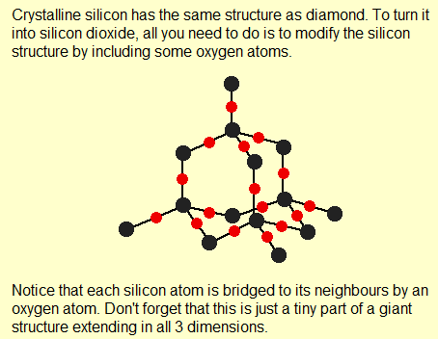
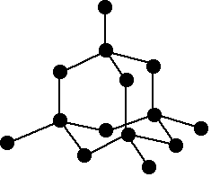
Physical properties - melting points, boiling points & conductivity: (from left → right)
Middle of PT: oxide of Si (silicon dioxide)
macromolecular structure
Strong diamond-like structure (covalently bonded network) accounts for high boiling point
diamond
SiO₂

Slide 9
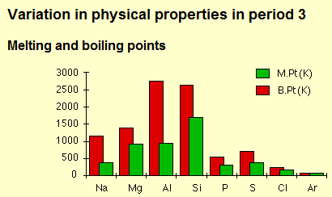
Physical properties - melting points, boiling points & conductivity: (from left → right)
Right side of PT: oxides of P, S and Cl
simple covalent molecules
difference in electronegativities between element and oxygen is small
low melting and boiling points

Slide 10
Formula | Na₂O | MgO | Al₂O₃ | SiO₂ | P₄O₁₀ (P₄O₆) | SO₃ (SO₂) | Cl₂O₇ (Cl₂O)
State at 25°C
Melting pt. (°C)
Boiling pt. (°C)
Electrical conductivity in molten state
Structure
Rxn w/ H₂O
Nature of oxide
solid
liquid
liquid
solid
solid
solid
solid
(solid)
(gas)
(gas)
1275
2852
2027
1610
24
17
-92
-
3600
2980
2230
175
45
80
very poor
good
none
covalent
macro-
molecular
simple covalent molecular
ionic
Forms NaOH(aq),
alkaline
Forms MgOH₂(aq),
Weakly alkaline
does
not
react
P₄O₁₀ forms H₃PO₄(aq),
a weak acid
SO₃ forms H₂SO₄(aq),
a strong acid
Cl₂O₇ forms HClO₄(aq),
a strong acid
does
not
react

Slide 11
Formula | Na₂O | MgO | Al₂O₃ | SiO₂ | P₄O₁₀ (P₄O₆) | SO₃ (SO₂) | Cl₂O₇ (Cl₂O)
State at 25°C
Melting pt. (°C)
Boiling pt. (°C)
Electrical conductivity in molten state
Structure
Rxn w/ H₂O
Nature of oxide
solid
liquid
liquid
solid
solid
solid
solid
(solid)
(gas)
(gas)
1275
2852
2027
1610
24
17
-92
-
3600
2980
2230
175
45
80
very poor
good
none
covalent
macro-
molecular
simple covalent molecular
ionic
Forms NaOH(aq),
alkaline
Forms MgOH₂(aq),
Weakly alkaline
does
not
react
P₄O₁₀ forms H₃PO₄(aq),
a weak acid
SO₃ forms H₂SO₄(aq),
a strong acid
Cl₂O₇ forms HClO₄(aq),
a strong acid
does
not
react
basic
amphoteric
acidic

Slide 12
Chemical properties - Acid-base nature of oxides: (from left → right)
Oxides of electropositive (opposite of electronegative) elements are very basic and form alkaline solutions.
Na₂O(s) + H₂O(l) →
MgO(s) + H₂O(l) →
2
NaOH(aq)
Mg(OH)₂(aq)

Slide 13
Chemical properties - Acid-base nature of oxides: (from left → right)
The amphoteric nature of aluminum oxide can be seen from its rxns w/ hydrochloric acid (a strong acid) and sodium hydroxide (a strong base)
Acting as a base:
Acting as an acid:
Al₂O₃(aq) + 6HCl(aq) → 2AlCl₃(aq) + 3H₂O(l)
Al₂O₃(aq) + 2NaOH(aq) + 3H₂O(l) → 2NaAl(OH)₃(aq)
sodium aluminate

Slide 14
Chemical properties - Acid-base nature of oxides: (from left → right)
Silicon dioxide behaves as a weak acid. It does not react with water (that would be weird… SiO₂ is sand, so if sand chemically reacted with water then our beaches would be very different places).
Imagine beach erosion rates if water chemically reacted with sand!!!

Slide 15
Chemical properties - Acid-base nature of oxides: (from left → right)
Silicon dioxide behaves as a weak acid. It does not react with water (that would be weird… SiO₂ is sand, so if sand chemically reacted with water then our beaches would be very different places). However, silicon dioxide will form sodium silicate with sodium hydroxide (meaning it reacts with a base).
SiO₂(s) + 2NaOH(aq) →
Na₂SiO₃(aq) + H₂O(l)

Slide 16
Chemical properties - Acid-base nature of oxides: (from left → right)
The oxides of phosphorus, sulfur and chlorine are all strongly acidic (all form strong acids when added to water).
SO₂(s) + H₂O(l) →
P₄O₁₀(s) + H₂O(l) →
Cl₂O₇(l) + H₂O(l) →
H₂SO₃(aq)
sulfurous acid
6
4
H₃PO₄(aq)
phosphoric acid
2
HClO₄(aq)
perchloric acid

Slide 17
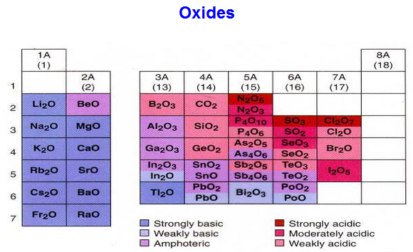
Chemical properties - Acid-base nature of oxides: (from left → right)

Slide 18
Chlorides of Period 3 Elements

Slide 19
Formula | NaCl | MgCl₂ | Al₂Cl₆ | SiCl₄ | PCl₃ (PCl₅) | S₂Cl₂ | Cl₂
State at 25°C
Melting pt. (°C)
Boiling pt. (°C)
Electrical conductivity in molten state
Structure
Rxn w/ H₂O
Nature of solution

Slide 20
Formula | NaCl | MgCl₂ | Al₂Cl₆ | SiCl₄ | PCl₃ (PCl₅) | S₂Cl₂ | Cl₂
State at 25°C
Melting pt. (°C)
Boiling pt. (°C)
Electrical conductivity in molten state
Structure
Rxn w/ H₂O
Nature of solution
liquid
solid
solid
solid
liquid
liquid
gas
(solid)
801
714
178
-70
-112
-80
-101
(sublimes)
1413
1412
-
58
76
136
-35

Slide 21
Formula | NaCl | MgCl₂ | Al₂Cl₆ | SiCl₄ | PCl₃ (PCl₅) | S₂Cl₂ | Cl₂
State at 25°C
Melting pt. (°C)
Boiling pt. (°C)
Electrical conductivity in molten state
Structure
Rxn w/ H₂O
Nature of solution
liquid
solid
solid
solid
liquid
liquid
gas
(solid)
801
714
178
-70
-112
-80
-101
(sublimes)
1413
1412
-
58
76
136
-35
good
poor
none

Slide 22
Formula | NaCl | MgCl₂ | Al₂Cl₆ | SiCl₄ | PCl₃ (PCl₅) | S₂Cl₂ | Cl₂
State at 25°C
Melting pt. (°C)
Boiling pt. (°C)
Electrical conductivity in molten state
Structure
Rxn w/ H₂O
Nature of solution
liquid
solid
solid
solid
liquid
liquid
gas
(solid)
801
714
178
-70
-112
-80
-101
(sublimes)
1413
1412
-
58
76
136
-35
good
poor
none
ionic
simple covalent molecule

Slide 23
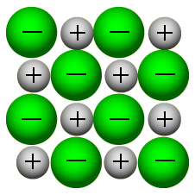
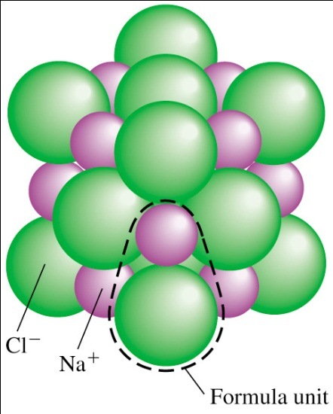
Physical properties - melting points, boiling points & conductivity: (from left → right)
Structure affects physical properties of chlorides in the same way it did for oxides.
NaCl and MgCl₂ are ionic – conduct electricity in molten state – high melting points

Slide 24
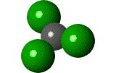
Physical properties - melting points, boiling points & conductivity: (from left → right)
AlCl₃ is covalent – poor conductor

Slide 25
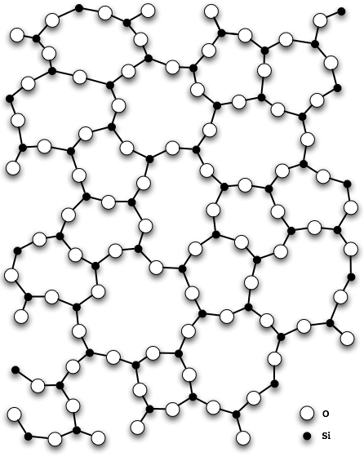
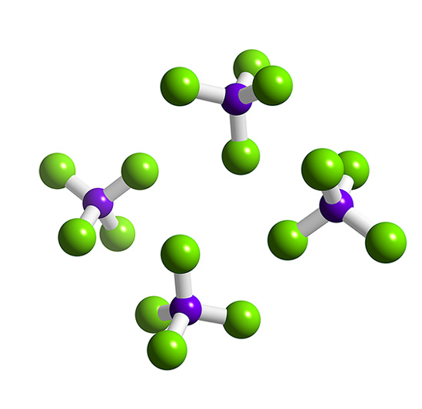
Physical properties - melting points, boiling points & conductivity: (from left → right)
Unlike SiO₂, SiCl₄ has a simple molecular structure (not a macromolecular network)
SiO₂ network
SiCl₄ molecules

Slide 26
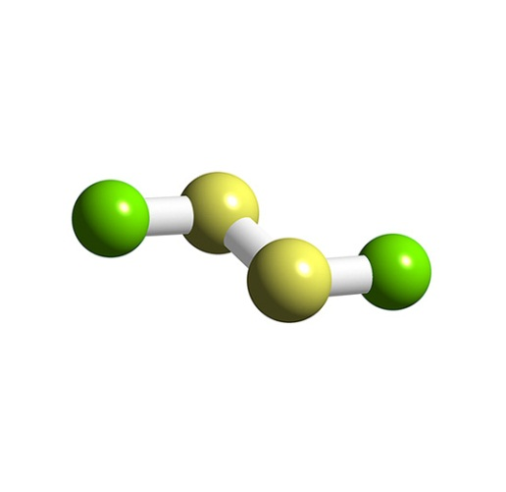
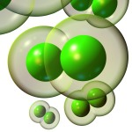
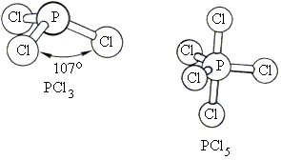
Physical properties - melting points, boiling points & conductivity: (from left → right)
PCl₃, PCl₅, S₂Cl₂, Cl₂ – all have simple molecular structures (covalently bonded molecules)
held together by weak van der Waals’ forces, resulting in low melting and boiling points.
S₂Cl₂
Cl₂ molecules

Slide 27
Formula | NaCl | MgCl₂ | Al₂Cl₆ | SiCl₄ | PCl₃ (PCl₅) | S₂Cl₂ | Cl₂
State at 25°C
Melting pt. (°C)
Boiling pt. (°C)
Electrical conductivity in molten state
Structure
Rxn w/ H₂O
Nature of solution
liquid
solid
solid
solid
liquid
liquid
gas
(solid)
801
714
178
-70
-112
-80
-101
(sublimes)
1413
1412
-
58
76
136
-35
good
poor
none
ionic
simple covalent molecule
dissolves easily
Fumes of HCl produced
Some rxn w/ H₂O

Slide 28
Formula | NaCl | MgCl₂ | Al₂Cl₆ | SiCl₄ | PCl₃ (PCl₅) | S₂Cl₂ | Cl₂
State at 25°C
Melting pt. (°C)
Boiling pt. (°C)
Electrical conductivity in molten state
Structure
Rxn w/ H₂O
Nature of solution
liquid
solid
solid
solid
liquid
liquid
gas
(solid)
801
714
178
-70
-112
-80
-101
(sublimes)
1413
1412
-
58
76
136
-35
good
poor
none
ionic
simple covalent molecule
dissolves easily
Fumes of HCl produced
Some rxn w/ H₂O
weakly
acidic
neutral
acidic

Slide 29
Chemical properties - Acid-base nature of chlorides: (from left → right)
NaCl dissolves in H₂O to give a neutral solution
(more on why when we get to the acid/base unit).
MgCl₂ gives a slightly acidic solution with water
(again, more on this later).

Slide 30
Chemical properties - Acid-base nature of chlorides: (from left → right)
All other chlorides including AlCl₃ react vigorously with water to produce acidic solutions of hydrochloric acid together with fumes of hydrogen chloride.
AlCl₃(s) + H₂O(l) →
SiCl₄(l) + H₂O(l) →
PCl₃(l) + H₂O(l) →
2
3
Al₂O₃(s) + HCl(aq)
6
4
4
Si(OH)₄(aq) + HCl(aq)
3
H₃PO₃(aq) + HCl(aq)
3

Slide 31
Chemical properties - Acid-base nature of chlorides: (from left → right)
Chlorine itself reacts with water to some extent to form acidic solution.
Cl₂(g) + H₂O(l) ⇔
HCl(aq) + HClO(aq)

