Slide 1
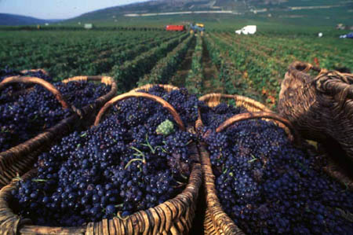
Organic Chemistry
Part 4: Reactions of Alcohols; Substitution Rxns

Slide 2
Reactions of Alcohols

Slide 3
Combustion
General eq’n for an alcohol combusting completely in oxygen:
C_{n}H_{(2n+1)}OH(l) + (2n+1)O₂(g) → nCO₂(g) + (n+1)H₂O(l)

Slide 4
Combustion
Ethanol is used as both a solvent and as a fuel. It combusts completely in excess oxygen to produce carbon dioxide and water.
C₂H₅OH(l) + 3O₂(g) → 2CO₂(g) + 3H₂O(l)
ΔH°=-1371 kJ⋅mol⁻¹

Slide 5
Combustion
Ethanol is already partially oxidized, so it releases less energy than burning and alkane of comparable mass.
However, it can be obtained by the fermentation of biomass; thus, in some countries it is mixed with gasoline to produce “gasohol” which decreases dependence on crude oil.

Slide 6
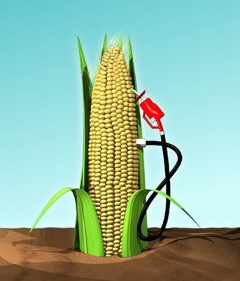
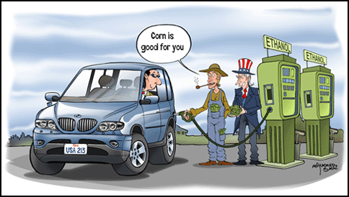
Ethanol as fuel?

Slide 7
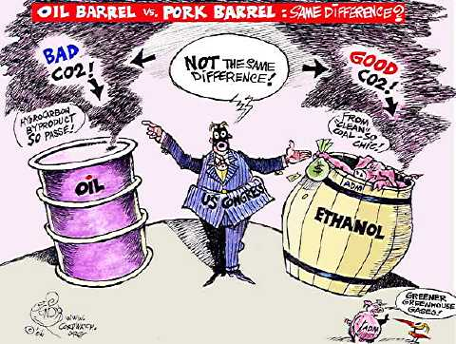
Ethanol as fuel?

Slide 8
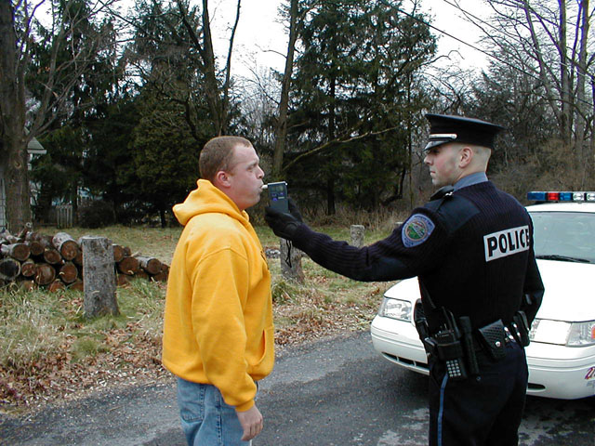
Oxidation of ethanol
Ethanol can be readily oxidized by warming with an acidified sol’n of potassium dichromate (VI). During the process, the orange dichromate(VI) ion Cr₂O₇²⁻ is reduced from an oxidation state of +6 to the green Cr³⁺ ion.
Breathalyzer test: blow into bag through tube of acidified KCr₂O₇ crystals. If orange crystals turn green, this indicates presence of a lot of ethanol (high BAC).

Slide 9
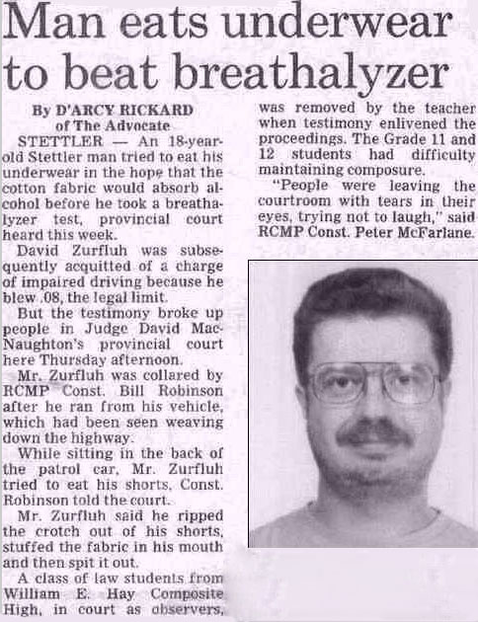

Slide 10
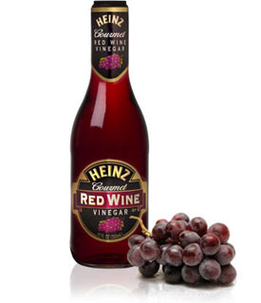
Oxidation of alcohols
Ethanol is initially oxidized to ethanal. The ethanal is then oxidized further to ethanoic acid.

Slide 11
Oxidation of alcohols
→ ethanal →
(b.p.=20.8°C)
ethanol (b.p.=78.5°C)
ethanoic acid (b.p.=118°C)
Low b.p. because no H-bonding
To stop rxn at ethanal stage, distill ethanal from the rxn mixture as soon as it is formed.
If complete oxidation to ethanoic acid is desired, heat the mixture under reflux so that none of the ethanal can escape.

Slide 12
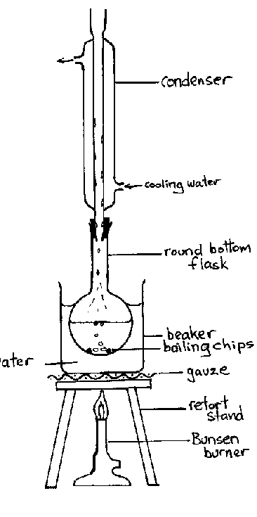
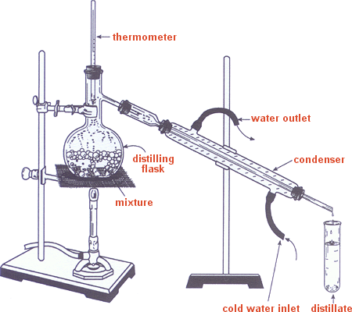
Distillation v. Reflux heating
Distillation:
Reflux:

Slide 13
Oxidation of alcohols: Ethanol is a primary alcohol. The oxidation reactions of alcohols can be used to distinguish between primary, secondary and tertiary alcohols.
All primary (1°) alcohols are oxidized by acidified KCr₂O₇, first to aldehydes then to carboxyllic acids.

Slide 14
Oxidation of alcohols: Ethanol is a primary alcohol. The oxidation reactions of alcohols can be used to distinguish between primary, secondary and tertiary alcohols.
All secondary (2°) alcohols are oxidized to ketones, which cannot undergo further oxidation.

Slide 15
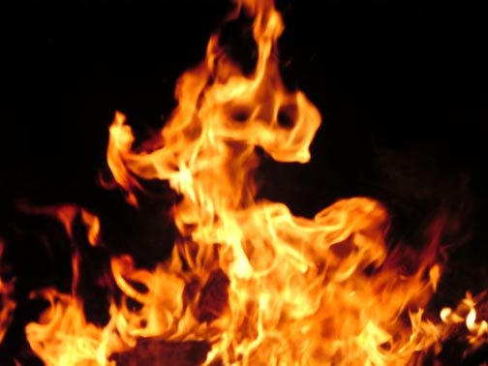
Oxidation of alcohols: Ethanol is a primary alcohol. The oxidation reactions of alcohols can be used to distinguish between primary, secondary and tertiary alcohols.
Tertiarary (3°) alcohols cannot be oxidized by acidified K₂Cr₂O₇ as they have no hydrogen atoms attached directly to the carbon atom containing the –OH group.
It is not true to say that tertiary alcohols can never be oxidized, as they burn readily. However, when this happens the carbon chain is destroyed.

Slide 16
Substitution reactions and reaction pathways

Slide 17
Substitution reactions of halogenoalkanes
Because of the greater electronegativity of the halogen atom compared with the carbon atom, halogenoalkanes have a polar bond.
Reagents that have a non-bonding pair of electrons are attracted to the carbon atom in halogenoalkanes and a substitution rxn occurs.
Such reagents are called nucleophiles.
Note: “curly arrows” show movement of electrons

Slide 18
Mechanism of nucleophilic substitution
Primary halogenoalkanes (one alkyl group attached to the carbon atom bonded to the halogen)
Example: CH₃CH₂Br + OH⁻ → CH₃CH₂OH + Br⁻
Determined experimentally: rate=k[C₂H₅Br][OH⁻]
The proposed mechanism involves the formation of a transition state which involves both of the reactants.
Because the molecularity of this single-step mechanism is two it is known as an S_{N}2 mechanism (bimolecular nucleophilic substitution).

Slide 19
Mechanism of nucleophilic substitution
Primary halogenoalkanes tend to react by an S_{N}2 mechanism. (bimolecular nucleophilic substitution)

Slide 20
Mechanism of nucleophilic substitution
Tertiary halogenoalkanes (three alkyl groups attached to the carbon atom bonded to the halogen).
Example: C(CH₃)₃Br + OH⁻ → C(CH₃)₃OH + Br⁻
Determined experimentally: rate=k[C(CH₃)₃Br]
A two-step mechanism is proposed that is consistent with this rate expression.
The 1st step is rate-determining. Because the molecularity is one the mechanism is known as S_{N}1 (unimolecular nucleophilic substitution).
3

Slide 21
Mechanism of nucleophilic substitution
Tertiary halogenoalkanes tend to react by an S_{N}1 mechanism. (unimolecular nucleophilic substitution)

Slide 22
Mechanism of nucleophilic substitution
What about secondary halogenoalkanes?
Proceed by a mixture of S_{N}1 and S_{N}2 mechanisms

Slide 23
Reaction Pathways
alkane
dihalogenoalkane
trihalogenoalkane tetrahalogenoalkane
M
halogenoalkane
alkene
poly(alkene)
M
alcohol
aldehyde
carboxylic acid
ketone
M = mechanism required

Slide 24
Reaction Pathways
You need to be able to deduce rxn pathways given the starting material and the product.
Conversions with more than two stages will not be assessed.
Reagents, conditions and equations should be included.

Slide 25
Reaction Pathways
Example: deduce a reaction pathway for the conversion of 2-butene to butanone can be done in two stages:
Step 1: 2-butene can be heated with steam and a catalyst to form 2-butanol.
Step 2: 2-butanol can then be oxidized by heating with acidified KCr₂O₇ to form butanone.

