Slide 1

Uncertainty and Error in Measurement
(IB text - Ch 11; AP text - section 1.4 pgs. 10-13 and A10-A13)
All measurements have some degree of uncertainty. Therefore, we need to give some indication of the reliability of measurements and the uncertainties in the results calculated from these measurements.

Slide 2
Uncertainty in Measurement
We customarily report a measurement by recording all the certain digits plus the first uncertain digit.
Collectively, these are known as “significant figures”

Slide 3
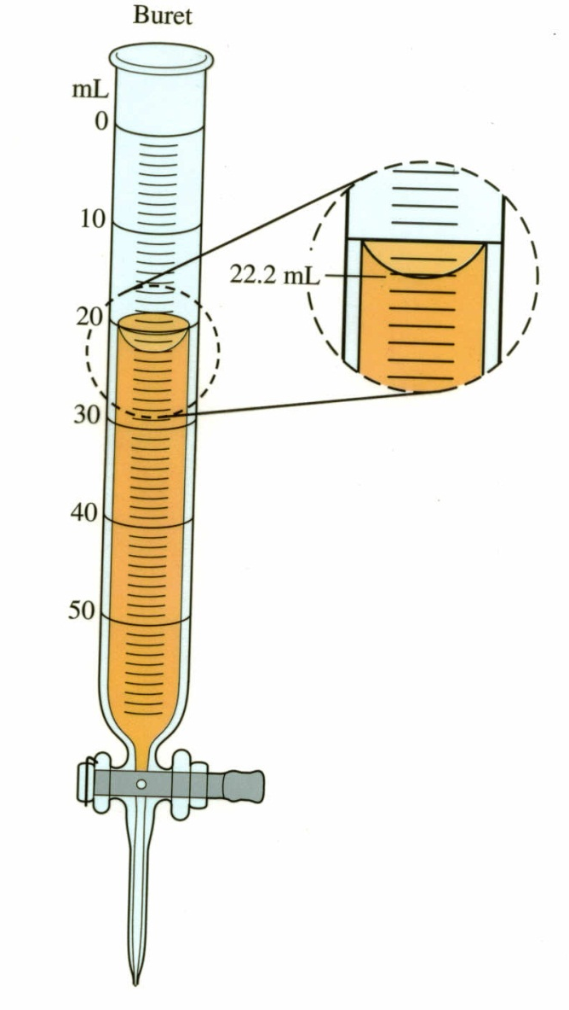
We can determine without question that the value is between 22 and 23 ml.
We then estimate the next digit as 2.
So the measurement should be reported as 22.2 ml.

Slide 4
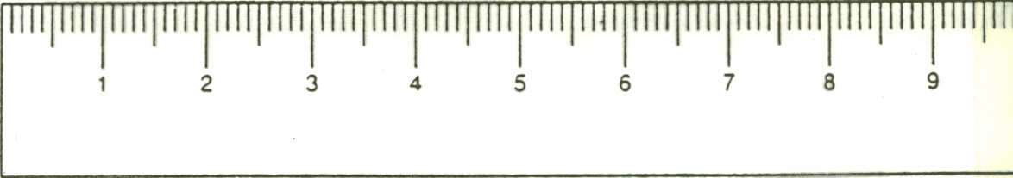
1
5.
7

Slide 5
Precision in measuring
The total number of digits and the number of decimal points tell you how precise a tool was used to make the measurement.
Which is a more precise tool for measuring small volumes, a graduated cylinder with mL markings or a pipette with 10 marks per mL?
  Why?
  What are the advantages of each?

Slide 6
The pipette is a more precise tool than the graduated cylinder because it has clear markings every tenth of a mL (i.e. 9.01 mL (± 0.05 mL)), while the graduated cylinder only has markings every mL (i.e. 9.0 mL (± 0.5 mL)).
Notice that the magnitude of the uncertainty should be in agreement with the precision of the measurement as written.

Slide 7
Precision:
The degree of agreement among several measurements of the same quantity. Precision reflects the reproducibility of a measurement.
(Precision does not imply accuracy)

Slide 8
Accuracy
The extent to which your measurement is in fact close to the true, or accepted value.
If you do not know the true value, it may be difficult to determine accuracy.

Slide 9
Accuracy & Precision
Neither accurate nor precise
Precise, not accurate
Accurate and precise
Accurate, not precise

Slide 10
Errors in Measurement
There are 2 different types of errors illustrated in the figures below:
Random errors and systematic errors
Neither accurate nor precise
Precise, not accurate
Accurate and precise
Accurate, not precise

Slide 11
Random Errors
(also called indeterminate errors pg. 12 of Zumdahl)
Every time you make a measurement you measure a slightly different quantity each time, as a result of making measurement on imperfect tools. The tendency of a measured value to “jump around” from measurement to measurement is the statistical error.
Random errors have an equal probability of being high or low as compared to the true value. It occurs in estimating the value of the last digit of a measurement.

Slide 12
Large random errors
(#s jump around)
Neither accurate nor precise
Precise, not accurate
Small Random Errors
Accurate and precise
Accurate, not precise

Slide 13
How to calculate random errors
For analog measurements, random errors can be estimated to be half of the smallest division on the scale
For a digital reading such as an electronic balance, random error of ± smallest division
  i.e. electronic balance that reads to the hundredths place could lead to a value of 3.01 g (± 0.01 g)

Slide 14
Systematic Errors
(determinate errors pg. 12, Zumdahl)
This is the uncertainty and error in measurement caused by anything that is not statistical error.
This generally has to do with instrumental effects, not taking things into account, and just doing stupid things.
Systematic errors are always either high or low, not both (occur in the same direction each time).

Slide 15
Large Systematic Errors
(too high from true value)
Neither accurate nor precise
Precise, not accurate
No Systematic Errors
Accurate and precise
Accurate, not precise

Slide 16
Examples of Systematic Errors
Leaking gas syringes
Calibration errors in pH meters
Calibration of a balance
Liquids evaporating
Changes in external influences such as temperature and atmospheric pressure affect the measurement of gas volume, etc.
etc…

Slide 17
Reporting Measurements
There are 3 parts to a measurement:
  The measurement
  The uncertainty (estimated magnitude of random error)
  The unit
  The absolute uncertainty is the size of the range of values in which the "true value" of the measurement probably lies.

Slide 18
Example:
5.2
An uncertainty of 0.5 cm for this measurement means you are reasonably sure the actual length is somewhere between 4.7 and 5.7.
± 0.5
cm
The unit
The uncertainty
The measurement

Slide 19
Practice
0 5 10 15 20 25 30 35 cm
What is the length of the blue bar?

Slide 20
31.0 cm
0 5 10 15 20 25 30 35 cm
We know for sure that the measurement is 31 cm, and therefore we estimate the last digit to be .0
The measurement of 31.0 cm has the measurement and the unit, but it’s missing the 3rd part (THE UNCERTAINTY)

Slide 21
The Uncertainty…
31.0 cm (± 0.5 cm)
0 5 10 15 20 25 30 35 cm
The bar appears to line up with the 31st mark and you know it’s more than ½ way from the 30 mark and less than ½ way from the 32nd mark. So, you can reasonably be sure the actual length of the bar is between 30.5 and 31.5 cm…
Remember!!! The uncertainty (measure of random error) is half of the smallest division (hash marks) on an analog scale. The division on the scale goes to the ones spot, so ½ of the ones spot is 0.5

Slide 22
More Practice
3
What is the correct measurement of the liquid in this container?
2
1
mL

Slide 23
REMEMBER!!!
3
Do you have the 3 requirements for reporting a measurement?
The measurement
The uncertainty
The unit
2
1
mL

Slide 24
More Practice
3
We know for sure it is 2.7 mL
We estimate the last digit to be 2.75 mL
2
1
mL

Slide 25
More Practice
3
What’s the uncertainty?
The uncertainty (measure of random error) is half of the smallest division (hash marks) on a scale.
The smallest division is in the tenths spot (2.7 mL). Therefore, ½ of 0.1 = 0.05 as the uncertainty.
2
1
mL

Slide 26
More Practice
3
2.75 mL (± 0.05 mL)
2
1
mL

Slide 27
Dealing with uncertainties
Now you know the kinds of errors (random and systematic) that can occur with measurements and you should also have a very good idea of how to estimate the magnitude of the random error that occurs when making measurements (the uncertainty).

Slide 28
What do we do with the uncertainties when we add or subtract two measurements?
Or divide / multiply two measurements?
REMEMBER SIG FIG RULES??!!!???

Slide 29
Significant Figures
1. Non zero integers always count as significant.
2. Leading zeros never count.
2 significant figures
.0025
3. Captive zeros always count.
90036
5 significant figures
4. Trailing zeros are significant only if the number contains a decimal point.
120
2 significant figures
120.
3 significant figures
.002000
4 significant figures

Slide 30

Significant Figures: Rules
Any number based on calculations and measurements must have the same number of significant figures as the least precise measurement that went into it.
This is a big deal!
Get it right!

Slide 31
Significant Figures in Calcs.
Multiplication and Division:
  Answer has the same number of significant figures as the least precise measurement.
2.00 x 15 =
30.
2.015
1.2
+ 31.1231
2. Addition and Subtraction:
Answer has the same number of decimal places
as the least precise measurement.
34.3

Slide 32
When you mathematically manipulate a measurement you must take into consideration the precision.
If you add two measurements, the result CANNOT BE MORE PRECISE!

Slide 33

Just because your calculator has all the numbers listed, doesn’t mean you should report them in your answer. You must pay attention to significant figures!

Slide 34
For example:
Mass of empty container = 2.3 g
Mass of copper = 20.24 g
What is the mass of the container with the copper in it?
2.3 g + 20.24 g = 22.5 g NOT 22.54 g

Slide 35
WHY 22.5g ???
Since the mass of the empty container is recorded to the tenths spot, it limits the answer to only the tenths spot (because the tenths spot is less precise than the hundreths spot of the copper mass measurement)
Mass of empty container = 2.3 g
Mass of copper = 20.24 g
Perhaps the actual value of the empty container is 2.2 g or 2.4 g based on a random error, then the mass of the container could turn out to be 22.44 g or 22.64 g. As you can see the difference in the tenths place is far more significant than the hundredths place. So, the mass should be reported to 22.5 g

Slide 36
Propagation of Uncertainty in Calculations
-Uses uncertainty (or precision) of each measurement, arising from limitations of measuring devices.
-The importance of estimating errors is due to the fact that errors in data propagate through calculations to produce errors in results.
Uncertainty propagation is required in IB labs and should help you direct the evaluation part of your conclusion.
(DCP, CE)
*this simplified version should be all that is needed for IB

Slide 37
3 rules for Propagating Uncertainties
1) Addition or subtraction of numbers with uncertainty
2) Multiplication and division of numbers with uncertainty
3) Multiplying or dividing by a pure number

Slide 38
1) Addition or subtraction of numbers with uncertainty
When values are added or subtracted, the absolute uncertainty (AU) of each value is added.
  For analog measurements (things with markings and a physical scale) the AU is typically half of the smallest division on the apparatus used
    ie. 25.0 mL (±0.5 mL) if markings are every 1 ml; thus measurement can be estimated to the nearest half of a mL)
  For digital measurements, the AU is typically ± smallest division
    ie. ±0.001 g for a milligram balance reading 3.426 g

Slide 39
Example
The change in temp of a mixture can be found by subtracting the initial from the final temperature
(ΔT = Tf – Ti)
So if the liquid started at 18.0°C (±0.5°C) and ended up at 25.0°C (±0.5°C), then the change in temperature is 7.0°C (±1°C).
  To understand this, consider that the real original temp of the liquid must lie between 17.5 °C and 18.5 °C and thus the change in temp can be as high as 8 or as low as 6 …thus difference is 7.0°C (±1°C)
  Sig. figs. of uncertainty values carry through the calculations independent from the sig. figs. of the measured values; thus, there will always be only one sig. fig. listed for the absolute uncertainty.

Slide 40
Practice Problems
1) 10.0 cm³ of acid is delivered from a 10cm³ pipette (± 0.1 cm³), repeated 3 times. What is the total volume delivered?
2) When using a burette (± 0.02 cm³), you subtract the initial volume from the final volume.
Final volume = 38.46 ± 0.02 cm³
Initial volume = 12.15 ± 0.02 cm³
What is the total volume delivered?

Slide 41
Answers
1)
10.0 ± 0.1 cm³
10.0 ±. 0.1 cm³
10.0 ± 0.1 cm³
Total volume delivered = 30.0 ± 0.3 cm³
2)
(38.46 ± 0.02 cm³) – (12.15 ± 0.02 cm³)
= 26.31 ± 0.04 cm³

Slide 42
2) Multiplication and division of numbers with uncertainty
Percentage (relative) uncertainties are added.
  Percentage uncertainty is the ratio of the absolute uncertainty of a measurement to the best estimate. It expresses the relative size of the uncertainty of a measurement (its precision).
It is important to know about relative uncertainties so that you can determine if the apparatus used to generate the data is up to the task.
% uncertainty = (A.U. / recorded value) x 100

Slide 43

Temperature MUST BE in KELVIN when converting to % uncertainty
  K = °C + 273
  So the % uncertainty of a temperature recorded as 2.0°C (±0.5°C) is not 25%, but rather it is (0.5/275) x 100 = 0.2%

Slide 44
EXAMPLE:
2.30g (±0.05) has an %U of
(0.05/2.30) x 100 = 2.2%

Slide 45
How does %U help w/ your CE?
So now when we look at a calculation and see percentage uncertainties of 11.5%, 0.1%, 0.05% and 2.2% in it, hopefully you will realize that you need to lower the 11.5% uncertainty if you want to reduce the uncertainty of your answer.
This should lead you to know exactly how to improve the method significantly (and this should be part of your conclusion & evaluation, CE)

Slide 46
Example
An object has a mass of 9.01 g (±0.01 g) and when it is placed in a graduated cylinder it causes the level of water in the cylinder to rise from 23.0 cm³ (±0.5 cm³) to 28.0 cm³ (±0.5 cm³).
(Recall that cm³ = mL).
Calculate the density of the object.

Slide 47
Density = mass / volume
First calculate the volume of the object:
volume object = final vol. water – initial vol. water
volume = [28.0 cm³ (±0.5 cm³)] – [23.0 cm³ (±0.5 cm³)]
volume = (28.0 cm³ - 23.0 cm³) ± (0.5 cm³ + 0.5 cm³)
Volume = 5.0 cm³ (± 1 cm³)
Rule #1 (add AUs)

Slide 48
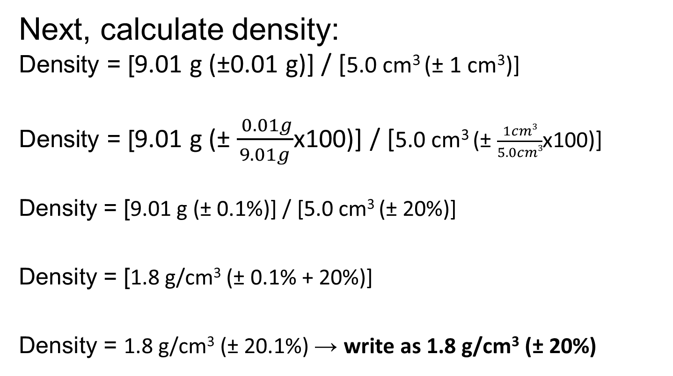
Density = mass / volume
Next, calculate density:
Density = [9.01 g (±0.01 g)] / [5.0 cm³ (± 1 cm³)]
Density = [9.01 g (± $\frac{ 0.01g}{9.01g}$x100)] / [5.0 cm³ (± $\frac{1cm3}{5.0cm3}$x100)]
Density = [9.01 g (± 0.1%)] / [5.0 cm³ (± 20%)]
Density = [1.8 g/cm³ (± 0.1% + 20%)]
Density = 1.8 g/cm³ (± 20.1%) → write as 1.8 g/cm³ (± 20%)
Rule #2
(add %U’s)
Notice that the uncertainty of the balance (mass) did not contribute significantly to the overall uncertainty of the calculated value; the graduated cylinder is therefore responsible for most of the random error. Something to state in CE.

Slide 49
Density = mass / volume
Finally, convert back to AU
Density = 1.8 g/cm³ (± 20.1%) → write as 1.8 g/cm³ (± 20%)
Density = 1.8 g/cm³ (± .201x1.802 g/cm³)
Density = 1.8 g/cm³ (± 0.362 g/cm³)
→ write as 1.8 g/cm³ (± 0.4 g/cm³)
always leave final answer in terms of absolute uncertainty

Slide 50
3) Multiplying or dividing by a pure number
A “pure number” is a number without an estimated uncertainty
When doing this, multiply or divide the AU by the pure number.

Slide 51
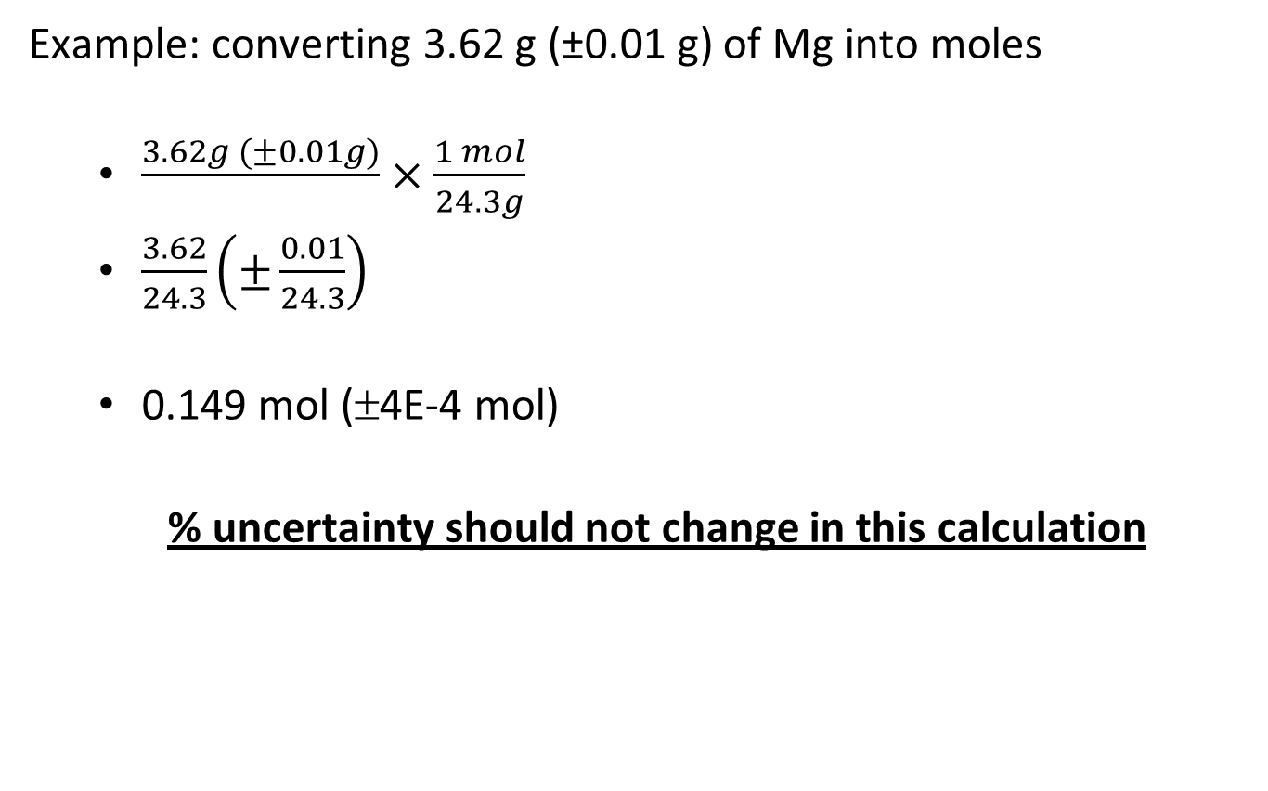
3) Multiplying or dividing by a pure number
Example: converting 3.62 g (±0.01 g) of Mg into moles
  $\frac{3.62g (±0.01g)}{}×\frac{1 mol}{24.3g}$
  $\frac{3.62}{24.3}\left(±\frac{0.01}{24.3}\right)$
  0.149 mol (±4E-4 mol)
  % uncertainty should not change in this calculation
Rule #3: divide AU by pure #

Slide 52
Graphing
Graphing is an excellent way to average a range of values.
When a range of values is plotted each point should have error bars drawn on it.

Slide 53
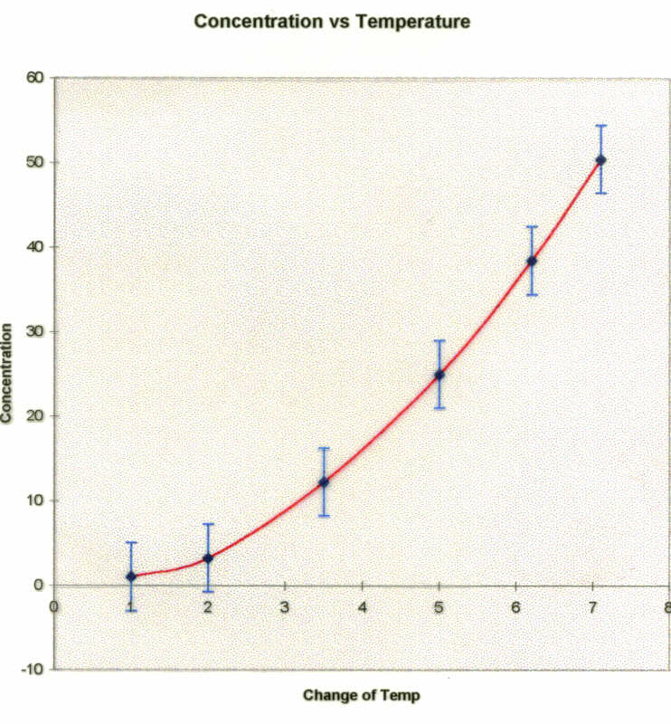
Error Bars

Slide 54
Error Bars
The size of the bar is calculated from the uncertainty due to random errors.
Any line that is drawn should be within the error bars of each point
If it is not possible to draw a line of “best” fit within the error bars then the systematic errors are greater than the random errors.

Slide 55
Additional uncertainty propagation example
100. cm³ (±0.5 cm³ ) of water at 23.0°C (±0.5°C) increased in temp to 28.0°C (±0.5°C).
(Remember that cm³ = mL, and that the density of water is 1 g/cm³).
Calculate the energy the water absorbed.

Slide 56
1st calc. is for %U
    Info:
    100.0 cm³ (±0.5) of water at 23.0 °C (±0.5) increased in temp to 28.0 ºC.
    %U= (A.U.) / (recorded value) x 100 =
    RU of water volume = (0.5/100.0) x 100 = 0.5%
    RU of temp change = (1/278) x 100 = 0.4%
    (the specific heat capacity of the water is taken as an absolute value).

Slide 57
Calculate Energy (q) q = mcΔT
q = ?
m = 100. g
c = 4.184 J/g°C
ΔT = 5.0 °C
q = 100. g x 4.184 J/g°C x 5.0 °C = 2.1 X 10³ J
Final Answer… (must include info about the uncertainty)

Slide 58
Propagation of Uncertainty
%U = 0.5% + 0.4% = 0.9% (remember that you must add %U. when numbers are multiplied)

Slide 59
    We must typically convert back to an AU for our final answer (A.U. = %U x recorded value).
    0.9% of 2100 is 18.9 (19 to 2 sig figs.)
    Thus we get 2,100 ± 19 J
      Record as 2,100 ± 20 J
    Lowering the %U. of a measurement can reduce the uncertainty of your answer (which should lead you to know exactly how to improve the method of your experiment significantly)

