Slide 1
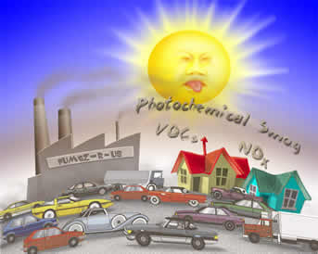
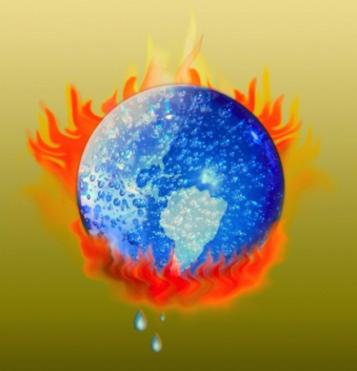
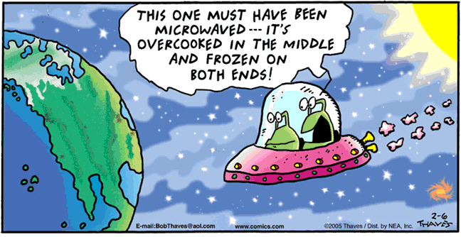
Environmental Chemistry
IB Option E Part 2: Smog, Greenhouse Effect & Ozone Depletion

Slide 2
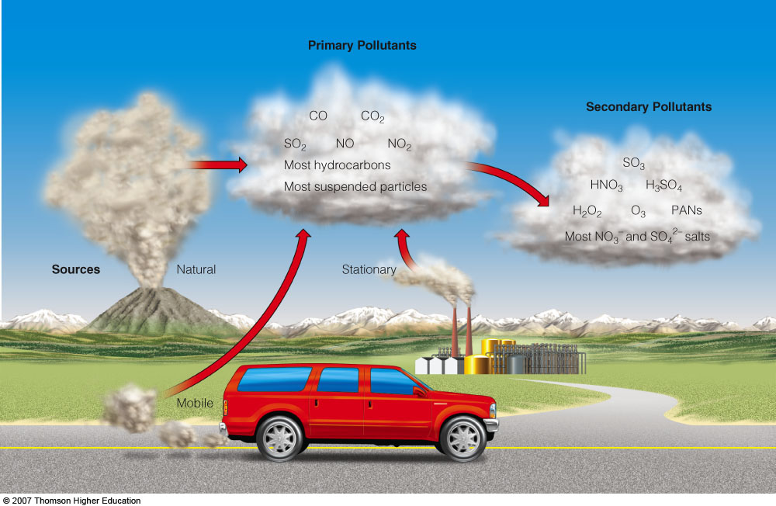
AIR POLLUTION
Some primary air pollutants may react with one another or with other chemicals in the air to form secondary air pollutants.

Slide 3
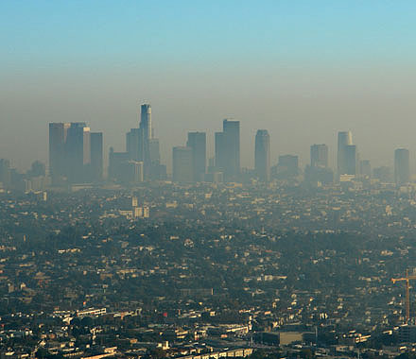
SMOG
Two types:
Oxidizing smog: “photochemical smog” – result of NOX rxns in the presence of UV light (occurs in dry sunshine). This is responsible for the brown cloud of LA.
Population density
Jan 2011 NO₂
Link to NASA’s AURA data
Los Angeles

Slide 4
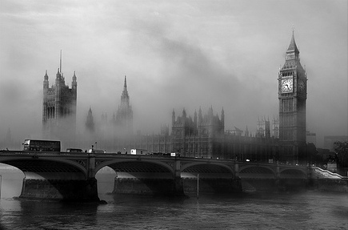
SMOG
Two types:
Reducing smog: “pea soup smog” – result of carbon particulates and sulfur dioxide (occurs in cold, damp weather). Creates yellow-green smog --- due to env. controls, largely a thing of the past (thank goodness!!!)
London Fog

Slide 5
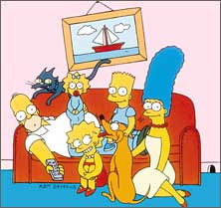
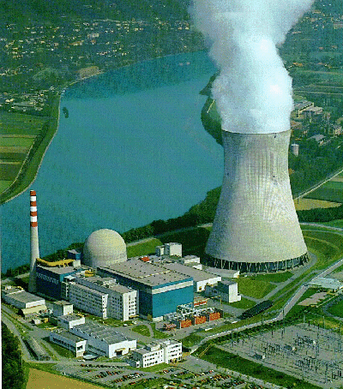
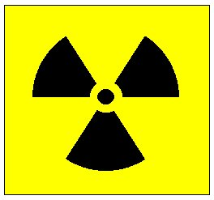
NUCLEAR ENERGY- Dream or Dilusion???

Slide 6
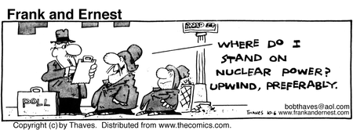
NUCLEAR ENERGY- Dream or Dilusion???

Slide 7
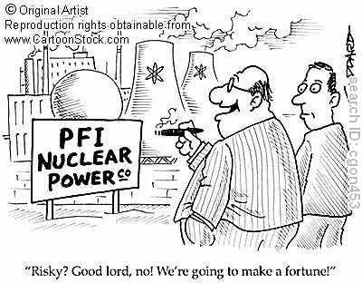
Nuclear Energy
Clean air, but in light of recent events in Japan, is this really a good alternative???

Slide 8
Thermal Inversions: occur when the normal temperature gradient is reversed (temp. ↑ with altitude).
tropospheric altitude
tropospheric altitude
temperature
temperature
Normal Conditions: temp. decreases by ≈ 1°C / 100 m of increasing altitude in dry tropospheric air
Thermal Inversion: layer of warm air becomes trapped, capping cool air near the surface

Slide 9
Thermal Inversions
Cold, cloudy weather in a valley surrounded by mountains can trap air pollutants (left).
Areas with sunny climate, light winds, mountains on three sides and an ocean on the other (right) are susceptible to inversions.
Denver
LA

Slide 10
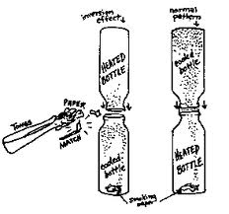
Thermal Inversion Demonstration

Slide 11
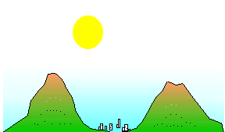
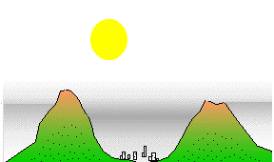
Thermal Inversion
Normal conditions
Thermal inversion

Slide 12
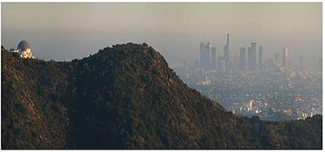
Thermal Inversions
Occur in bowl-shaped cities when it is warm and dry and there is no wind.

Slide 13
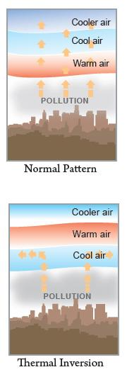
Thermal Inversions
Mountains, buildings and other barriers around cities can also promote the development of thermal inversions by preventing horizontal movement of air.

Slide 14
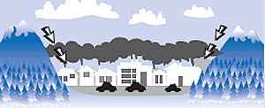
Thermal Inversions
Under these conditions, warm air caps/traps pollutants.

Slide 15
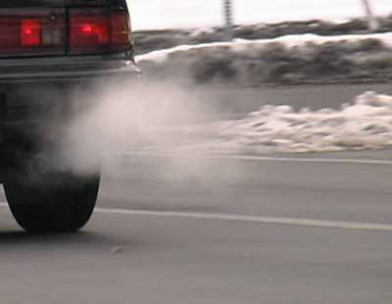
Photochemical Smog
Today’s air pollution problem
Caused by traffic exhaust fumes
Free radical rxns between sunlight, NO_{x} and VOC’s

Slide 16
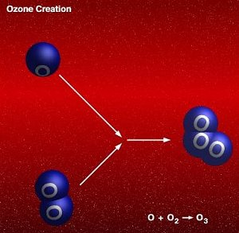
Ozone, O₃ (GOOD up high, BAD nearby)
Mechanism (know):
N₂ + O₂ → 2NO
2NO + O₂ → 2NO₂ (brown)
NO₂ + sunlight (UV) → NO + O•
O₂ + O• → O₃

Slide 17
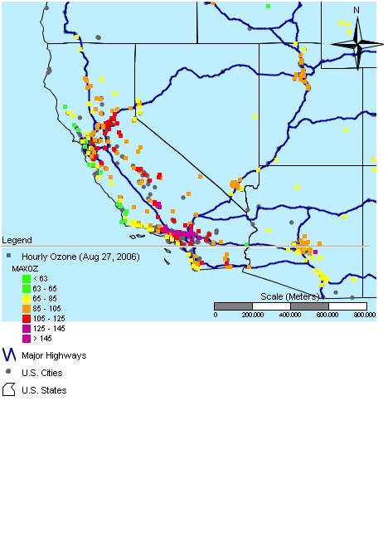
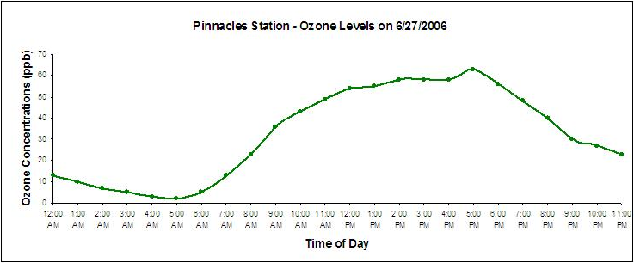
Tropospheric Ozone
Yes, a problem HERE
Link to Ozone GIS

Slide 18
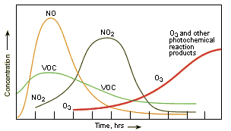
Daily pollution fluctuations

Slide 19
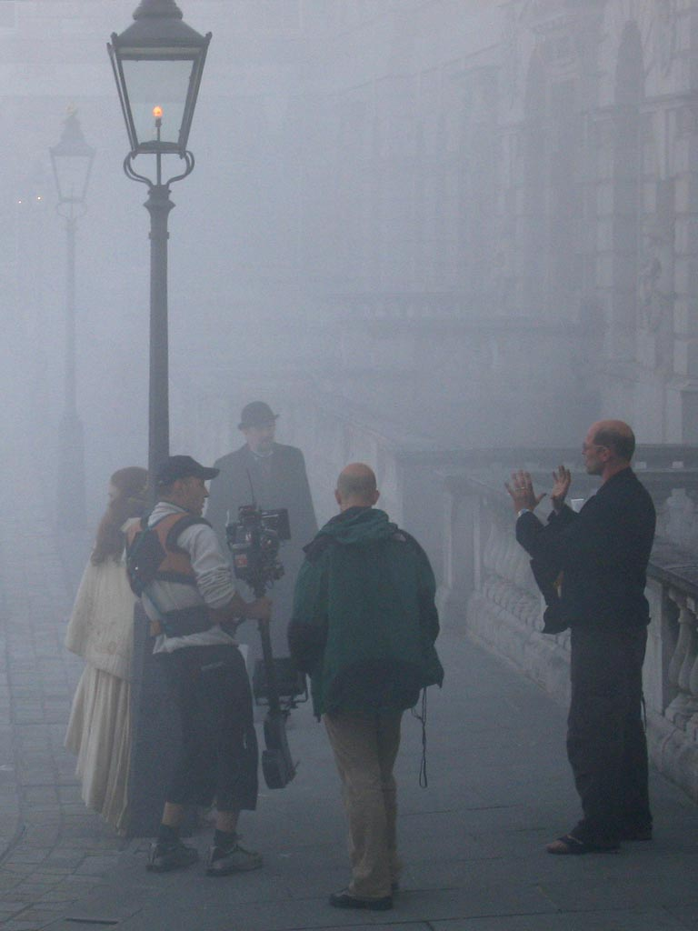
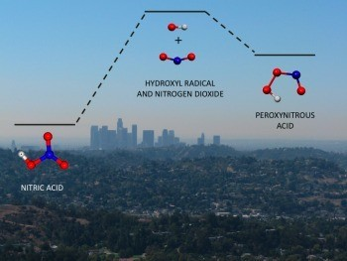
Peroxyacylnitrates, (PANs)
Secondary pollutants that are eye irritants

Slide 20
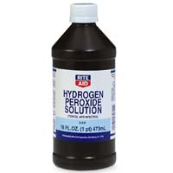
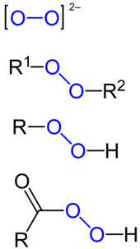
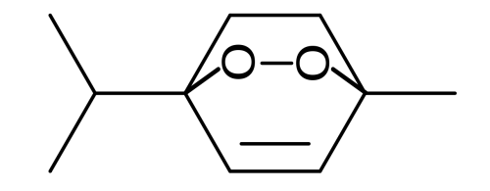
What is a peroxide?
Compound containing an O-O single bond or the peroxide anion (O-O)²⁻.
Here’s a fun one: ascaridole – a bicyclic monoterpene found in Mexican tea

Slide 21
Peroxyacylnitrates, (PANs)
Mechanism (know): Production of hydrocarbon radicals:
RH + O• → R• + •OH
alkyl radicals and hydroxyl radicals produced when VOCs are oxidized
RCH₃ + •OH → RCH₂• + H₂O
hydroxyl radicals react with alkanes to produce further alkyl radicals
RCH₂• + O₂ → RCH₂O₂•
these alkyl radicals react with O₂ molecules to produce peroxy radicals

Slide 22
Peroxyacylnitrates, (PANs)
Mechanism (know): Production of aldehydes:
RCH₂O₂• + NO• → RCH₂O• + NO₂
peroxy radicals react with nitrogen monoxide to produce nitrogen dioxide
RCH₂O• + O₂ → RCHO + HO₂•
RCH₂O• radicals react with oxygen to form aldehydes

Slide 23
Peroxyacylnitrates, (PANs)
Mechanism (know): Production of PANs by hydroxyl radicals and aldehydes
RCHO + •OH → RCO• + H₂O
H-atom is removed from an aldehyde
RCO• + O₂ → RCOOO•
resulting radical reacts with oxygen molecule to produce a peroxide
Termination step:
free radicals (above) + NO → PAN
(relatively stable)

Slide 24
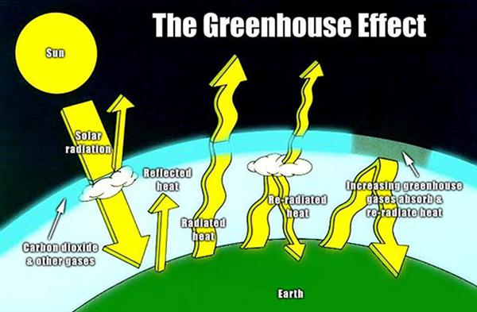
Greenhouse Effect
Greenhouse gases allow the passage of incoming solar short-wavelength radiation but absorb the longer-wavelength radiation from the Earth. Some of the absorbed radiation is re-radiated back to Earth.

Slide 25
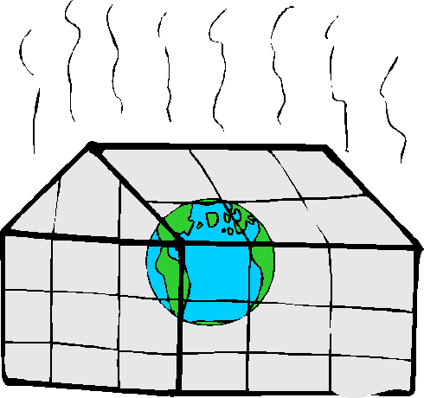
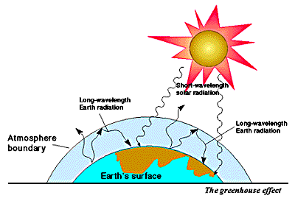
Major greenhouse gases
H₂O
CO₂
CH₄
N₂O
O₃
CFCs

Slide 26
Table 2: Major greenhouse gases you should know
Gas | Main Source | Heat Trapping Effectiveness Compared With CO₂ | Overall contribution to increased global warming
H₂O | Evaporation of oceans | 0.1 | -
CO₂ | Combustion of fossil fuels and biomass | 1 | 50%
CH₄ | Anaerobic decay of organic matter caused by intensive farming | 30 | 18%
N₂O | Artificial fertilizers and combustion of biomass | 150 | 6%
O₃ | Secondary pollutant in photochemical smog | 2000 | 12%
CFCs | Refrigerants, propellants, foaming agents, solvents | 10,000-25,000 | 14%

Slide 27
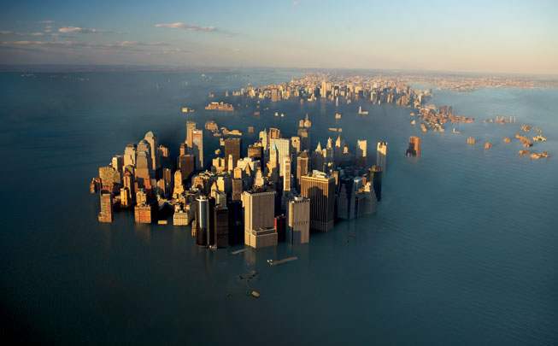
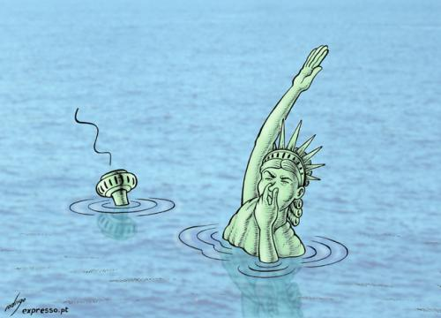
Effects of increasing amounts of greenhouse gases on the atmosphere:
Rising sea-levels (from thermal expansion of oceans and melting of the polar ice-caps)

Slide 28
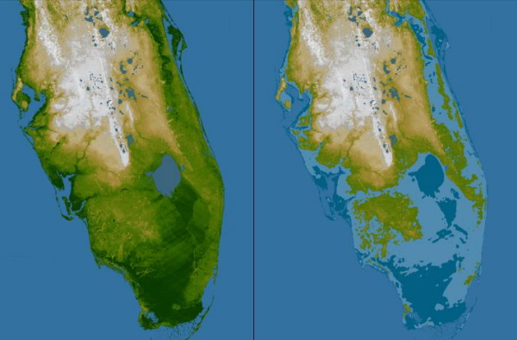
Effects of increasing amounts of greenhouse gases on the atmosphere:
Rising sea-levels (from thermal expansion of oceans and melting of the polar ice-caps)

Slide 29
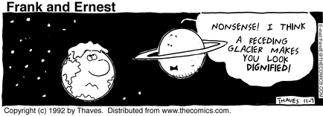
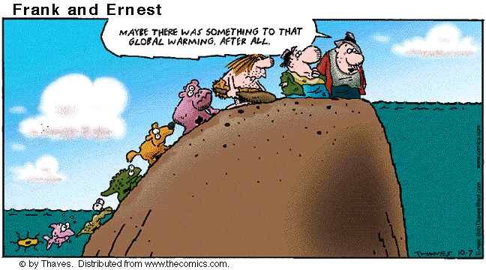
Effects of increasing amounts of greenhouse gases on the atmosphere:
Rising sea-levels (from thermal expansion of oceans and melting of the polar ice-caps)

Slide 30
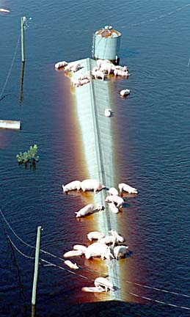
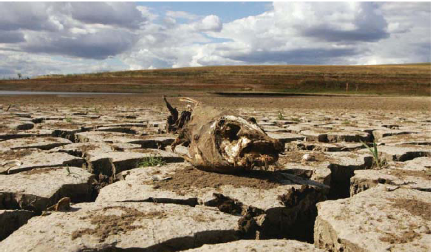
Effects of increasing amounts of greenhouse gases on the atmosphere:
Changes in precipitation and temperature of regions (causing floods and droughts)

Slide 31
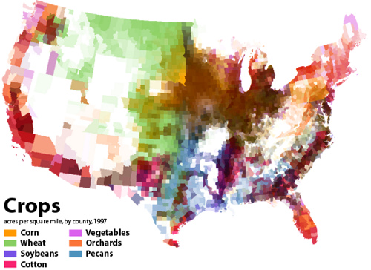
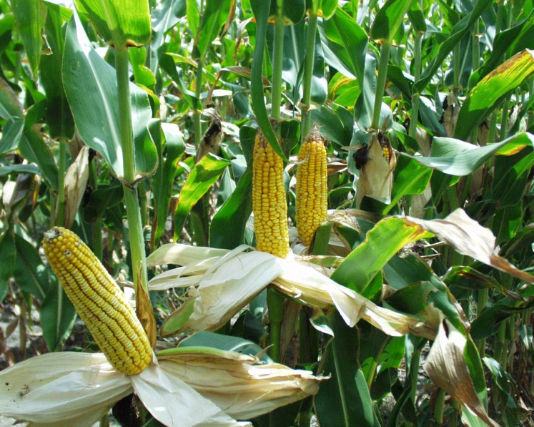
Effects of increasing amounts of greenhouse gases on the atmosphere:
Changes in yield and distribution of commercial crops

Slide 32
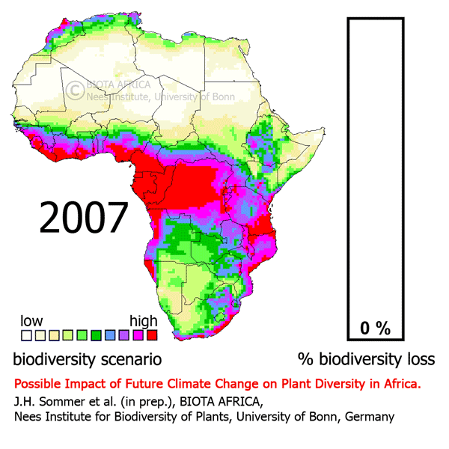
Effects of increasing amounts of greenhouse gases on the atmosphere:
Changes in yield and distribution of commercial crops

Slide 33
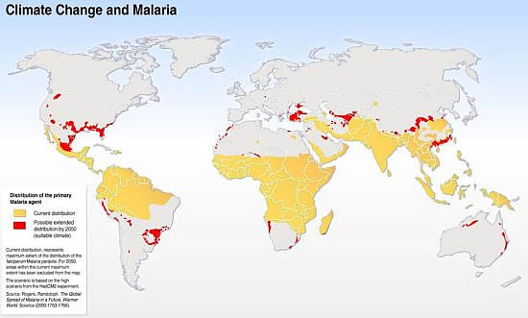
Effects of increasing amounts of greenhouse gases on the atmosphere:
Changes in distribution of pests and disease-carrying organisms

Slide 34
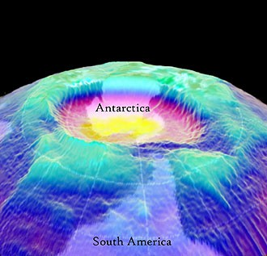
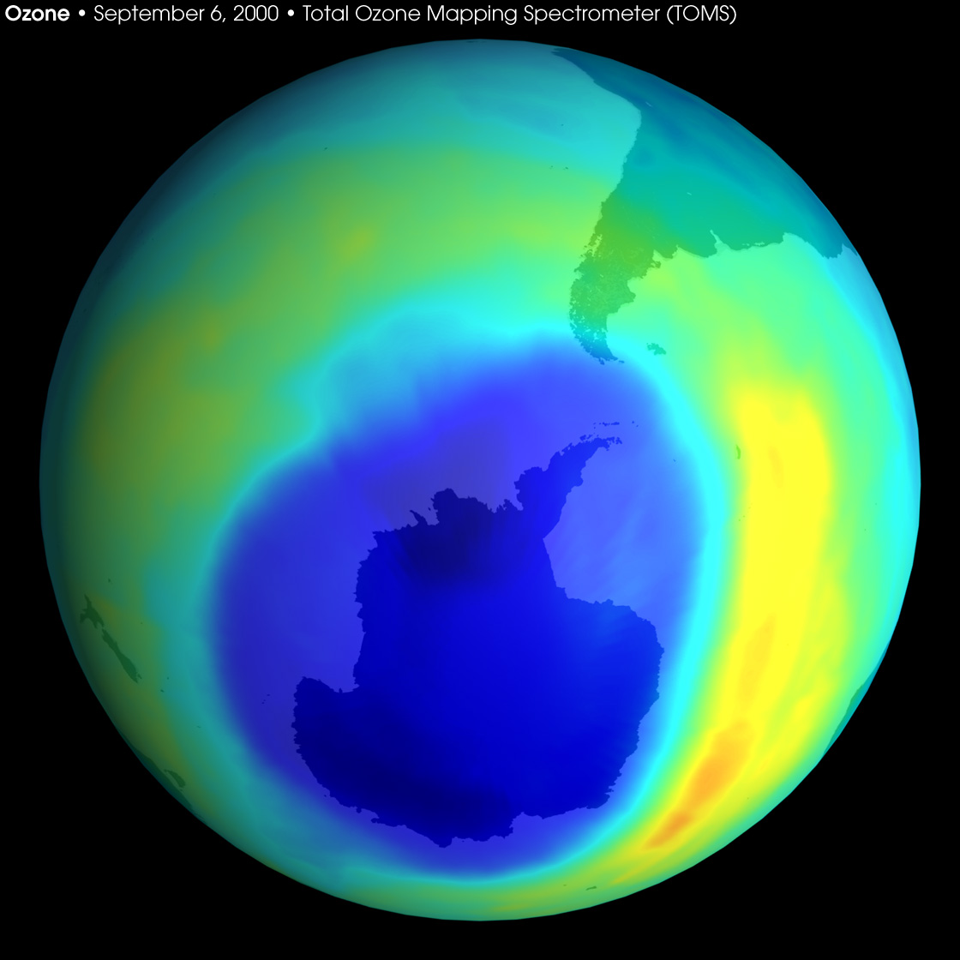

Slide 35
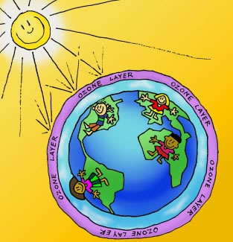
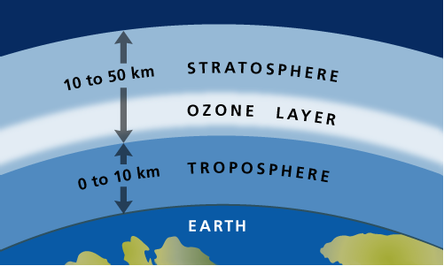
Stratospheric Ozone
Good up high! (Absorbs dangerous UV-C)

Slide 36
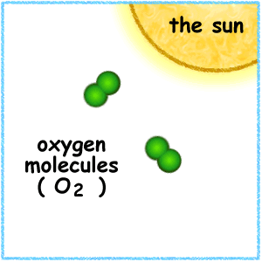
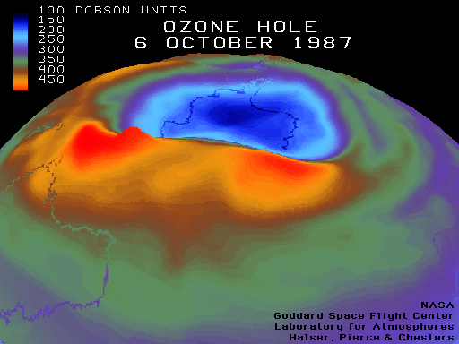
Stratospheric Ozone
Table 3: Formation and depletion of stratospheric ozone by natural processes
Formation | Depletion
O₂ + UV (λ<242 nm) → 2O• O₂ + O• → O₃ | O₃ + UV (λ<330 nm) → O₂ + O• O₃ + O•→ 2O₂

Slide 37
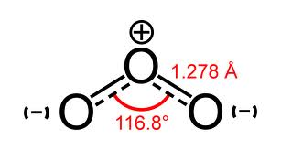
Stratospheric Ozone
Table 3: Formation and depletion of stratospheric ozone by natural processes
Formation | Depletion
O₂ + UV (λ<242 nm) → 2O• O₂ + O• → O₃ | O₃ + UV (λ<330 nm) → O₂ + O• O₃ + O•→ 2O₂
Shorter wavelength, thus higher energy
Longer wavelength, thus lower energy
Weaker bond to break
Stronger bond to break

Slide 38
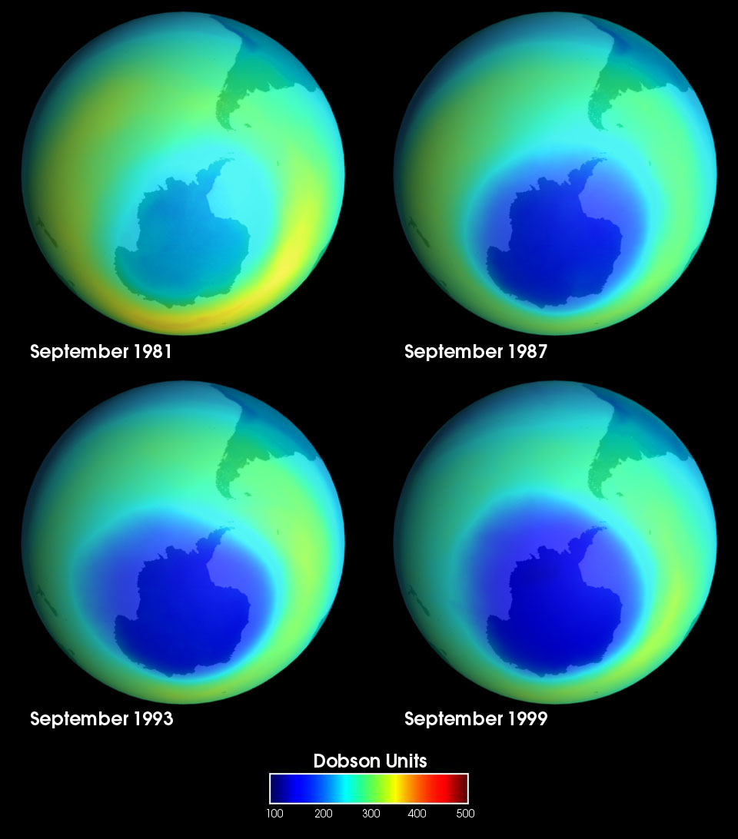
Ozone thinning problem

Slide 39
Stratospheric Ozone Depletion
Table 4: Mechanisms for ozone depletion by anthropogenic sources
Catalyst | Source | Sample Mechanism (know these) | Net Effect
CFCs (most common = CCl₂F₂, a.k.a. Freon or CFC-12) | Refrigerants, propellants for aerosols, foaming agents for expanding plastics and cleaning solvents | CCl₂F₂ → CClF₂ + Cl• Cl• + O₃ → ClO• + O₂ ClO• + O• → O₂ + Cl• | O₃ + O• → 2O₂

Slide 40
Stratospheric Ozone Depletion
Table 4: Mechanisms for ozone depletion by anthropogenic sources
Catalyst | Source | Sample Mechanism (know these) | Net Effect
NO_{X} | High temperatures inside combustion engines, power stations and jet aeroplanes. | NO + O₃ → NO₂ + O₂ NO₂ + O• → NO + O₂ | O₃ + O• → 2O₂

Slide 41
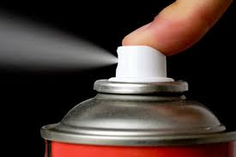
Alternatives to CFCs
Alternatives to CFCs for the future should have the following characteristics:
Similar properties to CFC’s, but
Low reactivity
Low toxicity
Low flammability
No weak C-Cl bonds that can easily be broken by UV to form radicals
Inability to absorb infrared radiation
(not greenhouse gases)

Slide 42
Alternatives to CFCs

Slide 43
Table 5: Most immediate replacements
Class of chemicals | Lewis structure of example | Benefits | Drawbacks
HCFCs | Chlorodifluormethane | Decompose more readily than CFCs and do not build up in stratosphere | Still contains one C-Cl bond per molecule
HFCs | 1,1,1,2-tetrafluoroethane | Good refrigerant | Flammable Greenhouse gases
hydrocarbons | 2-methylpropane | Good refrigerant | Flammable Greenhouse gases

Slide 44
Greatest ozone depletion occurs in polar regions:
Very low temperatures in winter
Small amounts of water vapor in air freezes to form ice crystals.
Crystals also contain small amounts of molecules, such as HCl and ClONO₂.
Catalytic rxns occur on the surface of the ice crystals to produce species such as hypochlorous acid (HClO) and chlorine (Cl₂).

Slide 45
Greatest ozone depletion occurs in polar regions:
Each spring, the Sun causes these molecules to break down, giving off Cl• radicals.
These Cl• radicals catalyze the destruction of ozone.

Slide 46
Greatest ozone depletion occurs in polar regions:
Largest ozone layer holes occur during early spring.
As Sun continues to warm the air, ice crystals disperse and ozone concentrations gradually increase again.

Slide 47
How does sunscreen work?
Contain conjugated unsaturated hydrocarbons (organic compounds) that absorb in the UV region.
e.g. para-aminobenzonic acid (PABA)

Slide 48
How does sunblock work?
Sunblock (e.g. zinc oxide), on the other hand, is just an opaque white inorganic solid substance that blocks out the sun entirely (reflects all UV and visible light).

