Slide 1
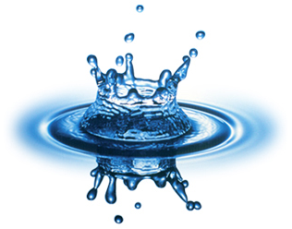
Environmental Chemistry
IB Option E Part 3: Water

Slide 2
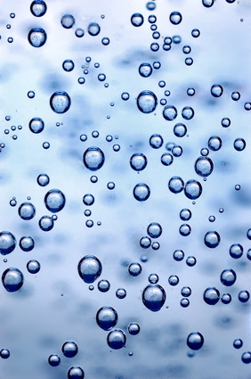
Dissolved oxygen (DO) in water
One of the most important indicators of quality
Required by most aquatic plants and animals for aerobic respiration
Consumed by microorganisms when they decompose organic material

Slide 3
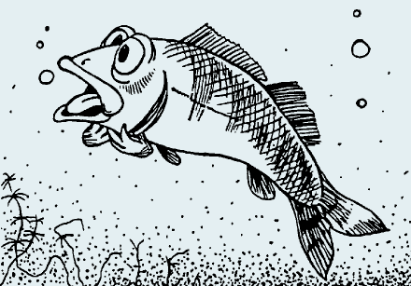
Dissolved oxygen (DO) in water
The presence of DO in natural water is a healthy sign.
The absence of DO can be a sign of severe pollution.

Slide 4
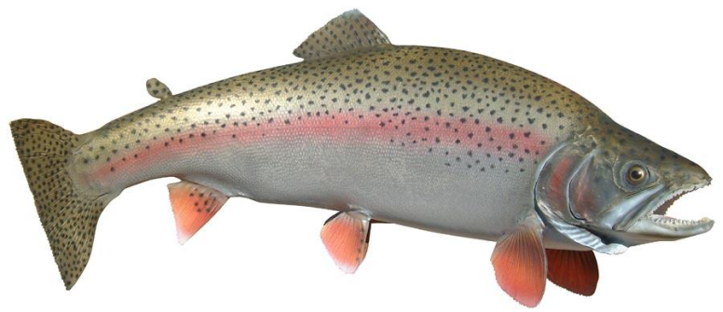
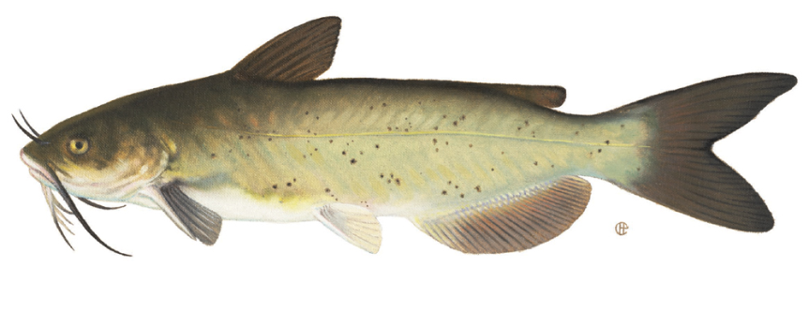
Dissolved oxygen (DO) in water
Fish such as trout require high levels of DO, while fish like carp and catfish can survive with lower levels.
Thus the type of organisms found in lakes and streams can be used as an indicator of the overall health of the water system.
trout
catfish

Slide 5
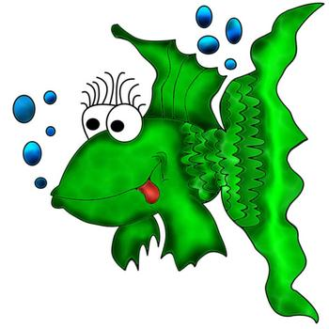
Dissolved oxygen (DO) in water
At 20°C, max solubility is 9 ppm (9 mg/L).
DO saturation levels vary with temperature (since oxygen is a gas), but here is a general guideline for stream water:
2-4 ppm ☹ - unhealthy, worm-infested stream
4-6 ppm – supports some varied organisms
6-8 ppm ☺ - healthy, trout-filled stream

Slide 6
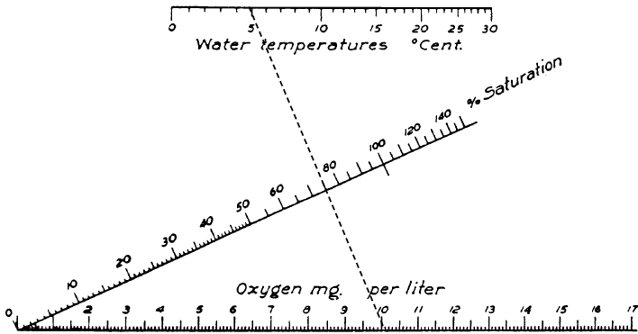

Slide 7
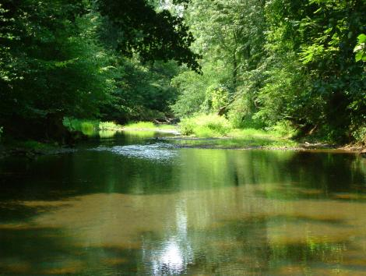
Biological Oxygen Demand (BOD)
Measure of the dissolved oxygen (in ppm) required to decompose the organic matter in water biologically.
Water with a high BOD without a means of replenishing oxygen (i.e. lakes or slow moving streams) will not sustain aquatic life.

Slide 8
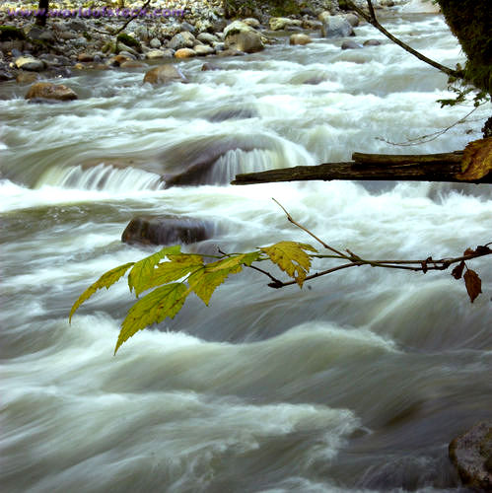
Biological Oxygen Demand (BOD)
Fast flowing, churning that aerates water can help recover purity as water is oxygenated.
Pure water BOD < 1 ppm
BOD > 5 ppm = polluted

Slide 9
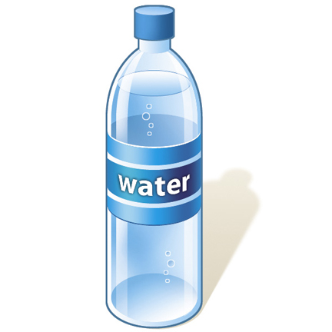
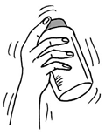
Measurement of BOD (Winkler method)
Sample of water is saturated with oxygen.

Slide 10
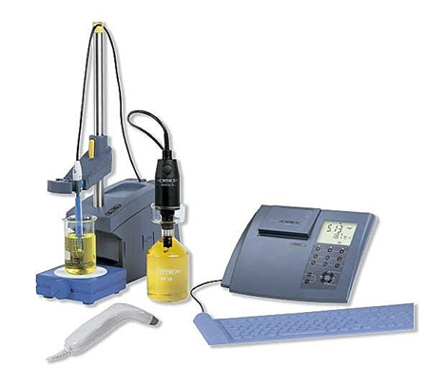
Measurement of BOD (Winkler method)
Measured volume of the sample is incubated at fixed temp. for 5 days (while microorganisms in the water oxidize the organic material)

Slide 11
Measurement of BOD (Winkler method)
After 5 days, determine how much oxygen is left in the system using a redox titration
Add an excess of a manganese (II) salt to the sample.
Under alkaline conditions, Mn(II) ions are oxidized to Mn(IV) oxide by the remaining oxygen
2Mn²⁺(aq) + 4OH⁻(aq) + O₂(aq) → 2MnO₂(s) + 2H₂O(l)
KI is then added which is oxidized by the Mn(IV) oxide in acidic sol’n to form iodine.
MnO₂(s) + 2I⁻(aq) + 4H⁺(aq) → Mn²⁺(aq) + I₂(aq) + 2H₂O(l)
The iodine released is then titrated with standard sodium thiosulfate sol’n
I₂(aq) + 2S₂O₃²⁻(aq) → S₄O₆²⁻(aq) + 2I⁻(aq)
By knowing the #moles of iodine produced, the amt. of oxygen that was present in the sample can be calculated (thus you know how much oxygen was consumed over the 5 day period)

Slide 12
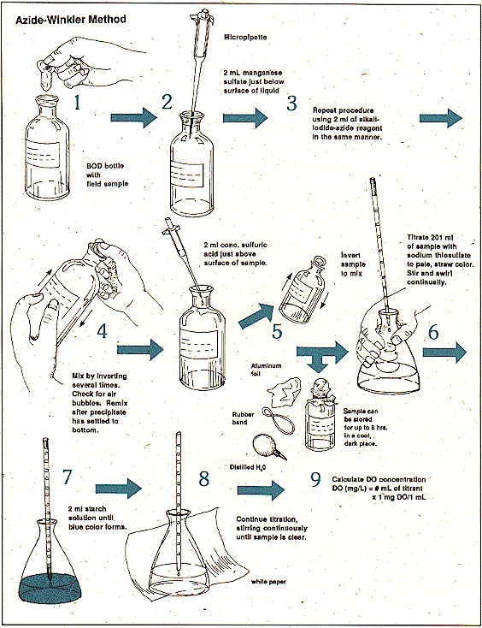

Slide 13
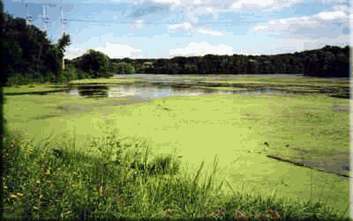
Eutrophication: too much of a good thing - killing a lake with excess nutrients
Excess nitrates (from artificial fertilizers) and phosphates (from artificial fertilizers and detergents) accumulate in lakes.
These nutrients cause CRAZY growth of algae.

Slide 14
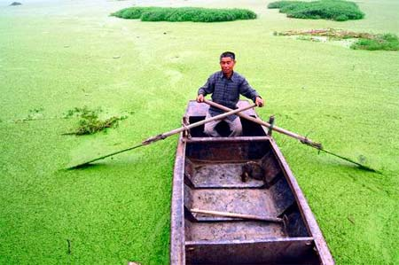
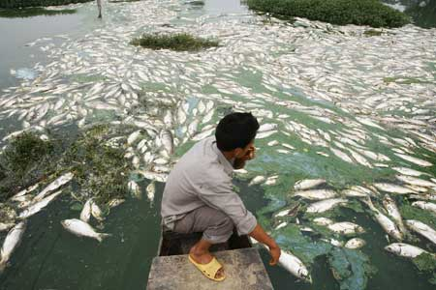
Eutrophication: too much of a good thing - killing a lake with excess nutrients
Excessive algal growth kills all life in the lake.
Too much decaying algae, insufficient DO, products of anaerobic decay poison life in the lake (plus it blocks the light from penetrating beneath the surface of the water), leading to more decay, etc.

Slide 15
Table 6: Products of Aerobic & Anerobic Decomposition
Element | Aerobic decay product | Anaerobic decay product
C | CO₂ | CH₄ (marsh gas)
N | NO₃- | NH₃ and amines
H | H₂O | CH₄, NH₃, H₂S and H₂O
S | SO₄²⁻ | H₂S (“rotten eggs” gas)
P | PO₄³⁻ | PH₃( phosphine)

Slide 16
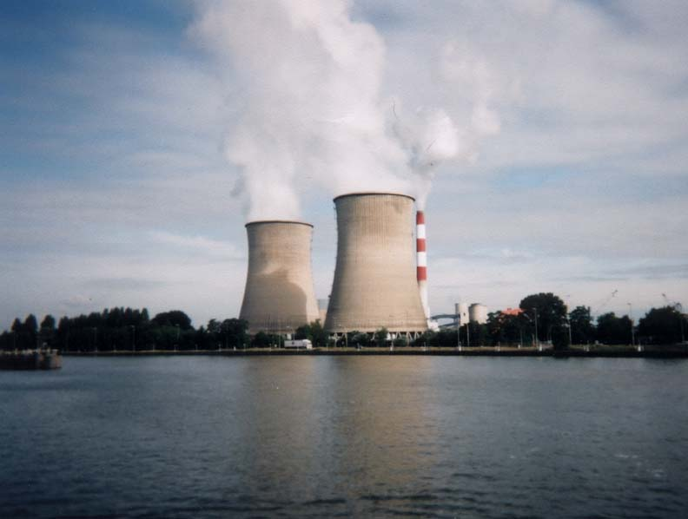
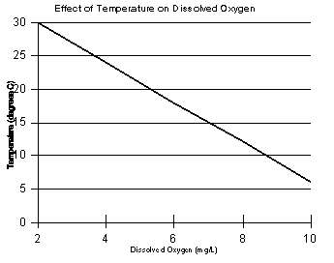
Thermal Pollution
Water that is removed from rivers by power stations can be returned with a temperature increase of up to 20°C.
Concentration of D.O. decreases with rising temperature.

Slide 17
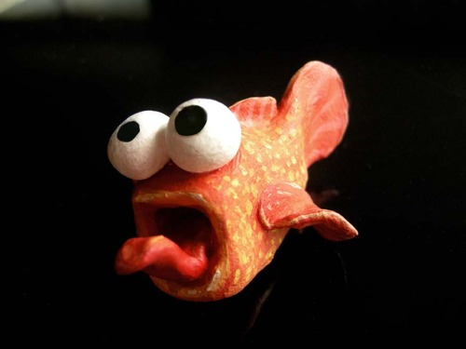
Thermal Pollution
Oxygen in water may be insufficient for fish to survive.
Metabolic rate of organisms increases with temp., placing additional demand for oxygen in the water.
Spawning, fertilization and hatching of eggs, is very sensitive to temperature.

Slide 18
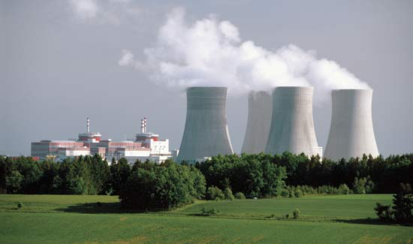
Thermal Pollution
Thermal pollution can be reduced by trickling water through a porous material and blowing air in the opposite direction.. The heat is transferred to the air where it is less damaging.

Slide 19
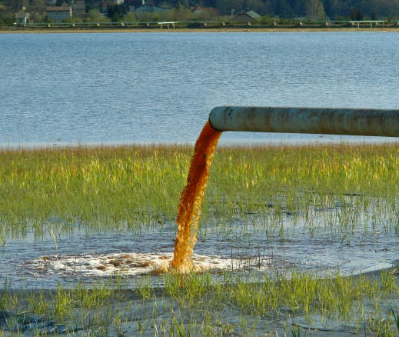
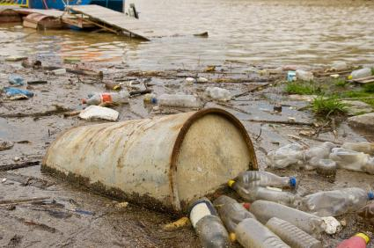
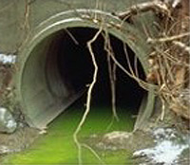
Primary pollutants in waste water and their sources…

Slide 20
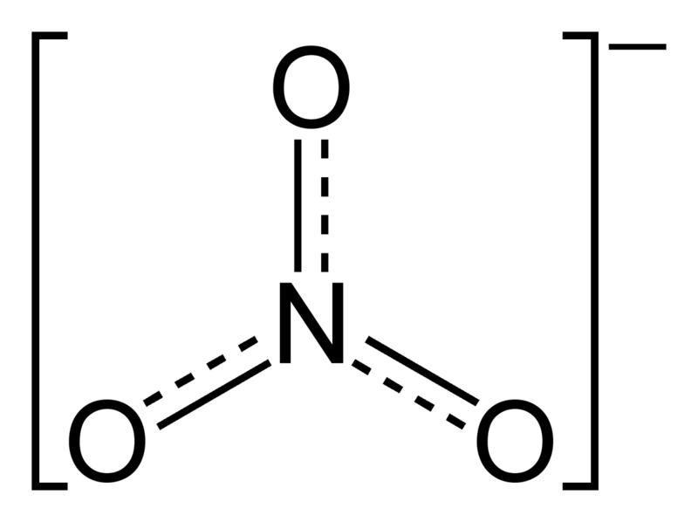
Nitrates
Enter the water from intensive animal farming, excessive use of artificial fertilizers and acid rain.
All nitrates are soluble, so it’s very difficult to remove them from water.

Slide 21
Nitrates
Unpolluted water is generally < 4 ppm
Max limit of nitrates in drinking water is 50 ppm (or 50 mg dm⁻³) as determined by the World Health Organization.

Slide 22
Nitrates
High nitrate levels in drinking water can poison babies under 6 mo. in age. It makes it difficult for them to get enough oxygen and they my turn blue and suffocate (infantile methaemoglobinaemia, a.k.a. blue baby syndrome)

Slide 23
Heavy metals Ions in polluted water may include cadmium, mercury, lead, chromium, nickel, copper and zinc.
Table 7: Sources and hazards of some heavy metals
Metal | Sources | Health hazard | Environmental hazard
Mercury | Paints, batteries, agriculture | Causes severe damage to the nerves and the brain. | Biomagnification up food chain; causes reproductive system failure in fish; inhibits growth and kills fish
Lead | Lead pipes, lead paint and glazes, leaded fuel (tetraethyl lead, banned in US) | Can cause brain damage, especially in young children | Biomagnification up food chain; toxic to plants and domestic animals
Cadmium | Metal plating, rechargeable batteries, pigments, byproduct of zinc refining | Makes enzymes ineffective by replacing zinc; causes brittle bones; can lead to lung and kidney cancer | Toxic to fish; produces birth defects in mice

Slide 24
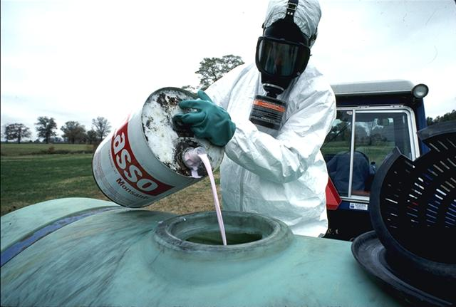
Pesticides
Include insecticides, fungicides and herbicides, which kill insects, fungi and weeds respectively.
Since they are poisonous, they can be problematic when washed off land into water.

Slide 25
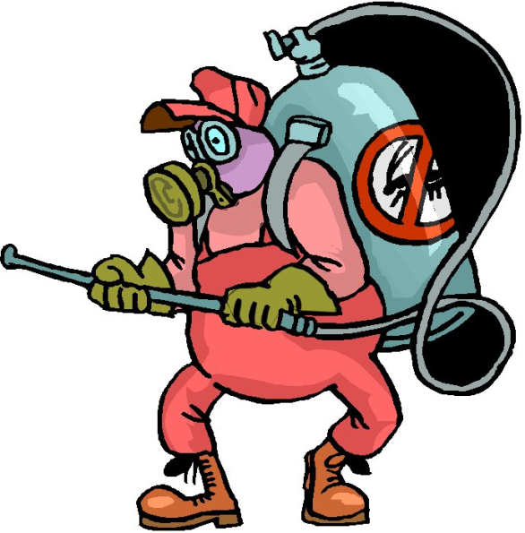
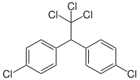
Pesticides
Example: DDT (dichlorodiphenyltrichloroethane) pesticide introduced into environment at low levels harmless to birds and animals (including humans), but because it is stable and fat soluble it accumulated and became concentrated over time via biological magnification. Has been banned in many countries because it had disastrous effects on bird life.

Slide 26
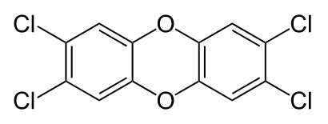
Dioxins
Group of compounds whose structure consists of two benzene rings connected via one or two oxygen atoms. Each benzene ring can have up to four chlorine atoms.
2,3,7,8-tetrachlorodibenzodioxin (a.k.a. “dioxin”) is 10,000 times more poisonous than the cyanide ion.

Slide 27
Dioxins
Sources: one of the herbicides present in Agent Orange used during the Vietnam war, and also forms when waste materials containing organochloro-compounds are not incinerated at high enough temperatures. Accumulate in fat and liver cells and therefore persist in environment.
Symptoms of exposure include cirrhosis of the liver, damage to the heart and memory and depression. Also causes malfunctions in fetuses.

Slide 28
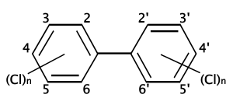
Polychlorinated biphenyls, PCBs
Can have up to 10 chlorines.
Source: used in electrical transformers and capacitors because of their chemical stability and high electrical resistance.
Persist in environment and accumulate in fatty tissue.
Reproduce reproductive efficient, impair learning in children and are thought to be carcinogenic.

Slide 29
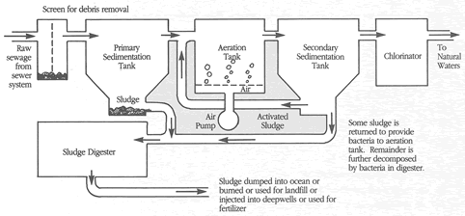
Waste Water Treatment Purpose: remove hazardous materials, reduce BOD and kill microorganisms before the water is returned to the environment.

Slide 30
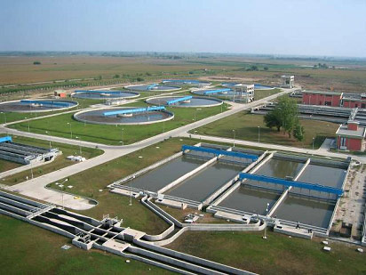
Primary treatment
Filtration: waste water passed through screens and grids to filter out debris.
Sedimentation: water is then passed into a sedimentation tank where it is allowed to settle. Resulting sludge is removed from the bottom of the tank.

Slide 31
Secondary treatment
Activated sludge process:
organic material is oxidized and broken down.
Involves introduction of bacteria and aeration.
Large blowers are used to bubble air, or air enriched with oxygen, through waste water mixed with bacteria-laden sludge.
Thus bacteria help to aerobically decompose the contents.
The water, containing decomposed suspended particles, is passed through another sedimentation tank and the sludge is removed for further processing.
After secondary treatment, about 90% of the organic oxygen-demanding wastes and suspended particles have been removed.

Slide 32
Tertiary treatment
involves specialized chemical, biological or physical processes which further treat the water and remove remaining organic material, heavy metals, phosphates and nitrates by chemical or biological processes.

Slide 33
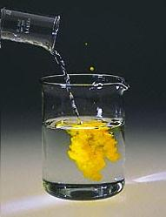
Tertiary treatment
Precipitation: Heavy metals such as Cd, Pb and Hg can be removed as sulfide salts, which have low solubility.
lead precipitation

Slide 34
Tertiary treatment
Ion exchange: all nitrates are soluble and are thus more difficult to remove. Resins or zeolites can be used to exchange the nitrate ions in polluted water with hydroxide ions. Positive ions can also be exchanged with H+ ions. The resulting OH- and H+ will then combine for form water.

Slide 35
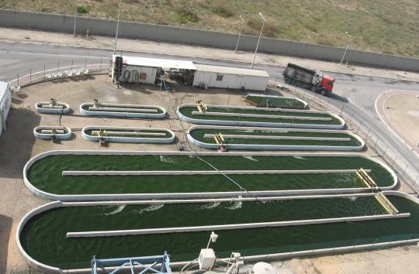
Tertiary treatment
Biological methods: algal ponds can also be used to remove nitrate ions by using the nitrate ions as nutrients which are then converted back into atmospheric nitrogen.

Slide 36
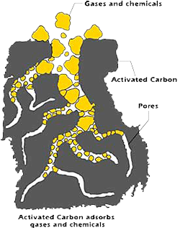
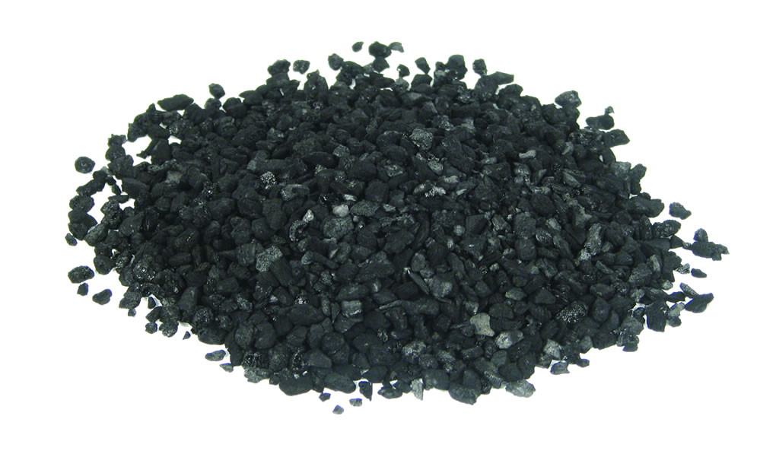
Tertiary treatment
Activated carbon bed method: activated carbon consists of tiny carbon granules with large surface area which have been treated and activated by high temperatures. Activated carbon readily adsorbs organic chemicals from the water.

Slide 37
Obtaining fresh water from sea water
Multistage distillation: sea water is heated in a series of coiled popes and then introduced into a pritially evacuated chamber. Under reduced pressure, the water boils instantly. The water vapor produced condenses when it makes contact with cold-water pipes carrying sea water. In this way, heat released when water condenses is used to preheat more sea water.

Slide 38
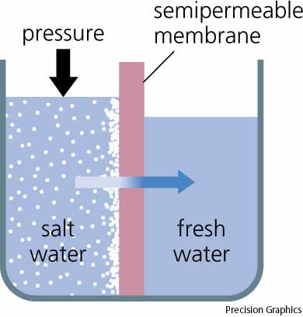
Obtaining fresh water from sea water
Reverse Osmosis: high pressure (up to 70 atm) is applied to seawater and pure water is pushed through a semipermeable membrane made of cellulose ethanoate, leaving the salts behind.

