Slide 1
Motion In 1D
Science Knowledge
My website: https://scienceknowledge.webador.com/

Slide 2
Learning Objectives
Understand the difference between vector quanitites and scalar quantities
Displacement VS distancs
Velocity VS velocity
Acceleration, etc
Being able to extract information from motions diagram
Know what gradient of a graph represents
Velocity VS Time (area under the curve, gradient, acceleration)
Acceleration VS Time
Know how to use the kinematics equations
Know how to do solve kinematics problems
Understand Free fall motion

Slide 3
Vector and Scalar

Slide 5
Displacement and Distance

Slide 6
Calculating Displacement: Pythagorean theorem

Slide 7
Worked Example1 - Displacement
A girl run to the left for 3 meters, and then goes up for 4 meters. What is the total displacment the girl travelled?

Slide 8
Worked Example 2
In a Cartesian coordinates plane, a ball initially locates at the position of (3,6). After a certain period of time, the ball is being moved to the position of (11,3) by winds. What is the total displacement travelled by the ball?

Slide 9
Velocity and Speed

Slide 10
Worked Example
A person runs to the left at 3m/s for 10 seconds, then he turns his direction and runs to the northern direction at 4m/s for 15 seconds.
What is the total displacement and distance?
What is the average velocity and average distance?

Slide 11
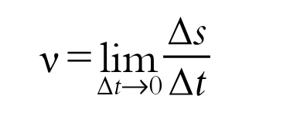
Instantaneous Velocity and Speed
Velocity changes→instantaneous velocity
Average velocity during an infinitely small time interval
Is equal to the slope of the tangent line
Magnitude = instantaneous speed

Slide 12
Acceleration
Acceleration is a vector quantity, referring to the rate of change of the velocity of an object with respect to time
Average acceleration: Rate at which velocity changes over a specified time interval. A vector quantity with SI units of m/s^2
Instantaneous acceleration: Rate at which velocity changes at a specific instant in time. A vector quantity with SI units of m/s^2

Slide 13
Instantaneous acceleration

Slide 14
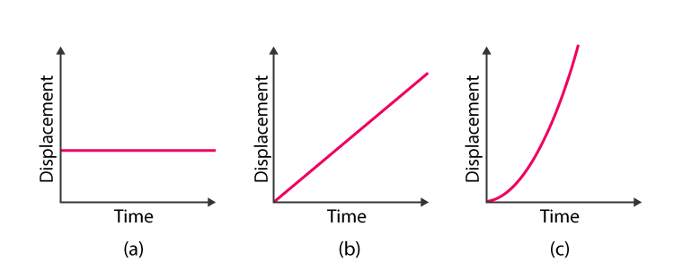
Motion Diagram – Displacement VS Time

Slide 15
Motion Diagram – Velocity VS Time

Slide 16
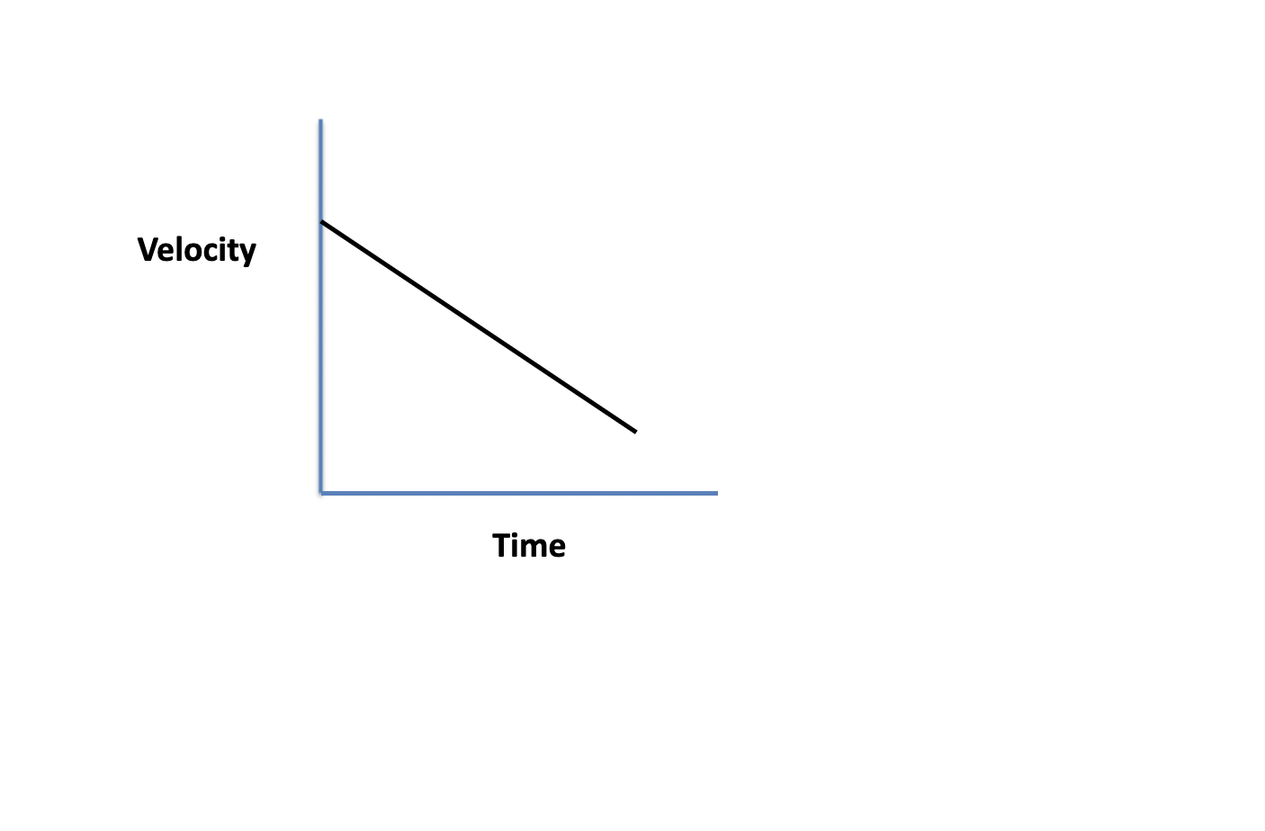
A negative slope means that the object delerates constantly

Slide 18
Velocity Versus Time Graph Summary
Gradient represents acceleration
Area under the curve (with negative and positive signs) represents displacement
Area under the curve (without negative and positive signs) represents diistance

Slide 19
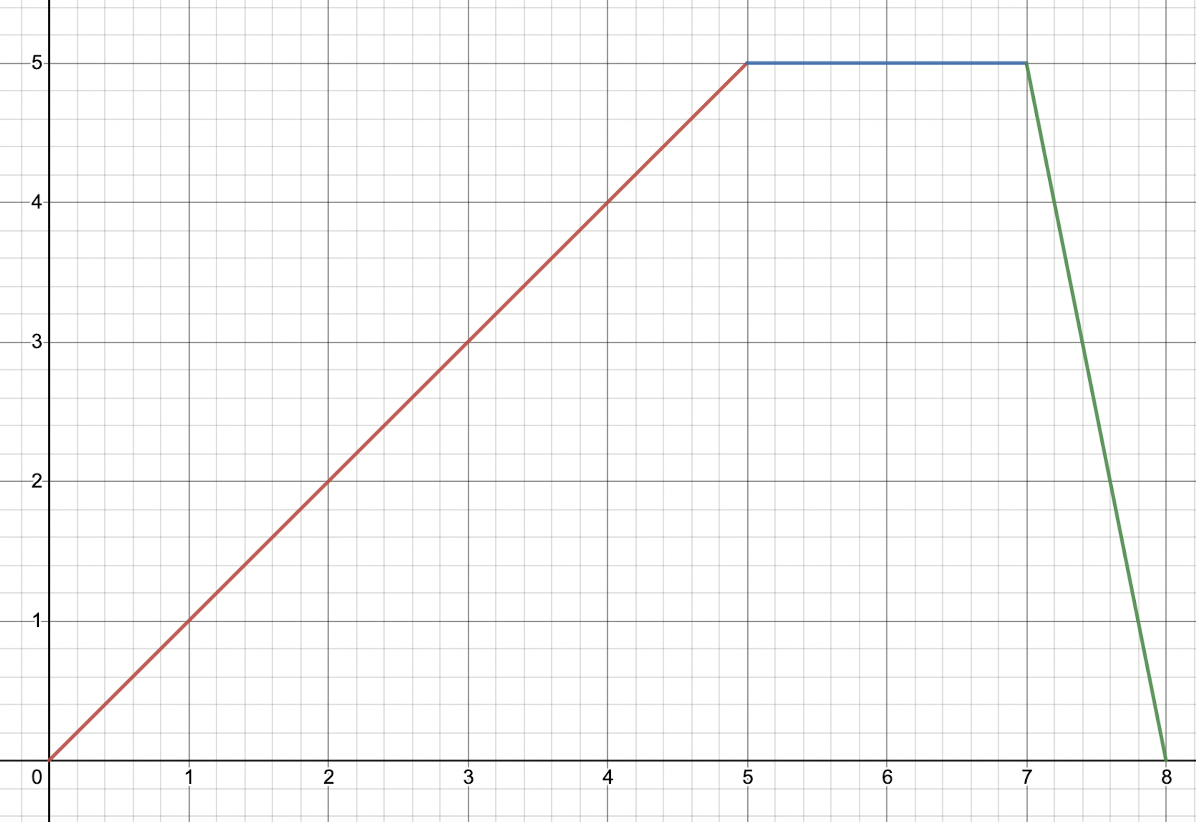
Worked Examle 1
Calculate the total displacement if the -aixs represent velocity and x-axis represent time
https://www.desmos.com/calculator/tgknfg8biz

Slide 20
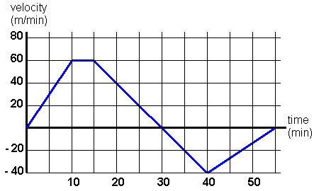
Worked Examle 2
Calculate the total displacement and distance

Slide 21
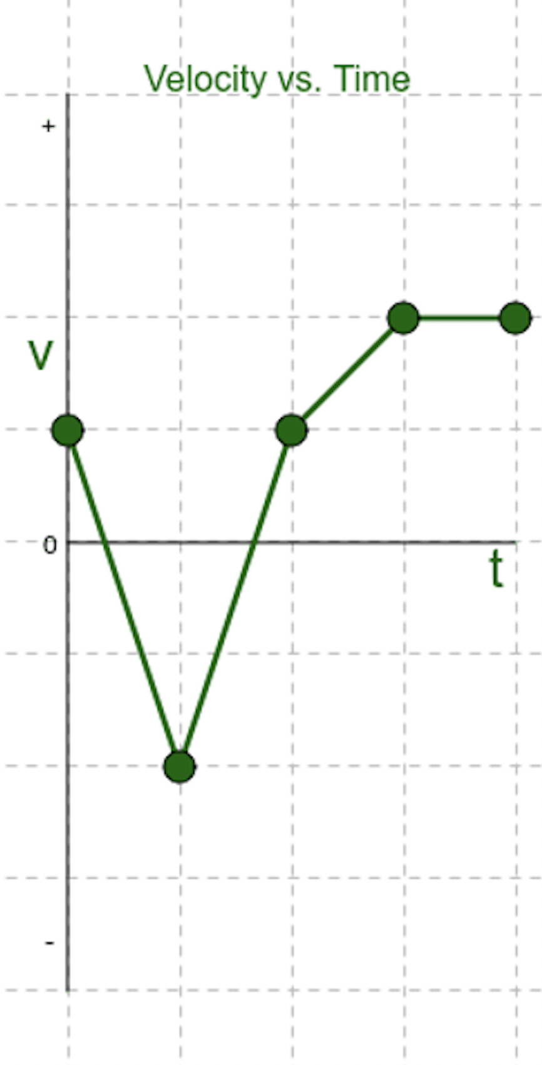
Graph Acceleration

Slide 22
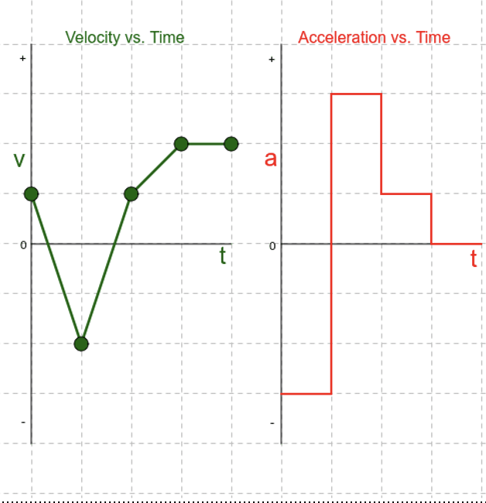
Answer

Slide 23
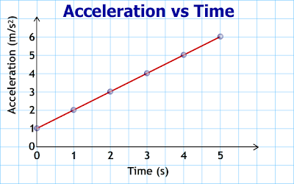
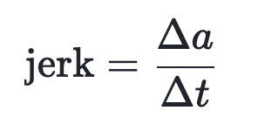
Acceleration Versus Time Graph
Acceleration vs time graphs tells us about an object's velocity
Slope/gradient: rate of change of acceleration
Area under the curve: change in velocity during a time interval.

Slide 24
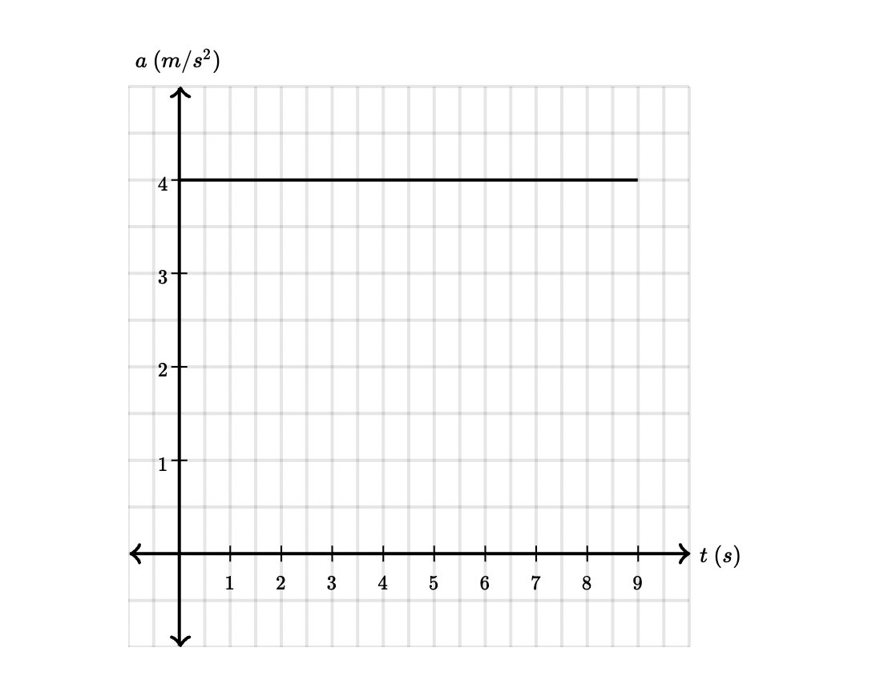
Worked Example
Find the change in velocity and jerk

Slide 25
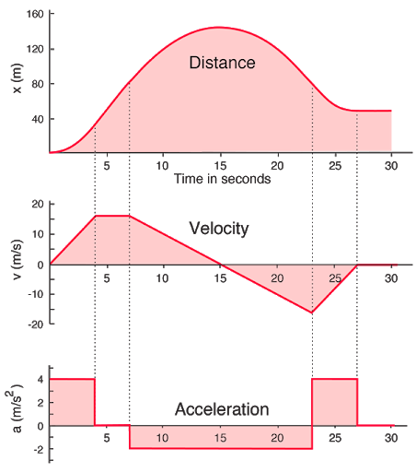
Diaplcement, Velocity, and Acceleration
Displacement to velocity: First derivative
Displacement to acceleration: Second derivation

Slide 26
In Mathematical Expression

Slide 27
Worked Example 1-Calculus

Slide 28
Worked Example2 - Calculus

Slide 29
Kinematics Equation
CONSTANT ACCELERARION

Slide 30
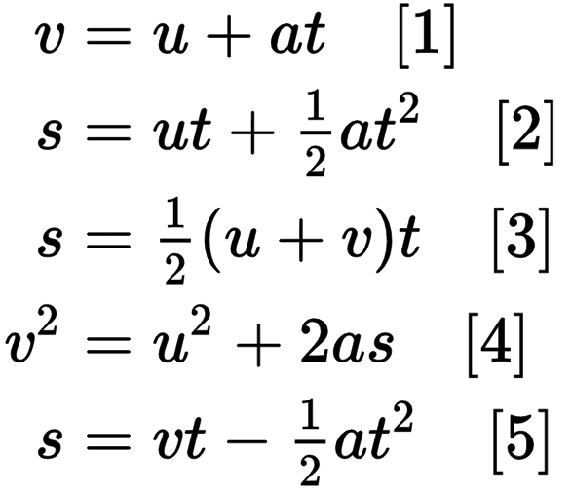
For IB
CONSTANT ACCELERARION

Slide 31
Kinematic Equation From Motion Diagram

Slide 32
Worked Example 1

Slide 33
Worked Example 2

Slide 34
Worked Example 3

Slide 35
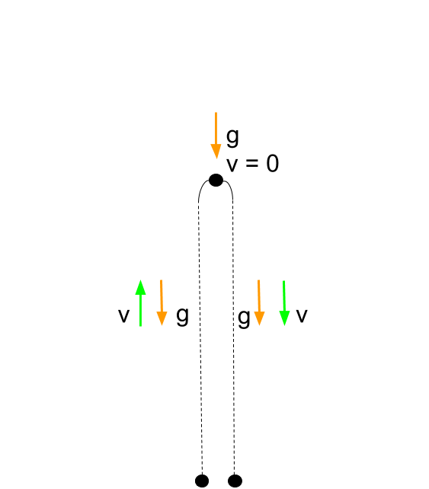
Free Fall Motion: Properties
Affected by gravity only
Vertical Acceleration
Vertical Velocity
Horizontal Velocity
Vertical Displacement
Formula

Slide 36
Worked Example 1

Slide 37
Worked Example 2

Slide 38
Worked Example 3

Slide 39
Worked Example 4

Slide 40
References
https://www.google.com.hk/search?q=velocity+to+acceleration+graph&newwindow=1&safe=strict&sxsrf=ALeKk01JJhg2kFuJlwKx1W7s2noB-TiFXg:1618895866606&source=lnms&tbm=isch&sa=X&ved=2ahUKEwj5tbqIiYzwAhWJad4KHW-ACTEQ_AUoAXoECAEQAw&biw=1440&bih=687#imgrc=9d6dZ-ezMEi-QM
https://easylifephysics.wordpress.com/mechanics/motion-along-straight-line/
https://www.wlwv.k12.or.us/cms/lib8/OR01001812/Centricity/Domain/1335/BW15%20Test%20review%20bookwork%20answers.pdf

