Slide 1
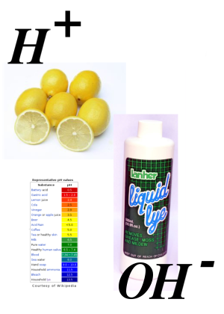
Unit 8: Acids & Bases
PART 1:
Acid/Base Theory & Properties

Slide 2
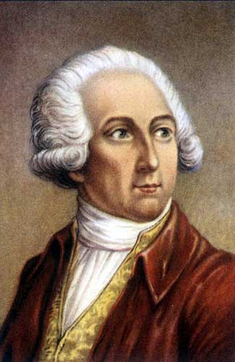
I hereby define acids as compounds of oxygen and a nonmetal. (1777)
In fact, I just named the newly discovered gas oxygen, which means “acid-former.”
Antoine-Laurent de Lavoisier
(1777)

Slide 3
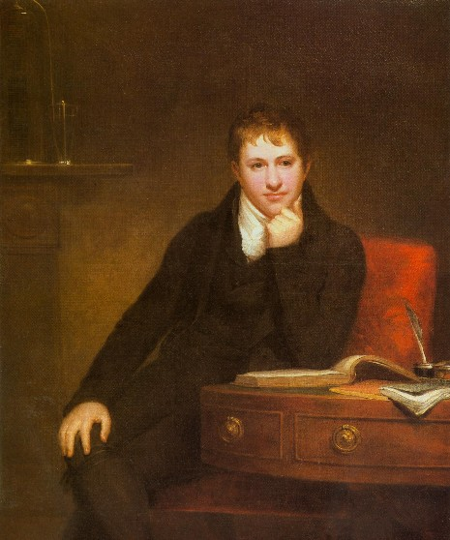
Actually, one of the acids you worked with is composed entirely of hydrogen and chlorine (HCl).
Humphry Davy (1818)

Slide 4
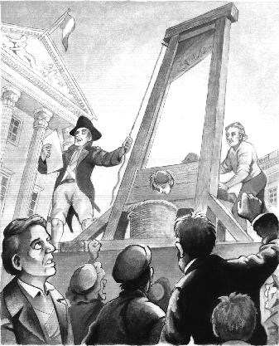
Awwwe SNAP! My definition won’t work since it is no longer valid for all acids. I guess I’ll go back to just being a tax collector.
Antoine-Laurent de Lavoisier
(1777)

Slide 5
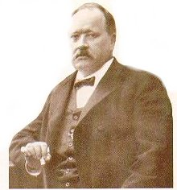

The Arrhenius Theory of Acids and Bases: acids donate H⁺ in sol’n; bases donate OH⁻
Commentary on Arrhenius Theory…
One problem with the Arrhenius theory is that it’s not comprehensive enough. Some compounds act like acids and bases that don’t fit the standard definition.

Slide 6
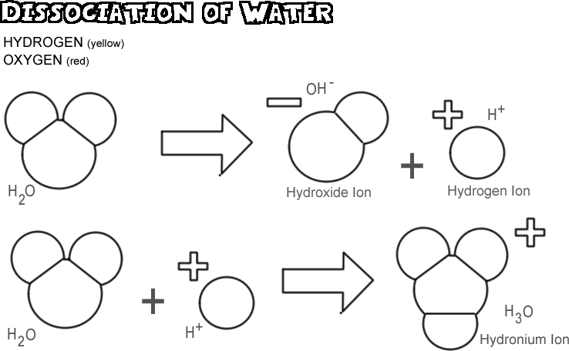
A note on H⁺ and H₃O⁺…

Slide 7
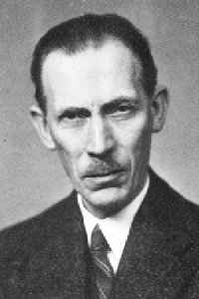

Bronsted-Lowry Theory of Acids & Bases

Slide 8
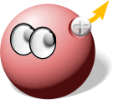
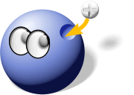
BrØnsted-Lowry: a theory of proton transfer
A B-L ACID is a proton (H⁺) donor.
A B-L BASE is a proton (H⁺) acceptor.

Slide 9
Conjugate Pairs
Acids react to form bases and vice versa.
The acid-base pairs related to each other in this way are called conjugate acid-base pairs.
They differ by just one proton.
base
conj. acid
HA + B ↔ A⁻ + BH⁺
acid
conj. base

Slide 10
Ex) List the conjugate acid-base pairs in the following reaction:
conjugate pair
CH₃COOH(aq) + H₂O(l) ↔ CH₃COO⁻(aq) + H₃O⁺(aq)
acid
base
conj. base
conj. acid
conjugate pair

Slide 11
Ex) Write the conjugate base for each of the following.
H₃O⁺
NH₃
H₂CO₃
→ H₂O
→ NH₂⁻
→ HCO₃⁻

Slide 12
Ex) Write the conjugate acid for each of the following.
NO₂⁻
OH⁻
CO₃²⁻
→ HNO₂
→ H₂O
→ HCO₃⁻

Slide 13
Amphoteric / amphiprotic substances
substances which can act as Bronsted-Lowry acids and bases, meaning they can either accept or donate a proton (capable of both).
The following features enable them to have this “double-identity:”
  To act as a Bronsted-Lowry acid, they must be able to dissociate and release H⁺.
  To act as a Bronsted-Lowry base, they must be able to accept H+, which means they must have a lone pair of electrons.

Slide 14
Amphoteric / amphiprotic substances
Water is a prime example – it can donate H⁺ and it has two lone pairs of electrons.
Auto-ionization of water:
H₂O + H₂O ↔ H₃O⁺ + OH⁻
Water reacting as a base with CH₃COOH:
CH₃COOH(aq) + H₂O(l) ↔ CH₃COO⁻ (aq) + H₃O⁺(aq)
Water reacting as an acid with NH₃:
NH₃(aq) + H₂O(l) ↔ NH₄⁺(aq) + OH⁻(aq)

Slide 15
Ex) Write equations to show HCO₃⁻ reacting with water
(a) HCO₃⁻ acting as an acid
(b) HCO₃⁻ acting as a base.
To act as an acid, it donates H+
  HCO₃⁻(aq) + H₂O(l) ↔ CO₃²⁻(aq) + H₃O⁺(aq)
To act as a base, it accepts H+
  HCO₃⁻(aq) + H₂O(l) ↔ H₂CO₃ (aq) + OH⁻(aq)

Slide 16
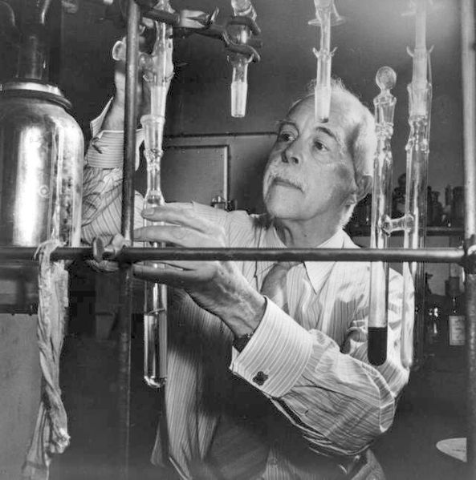
The Lewis Theory of Acids and Bases
A Lewis ACID is an electron pair acceptor.
A Lewis BASE is an electron pair donor.

Slide 17

Lewis: a theory of electron pairs
Lewis acid-base reactions result in the formation of a covalent bond, which will always be a dative bond (a.k.a. coordinate covalent bond) because both the electrons come from the base.

Slide 18
Example:
Lewis acid
Lewis base
note – the “curly arrow” is a convention used to show donation of electons.

Slide 19
Example:
Lewis acid
Lewis base
note – boron has an incomplete octet, so it is able to accept an electron pair

Slide 20
Example: Cu²⁺(aq) + 6H₂O(l) →[Cu(H₂O)₆]²⁺(aq)
Lewis acid
Lewis base
note – metals in the middle of the periodic table often form ions with vacant orbitals in their d subshell, so they are able to act as Lewis acids and accept lone pairs of electrons when they bond with ligands to form complex ions. Ligands, as donors of lone pairs, are therefore acting as Lewis bases

Slide 21
Ligands
Typical ligands found in complex ions include H₂O, CN⁻ and NH₃.
Note that they all have lone pairs of electrons, the defining feature of their Lewis base properties.

Slide 22
Acid-Base Theory Comparison
Theory | Definition of acid | Definition of base
Bronsted-Lowry | Proton donor | Proton acceptor
Lewis | Electron pair acceptor | Electron pair donor
Lewis acid
Bronsted-Lowry acid

Slide 23
Ex: For each of the following reactions, identify the Lewis acid and the Lewis base.
4NH₃(aq) + Zn²⁺(aq) ↔ [Zn(NH₃)₄]²⁺(aq)
2Cl⁻(aq) + BeCl₂ (aq) + ↔ [BeCl₄]²⁻ (aq)
Mg²⁺(aq) + 6H₂O(l) ↔ [Mg(H₂O)₆]²⁺(aq)
base
acid
base
acid
acid
base

Slide 24
Ex: Which of the following could not act as a ligand in a complex ion of a transition metal?
Cl⁻ b) NCl₃
c) PCl₃ d) CH₄
no lone pairs

Slide 25
Properties of acids and bases
For acids and bases here, we will use the following definitions:
Acid: a substance that donates H⁺ in solution
Base: a substance that can neutralize an acid to produce water --- includes metal oxides, hydroxides, ammonia, soluble carbonates (Na₂CO₃ and K₂CO₃) and hydrogencarbonates (NaHCO₃ and KHCO₃)

Slide 26
Properties of acids and bases
Alkali: a soluble base. When dissolved in water, alkalis all release the hydroxide ion, OH⁻
For example:
  K₂O(s) + H₂O(l) → 2K⁺(aq) + 2OH⁻(aq)
  NH₃(aq) + H₂O(l) ↔ NH₄⁺(aq) + OH⁻(aq)
  CO₃²⁻ (aq) + H₂O(l) ↔ HCO₃⁻(aq) + OH⁻(aq)
  HCO₃⁻(aq) ↔ CO₂(g) + OH⁻(aq)
bases
alkalis

Slide 27
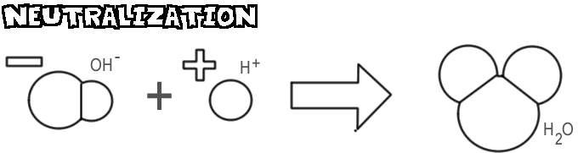
Properties of acids and bases
Neutralization:
net ionic equation = H⁺(aq) + OH⁻(aq)↔ H₂O(l)

Slide 28
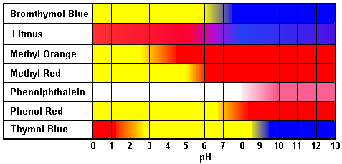
Acid-Base Indicators
Acid-Base indicators change color reversibly according to the concentration of H⁺ ions in solution.
HIn(aq) ↔ H⁺(aq) + In⁻(aq)

Slide 29


Acid-Base Indicators
Many indicators are derived from natural substances such as extracts from flower petals and berries.

Slide 30
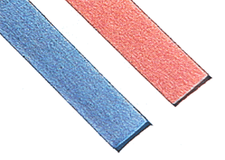
Acid-Base Indicators
Litmus, a dye derived from lichens, can distinguish between acids and alkalis, but cannot indicate a particular pH.

Slide 31
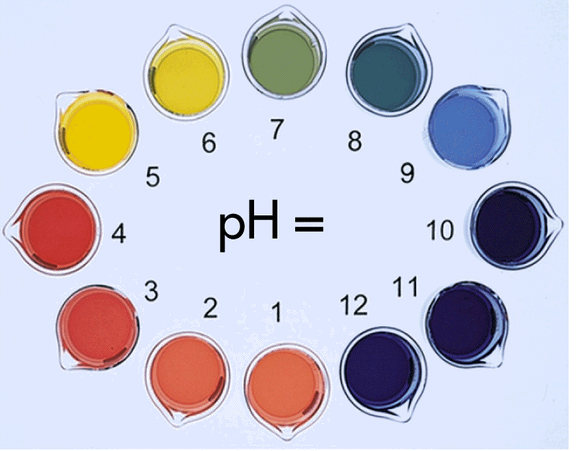
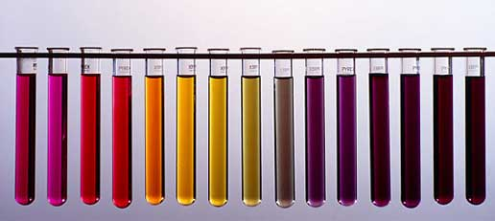
Acid-Base Indicators
For this purpose, universal indicator was created by mixing together several indicators; thus universal indicator changes color many times across a range of pH levels.
0
7
14

Slide 32
Acid-Base Indicators
Indicator | Color in acid | Color in alkali
litmus | pink | blue
methyl orange | red | yellow
phenolphthalein | colorless | pink

Slide 33
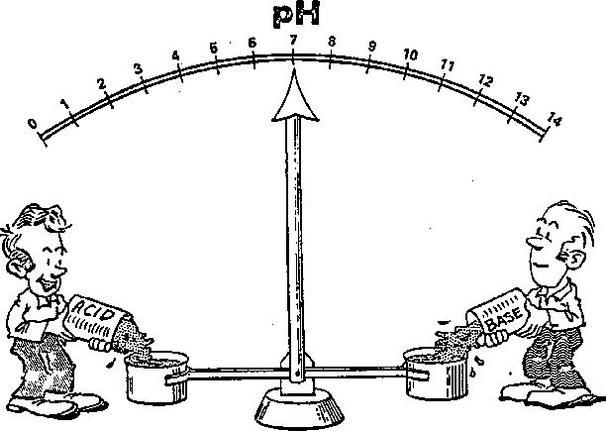
Acids react with metals, bases and carbonates to form salts…
Neutralization reactions with bases:
acid + base → salt + water
a) with hydroxide bases
HCl(aq) + NaOH(aq) →
NaCl(aq) + H₂O(l)

Slide 34
Acids react with metals, bases and carbonates to form salts…
Neutralization reactions with bases:
acid + base → salt + water
b) With metal oxide bases
2 Cu(CH₃COO)₂(aq) + H₂O(l)
CH₃COOH(aq) + CuO(s) →

Slide 35
Acids react with metals, bases and carbonates to form salts…
Neutralization reactions with bases:
acid + base → salt + water
c) With ammonia (via ammonium hydroxide)
HNO₃(aq) + NH₄OH(aq) →
NH₄NO₃(aq) + H₂O(l)

Slide 36
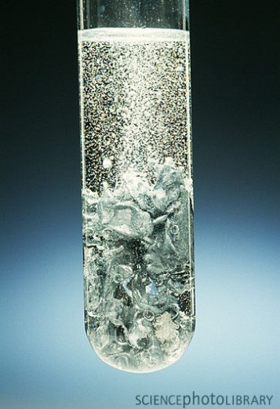
Acids react with metals, bases and carbonates to form salts…
2) With reactive metals (those above copper in the reactivity series):
acid + metal → salt + hydrogen
2HCl(aq) + Zn(s) →
ZnCl₂(aq) + H₂(g)
2CH₃COOH(aq) + Mg(s) →
Mg(CH₃COO)₂(aq) + H₂(g)

Slide 37
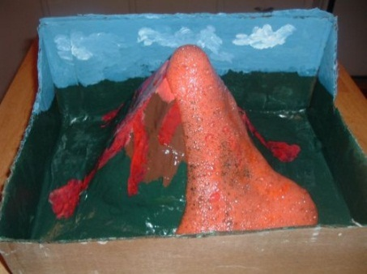
Acids react with metals, bases and carbonates to form salts…
3) With carbonates (soluble or insoluble) / hydrogencarbonates:
acid + carbonate → salt + water + carbon dioxide
2HCl(aq) + CaCO₃(aq) →
CaCl₂(aq) + H₂O(l) + CO₂(g)
H₂SO₄(aq) + Na₂CO₃(aq) →
Na₂SO₄(aq) + H₂O(l) + CO₂(g)
CH₃COOH(aq) + KHCO₃(aq) →
KCH₃COO(aq) + H₂O(l) + CO₂(g)

Slide 38

Strong, Concentrated and Corrosive
In everyday English, strong and concentrated are often used interchangeably. In chemistry, they have distinct meanings:
strong: completely dissociated into ions
concentrated: high number of moles of solute per liter (dm³) of solution
corrosive: chemically reactive

Slide 39
Strong, Concentrated and Corrosive
Similarly, weak and dilute also have very different chemical meanings:
weak: only slightly dissociated into ions
dilute: a low number of moles of solute per liter (dm³) of solution

Slide 40
Strong and Weak Acids and Bases
Consider the acid dissociation reaction: HA(aq) ↔ H⁺(aq) + A⁻(aq)
Strong acid: equilibrium lies to the right (acid dissociates fully) → reversible rxn is negligible → exists entirely as ions
  Ex: HCl(aq) → H⁺(aq) + Cl⁻(aq)

Slide 41
Strong and Weak Acids and Bases
Consider the acid dissociation reaction: HA(aq) ↔ H⁺(aq) + A⁻(aq)
Weak acid: equilibrium lies to the left (partial dissociation) → exists almost entirely in the undissociated form
  Ex: CH₃COOH(aq) ↔ H⁺(aq) + CH₃COO⁻(aq)

Slide 42
Strong and Weak Acids and Bases
Similarly, the strength of a base refers to its degree of dissociation in water.
Strong base ex:
Weak base ex:
  NaOH(aq) → Na⁺(aq) + OH⁻(aq)
  NH₃(aq) + H₂O(l) ↔ NH₄⁺(aq) + OH⁻(aq)

Slide 43
Strong and Weak Acids and Bases
NOTE: Weak acids and bases are much more common than strong acids and bases.

Slide 44
Strong Acids (only six; know 1st three for IB) | Strong Bases (Grp 1 hydroxides & barium hydroxide) | Weak Acids carboxylic and carbonic acids | Weak Bases ammonia and amines
H₂SO₄, sulfuric acid* | LiOH, lithium hydroxide | CH₃COOH, ethanoic acid and other organic acids | C₂H₅NH₂, ethylamine and other amines
HNO₃, nitric acid | NaOH, sodium hydroxide | H₂CO₃, carbonic acid Note CO₂(aq) = H₂CO₃(aq) | NH₃, ammonia Note NH₃(aq) = NH₄OH(aq)
HCl, hydrochloric acid | KOH, potassium hydroxide | H₃PO₄, phosphoric acid
HI, hydroiodic acid | Ba(OH)₂, barium hydroxide
HBr, hydrobromic acid
HClO₄, perchloric acid

Slide 45
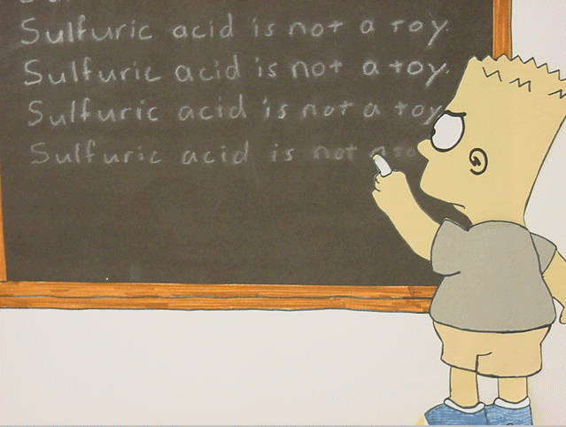
NOTE: Sulfuric acid, H₂SO₄, is a diprotic acid which is strong in the dissociation of the first H⁺ and weak in the dissociation of the second H⁺.
For purposes of IB, only monoprotic dissociations are considered.

Slide 46
Experimental methods for distinguishing between strong and weak acids and bases
Electrical conductivity: strong acids and bases will have a higher conductivity (higher concentration of mobile ions)
Rate of reaction: faster rate of rxn with strong acids (higher concentration of ions)
pH: measure of H⁺ concentration in sol’n. A 1.0 M sol’n of strong acid will have lower pH than 1.0 M sol’n of weak acid; 1.0 M sol’n of strong base will have higher pH than 1.0 M sol’n of weak base

