Slide 1
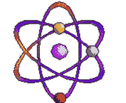
Atomic Structure

Slide 2
Part 1
The Atom

Slide 3
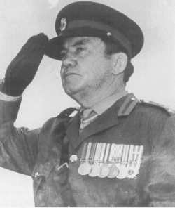
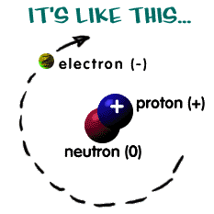
ATOM BASICS
General Concepts
All atoms, with the exception of H, are made up of 3 subatomic particles: protons, neutrons and electrons.
Hydrogen is the simplest atom (1 proton & 1 electron)
Atomic radius is on the order of 10⁻¹⁰ m.
Atoms are mostly empty space.
Protons and neutrons are located in the nucleus.
Electrons are found in energy levels (shells) surrounding the nucleus.

Slide 4
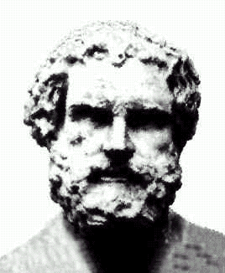
Cultural bias in scientific history?
“Nothing exists but atoms and empty space; everything else is opinion.”
“Atom” – Greek word meaning “indivisible”
In 420 BCE, the Greek philosopher, Democritus, suggested that the universe was made of indivisible units…
…or so we’ve heard.
Δημόκριτος, Dēmokritos,
"chosen of the people“
(460 – 370 BCE)

Slide 5
Cultural bias in scientific history?
“I grew up in Europe,
where the history comes from.”
Eddie Izzard
(Dress to Kill)

Slide 6
Cultural bias in scientific history?
Many historians believe the idea was first proposed at least a century earlier in the Indian subcontinent.
The theory of atomism was also much developed in both Chinese and Arabic culture during the Dark Ages in Europe, when the teachings of the church dictated much of Western thought.

Slide 7
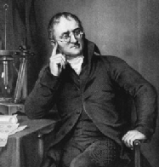
JOHN DALTON
Dalton’s Atomic Theory (proposed in 1808):
All elements are made of tiny atoms.
Atoms cannot be subdivided.
Atoms of the same element are exactly alike.
Atoms of different elements can join to form molecules.

Slide 8
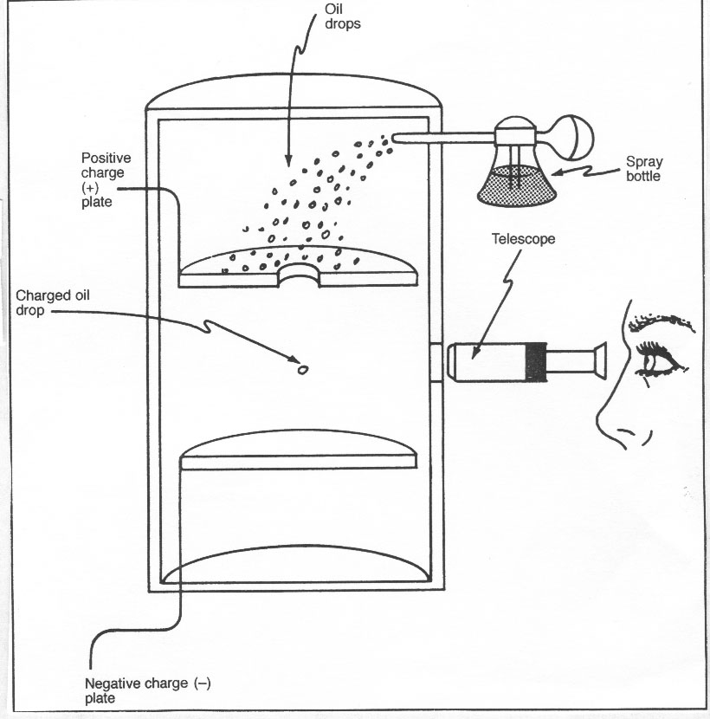
Evidence for Subatomic Particles
Thompson and Millikan are given credit for the first discoveries relating to electrons.
Robert Millikan
J.J. Thompson
J.J. Thomson
(1856 - 1940)
1906 Nobel

Slide 9
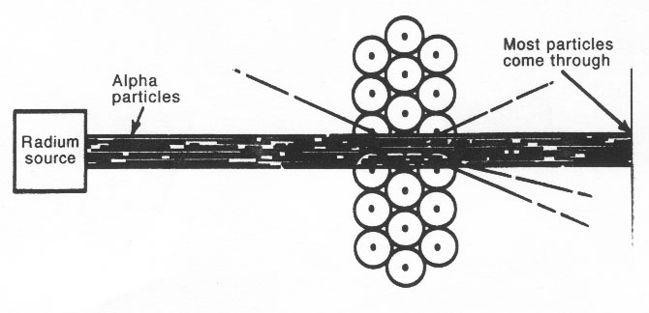
Evidence for Subatomic Particles
Rutherford discovered the positively charged nucleus.
Ernest Rutherford
Ernest Rutherford
(1871 - 1937)
1908 Nobel
Observations:
1) Most of the particles passed directly through - no deflection 2) Some of the particles were deflected somewhat from their path. 3) Some of the particles bounced back in the same direction from which they approached the gold foil.

Slide 10
Relative mass and charge of subatomic particles
Actual mass of a proton: 1.672 x 10²⁴ g
neutron mass is virtually identical
electron is 1/2000 of this mass
Actual charge of an electron: 1.602 x 10⁻¹⁹ Coulombs
PARTICLE | RELATIVE MASS | RELATIVE CHARGE
proton | 1 | +1
neutron | 1 | 0
electron | 5 x 10⁻⁴ | -1

Slide 11
Periodic Key
6
C
Carbon
12.011
Atomic number (Z)
Element’s symbol
Element’s name
Atomic mass (A)
# of protons = Z
# of electrons = # of protons (in a neutral atom)
# of neutrons = A-Z

Slide 12
Shorthand notation for an atom or ion
MASS #: # protons + # neutrons
A
X
n+/n-
Z
CHARGE: leave blank if n=0 (neutral atom)
ATOMIC #: # protons (which is = # electrons if a neutral atom)

Slide 13
Examples
Symbol | Atomic number (Z) | Mass number (A) | # protons | # neutrons | # electrons
4
9
4
5
4
20
40
20
20
18
17
37
17
20
18

Slide 14
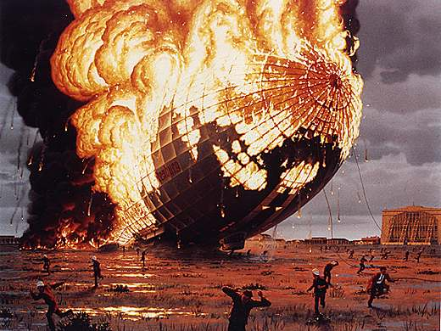
ISOTOPES
Isotopes: atoms that have the same # of protons, but a different # of neutrons.
Example: Isotopes of hydrogen
1p+, 1e-, 0n
1p+, 1e-, 1n
1p+, 1e-, 2n

Slide 15
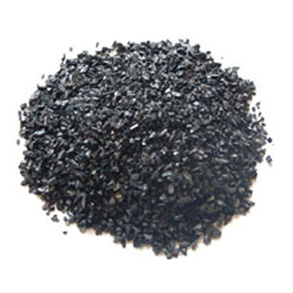
ISOTOPES
Isotopes: atoms that have the same # of protons, but a different # of neutrons.
Example: Isotopes of carbon
6p+, 6e-, 6n
6p+, 6e-, 8n

Slide 16
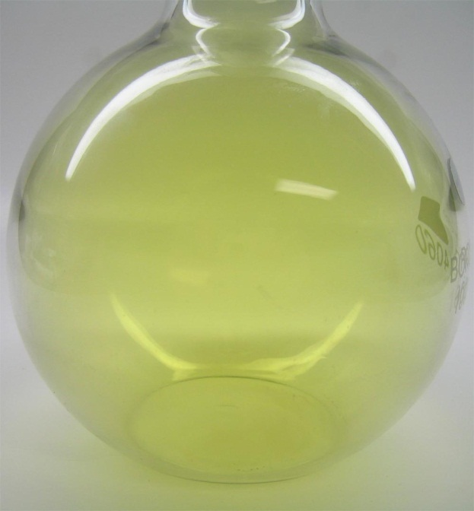
ISOTOPES
Isotopes: atoms that have the same # of protons, but a different # of neutrons.
Example: Isotopes of chlorine
17p+, 17e-, 18n
17p+, 17e-, 20n

Slide 17
RELATIVE ATOMIC MASS: weighted mean molar mass of atoms of elements.
Example: The two isotopes of chlorine occur in the ratio of 3:1. Thus, naturally occurring chlorine contains 75% and 25% . Determine the relative atomic mass of chlorine.

Slide 18
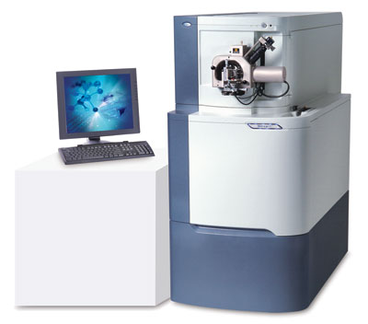
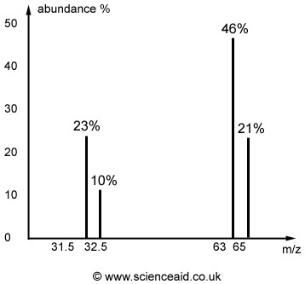
Part 2
Mass Spectrometry

Slide 19
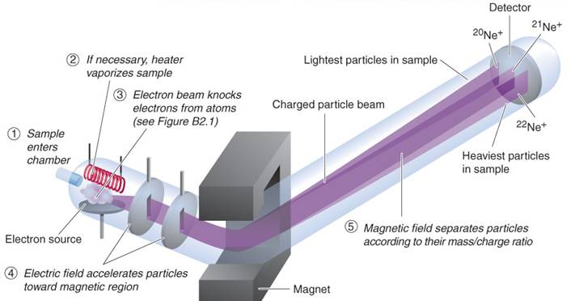
The Mass Spectrometer
Relative atomic masses (among other things we will discuss when we get to organic chemistry) can be determined using this instrument.

Slide 20
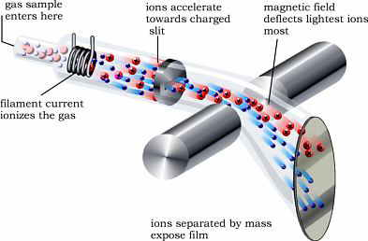
How it works (5 basic steps):
1.
vaporization: if the sample is not already as gas, the sample is heated to this point.

Slide 21
How it works (5 basic steps):
2.
ionization: sample is bombarded with a stream of high energy electons. In practice, the instrument is set so that only ions with a single positive charge are formed (M⁺).

Slide 22
How it works (5 basic steps):
3.
acceleration: resulting unipositive ions pass through slits in parallel plates under the influence of an electric field.

Slide 23
How it works (5 basic steps):
4.
deflection: ions are then passed over an external magnetic field. The magnetic field causes the ions to be deflected, and the amount of deflections is proportional to the charge/mass ratio. Ions with smaller masses are deflected more than heavier ions. Ions with higher charges are deflected more as they interact more effectively with the magnetic field.
Heavier particles
lighter particles

Slide 24
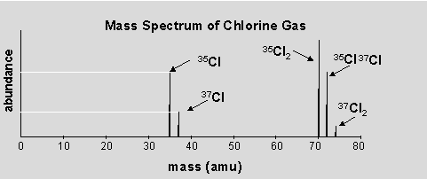
How it works (5 basic steps):
5.
detection: positive ions of a particular mass/charge ratio are detected and a signal is sent to a recorder. The strength of the signal is a measure of the number of ions with that charge/mass ratio that are detected.

Slide 25
Example: Find the relative atomic mass (A_{r}) of naturally occurring lead from the data below. Record your answer to the nearest tenth.
Isotopic mass | Relative abundance | % relative abundance
204 | 0.2 | 2
206 | 2.4 | 2.4
207 | 2.2 | 2.2
208 | 5.2 | 52
$$A_{r}=\frac{\left(2×204\right)+\left(24×206\right)+\left(22×207\right)+\left(52×208\right)}{100}$$
$A_{r}=$207.2
Figure: The Mass Spectrum of Naturally Occurring Lead

Slide 26
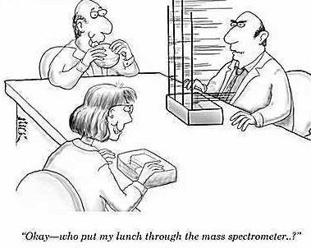

Slide 27
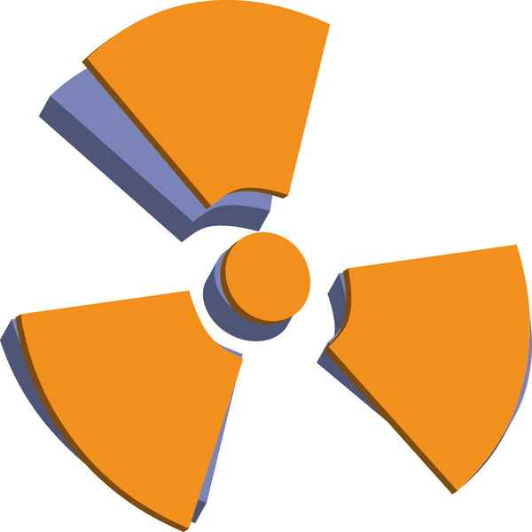
Radioisotopes
Nucleus stability depends upon the balance between the number of protons and neutrons. Nuclei that contain too many or too few neutrons are unstable (radioactive) and change to form more stable nuclei by giving off radiation.

Slide 28
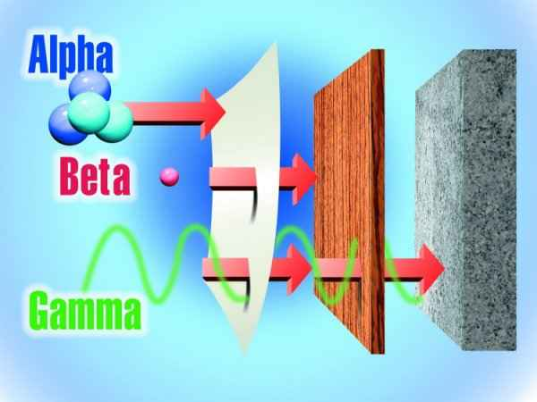
Radioisotopes
Alpha (α): particles (identical to helium nuclei) emitted by nuclei with too many protons.
Beta (β): electrons are ejected (owing to neutron decay) from nuclei with too many neutrons.
Gamma (γ): rays that are a high-energy form of electromagnetic ration.

Slide 29
Uses of radioisotopes
can be used to generate energy in nuclear power plants (fission), sterilize surgical instruments in hospitals, preserve food, detect cracks in structural materials, etc.
While the high energy nature of radioactivity can be used save human life, uncontrolled levels of exposure can have quite the opposite effect.

Slide 30
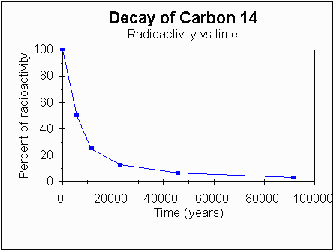
Carbon-14 dating
Decays as (beta emission) at a known rate.
Half life (time it takes for 50% of sample to decay) for C-14 is 5730 years.

Slide 31
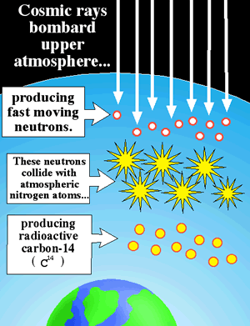
Carbon-14 dating
C-14 continually forms in the upper atmosphere and is in equilibrium with C-12 (concentrations are constant).
As living things function, they constantly recycle carbon, thus maintaining a constant C-14/C-12 ratio.

Slide 32
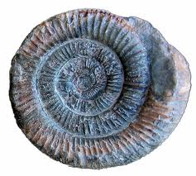
Carbon-14 dating
As living things function, they constantly recycle carbon, thus maintaining a constant C-14/C-12 ratio.
The C-14/C-12 ratio falls by 50% every 5730 years after the death of a living organism.
Measurement of current activity allows us to determine how long ago a fossil was deposited. After 50,000 years, the activity is so low that other radionuclides must be used for accurate fossil dating.

Slide 33
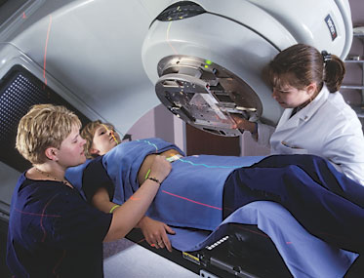
Cobalt-60 used in radiotherapy
Radiotherapy (radiation therapy) targets ionizing radiation at cancer cells, damaging the genetic material of these cells by knowcking off electrons and making it impossible for these cells to grow and divide.
Co-60 is commonly used as it emits very penetrating gamma radiation when its protons an neutrons change their relative positions in the nucleus.
Although radiotherapy damages both cancer and normal cells, the normal cells are able to recover if the treatment is carefully controlled.

Slide 34
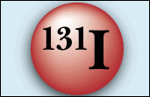
Iodine-131 as a medical tracer
Emitter of both beta and gamma radiation.
Radioisotopes have same chemical properties as any other atom of the same element and so they play the same roll in the body; however, their positions, unlike other isotopes, can be monitored by detecting radiation levels, making them suitable as medical tracers.

Slide 35
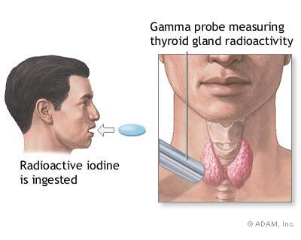
Iodine-131 as a medical tracer
I-131 in the form of sodium iodide can be used to investigate activity of the thyroid gland and to diagnose and treat thyroid cancer.
Half life for I-131 is short, 8 days, so it is quickly eliminated from the body.
Another isotope, I-125 is used in treatment of prostate cancer (half-life=80 days).

