Slide 1
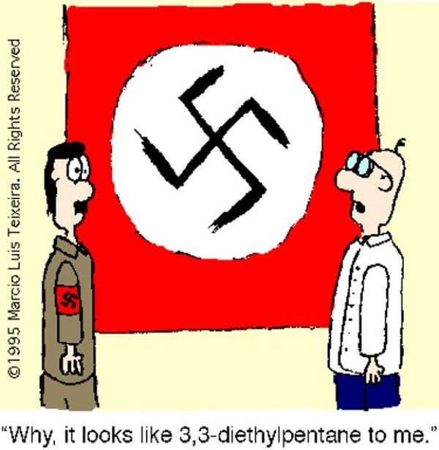
Organic Chemistry
Topics 10 & 20
Chapter 22
PART 1: Naming Organic Compounds

Slide 2
Formulas for organic compounds:
empirical
molecular
structural

Slide 3
Empirical Formulas
Empirical formula: simplest whole number ratio of the atoms it contains.
Example: What is the empirical formula of ethane, C₂H₆?
CH₃

Slide 4
Molecular Formulas
Molecular: actual number of atoms of each present. It can be deduced if both the empirical formula and relative molecular mass, M_{r}, are known.
Example: What is the molecular formula of a compound with relative molecular mass, M_{r}, of 30 and an empirical formula of CH₃?
M_{r} CH₃ = 15
30/15 = 2
2(CH₃) = C₂H₆

Slide 5
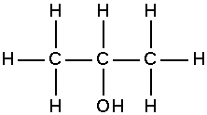
Structural Formulas
Structural: representation of molecule showing how the atoms are bonded to each other.
Full structural formula – graphic formula showing every bond and atom. Usually 90° and 180° angles are used to show the bonds because this is the clearest representation on a 2-dimensional page, although it is not the true geometry of the molecule. (MUST DRAW H’s!)

Slide 6
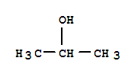
Structural Formulas
Structural: representation of molecule showing how the atoms are bonded to each other.
Condensed structural formula – often omits bonds where they can be assumed, and groups atoms together. It contains the minimum information needed to describe the molecule unambiguously.

Slide 7
Structural Formulas
Structural: representation of molecule showing how the atoms are bonded to each other.
Stereochemical formula – attempts to show the relative position of atoms and groups around carbon in three dimensions. The convention is that a bond coming out of the page is shown as a solid, enlarging wedge; a bond sticking behind the page is shown as a dotted line; a bond in the plane of the paper is a solid line.
Examples: methanol, CH₃OH ethene, C₂H₄

Slide 8
Example: different formulas applied to 3 compounds
formula | ethane | ethanoic acid | glucose
empirical
molecular
full structural
condensed structural
CH₃
CH₂O
CH₂O
C₂H₆
C₂H₄O₂
C₆H₁₂O₆
CH₃CH₃
CH₃COOH
CHO(CHOH)₄CH₂OH

Slide 9
IUPAC: International Union of Pure and Applied Chemistry
International, non-governmental organization that is best known for its system of nomenclature, which is now recognized as the world authority in this field.

Slide 10
Rule #1: Identify the longest chain of carbon atoms
The longest chain of carbon atoms gives the stem/root of the name as shown in the table below:
# of C-atoms in longest chain | Stem in IUPAC name | Example (C₂H_{2n+2} for alkanes)
1 | meth- | CH₄, methane
2 | eth- | C₂H₆, ethane
3 | prop- | C₃H₈, propane
4 | but- | C₄H₁₀, butane
5 | pent- | C₅H₁₂, pentane
6 | hex- | C₆H₁₄, hexane
7 | hept- | C₇H₁₆, heptane
8 | oct- | C₈H₁₈, octane
9 | non- | C₉H₂₀, nonane

Slide 11
Rule #1: Identify the longest chain of carbon atoms
If two chains have equal lengths, pick the one with more branch points.

Slide 12
Rule #2: Number the carbons in the main chain
Number chain to minimize the position/number of the following in order of priority:
thing you’re naming the compound after (double bond if alkene; -OH group if alcohol, etc)
note: for multiple double bonds →-diene, -triene, -tetraene
first branch/substituent group
If both ends have the same first branching number, then number chain to minimize position of second branch (and then third and so on).
if still in need of a tie breaker, minimize # of substituent group that comes first alphabetically
Note: in cyclic and aromatic (benzene derivatives) compounds, no number needed if only one substituent.

Slide 13
Rule #3: Identify the functional group and attach appropriate suffix
Note: the name for the stem/root is derived from the longest carbon chain, which may include the carbon of the functional group.
Homologous series | Functional group | Suffix | Example of compound
alkane |  | -ane

Slide 14
Rule #3: Identify the functional group and attach appropriate suffix
Note: the name for the stem/root is derived from the longest carbon chain, which may include the carbon of the functional group.
Homologous series | Functional group | Suffix | Example of compound
alkene |  | -ene

Slide 15
Rule #3: Identify the functional group and attach appropriate suffix
Note: the name for the stem/root is derived from the longest carbon chain, which may include the carbon of the functional group.
Homologous series | Functional group | Suffix | Example of compound
alkyne |  | -yne

Slide 16
Rule #3: Identify the functional group and attach appropriate suffix
Note: the name for the stem/root is derived from the longest carbon chain, which may include the carbon of the functional group.
Homologous series | Functional group | Suffix | Example of compound
alcohol |  | -anol

Slide 17
Rule #3: Identify the functional group and attach appropriate suffix
Note: the name for the stem/root is derived from the longest carbon chain, which may include the carbon of the functional group.
Homologous series | Functional group | Suffix | Example of compound
nitrile |  | -anenitrile

Slide 18
Rule #3: Identify the functional group and attach appropriate suffix
Note: the name for the stem/root is derived from the longest carbon chain, which may include the carbon of the functional group.
Homologous series | Functional group | Suffix | Example of compound
aldehyde |  | -anal

Slide 19
Rule #3: Identify the functional group and attach appropriate suffix
Note: the name for the stem/root is derived from the longest carbon chain, which may include the carbon of the functional group.
Homologous series | Functional group | Suffix | Example of compound
ketone |  | -anone

Slide 20
Rule #3: Identify the functional group and attach appropriate suffix
Note: the name for the stem/root is derived from the longest carbon chain, which may include the carbon of the functional group.
Homologous series | Functional group | Suffix | Example of compound
carboxylic acid |  | -anoic acid

Slide 21
Rule #3: Identify the functional group and attach appropriate suffix
Note: the name for the stem/root is derived from the longest carbon chain, which may include the carbon of the functional group.
Homologous series | Functional group | Suffix | Example of compound
amine* |  | -anamine

Slide 22
Amine functional group*
primary amines have an –NH2 group which can undergo substitution by alkyl groups, giving rise to secondary and tertiary amines. These are named using N- to show the position of the substituents.
Example 1: (primary amine)
Example 2: (secondary amine)
Example 3: (tertiary amine)
propanamine (or 1-aminopropane)
N-methylpropanamine
N,N-dimethylpropanamine

Slide 23
Rule #3: Identify the functional group and attach appropriate suffix
Note: the name for the stem/root is derived from the longest carbon chain, which may include the carbon of the functional group.
Homologous series | Functional group | Suffix | Example of compound
amide* |  | -anamide

Slide 24
Amide functional group*
acid derivatives where the –OH of the acid has been replaced by –N<
Example 1: (primary amide)
Example 2: (secondary amide)
Example 3: (tertiary amide)
propanamide
N-methylpropanamide
N,N-dimethylpropanamide

Slide 25
Rule #3: Identify the functional group and attach appropriate suffix
Note: the name for the stem/root is derived from the longest carbon chain, which may include the carbon of the functional group.
Homologous series | Functional group | Suffix | Example of compound
ester* |  | -anoate

Slide 26
Ester functional group*
organic salts where the alkyl group of the alcohol has replaced the hydrogen of the carboxylic acid. Their name puts the alkyl group first, followed by the name of the acid anion.
Example: C₂H₅COOCH₃
methylpropanoate
(alkyl group has replaced the hydrogen of the carboxylic acid)
name = alkyl group + name of acid anion

Slide 27
Indicating position of the functional group
shown by a number inserted before the functional group ending. The number refers to the carbon atom to which the functional group is attached when the chain is numbered starting at the end that will give the smallest number to the group.
Example 1:
Example 2:

Slide 28
Indicating position of the functional group
shown by a number inserted before the functional group ending. The number refers to the carbon atom to which the functional group is attached when the chain is numbered starting at the end that will give the smallest number to the group.
Example 1:
Example 2:
2-propanol
1-butene
or propan-2-ol
or but-1-ene

Slide 29
Indicating position of the functional group
Sometimes a functional group can only be in one place, and in these cases we do not need to give a number to show its position.
Example 1:
Example 2:

Slide 30
Rule #4: Identify the side chains or substituent groups
Assign number of carbon at point of attachment.
Side chain/ substituent group | Prefix in IUPAC name | Example of Compound
 |  | Condensed formula | Structural formula | name
-CH₃ | methyl- | CH₃CH(CH₃)CH₃ |  | 2-methylpropane
-C₂H₅ | ethyl | CH(C₂H₅)₃ |  | 3-ethylpentane
-C₃H₇ | propyl- | CH(C₃H₇)₃ |  | 4-propylheptane

Slide 31
Rule #4: Identify the side chains or substituent groups
Assign number of carbon at point of attachment.
Side chain/ substituent group | Prefix in IUPAC name | Example of Compound
 |  | Condensed formula | Structural formula | name
-F, -Cl, -Br, -I | fluoro-, chloro-, bromo-, iodo- | CCl₄ |  | tetrachloromethane
-NH₂ | amino- | CH₂(NH₂)COOH |  | 2-aminoethanioic acid

Slide 32
Rule #5: Assemble name as a single word → #, substituent, root, suffix
List substituents alphabetically
(i.e. butyl- before methyl-)
If multiples of one substituent are present: “di-,” “tri-,” “tetra,” etc.
Note: “di-,” “tri-,” “tetra,” etc. aren’t part of alphabetical name (i.e. triethyl- before dimethyl-)
punctuation: commas between numbers; hyphens between numbers and letters; merged into one word (exception: acid = word #2 for carboxylic acids)

Slide 33
EXAMPLES:

Slide 34
EXAMPLES:
1,3-
di
methyl
propyl
cyclohexane
-2-

Slide 35
EXAMPLES:

Slide 36
EXAMPLES:

Slide 37
EXAMPLES:
-3-
2,5-
dimethyl
heptene
or 2,3-dimethylhept-3-ene

Slide 38
EXAMPLES:

Slide 39
EXAMPLES:
2
2
1
1
-bromo-
-methyl
benzene

Slide 40
EXAMPLES:
2
1
1
-bromo-
-methyl
benzene
2
OR…

Slide 41
EXAMPLES:

Slide 42
EXAMPLES:
ortho- or o-
para- or p-
meta- or m-
2
-bromo
toluene
or o-bromotoluene

Slide 43
For fun, what would this one be?
paradox

Slide 44
For fun, what would this one be?
metaphor

Slide 45
For fun, what would this one be?
“ferrous” wheel

Slide 46
For fun, what would this one be?
Mercedes benzene

