Slide 1
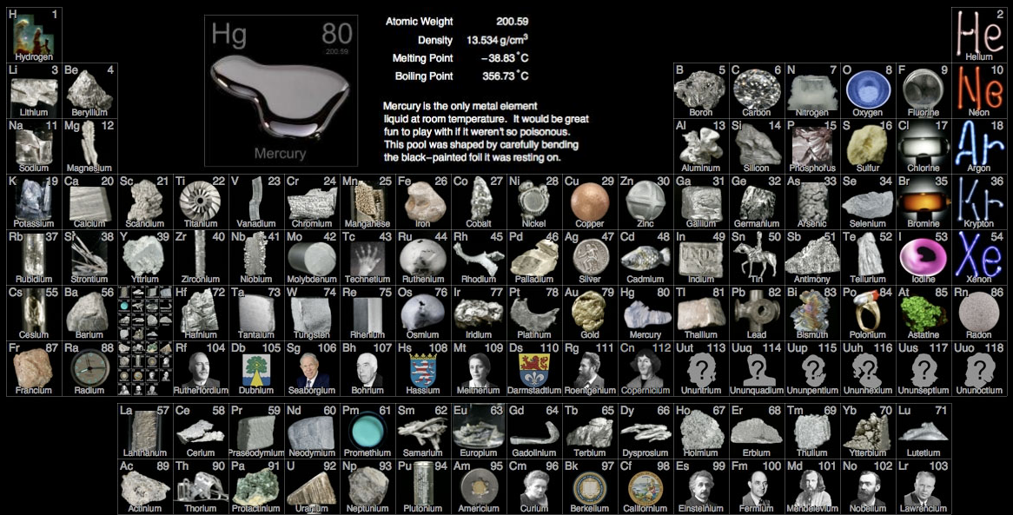
PART 2: The Periodic Table and Chemical Properties of Groups 1 & 7

Slide 2
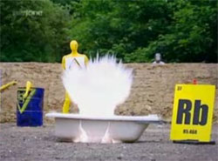
Group 1 – the alkali metals
React by losing an electron (good reducing agents; tend to be oxidized)
Reactivity increases down the group as the outer electron is in successively higher energy levels and less energy is therefore required to remove it.
Called “alkali metals” because all react with water to form an alkali solution of the metal hydroxide and hydrogen gas.
Alkali metal + water → metal hydroxide (base) + H₂ gas
Alkali metal rxns with water: click here

Slide 3
Reactions you should know: Li, Na, K + H₂O
2
Li(s) + H₂O(l) →
Na(s) + H₂O(l)→
K(s) + H₂O(l) →
2
2
LiOH(aq) + H₂(g)
or → 2Li⁺(aq) + 2OH⁻(aq) + H₂(g)
2
2
2
NaOH(aq) + H₂(g)
2
2
2
KOH(aq) + H₂(g)

Slide 4
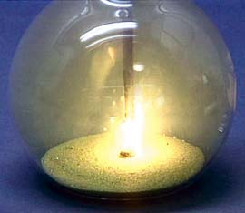
Group 1 – the alkali metals
All react with chlorine, bromine and iodine to form ionic salts
Alkali metal + halogen gas → metal halide (salt)
This rxn of sodium metal and chlorine gas to produce sodium chloride initiated by the addition of a drop of water. Click this image to view video (JChemEd).

Slide 5
Rxns you should know: Li, Na, K + I, Br, Cl
2
Na(s) + Cl₂(g) →
K(s) + Br₂(g) →
Li(s) + I₂(g) →
2
NaCl(s)
2
2
KBr(s)
2
2
LiI(s)

Slide 6
Group 7 – the halogens
React by gaining electrons (good oxidizing agents; tend to be reduced)
Reactivity decreases down the group as the outer shell is increasingly at higher energy levels and further from the nucleus. This, together with the fact that there are more electrons between the nucleus and the outer shell (more shielding), decreases the attraction for an extra electron.
Since chlorine is a stronger oxidizing agent than bromine, it can remove the electron from bromide ions in solution to form chloride ions and bromine. Similarly, both chlorine and bromine can oxidize iodide ions to form iodine.

Slide 7
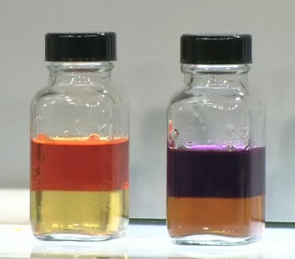
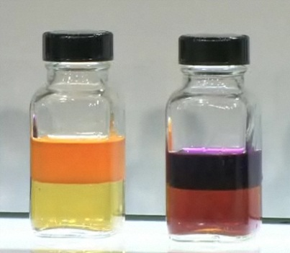
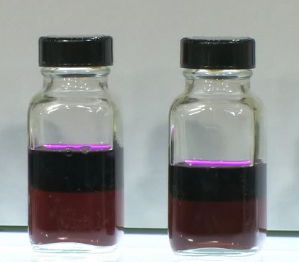
Recall the demo/lab…
Before reaction:
After reaction: (after adding NaI, NaBr, NaCl)
Hexane layer
water layer
Cl₂(aq)
Br₂(aq)
l₂(aq)
Hexane layer
water layer
+Br⁻(aq)
+I⁻(aq)
+Cl⁻(aq)
+I⁻(aq)
+Cl⁻(aq)
+Br⁻(aq)
2 rxns
1 rxn
no rxns

Slide 8
Rxns you should know: Cl, Br, I + Cl⁻, Br⁻, I⁻
Cl₂(aq) + Br ⁻(aq) →
Cl₂(aq) + I ⁻(aq) →
Br₂(aq) + I ⁻(aq) →
2
2
Cl ⁻(aq) + Br₂(aq)
2
2
Cl ⁻(aq) + I₂(aq)
2
2
Br ⁻(aq) + I₂(aq)
Note: none will react with Cl⁻ since it is most reactive
only chlorine gas will react with Br⁻ since bromine is more reactive than iodine

Slide 9
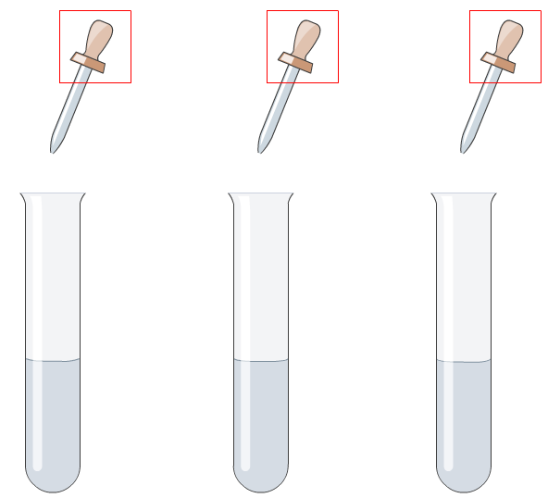
Test for halide ions
The presence of halide ions in solution can be detected by adding silver nitrate solution.
This works well because all silver halides are insoluble in water and have characteristic colors.
Ag⁺ + halide ions (X⁻) → AgX(s), where X = Cl, Br or I
AgCl = white
AgBr = cream
AgI = yellow
Click picture to see simulation
http://www.absorblearning.com/media/item.action?quick=v5

Slide 10
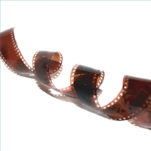
Test for halide ions
Silver halides react with light to form silver metal. This is the basis of photography.
AgX(s) + light →Ag(s) + ½X₂

