Slide 1
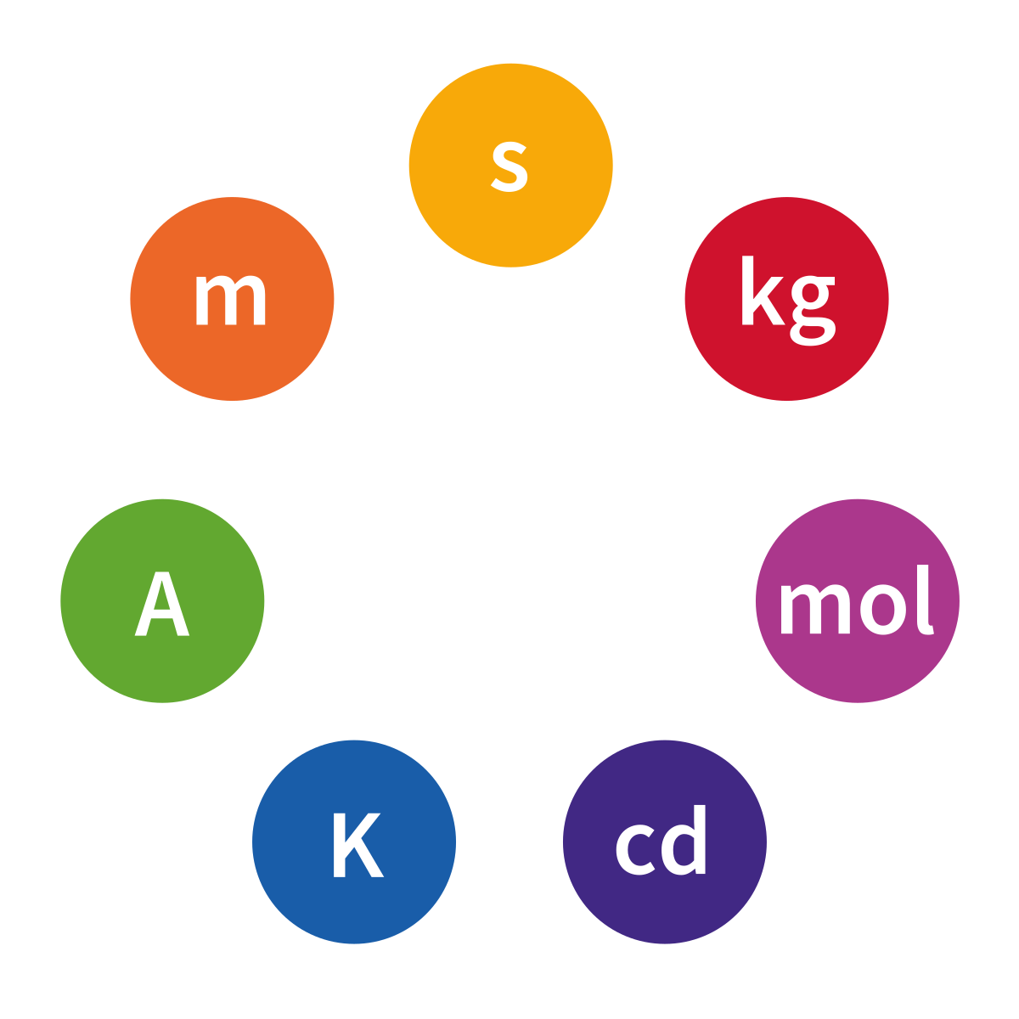
SI Units

Slide 2
Learning Objectives
History of SI Units
SI Base Units
SI units prefix
Frequent unit for length, mass, and volume
Basic unit conversion

Slide 3
History of SI Units
The International System of Units, universally abbreviated SI (from the French Le Système International d'Unités), is the modern metric system of measurement.
The SI was established in 1960 by the 11th General Conference on Weights and Measures (CGPM, Conférence Générale des Poids et Mesures)

Slide 4
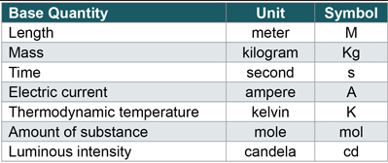
SI Base Units
The SI base units are the standard units of measurement defined by the International System of Units (SI)

Slide 5
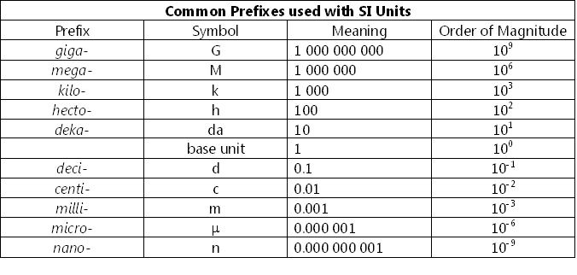
SI Unit Prefix

Slide 6
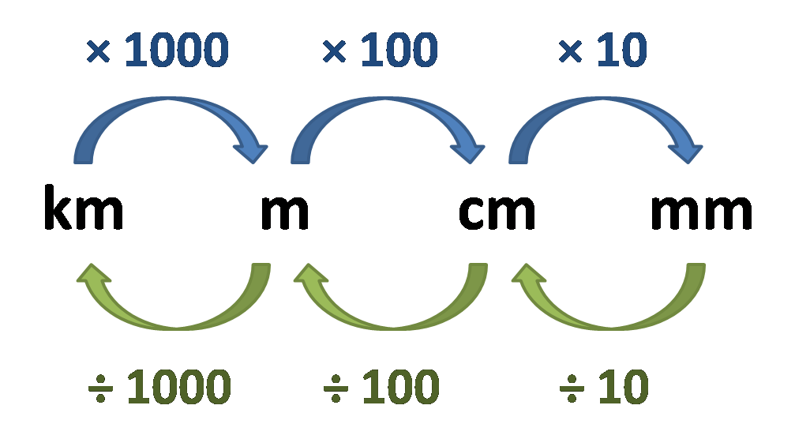
Useful Units (Length)
Length is a measurement of distance or dimension
km = kilometer
m = meter
cm = centimeter
mm = millimeter

Slide 7
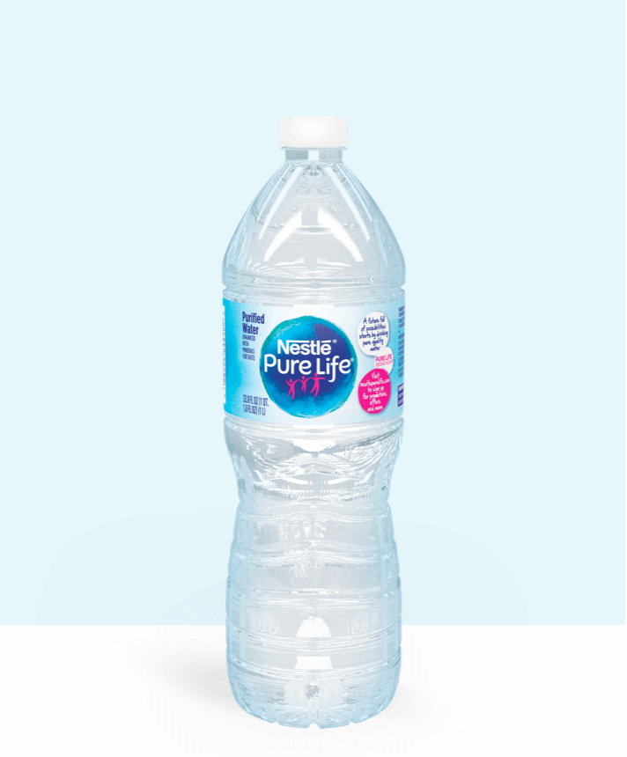
Useful Unit for Volume
Volume is the amount of space an object takes up
Liter (L), milliliters (mL)
1L = 1 cubic decimeter = 1000 mL = 1000 cubic centimeter

Slide 8
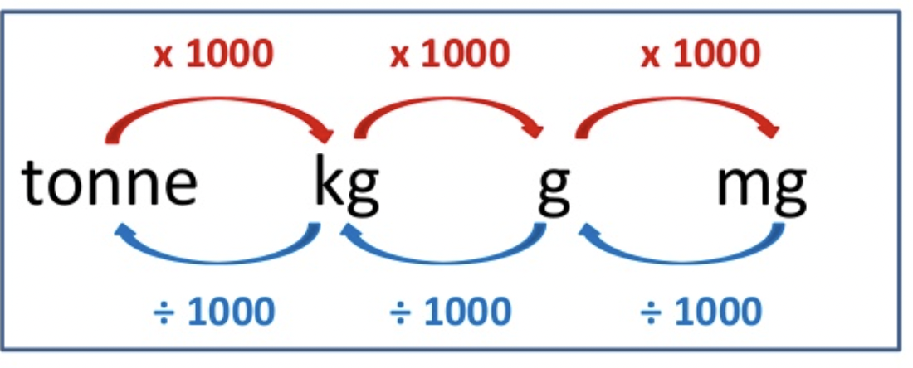
Useful Unit for Mass
Tonne, kg, g, mg
1 tonne = 1000 kg
1kg =1000g
1g = 1000mg
Mass is a measure of the amount of matter in an object.

Slide 9
Useful Unit for Temperature
Temperature measures how hot or cold an object is.
Kelvin to Celsius
Fernite to Celsius

Slide 10
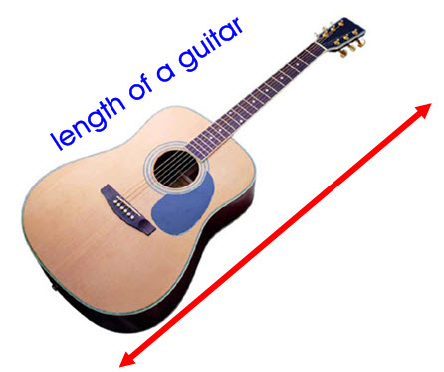
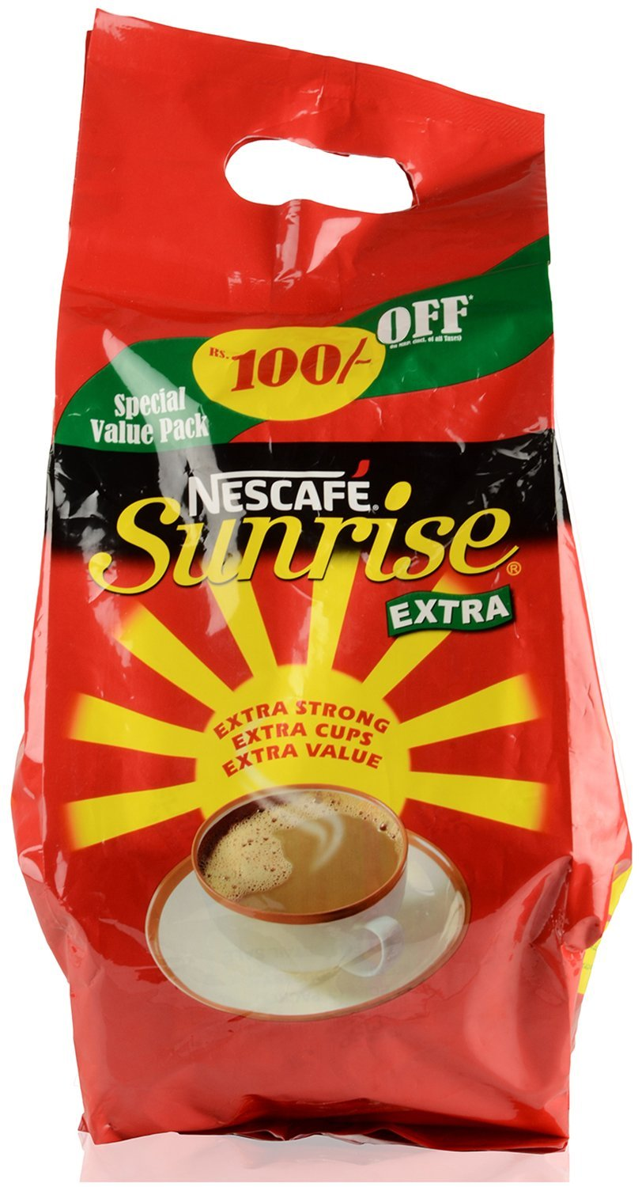
Unit Conversion
1 m = 39.3701 inches
1 m = 3.28094 feet
1 kg = 2.204 ibs
1 liter = 0.264 galloms

