Slide 1
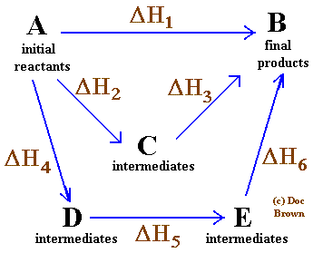
Energetics
IB Topics 5 & 15
PART 3:
Energy Cycles

Slide 2
STANDARD ENTHALPY CHANGE OF FORMATION,
Definition: the enthalpy change when one mole of the compound is formed from its elements in their standard states at 298 K and 1 atm of pressure.
Note: it follows that the for an element in its standard state will be zero.
0
0
H₂(g) + ½O₂(g) → H₂O(l) ∆H_{rxn}=?
∴ ∆H_{rxn} = ∆H_{f} (H₂O) = -285.8 kJ mol⁻¹

Slide 3
Recall that…
sum of (sigma)
moles

Slide 4
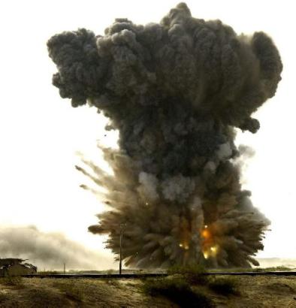
STANDARD ENTHALPY CHANGE OF COMBUSION,
Definition: the enthalpy change when one mole of a substance is completely combusted in oxygen under standard conditions.

Slide 5
Example: An accurate value for the standard enthalpy change of formation of ethanol can be determined from the cycle below.
2C(s) + 3H₂(g) + ½O₂(g) C₂H₅OH(l)
2O₂(g)
3/2 O₂(g)
3O₂(g)
2CO₂(g) + 3H₂O(g)

Slide 6
LATENT HEAT OF FUSION, ΔH_{fus}
Definition: the enthalpy change (energy absorbed) when one mole of the compound is converted from a solid to a liquid without a change in temperature.
“Latent” means hidden; the heat absorbed/released during a phase change does not cause the temperature to change.
Note: for water is
334 kJ/kg = 334 J/g = 6.01 kJ mol⁻¹

Slide 7
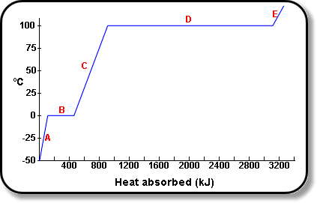
LATENT HEAT OF FUSION, ΔH_{fus}
A = solid
B = melting (solid + liquid)
C = liquid
D = boiling (liquid + gas)
E = gas

Slide 8
LATENT HEAT OF VAPORIZATION, ΔH_{vap}
Definition: the enthalpy change (energy absorbed) when one mole of the compound is converted from a liquid to a gas without a change in temperature.
Note: for water is
2260 kJ/kg = 2260 J/g = 40.8 kJ mol⁻¹

Slide 9
LATENT HEAT OF VAPORIZATION, ΔH_{vap}
A = solid
B = melting (solid + liquid)
C = liquid
D = boiling (liquid + gas)
E = gas

Slide 10
Example: How much heat is released by 250.0 g of H₂O as it cools from 125.0°C to -40.0°C? (Recall that the specific heat of water = 4.18 J/g•°C)
Five steps…
Cool the steam m∙c_{steam}∙ΔT
Condense m(-ΔH_{vap})
Cool the liquid water m∙c_{water}∙ΔT
Freeze m(-ΔH_{fus})
Cool the solid ice m∙c_{ice}∙ΔT

Slide 11
Example: How much heat is released by 250.0 g of H₂O as it cools from 125.0°C to -40.0°C? (Recall that the specific heat of water = 4.18 J/g•°C)
When substances change state, they often have different specific heats:
c_{ice} = 2.09 J/gºC
c_{water} = 4.18 J/gºC
c_{steam} = 2.03 J/gºC

Slide 12
Example: How much heat is released by 250.0 g of H₂O as it cools from 125.0°C to -40.0°C? (Recall that the specific heat of water = 4.18 J/g•°C)
cooling = exothermic → negative heat values
q_{steam} = mcΔT = (250.0g)(2.03J/gºC)(100.0–125.0) = -12,700 J
q_{vap} = mH_{vap} = (250.0g)(-2260J/g) = -565,000 J
q_{water} = mcΔT = (250.0g)(4.18J/gºC)(0-100) = -105,000 J
q_{fus} = mH_{fus} = (250.0g)(-334J/g) = -83,500 J
q_{ice} = mcΔT = (250.0g)(2.09J/gºC)(-40.0-0) = -20,900 J
q_{total} = -787,000J
-787 kJ

Slide 13
Example: What will be the final temperature of 50.0 mL of water, initially at 60°C, after a 3.2 g ice-cube is dropped in and allowed to melt. Assume no heat transfer to/from the surroundings.
q_{rxn} = (334 J/g)(3.2 g)
q_{rxn} = 1068.8 J
q_{calorimeter} = - q_{rxn} = -1068.8 J
q_{calorimeter} = mc∆T
-1068.8 J = (50.0 g)(4.18 J/g°C)(∆T)
∆T = -5.11 °C = T_{f} - T_{i}
-5.11 °C = T_{f} – 60 °C
T_{f} = 55 °C

Slide 14
STANDARD ENTHALPY CHANGE OF ATOMIZATION,
Definition: enthalpy change when one mole of gaseous atoms is formed from the element in its standard state under standard conditions. For diatomic molecules this is equal to half the bond dissociation enthalpy.
½Cl₂(g) → Cl(g) ∆H_{at} = +121 kJ mol⁻¹

Slide 15
ELECTRON AFFINITY,
Definition: the enthalpy change when an electron is added to an isolated atom in the gaseous state.
X(g) + e⁻ → X⁻(g)

Slide 16
ELECTRON AFFINITY,
Atoms “want” an excess electron, so electron affinity values are negative for the first electron. However, when oxygen forms the O²⁻ ion, the overall process is endothermic.
O(g) + e⁻ → O⁻(g) ∆H° = -142 kJ mol⁻¹
O⁻(g) + e⁻ → O²⁻(g) ∆H° = +844 kJ mol⁻¹
overall
O(g) + 2e⁻ → O²⁻(g) ∆H° = +702 kJ mol⁻¹

Slide 17
LATTICE ENTHALPY,
relates either to the endothermic process of turning a crystalline solid into its gaseous ions or to the exothermic process of turning gaseous ions into a crystalline solid.
MX(s) ↔ M⁺(g) + X⁻(g)

Slide 18
LATTICE ENTHALPY,
The sign of the lattice enthalpy indicates whether the lattice is being formed (-) or broken (+).
The size of the lattice enthalpy depends both on the size of the ions and on the charge carried by the ions.

Slide 19
LATTICE ENTHALPY,
increasing
Cation size ____________
LiCl
NaCl
KCl
Lattice
Enthalpy
(kJ mol⁻¹)
846
771
701

Slide 20
LATTICE ENTHALPY,
increasing
anion size ____________
NaCl
NaBr
NaI
Lattice
Enthalpy
(kJ mol⁻¹)
771
733
684

Slide 21
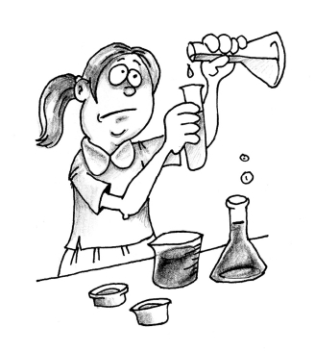
Makes sense… the larger the ion, the easier to separate

Slide 22
LATTICE ENTHALPY,
Charge on cation ____________
increasing
NaCl
MgCl₂
Lattice
Enthalpy
(kJ mol⁻¹)
771
2493

Slide 23
LATTICE ENTHALPY,
Charge on anion ____________
increasing
MgCl₂
MgO
Lattice
Enthalpy
(kJ mol⁻¹)
2493
3889

Slide 24
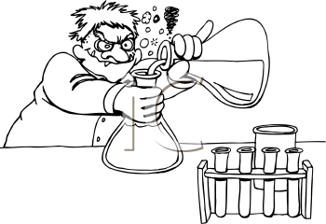
Makes sense… the greater the difference in charge, the stronger the attraction and the harder it is to separate ions

Slide 25
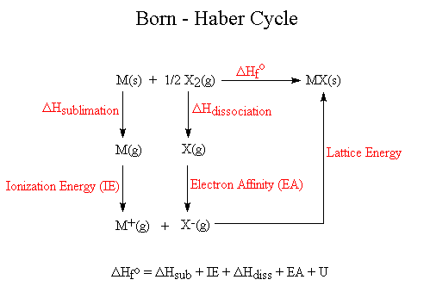
BORN-HABER CYCLES
energy cycles for the formation of ionic compounds.

Slide 26
Example: The enthalpy change for the formation of sodium chloride can be considered to occur through a series of separate steps.
Na(s) + ½Cl₂(g) Na⁺Cl⁻(s)
Na(g)
Cl(g)
Na⁺(g) + Cl⁻(g)

Slide 27
Use of Born-Haber Cycles:
Like any energy cycle, Born-Haber cycles can be used to find the value of an unknown.
They can also be used to assess how ionic a substance is.

Slide 28
Use of Born-Haber Cycles:
The lattice enthalpy can be calculated theoretically by considering the charge and size of the constituent ions.
It can also be obtained indirectly from the Born-Haber cycle.
If there is good agreement between the two values then it is reasonable to assume that there is a high degree of ionic character (e.g. NaCl). However, if there is a big difference between the two values then it is because the compounds possess a considerable degree of covalent character (eg. AgCl).

Slide 29
Use of Born-Haber Cycles:
Compound | NaCl | AgCl
Theoretical value (kJ mol⁻¹)
Experimental value (kJ mol⁻¹)
766
770
771
905
Good agreement of #s – high degree of ionic character
poor agreement – considerable covalent character

