Slide 1
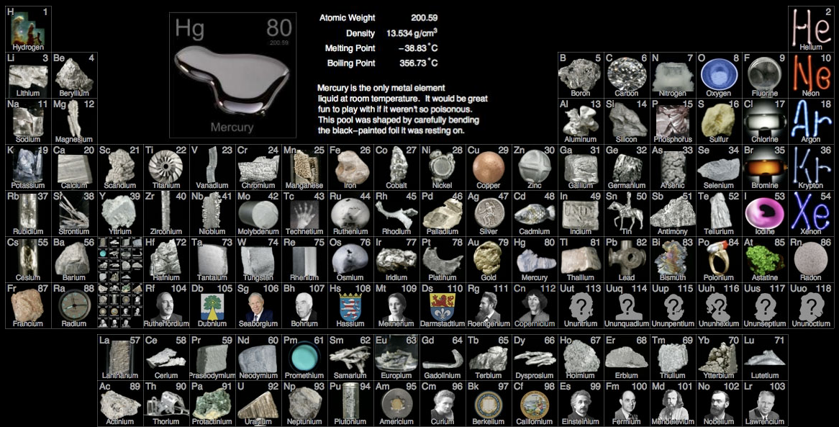
PART 4: d-block elements (first row)

Slide 3
The first row transition elements: electron configurations are [Ar]…
(Sc) | Ti | V | Cr | Mn
4s²3d¹
4s²3d²
4s²3d³
4s¹3d⁵
4s²3d⁵
Fe | Co | Ni | Cu | (Zn)
4s²3d⁶
4s²3d⁷
4s²3d⁸
4s¹3d¹⁰
4s²3d¹⁰
Note: for Cr and Cu it is more energetically favorable to half-fill or completely fill the d sub-level so they have only one 4s electron

Slide 4
Oxidation states of the first row transition series: (you need to be familiar with the ones in bold)
(Sc) | Ti | V | Cr | Mn | Fe | Co | Ni | Cu | (Zn)
 |  |  |  |  |  |  |  | +1
 | +2 | +2 | +2 | +2 | +2 | +2 | +2 | +2 | +2
+3 | +3 | +3 | +3 | +3 | +3 | +3 | +3 | +3
 | +4 | +4 | +4 | +4 | +4 | +4 | +4
 |  | +5 | +5 | +5 | +5 | +5
 |  |  | +6 | +6 | +6
 |  |  |  | +7

Slide 5
Transition elements
Transition element: an element that possesses an incomplete d sublevel in one or more of its oxidation states.
Based on the above definition, which of the elements above are not transition elements? Explain.

Slide 6
Transition elements
Transition element: an element that possesses an incomplete d sublevel in one or more of its oxidation states.
Scandium and zinc are not considered transition metals because…
Sc³⁺ has no d-electrons
Zn²⁺ has a full d sublevel
None of the possible oxidation states have incomplete d sublevels

Slide 7
Characteristic properties of transition elements:
Variable oxidation states
Formation of complex ions
Colored complexes
Catalytic behavior

Slide 8
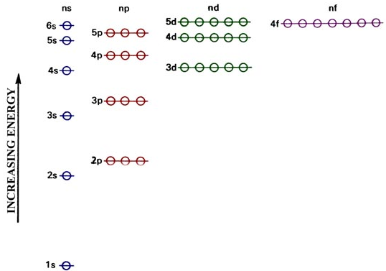
Variable oxidation states
3d and 4s sublevels are similar in energy

Slide 9
Variable oxidation states
Transition metals lose their s-electrons first
Cu: [Ar]4s¹3d¹⁰
Cu¹⁺: [Ar]3d¹⁰

Slide 10
Variable oxidation states
The gradual increase in ionization energy from losing the last 4s election to the first 3d election explains the existence of additional oxidation states
Ti’s I.E. increases gradually (because energy of 4s and 3d are similar) and does not jump until the removal of the 5th electron, which explains why Ti can be +2, +3, or +4, but not +5…
Ca has a huge “jump” in I.E. after removing just 2 electrons

Slide 11
Variable oxidation states
All transition metals can show an oxidation number of +2
Some transition metals can form the +3 or +4 ion
Fe³⁺
Mn⁴⁺
The M⁴⁺ ion is rare and in higher oxidation states the element is generally found not as the free metal ion, but either covalently bonded or as the oxyanion, such as MnO₄⁻.

Slide 12
Some common examples of variable oxidation states in addition to +2
Transition element | Oxidation # | Formula | Name
Cr |  | CrCl₃
Cr |  | Cr₂O₇²⁻
Mn |  | MnO₂
Mn |  | MnO₄⁻
Fe |  | Fe₂O₃
Cu |  | Cu₂O
+3
chromium (III) chloride
+6
dichromate (VI) ion
+4
manganese (IV) oxide
+7
manganate (VII) ion
+3
iron (III) oxide
+1
copper (I) oxide

Slide 13
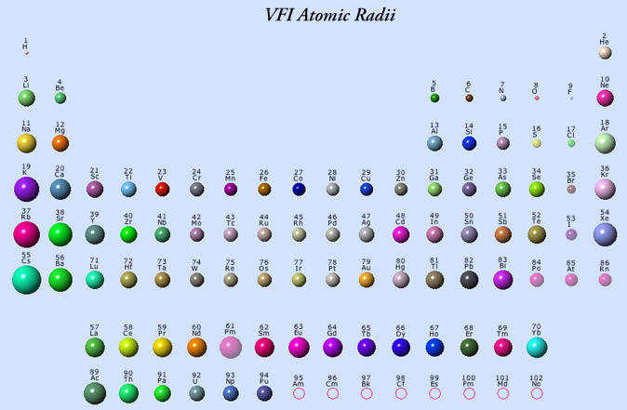
Formation of complex ions
Ions of the d-block elements attract species that are rich in electrons (ligands) because of their small size.

Slide 14
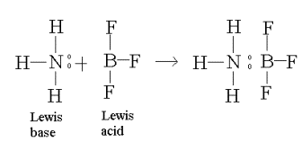
Formation of complex ions
The electron pair from a ligand can form coordinate covalent bonds with the metal ion to form complex ions.
A “coordinate covalent bond” is also known as a “dative” - a bond in which both shared electrons are supplied by one species… remember Lewis Bases from Honors Chem?
ligand
coordinate covalent bond

Slide 15
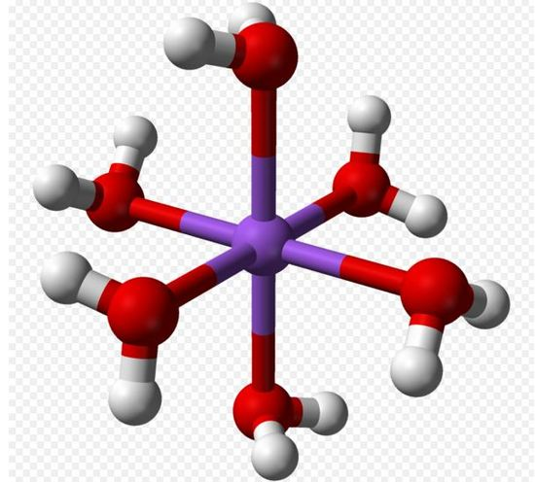
Formation of complex ions
Ligand: a neutral molecule or anion which contains a nonbonding pair of electrons.
H₂O is a common ligand
The word “ligand” is derived from ligandus, the Latin word for “bound”
Most (but not all) transition metal ions exist as hexahydrated complex ions in aqueous solutions (i.e. [Fe(H₂O)₆]³⁺)
Ligands can be replaced by other ligands (such as NH₃ or CN⁻).

Slide 16
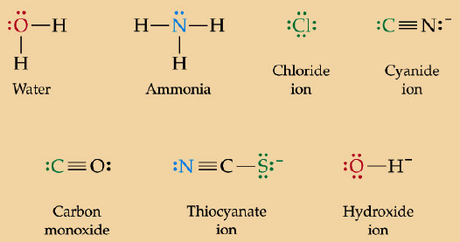
Formation of complex ions
Ligands:

Slide 17
Formation of complex ions
Coordination number: the number of lone pairs bonded to the metal ion.
L:
:L
M^{n+}
Shape: linear
Coordination # = 2

Slide 18
Formation of complex ions
Coordination number: the number of lone pairs bonded to the metal ion.
L:
:L
M^{n+}
L:
:L
Shape: square planar
Coordination # = 4

Slide 19
Formation of complex ions
Coordination number: the number of lone pairs bonded to the metal ion.
L
..
Shape: tetrahedral
Coordination # = 4
M^{n+}
L:
:L
..
L

Slide 20
Formation of complex ions
Coordination number: the number of lone pairs bonded to the metal ion.
L
..
:L
L:
Shape: octahedral
Coordination # = 6
M^{n+}
L:
:L
..
L

Slide 21
Coordination number: the number of lone pairs bonded to the metal ion.
Examples: state the coordination numbers of the species below.
[Fe(CN)₆]³⁻
[CuCl₄]²⁻
[Ag(NH₃)₂]⁺
6
4
2

Slide 22
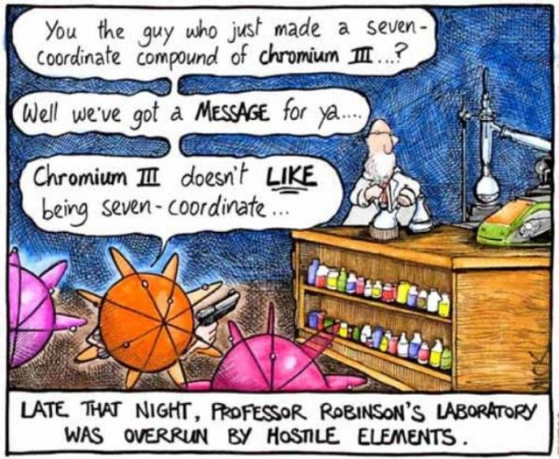

Slide 23
More examples: fill in the ligand, coordination number and oxidation number in the table below.
Complex | Ligand | Coordination number | Oxidation number of central ion | Shape (more on this next unit)
Fe(H₂O)₆]³⁺ |  |  |  | octahedral
[CuCl₄]²⁻ |  |  |  | tetrahedral
Co(NH₃)₆]³⁺ |  |  |  | octahedral
[Ag(NH₃)₂]⁺ |  |  |  | linear
MnO₄⁻ |  |  |  | tetrahedral
Ni(CO)₄ |  |  |  | tetrahedral
PtCl₂(NH₃)₂ |  |  |  | square planar
H₂O
6
+3
Cl⁻
4
+2
NH₃
6
+3
NH₃
2
+1
O²⁻
6
+7
CO
4
0
Cl⁻ & NH₃
4
+2

Slide 24
Formation of complex ions
Ions of the d-block elements attract species that are rich in electrons (ligands) because of their small size.
The electron pair from a ligand can form coordinate covalent bonds with the metal ion to form complex ions.
A Coordinate covalent bond is also known as a “dative” - a bond in which both shared electrons are supplied by one species… remember Lewis Bases from Honors Chem?

Slide 25
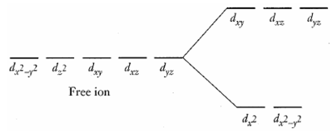
Colored Complexes
In the free ion the five d-orbitals are degenerate (of equal energy). However, in complexes the d orbitals are split into two distinct energy levels.
ΔE

Slide 26
Colored Complexes
The energy difference between the levels corresponds to a specific frequency and wavelength in the visible region of the electromagnetic spectrum.
ΔE=hf

Slide 27
Colored Complexes
When the complex is exposed to light, energy of a specific wavelength is absorbed and electrons are excited from the lower level to the higher level.
In the example above, [Ti(H₂O)₆]³⁺ contains a single d-electron in lower energy orbitals. 500 nm light absorption promotes the d-electron.

Slide 28
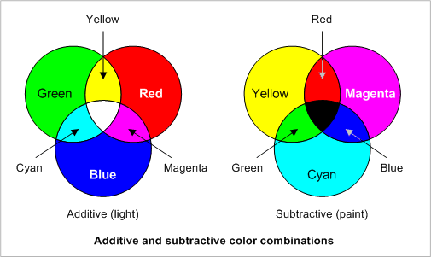
Colored Complexes
Cu²⁺(aq) appears blue because it is the complementary color to the wavelengths that have been absorbed.
When yellow light is subtracted out of white light, blue light is transmitted

Slide 29
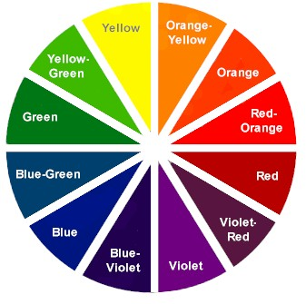
Colored Complexes
The observed color is across the color wheel from the absorbed color.
Color Wheel
white light in
violet transmitted

Slide 30
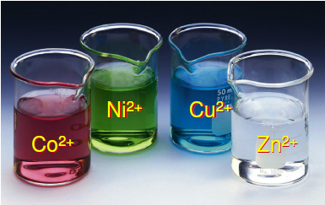
Colored Complexes
The energy separation between the orbitals and hence the color of the complex depends on the following factors:
1) Nuclear charge (based on identity of the central metal ion)

Slide 31
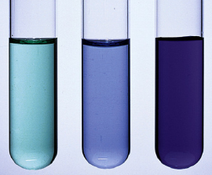
Colored Complexes
2) Charge density of the ligand
[Ni(NH₃)₆]²⁺
[Ni(H₂O)₆]²⁺
[Ni(en)₃]²⁺

Slide 32
Colored Complexes
Ex: NH₃ has a higher charge density than H₂O and so produces a larger split in the d sublevel.
[Cu(H₂O)₆]²⁺ absorbs red-orange light and appears pale blue
[Cu(NH₃)₄(H₂O)₂]²⁺ absorbs the higher energy yellow light and appears deep blue
I⁻ < Br⁻ < Cl⁻ < F⁻ < OH⁻ < H₂O < NH₃ < en < NO₂⁻ < CN⁻
Weak-field ligands
(small Δ)
Strong-field ligands
(large Δ)

Slide 33
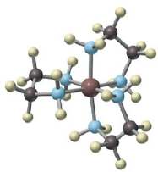
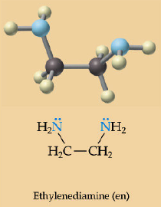
Colored Complexes
What is en?
It is part of a class of ligands called bidentate ligands (more than one atom of the ligand is involved in the bonding to the central atom… you don’t need to worry about these at this level).

Slide 34
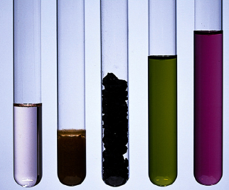
Colored Complexes
3) Number of d electrons present (and hence the oxidation # of the central ion)
Mn²⁺
Mn³⁺
Mn⁴⁺
Mn⁶⁺
Mn⁷⁺

Slide 35
Colored Complexes
4) Shape of the complex ion
Electric field created by the ligand’s lone pair of electrons depends on the geometry of the complex ion

Slide 36
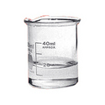
Colored Complexes
If the d sublevel is completely empty, as in Sc³⁺, or completely full, as in Cu⁺ or Zn²⁺, no transitions within the d sublevel can take place and the complexes are colorless.
Notes:
`

Slide 37
Colored Complexes
NOTE: it is important to distinguish between the words “clear” and “colorless.” Neither AP, nor IB, will give credit for use of the word clear (which means translucent) when colorless should have been used. Think about it, something can be pink and clear… colorless means something else.
Both are “clear.” Only the beaker on the left is “colorless.”

Slide 38
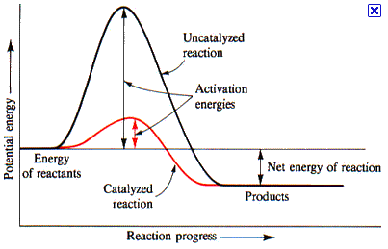
Catalytic Behavior
Many transition elements and their compounds are very efficient catalysts.
Catalysts increase the rate of chemical reactions.
Notes:
`

Slide 39
Catalytic Behavior
Examples: (need to be familiar with examples --- which metal or ion helps with each process --- plus economic significance of those in bold, but mechanisms will not be assessed)
Fe in the Haber Process
V₂O₅ in the Contact Process
Ni in the conversion of alkenes to alkanes
Pd and Pt in catalytic converters
MnO₂ in the decomposition of hydrogen peroxide
Fe²⁺ in heme
Co³⁺ in vitamin B12
Notes:
`

Slide 40
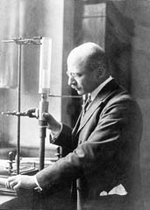
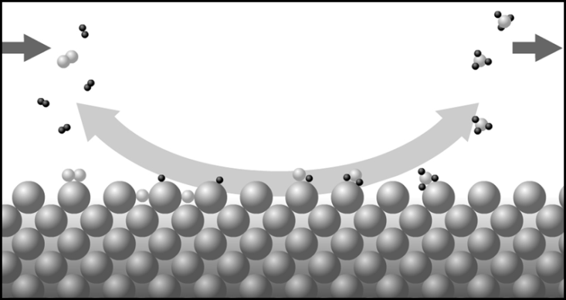
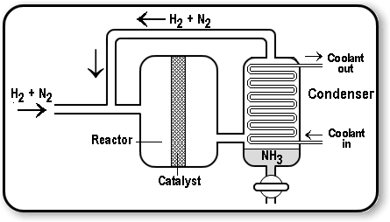
Catalytic Behavior
*Fe in the Haber Process
Ammonia (NH₃) is the raw material for a large number of chemical products including fertilizers, plastics, drugs and explosives.
Notes:
`

Slide 41
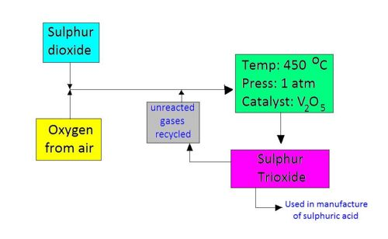
Catalytic Behavior
*V₂O₅ in the Contact Process
Sulfur trioxide (SO₃) is used in the manufacture of sulfuric acid, the manufacturing world’s most important chemical.
Notes:
`

Slide 42
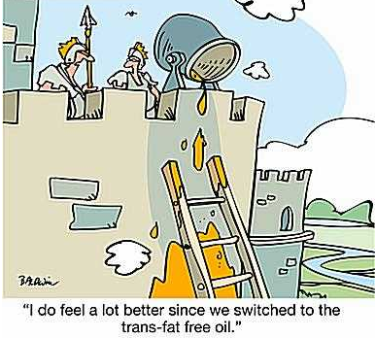
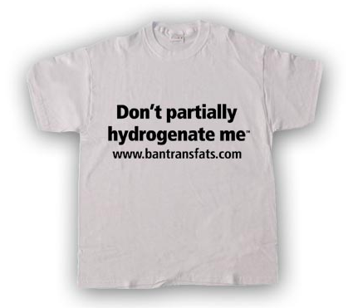
Catalytic Behavior
Ni in the conversion of alkenes to alkanes
This rxn allows unsaturated vegetable oils with a double C-C bond to be converted to margerine.
Notes:
`

Slide 43
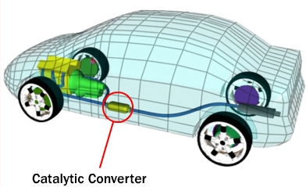
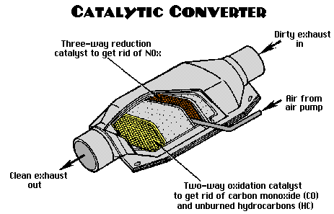
Catalytic Behavior
Pd and Pt in catalytic converters
This rxn removes harmful primary pollutants from a car’s exhaust gases.
Notes:
`

Slide 44
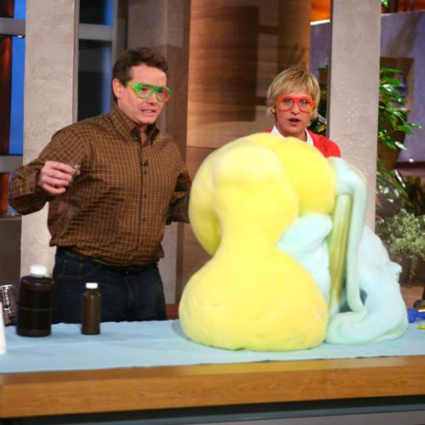
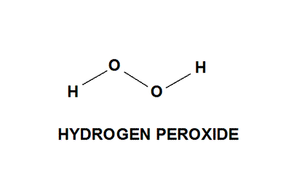
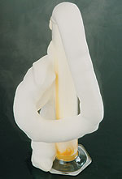
Catalytic Behavior
MnO₂ in the decomposition of hydrogen peroxide
Notes:
`

Slide 45
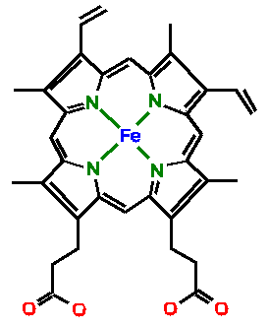
Catalytic Behavior
Fe²⁺ in heme
O₂ is transported through bloodstream by forming a weak bond with the heme group of hemoglobin. The O₂ - Fe²⁺ bond is easily broken when oxygen needs to be released.
Notes:
`

Slide 46
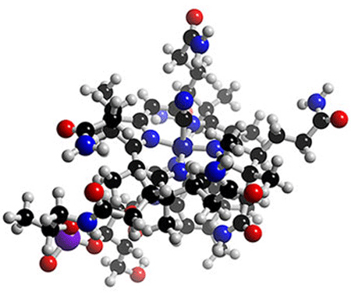
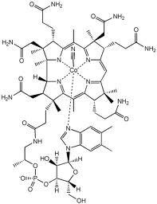
Catalytic Behavior
Co³⁺ in vitamin B12
Part of Vit.B-12 is octahedral Co3+ complex. 5 of the sites are bonded to N atoms, leaving the 6th site available for biological activity.
Vit.B-12 is needed for the production of red blood cells and for a healthy nervous system.
Want to know more? Please ask a biologist.. or contact General Google. ☺
Notes:
`

