Slide 1
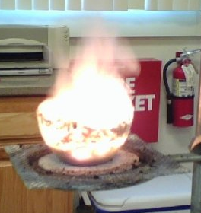
Energetics
IB Topics 5 & 15
PART 2: Calculating ΔH via Bond Enthalpies & Hess’s Law
Above: thermit rxn

Slide 2
BOND ENTHALPIES
Enthalpy change (ΔH) can also be calculated directly from bond enthalpies.
Bond enthalpy for a diatomic molecule is defined as the enthalpy change for the following process:
X-Y(g) ↔ X(g) + Y(g)

Slide 3
BOND ENTHALPIES
Breaking bonds: ΔH = positive (endothermic)
Forming bonds: ΔH = negative (exothermic)
Calculating ΔH from bond enthalpies:
ΔH_{rxn} = Σ(bonds broken) - Σ(bonds formed)

Slide 4
Table of bond enthalpies

Slide 5
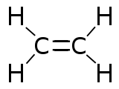
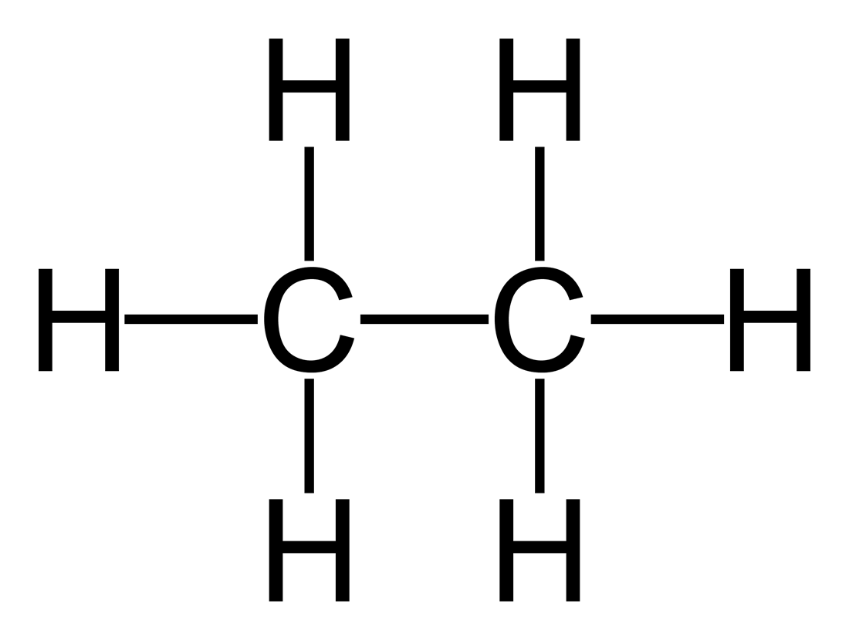
Example: Calculate ΔH for the hydrogenation of ethane
(g)
+
H−H (g)
(g)
Energy absorbed to break bonds:
Energy released as bonds form:
C=C 612
4 C-H 4 x 412
H-H 436
C-C 348
6 C-H 6 x 412
2696 kJ
2820 kJ
There is more energy released than absorbed,
so the rxn is exothermic.
ΔH = 2696 – 2820 = -124 kJ mol⁻¹

Slide 6
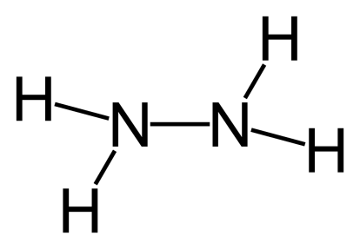
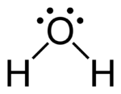
Example: Calculate ΔH for the combustion of hydrazine in oxygen. This reaction has been used to power spacecraft.
(g)
+
O=O (g)
N≡N (g)
+
2
(g)
Energy absorbed to break bonds:
Energy released as bonds form:
N-N 163
4 N-H 4 x 388
O=O 496
N≡N 944
4 O-H 4 x 463
2211 kJ
2796 kJ
There is more energy released than absorbed,
so the rxn is exothermic.
ΔH = 2211 – 2796 = -585 kJ mol⁻¹

Slide 7
Limitations of Using Average Bond Enthalpies
Average bond enthalpies can only be used if all reactants and products are gases.
If the H₂O product in the previous example were a liquid, then even more heat would be evolved since the ΔH_{vap} for H₂O would also need to be included in the calculation.
Average bond enthalpies are obtained by considering a number of similar compounds, but in reality the energy of a particular bond will vary slightly in different compounds (it will be affected by neighboring atoms).
Thus, ΔH values obtained using average bond enthalpies are not necessarily very accurate.

Slide 8
HESS’ LAW
The value of ΔH for a reaction is the same whether it occurs in one step or in a series of steps.
ΔH for the overall equation is the sum of the ΔH’s for the individual equations.
ΔH_{rxn} = ΔH₁ + ΔH₂ + …

Slide 9
Example: Calculate the enthalpy of reaction, ΔH_{rxn}, for the formation of nitrogen monoxide from its elements N₂ + O₂ → 2NO ΔH_{rxn} = ?
Using these equations:
4NH₃ + 3O₂ → 2N₂ + 6H₂O ΔH = -1530 kJ 4NH₃ + 5O₂ → 4NO + 6H₂O ΔH = -1170 kJ
flip
2N₂ + 6H₂O → 4NH₃ + 3O₂ ΔH = +1530 kJ
2N₂ + 2O₂ → 4NO ΔH = +360 kJ
÷ 2
N₂ + O₂ → 2NO ΔH =+180 kJ

Slide 10
HESS’ LAW
Another way of thinking about Hess’ Law is graphically in terms of “energy cycles.”
The enthalpy change for a reaction depends only on the difference between the enthalpy of the products and the enthalpy of the reactants. It is independent of the reaction pathway.

Slide 11
HESS’ LAW
The enthalpy change going from A to B is the same whether the reaction proceeds directly to A or whether it goes via an intermediate.
A
ΔH₂
ΔH₁
C
ΔH₁ = ΔH₂ + ΔH₃
ΔH₃
B

Slide 12
HESS’ LAW
This law is simply a statement of the law of conservation of energy.
It can be used to determine enthalpy changes which cannot be measured directly.

Slide 13
HESS’ LAW
For example, the enthalpy of combustion of both carbon and carbon monoxide to form carbon dioxide can easily be measured directly, but the combustion of carbon to carbon monoxide cannot. This can be represented by an energy cycle.
ΔH_{x}
C(s) + ½O₂(g) CO(g)
-393 kJ mol⁻¹
O₂(g)
½O₂(g)
-283 kJ mol⁻¹
CO₂(g)
-393 = ΔH_{x} + (-283)
ΔH_{x} = -393 + 283
= -110 kJ mol⁻¹

Slide 14
Example: Calculate the standard enthalpy change when one mole of methane is formed from its elements in their standard states. The standard enthalpies of combustion ( ) of carbon, hydrogen and methane are -393, -286 and -890 kJ mol⁻¹ respectively.
Step 1: Write the equation for enthalpy change with the unknown ΔH value. Call this value ΔH_{x}.
ΔH_{x}
C(s) + 2H₂(g) CH₄(g)

Slide 15
Example: Calculate the standard enthalpy change when one mole of methane is formed from its elements in their standard states. The standard enthalpies of combustion ( ) of carbon, hydrogen and methane are -393, -286 and -890 kJ mol⁻¹ respectively.
Step 2: Construct an energy cycle showing the different routes to the products (in this case the products of combustion).
ΔH_{x}
C(s) + 2H₂(g) CH₄(g)
O₂(g)
O₂(g)
2O₂(g)
CO₂(g) + 2H₂O(g)

Slide 16
Example: Calculate the standard enthalpy change when one mole of methane is formed from its elements in their standard states. The standard enthalpies of combustion ( ) of carbon, hydrogen and methane are -393, -286 and -890 kJ mol⁻¹ respectively.
Step 3: Use Hess’ Law to equate the energy changes for the two different routes.
ΔH_{x}
C(s) + 2H₂(g) CH₄(g)
O₂(g)
O₂(g)
2O₂(g)
CO₂(g) + 2H₂O(g)
direct route
route via methane

Slide 17
Example: Calculate the standard enthalpy change when one mole of methane is formed from its elements in their standard states. The standard enthalpies of combustion ( ) of carbon, hydrogen and methane are -393, -286 and -890 kJ mol⁻¹ respectively.
Step 4: Rearrange the equation and substitute values to solve for the unknown ΔH value.

