Slide 1
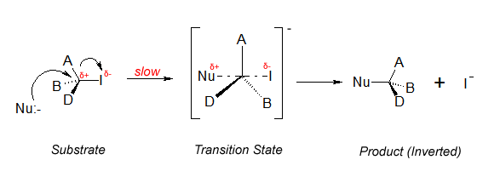
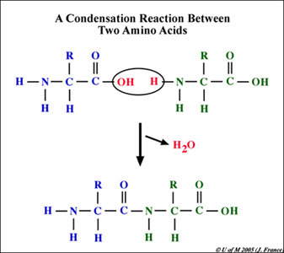
Organic Chemistry
Part 5: SN1 & SN2; Elimination & Condensation Rxns

Slide 2
Nucleophilic Substitution
Common nucleophiles include OH⁻ (from dilute NaOH sol’n), CN⁻, NH₃ and H₂O.
The nucleophiles are attracted to the δ⁺ carbon atom and substitute the halogen atom in halogenoalkanes.
Primary halogenoalkanes react by an S_{N}2 mechanism.
Tertiary halogenoalkanes react by an S_{N}1 mechanism.
HL

Slide 3
Factors affecting the rate of nucleophilic substitution
The nature of the nucleophile
Effectiveness of nucleophile depends on its electron density.
Anions tend to be more reactive than the corresponding neutral species.
Ex: the rate of substitution w/ OH⁻ is faster than with H₂O.
Among species with same charge, a less electronegative atom carrying a non-bonded pair of electrons is a better nucleophile than a more electronegative one.
NH₃ is a better nucleophile than H₂O
This is because the less electronegative atom can more easily donate its pair of electrons as they are held less strongly.
HL

Slide 4
Factors affecting the rate of nucleophilic substitution
The nature of the nucleophile
Example: Put the following nucleophiles on order of increasing reactivity: NH₃, H₂O, CN⁻, OH⁻
H₂O < NH₃ < OH⁻ < CN⁻
HL

Slide 5
Factors affecting the rate of nucleophilic substitution
2) The nature of the halogen
For both S_{N}1 an S_{N}2 rxns, iodoalkanes react faster than bromoalkanes, which react faster than chloroalkanes.
C-I bond is weaker than the C-Cl bond and breaks more readily.
Type of bond | Bond enthalpy (kJ/mol)
C-I | 238
C-Br | 276
C-Cl | 338
HL

Slide 6
Factors affecting the rate of nucleophilic substitution
3) The nature of the halogenoalkane
Tertiary react faster than secondary, which are faster than primary halogenoalkanes.
The S_{N}1 route is faster than the S_{N}2 route
S_{N}1involves formation of intermediate carbocation
S_{N}2 involves a transition state w/ relatively high activation energy
HL

Slide 7
Substitution with ammonia and potassium cyanide
Halogenoalkanes can react with NH₃ to form amines and with CN⁻ to form nitriles.
With 1° halogenoalkanes the mechanism is S_{N}2.
Example: bromoethane + CN⁻
HL

Slide 8
Substitution with ammonia and potassium cyanide
Halogenoalkanes can react with NH₃ to form amines and with CN⁻ to form nitriles.
With 1° halogenoalkanes the mechanism is S_{N}2.
Example: bromoethane + NH₃
HL

Slide 9
Substitution with ammonia and potassium cyanide
The rxn with KCN provides a means for extending the C-chain length by one C.
The nitrile can then be converted either into amines by reduction using H₂ with a Ni catalyst or into carboxyllic acid by acid hydrolysis.
Example:
HL

Slide 10
Elimination rxns of halogenoalkanes
Altering rxn conditions can cause same reactants to make completely different products.
Example:
With dilute NaOH sol’n, the OH⁻ ion acts as a nucleophile and substitution occurs to produce an alcohol.
With hot alcoholic NaOH sol’n (i.e. NaOH dissolved in ethanol), elimination occurs and an alkene is formed.
HL

Slide 11
Elimination rxns of halogenoalkanes
In this second rxn, OH⁻ acts as a base. Elimination of HBr can proceed by either a carbocation or as a concerted process…
OR…
HL

Slide 12
Elimination rxns of halogenoalkanes
In this second rxn, OH⁻ acts as a base. Elimination of HBr can proceed by either a carbocation or as a concerted process…
HL

Slide 13
Elimination rxns of halogenoalkanes
In the presence of ethanol there will also be some ethoxide ions present.
Ethoxide is a stronger base than OH-, so the equilibrium lies to the left but some ethoxide ions will be present and these may be the actual species acting as the base.
HL

Slide 14
Condensation rxns
Rxns between 2 molecules to form a larger molecule with the elimination of a small molecule such as H₂O or HCl.
alcohol + carboxylic acid → ester + water
Example:
HL

Slide 15
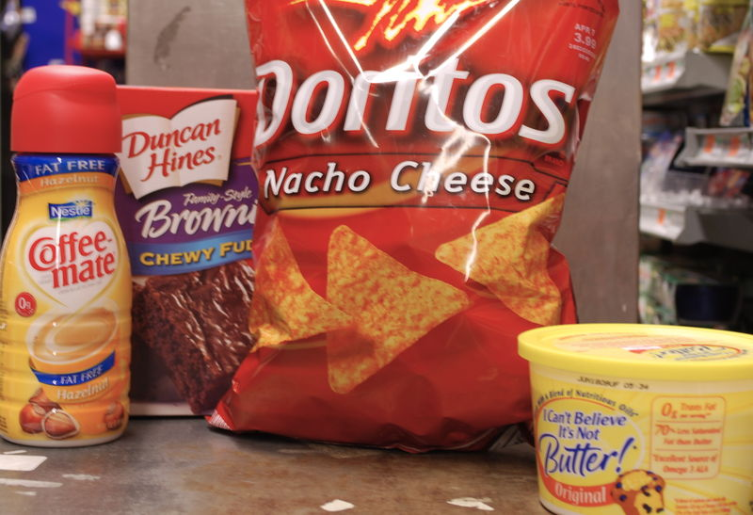
Esters
Most have distinctive, pleasant, fruity smell
Many uses:
Used as natural and artificial flavoring agents in food
HL

Slide 16
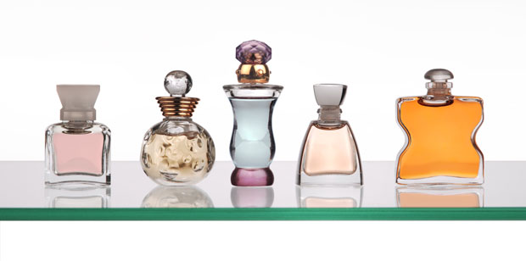
Esters
Many uses:
Used as solvents in perfumes
HL

Slide 17
Esters
Many uses:
used as plasticizers, substances used to modify the properties of polymers (i.e. PVC) by making them more flexible.
Phthalate esters (esters of phthalic acid) - Many health concerns!
HL

Slide 18
Condensation rxns
Example: Show the general rxn for a carboxylic acid with an amine.
This rxn is important in biological rxns --- amino acids contain an amine group and a carboxylic acid group , thus amino acids can condense together in the presence of enzymes to form poly(amides).
HL

Slide 19
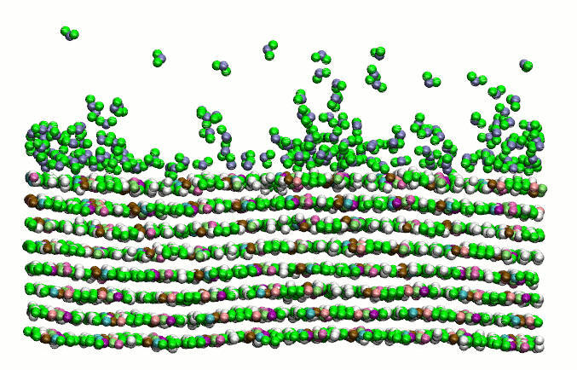
Condensation polymerization
If each of the reactants in a condensation rxn contain two functional groups that can undergo condensation, then the condensation can continue to form a polymer.
HL

Slide 20
Condensation polymerization
Example:
benzene-1,4-dicarboxylic acid + ethane-1,2-diol
Dacron = type of polyester
HL

Slide 21
Condensation polymerization
Example:
hexane-1,6-dioic acid + 1,6-diaminohexane
amide link (peptide bond)
Amine + carboxylic acid → polyamide
HL

Slide 22
Reaction Pathways
alkane
halogenoalkane
nitrile
alcohol
amine
ester
carboxylic acid
amide
Given the starting materials, two step synthesis for new products can be devised.
HL

Slide 23
Rxn Pathways
Example: Propose a process for the conversion of 1-bromopropane to 1-aminobutane (a.k.a. 1-butylamine)
Step 1: nucleophillic substitution
Step 2: reduction by heating with H₂ w/ Ni catalyst
HL

Slide 24
Rxn Pathways
Example: Propose a process for the conversion ethane into ethylamine
Step 1: free radical substitution
Step 2: react chloroethane with ammonia
HL

