Slide 1
Unit and Measurement
Unit 1 – Science Knwoledge

Slide 2
Learn Objectives
Know different measurement and know how to use them
Understand the SI System
SI Base Units
Meter, kg, L, mL, etc
Unit Conversion
Know significant figures
Know and understand different types of errors
Know how to calculate average value and uncertainty

Slide 3
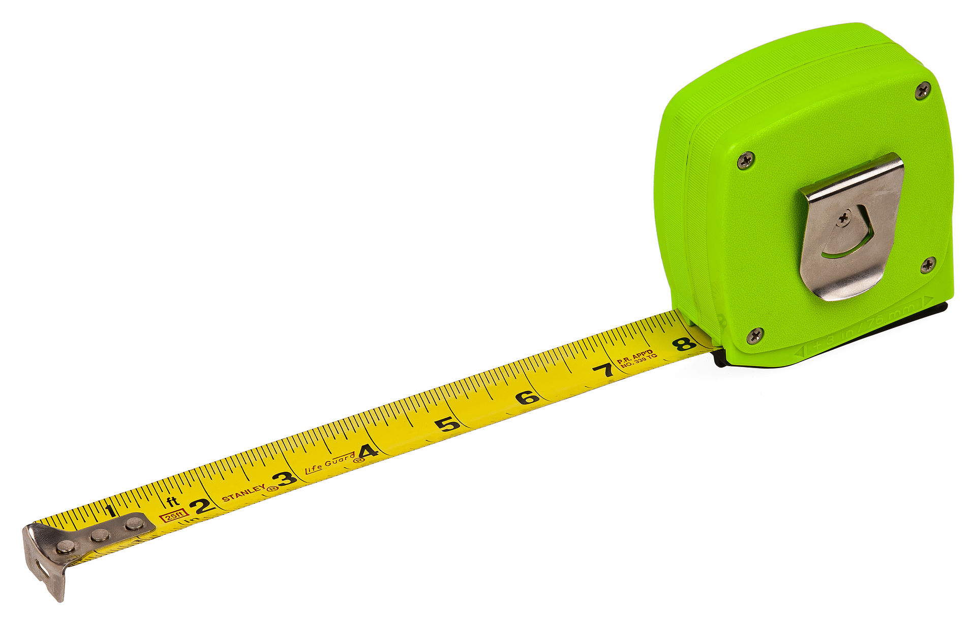
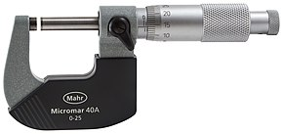
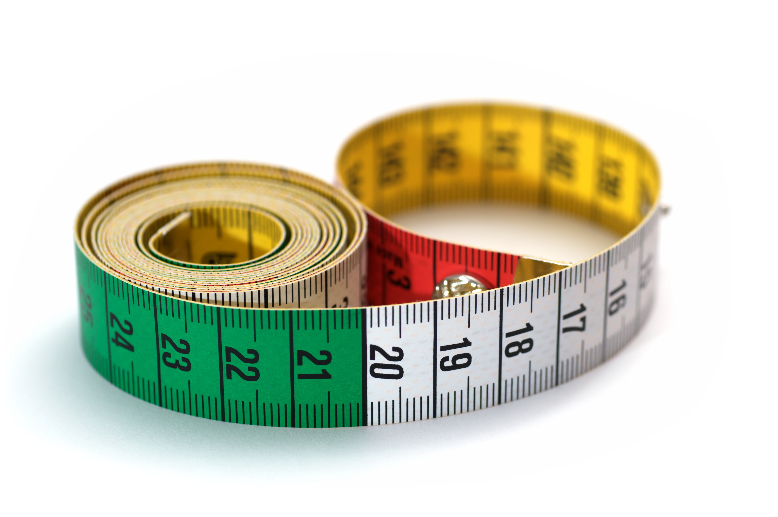
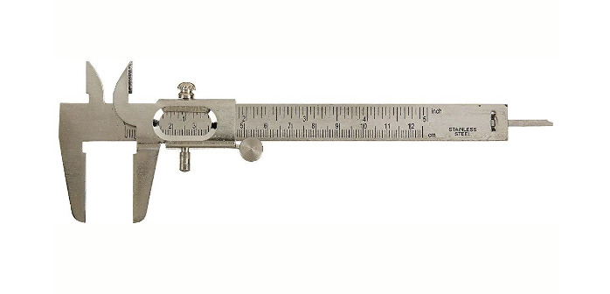
Measurement Tools
Micrometer
By Evan-Amos - Own work, Public Domain, https://commons.wikimedia.org/w/index.php?curid=11294046
Tape Measure
vernier caliper
Tape Measure
By Simon A. Eugster - Own work, CC BY-SA 3.0, https://commons.wikimedia.org/w/index.php?curid=7892806

Slide 4
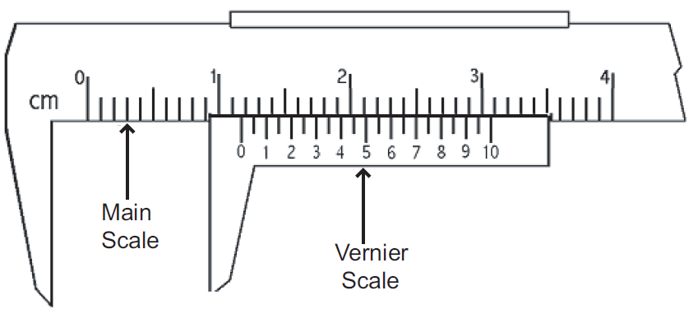
Vernier Caliper

Slide 5
Read a Vernier Caliper
Follow these steps to read the vernier scale:
Read the main scale. (Last whole increment visible before the 0 (zero) mark)
Read the secondary scale measurement. (Division that lines up best with a mark on the main scale.)
Add the two measurements together.

Slide 6
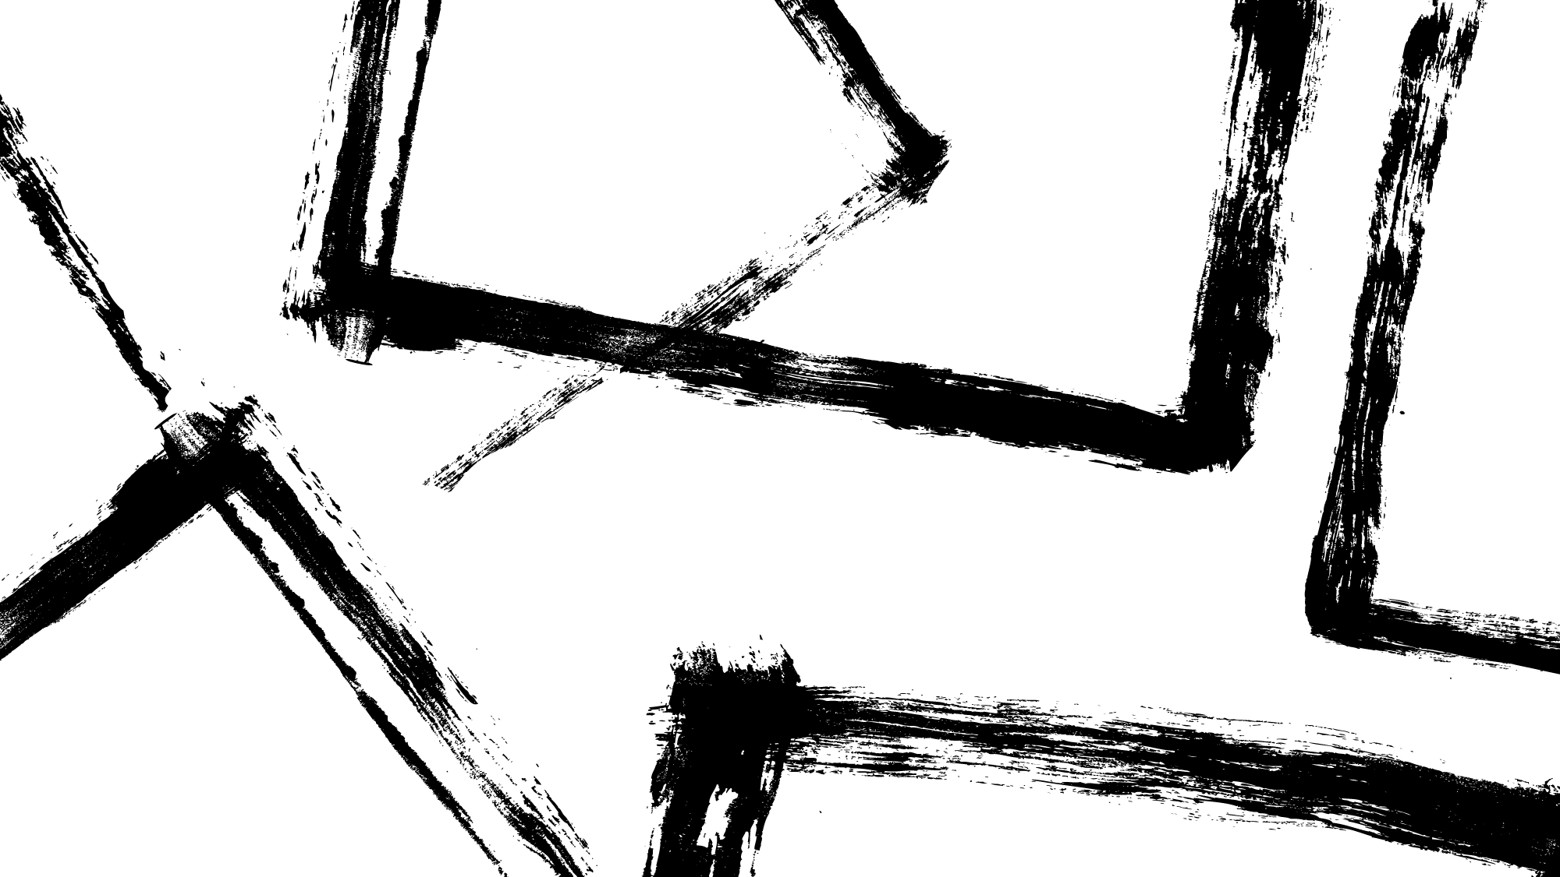
Significant Figures
The number of figits used to express a number carries information about how precise the number is known

Slide 7
Counting Significant Number
Number | Significant number | Why? | Scientific Motation
786 | 3 | In a integer, all digits count if the last digit is not zero. | $$7.86×{10}^{2}$$
859000 | 3 | Zero at the en does not count because its reliability is uncertainty. For example 859999.999999 = 859000 | $$8.59×{10}^{5}$$
100 | 1 | Zero at the en does not count because its reliability is uncertainty. | $$1×{10}^{2}$$
0.004900 | 4 | Zero at the end count, those at the front does not count | $$4.9×{10}^{−3}$$
$$8.38485×{10}^{5}$$ | 6 | Cuase $8.38485$ has six significant digits | $$8.38485$$

Slide 8
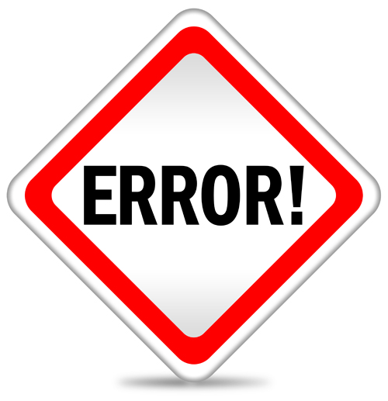
Uncertainty and Errors
Types of Uncertainty
Systematic and random
Systematic Error: A systematic is a consistent, repeatable error
E.g: If you use a ruler to measure the length of a book, the ruler itself might contain some measuring inaccuracy

Slide 9
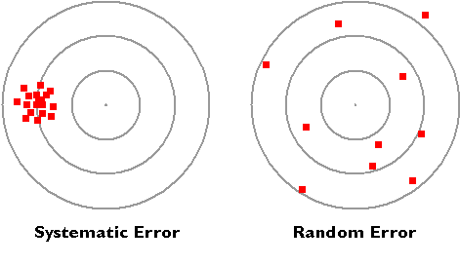
Random Error
Random Error: Error caused by unknown and unpredictable changes in the experiment. These changes may occur in the measuring instruments or in the environmental conditions.
E.g: You record the amount of time for a student to run 100 meters, but you might start the timer earlier or later, causing random error.

Slide 10
Reduce Random Error
Doing repeated measurement (Multiple trials of experiment)
Take an average value of multiples trails of data to get a more accurate estimate of the result.
Calculate uncertainty: reading uncertainty = $±$ half of its samllest precision
There might be reading uncertainty when you are measuring
Precision refers to the closeness of two or more measurements to each other

Slide 11
Reading Uncertianty
Best estimate $±$ uncertainty
Always round the experimental measurement or result to the same decimal place as the uncertainty
For Example
54.6mL $±$ 0.05ml is wrong
54.60mL $±$ 0.05ml is correct
Wrong: 1.237 s ± 0.1 s Correct: 1.2 s ± 0.1 s

Slide 12
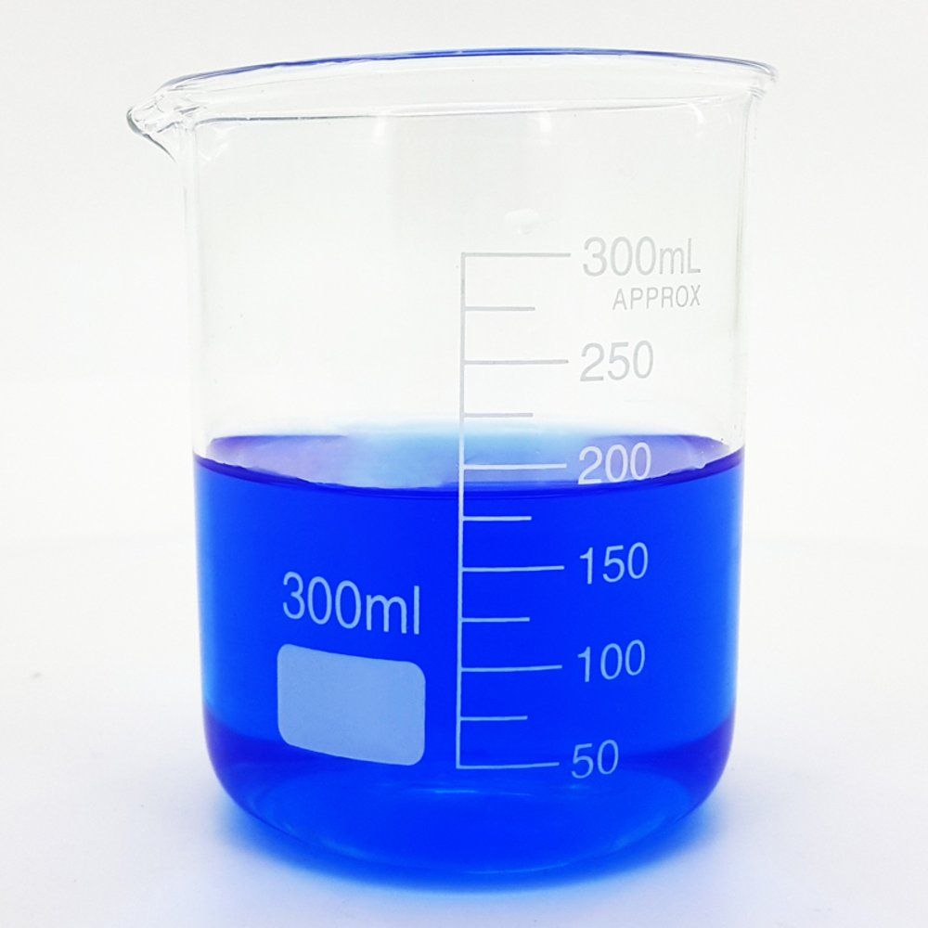
Reading Uncertainty Example
The smallest precision of the beaker is 25mL. The uncertainty is 25mL/2 = 12.25 mL
The volum of the liquid is somewhere between 175mL and 200 mL.
The average value = (175 +200)/2 = 187.50 mL
Reading with uncertainty: 187.50mL$±12.25$mL

Slide 13
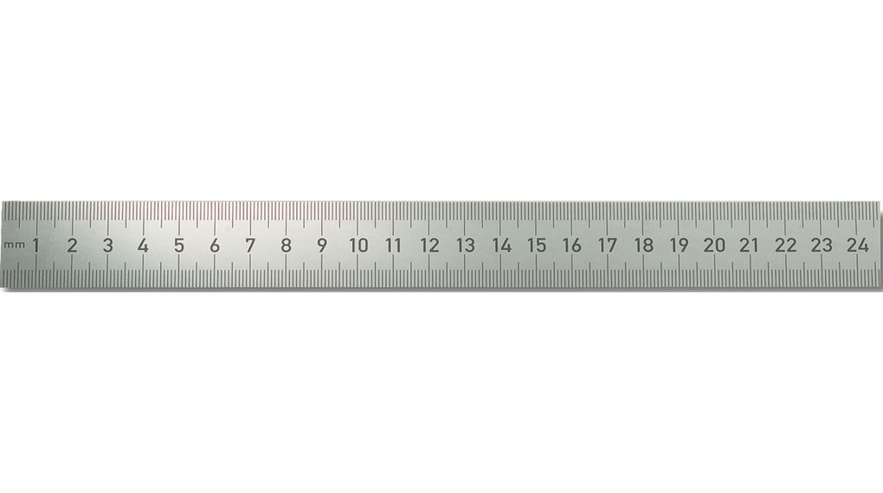
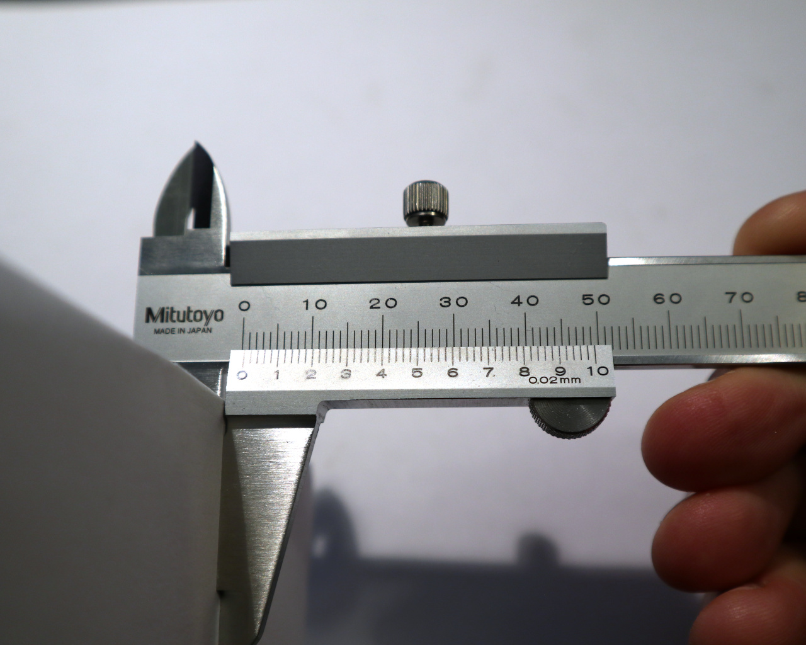
Uncertainty Table
Usually
Ruler: $±0.05mm$
Vernier calipers: $±$ 0.05mm
Micrometer: $±$ 0.005mm
The above measuring tools’ uncertainties might changes
The table only shows the fruquent cases

Slide 14
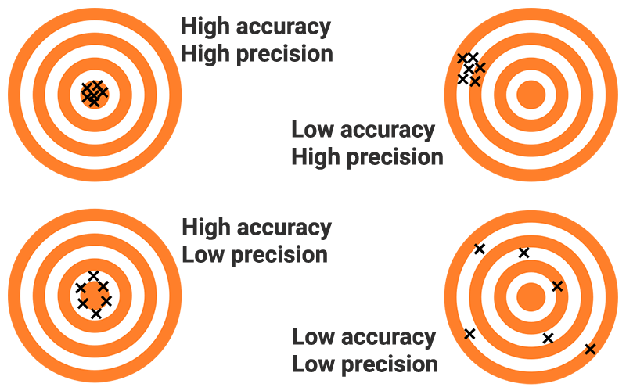
Accuracy And Precision
Accuaracy: How close to the ture/theoretical value
Precison: is the closeness of the measurements to each other.

Slide 15
Average, Uncertainty
$\frac{sum of all terms}{number of terms}=\frac{x_{1}+x_{2}+x_{3}+…+x_{N}}{N}=\overline{x}$
The average is the best estimate for the quantity $x$ based on N measurement.
$∆x$ = $\frac{x_{max}−x_{min}}{2}$

Slide 16
Example 1
Length of a string are listed below
163,173,165, 164, 124, 178, 195, 187, 175, 174 (in cm)
Average Value = $\frac{\text{163}\text{+}\text{173}\text{+}\text{165}\text{+}\text{164}\text{+}\text{124}\text{+}\text{178}\text{+}\text{195}\text{+}\text{187}\text{+}\text{175}\text{+}\text{174 }}{10}$ = 169.8cm
Uncertainty = $\frac{195−124}{2}$ = 35.5cm
Result: 169.8cm$±$ 35.5 cm

Slide 17
Example 2
Calculate the average value and uncertainty
Pressure (Pa) | Pressure (Pa) | Pressure (Pa)
101504.0 | 101560.3 | 101567.1
101459.0 | 101541.0 | 101527.0
101435.6 | 101511.6 | 101511.6
101416.8 | 101493.1 | 101492.6
101396.6 | 101472.2 | 101471.8
101377.6 | 101454.0 | 101455.3
101356.5 | 101428.7 | 101431.6
101334.1 | 101413.6 | 101410.4
101319.5 | 101392.1 | 101389.6
101296.7 | 101367.1 | 101374.0

Slide 18
Example 2
Pressure | Pressure | Pressure | Max Pressure | Min Pressure | Pressure Uncertainty | Average Pressure
101504.0 | 101560.3 | 101567.1 | 101567.2 | 101503.9 | 31.6 | 101535.5
101459.0 | 101541.0 | 101527.0 | 101541.0 | 101459.0 | 41.0 | 101500.0
101435.6 | 101511.6 | 101511.6 | 101511.6 | 101435.6 | 38.0 | 101473.6
101416.8 | 101493.1 | 101492.6 | 101493.1 | 101416.8 | 38.1 | 101455.0
101396.6 | 101472.2 | 101471.8 | 101472.2 | 101396.6 | 37.8 | 101434.4
101377.6 | 101454.0 | 101455.3 | 101455.3 | 101377.6 | 38.9 | 101416.4
101356.5 | 101428.7 | 101431.6 | 101431.6 | 101356.4 | 37.6 | 101394.0
101334.1 | 101413.6 | 101410.4 | 101413.7 | 101334.1 | 39.8 | 101373.9
101319.5 | 101392.1 | 101389.6 | 101392.1 | 101319.5 | 36.3 | 101355.8
101296.7 | 101367.1 | 101374.0 | 101374.0 | 101296.7 | 38.7 | 101335.4

Slide 19
Propagation of Uncertainties
28.3cm $±0.4$ cm
28.3 cm is the best estimate/mean value/average value, and 0.4 cm is the absolute uncertainty
$\frac{absolute value}{mean value}$ = fractional uncertainty = $\frac{0.4}{28.3}$ = 0.0141
Percentage uncertainty = 0.0141 x 100% = 1.41%

Slide 20
Propagation of Uncertainties
In General
Absolute uncertainty = $∆a$
Fractional uncertainty = $\frac{ ∆a }{a}$
Percentage uncertainty = $\frac{ ∆a }{a}×100\%$
$$a±∆a$$
Best estimate $±$uncertainty

Slide 21
Uncertainty-Addition and Subtraction
Calculate the estimate values, then $±$ all absolute uncertainty
Example
A = 3.56 $±$ 0.23
B = 193.34 $±$ 2.20
A + B = (3.56+ 193.34) $±$ (0.23+2.20)
B-A = (193.34- 3.56) $±$ (0.23+2.20)

Slide 22
Multiplication and Division
Q = ab → $\frac{∆Q}{Q_{o}}$ = $\frac{∆a}{a_{o}}$ + $\frac{∆b}{b_{o}}$
Q = $\frac{a}{b}$ → $\frac{∆Q}{Q_{o}}$ = $\frac{∆a}{a_{o}}$ + $\frac{∆b}{b_{o}}$
Q = $\frac{ab}{c}$ → $\frac{∆Q}{Q_{o}}$ = $\frac{∆a}{a_{o}}$ + $\frac{∆b}{b_{o}}$ + $\frac{∆c}{c_{o}}$

Slide 23
Work Example
The side of a rectangle is measured to be a= 2.5cm$±0.1$cm, and b=5.0cm $±$0.1cm. Find the area A of the reatangle

Slide 24
Work Example
The side of a rectangle is measured to be a= 2.5cm$±0.1$cm, and b=5.0cm $±$0.1cm. Find the area A of the reatangle
$\frac{∆a}{a_{o}}$ = $\frac{0.1}{2.5}=0.04 or 4\%$
$\frac{∆b}{b_{o}}$ = $\frac{0.1}{5.0}$ = 0.02 or 2%
$\frac{∆A}{A_{o}}$ = 0.04 +0.02 = 0.06
$A_{o}$=(2.5$×$5.0) = 12.5 ${cm}^{2}$
$∆A$ = (0.06)$×$(12.5) = 0.75${cm}^{2}$
Final Answer
12.5 ${cm}^{2}±$ 0.75${cm}^{2}$

Slide 25
Powers and Roots
Q = $a^{b}$→ $\frac{∆Q}{Q_{o}}$ = |b| $\frac{∆a}{a_{o}}$
Q = $\sqrt[n]{a}$ → $\frac{∆Q}{Q_{o}}$ =$\frac{1}{\text{|}\text{n}\text{|}}×$ $\frac{∆a}{a_{o}}$

Slide 26
Worked Example
The length of a simple pendulum L is increased by 4%. What is the fractional increase in pendulum’s period T. Given that T=2$π\sqrt{\frac{L}{g}}$

Slide 27
Worked Example
The length of a simple pendulum L is increased by 4%. What is the fractional increase in pendulum’s period T. Given that T=2$π\sqrt{\frac{L}{g}}$
$\frac{∆T}{T_{o}}$ = $\frac{1}{2}×\frac{∆L}{L_{o}}$ = $\frac{1}{2}×$4% = 2%
The fractional increase in pendulum’s period T in 2%

Slide 28
References
https://www.123rf.com/photo_17309282_best-icon-located-on-a-white-background.html
Physics for the IB Diploma, six edition ny K.A Tsokos (Cambridge University Press)
https://www.amazon.in/SSU-Silver-Vernier-Caliper-Range/dp/B01N8UUMKH
https://en.wikipedia.org/wiki/Tape_measure
https://www.stefanelli.eng.br/en/virtual-vernier-caliper-simulator-05-millimeter/#swiffycontainer_2

