Slide 1
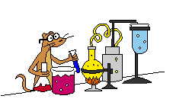
Oxidation & Reduction
IB Topics 9 & 19 AP Chapters 4.9-4.10; 17

Slide 2
Oxidation-Reduction (“Redox”)
Ionic compounds are formed through the transfer of electrons
An oxidation-reduction rxn involves the transfer of electrons
We need a way of keeping track – oxidation states

Slide 3
Oxidation States
A way of keeping track of the electrons.
Not necessarily true of what is in nature, but it works.
Use “+2” instead of “2+” since not necessarily actual charge
need the rules for assigning
memorize these!

Slide 4
Rules for assigning oxidation states
The oxidation state of an atom in an element is zero (i.e. Na(s), O₂(g), O₃(g), Hg(l))
Oxidation state for monoatomic ions are the same as their charge. (i.e. Na⁺, Cl⁻)
Oxygen is assigned an oxidation state of -2 in its covalent compounds except as a peroxide (such as H₂O₂).
In compounds with nonmetals hydrogen is assigned the oxidation state +1.
In its compounds fluorine is always –1.
The sum of the oxidation states must be zero in compounds or equal the charge of the ion.

Slide 5
Oxidation States Practice Assign the oxidation states to each element in the following.
CO₂
NO₃⁻
H₂SO₄
Fe₂O₃
Fe₃O₄
+4
-2
+3
-2
+5
-2
-2
+8/3
-2
+1
+6
-2

Slide 6
Oxidation-Reduction
Electrons are transferred, so the oxidation states change.
2Na + Cl₂ → 2NaCl
CH₄ + 2O₂ → CO₂ + 2H₂O
0 0 +1 -1
-4 +1 0 +4 -2 +1 -2

Slide 7
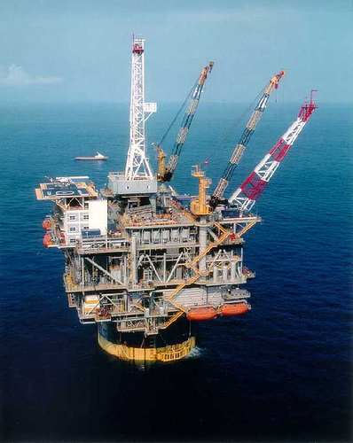
Oxidation-Reduction
OIL RIG
Oxidation is the loss of electrons.
Reduction is the gain of electrons.

Slide 8
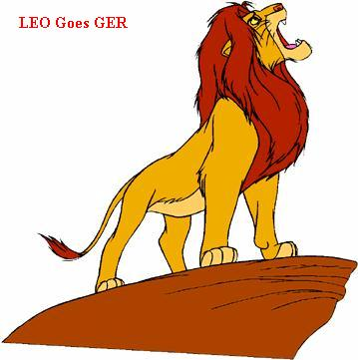
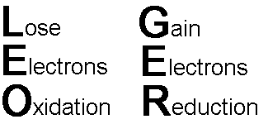
Oxidation-Reduction
LEO GER
Losing electrons - oxidation
Gaining electrons - reduction

Slide 9
Oxidation-Reduction
Oxidation means an increase in oxidation state - lose electrons.
Reduction means a decrease in oxidation state - gain electrons.
The substance that is oxidized is called the reducing agent.
The substance that is reduced is called the oxidizing agent.

Slide 10
Redox Reactions

Slide 11
Agents
Oxidizing agent gets reduced.
Gains electrons.
More negative oxidation state.
Reducing agent gets oxidized.
Loses electrons.
More positive oxidation state.

Slide 12
Practice In the following reaction, identify the… Oxidizing agent; Reducing agent; Substance oxidized; Substance reduced
Fe (s) + O₂(g) → Fe₂O₃(s)
(+3) oxidation
0
0
+3
-2
(-2) reduction
OA = O₂
RA = Fe

Slide 13
Practice In the following reaction, identify the… Oxidizing agent; Reducing agent; Substance oxidized; Substance reduced
Fe₂O₃(s)+ 3 CO(g) → 2 Fe(l) + 3 CO₂(g)
(+2) oxidation
+3
-2
+2
-2
0
+4
-2
(-3) reduction
OA = Fe
RA = C

Slide 14
Practice In the following reaction, identify the… Oxidizing agent; Reducing agent; Substance oxidized; Substance reduced
SO₃²⁻ + H⁺ + MnO₄⁻ → SO₄²⁻ + H₂O + Mn²⁺
(+2) oxidation
+4
-2
+1
+7
-2
+6
-2
+1
-2
+2
(-5) reduction
OA = MnO₄⁻
RA = SO₃²⁻

Slide 15
Half-Reactions
All redox reactions can be thought of as happening in two halves.
One produces electrons - oxidation half.
The other requires electrons - reduction half.

Slide 16
Half-Reactions Practice
Write the half reactions for the following:
Na + Cl₂ → Na⁺ + Cl⁻
(+1) oxidation
0
0
+1
-1
(-1) reduction
Oxidation:
Na → Na⁺
Reduction:
Cl₂ → Cl⁻
+ e⁻
+ 2e⁻
2

Slide 17
Half-Reactions Practice
Write the half reactions for the following:
SO₃²⁻ + H⁺ + MnO₄⁻ → SO₄²⁻ + H₂O + Mn²⁺
(+2) oxidation
+4
-2
+1
+7
-2
+6
-2
+1
-2
+2
(-5) reduction
Oxidation:
SO₃²⁻ → SO₄²⁻
Reduction:
MnO₄- → Mn²⁺
Clearly there’s more to this than just adding electrons…

Slide 18
Balancing Redox Equations
In aqueous solutions the key is the number of electrons produced must be the same as those required.

Slide 19
Acidic Solution
For reactions in acidic solution an 8 step procedure:
Write separate half reactions
For each half rxn, balance all reactants except H and O
Balance O using H₂O
Balance H using H⁺
Balance charge using e⁻
Multiply equations to make electrons equal
Add equations and cancel identical species
Check that charges and elements are balanced.

Slide 20
Redox Balancing Practice
Balance the following redox rxn that takes place in acidic sol’n:
(+6) oxidation
acid
Cr₂O₇²⁻(aq) + C₂H₅OH(l) → Cr³⁺(aq) + CO₂(g)
+6
-2
-2
+1
-2
+1
+3
+4
-2
(-3) reduction
Oxidation:
C₂H₅OH → CO₂
3H₂O +
2
+ 12H⁺
+ 12e⁻
Reduction:
6e⁻ +
14H⁺ +
Cr₂O₇²⁻ → Cr³⁺
2
2
+ 7H₂O
12e⁻ +
28H⁺ +
2Cr₂O₇²⁻ → Cr³⁺
4
+ 14H₂O

Slide 21
Redox Balancing Practice
Balance the following redox rxn that takes place in acidic sol’n:
Now add the oxidation and reduction reactions together:
C₂H₅OH → CO₂
+ 12e⁻
3H₂O +
2
+ 12H⁺
16
11
12e⁻+
28H⁺ + 2
Cr₂O₇²⁻→ Cr³⁺
4
+ 14H₂O
16H⁺ + 2Cr₂O₇²⁻ + C₂H₅OH → 2CO₂ + 4Cr³⁺ + 11H₂O

Slide 22
Practice
The following reactions occur in aqueous solution. Balance them
Cr(OH)₃ + OCl⁻ + OH⁻ → CrO₄⁻² + Cl⁻ + H₂O
MnO₄⁻ + Fe⁺² → Mn⁺² + Fe⁺³
Cu + NO₃⁻ → Cu⁺² + NO(g)
Pb + PbO₂ + SO₄⁻² → PbSO₄
Mn⁺² + NaBiO₃ → Bi⁺³ + MnO₄⁻

Slide 23
Now for a tough one…
Fe(CN)₆⁻⁴ + MnO₄⁻ → Mn⁺² + Fe⁺³ ⁺ CO₂ + NO₃⁻

Slide 24
Basic Solution
Do everything you would with acid, but add one more step.
Add enough OH⁻ to both sides to neutralize the H⁺ (OH- and H+ combine to form H₂O)

Slide 25
Redox Balancing Practice
Balance the following redox rxn that takes place in basic sol’n:
(+1) oxidation
base
Ag(s) + CN⁻(aq) + O₂(g) → Ag(CN)₂⁻(aq)
0
+2
-3
0
+1
+2
-3
reduction?
Oxidation:
4
2
CN⁻(aq) + Ag(s) → Ag(CN)₂⁻(aq)
+ e⁻
8
CN⁻(aq) + 4Ag(s) → 4Ag(CN)₂⁻(aq)
+ 4e⁻
Reduction:
4e⁻ +
4H⁺(aq) +
O₂(g) →
2H₂O(l)

Slide 26
Redox Balancing Practice
Balance the following redox rxn that takes place in acidic sol’n:
Now add the oxidation and reduction reactions together:
8
CN⁻(aq) + 4Ag(s) → 4Ag(CN)₂⁻(aq)
+ 4e⁻
4e⁻ +
4H⁺(aq) +
O₂(g) →
2H₂O(l)
8CN⁻(aq) + 4Ag(s) + 4H⁺(aq) + O₂(g) → 4Ag(CN)₂⁻(aq) + 2H₂O(l)
+4OH⁻(aq)
+4OH⁻(aq)
2
=4H₂O(l)
8CN⁻(aq) + 4Ag(s) + 2H₂O(aq) + O₂(g) → 4Ag(CN)₂⁻(aq) + 4OH⁻(aq)

Slide 27
Basic Solution Practice
CrI₃ + Cl₂ → CrO₄⁻ + IO₄⁻ + Cl⁻
Fe(OH)₂ + H₂O₂ → Fe(OH)⁻

Slide 28
Redox Titrations
Same as any other titration.
The permanganate ion is used often because it is its own indicator.
MnO₄⁻ is purple, Mn⁺² is colorless. When reaction solution remains clear, MnO₄⁻ is gone.
Chromate ion is also useful, but color change (orangish-yellow to green) is harder to detect.

Slide 29
Example
The iron content of iron ore can be determined by titration with standard KMnO₄ solution. The iron ore is dissolved in excess HCl, and the iron reduced to Fe⁺² ions. This solution is then titrated with KMnO₄ solution, producing Fe⁺³ and Mn⁺² ions in acidic solution. If it requires 41.95 mL of 0.205 M KMnO₄ to titrate a solution made with 0.6128 g of iron ore, what percent of the ore was iron?

