Slide 1
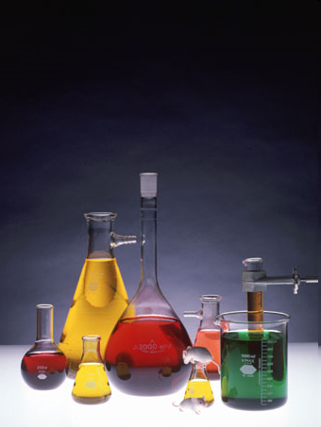
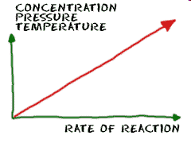
Unit 6: Kinetics
IB Topics 6 & 16
Part 1:
Reaction
Rates

Slide 2
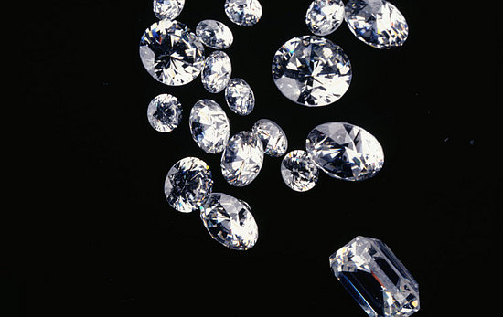


Is it so??

Slide 3

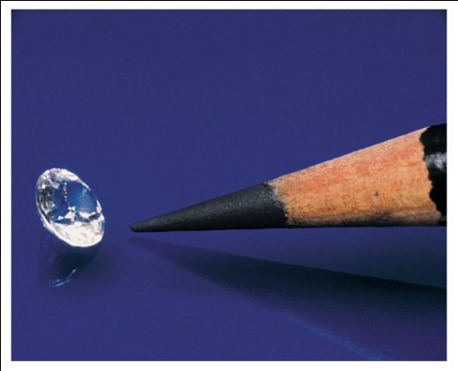
Consider: Gibb’s Free Energy
?
C_{diamond} → C_{graphite}
ΔG = ∑ ΔG_{products} - ∑ ΔG_{reactants}
ΔG = ΔG_{graphite} - ΔG_{diamond}
ΔG = (0) - (3 kJ/mol)
ΔG = -3 kJ/mol

Slide 4

Look quick, before it turns into graphite.

Slide 5


While it’s true her diamond is spontaneously turning into graphite before her eyes, it’s happening very slowly. Don’t hold your breath waiting to see any change. It takes billions of years.

Slide 6
While thermodynamics tells us whether or not a reaction or event is spontaneous, it DOES NOT tell how fast a reaction goes.
This is what kinetics does....describes the rate of the reaction.

Slide 7
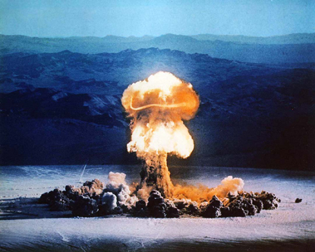
Why care about kinetics?
To be able to predict how long and area will remain significantly radioactive after radiation has been released.

Slide 8
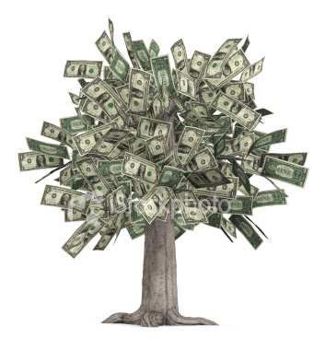
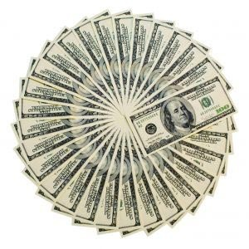
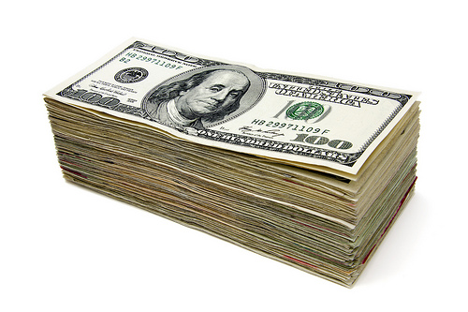
Why care about kinetics?
To gain information about how quickly products form and on the conditions that give the most efficient and economic yield.

Slide 9
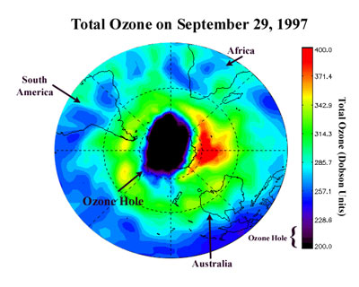
Why care about kinetics?
To help us learn how to slow down reactions such as the destruction of stratospheric ozone.

Slide 10
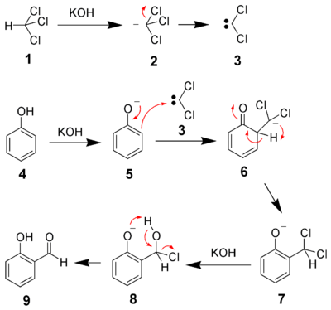
Why care about kinetics?
To understand the reaction mechanisms, which explain how reactions happen at a molecular level by suggesting a sequence of bond breaking & bond making (rxn steps).

Slide 11
Chemical Kinetics: The study of the factors that control the rate (speed) of a chemical rxn
Kinetic measurements are often made under conditions where the reverse reaction is insignificant
The kinetic and thermodynamic properties of a reaction are not fundamentally related
Rate is defined in terms of the change in concentration of a given reaction component per unit time.

Slide 12
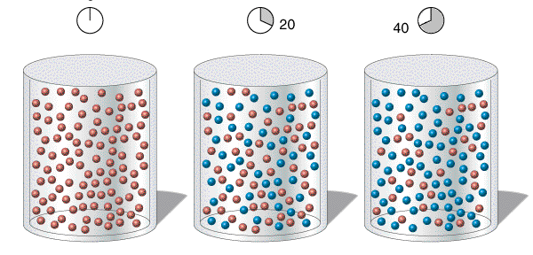
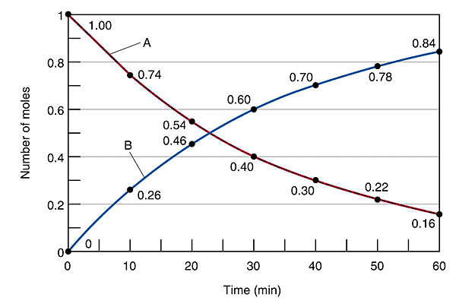
Reaction Rates
Red → Blue
NOTE: whether you are measuring increase in product over time or decrease in reactant over time, by convention rate is expressed as a positive value.

Slide 13
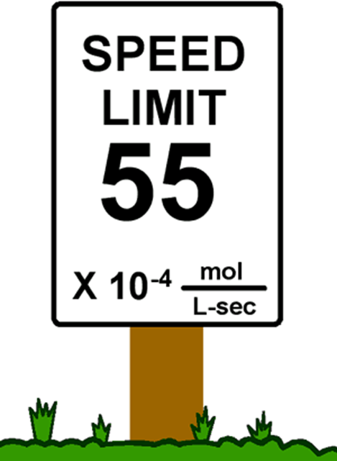
Units of rate
Rate = change in amt., or concentration over time, so units are…
  M / time unit
  mol / L⋅sec
  mol dm⁻³ s⁻¹

Slide 14
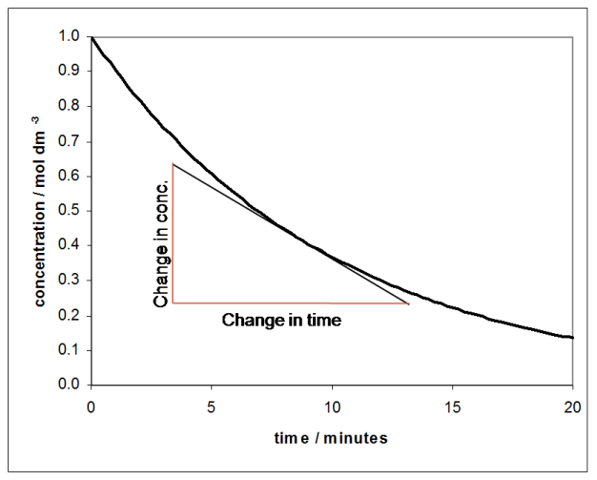
Measuring reaction rate
From a graph of [A] v. time, instantaneous rate can be determined by taking the slope of the tangent line at a given time.
[A]

Slide 15
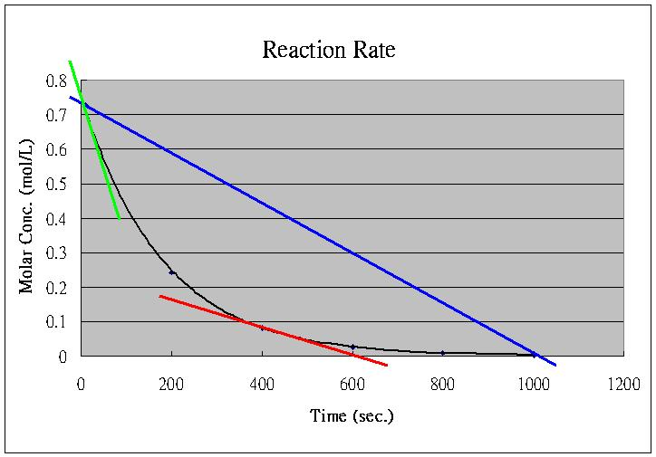
Why measure instantaneous rates?
Blue line: avg rate from t=0 to t=1000 sec
  not very reflective of what’s really happening

Slide 16
Why measure instantaneous rates?
Green line: rate at t = 0 (initial rate)
Red line: rate at t = 400 sec

Slide 17

So how would you design an experiment to measure rates of reaction?
← Mrs. Dogancay’s niece, Chrislyn (age 2)

Slide 18
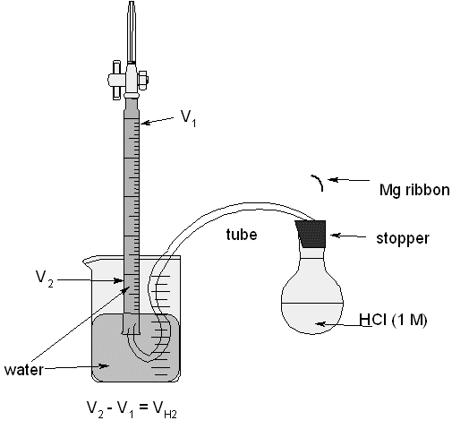
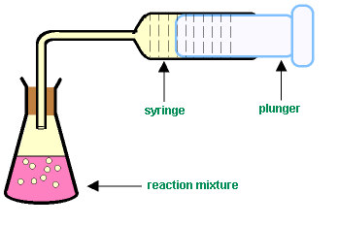
Measuring rates of reaction: different techniques depending on reaction
Change in volume of gas produced.
Convenient method if one of products is a gas
    Ex: Mg(s) + 2HCl(aq) → MgCl₂(aq) + H₂(g)
or

Slide 19
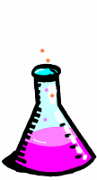
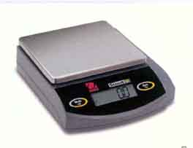
Measuring rates of reaction: different techniques depending on reaction
Change in mass
If rxn is giving off a gas, the corresponding decrease in mass can be measured by standing the rxn mixture directly on a balance.
    Ex: CaCO₃(s) + 2HCl(aq) → CaCO₃(aq) + CO₂(g) + H₂O(l)

Slide 20
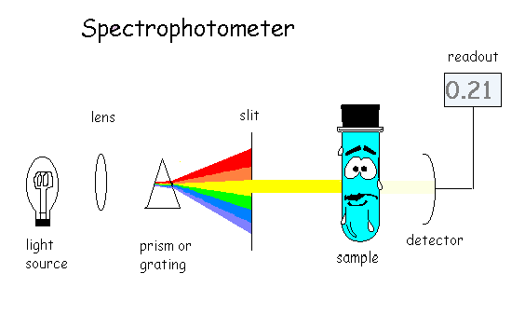
Measuring rates of reaction: different techniques depending on reaction
Change in absorbance/transmission of light: colorimetry/spectrophotometry
Useful if one of the reactants or products is colored (and thus will give characteristic absorption in the visible region)
  Ex: 2HI(g) → 2H₂(g) + 2I₂(g)
colorless
colorless
colored

Slide 21
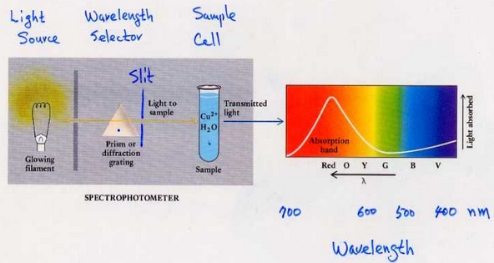
Spectrophotometry / colorimetry
Notice that a blue sample will absorb in the blue region and transmit in the red (complementary color)… thus red light should be selected to pass through the sample.
(You will do a lab like this soon)

Slide 22
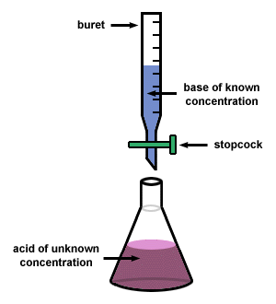
Measuring rates of reaction: different techniques depending on reaction
Change in concentration measured using titration
In some rxns it may be possible to measure the conc. of a reactant or product by titrating it against a solution of known conc..
However, since titrating changes the conc. of sol’n, this cannot be done continuously as rxn proceeds.
Instead, samples can be removed at given intervals in time & then titrated.
But since titration takes time, a technique known as quenching must be used on sample removed (an introduced substance halts rxn)
Tricky!

Slide 23
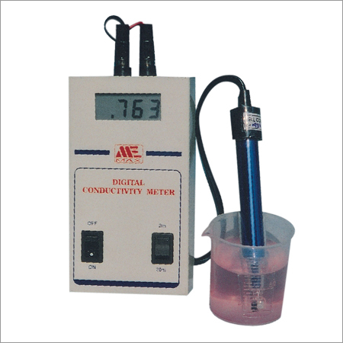

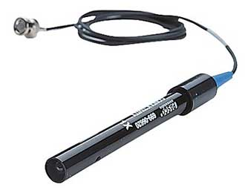
Measuring rates of reaction: different techniques depending on reaction
Change in concentration measured using conductivity
Useful when there is a change in ionic concentrations (total conductivity of sol’n depends on total conc. of ions and their charges).
  Ex: BrO₃⁻(aq) + 5Br⁻(aq) + 6H⁺(aq) → 3Br₂(aq) + H₂O(l)
Can be measured directly with conductivity meter, which involves immersing inert electrodes in the sol’n

Slide 24
Measuring rates of reaction: different techniques depending on reaction
Non-continuous methods of detecting change during a reaction: “clock reactions”
Sometimes it’s difficult to record continuous change in the rate of a reaction.
In these cases, it may be more convenient to measure the time it takes for a rxn to reach a fixed observable point.
Time taken to reach this pt. over varied conditions can be measured.
Limitation: can only measure avg. rate over the time interval

Slide 25
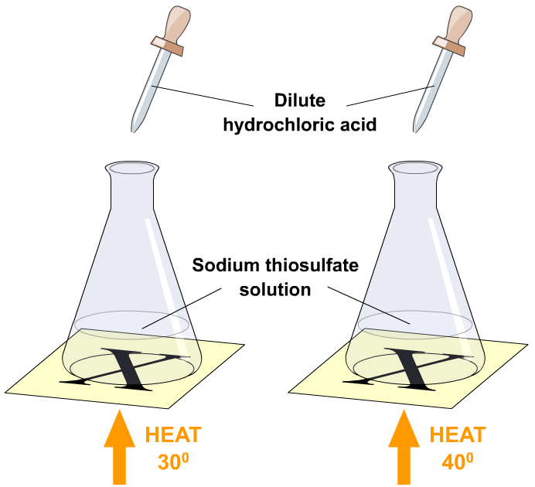
Measuring rates of reaction: different techniques depending on reaction
Non-continuous methods of detecting change during a reaction: “clock reactions”
  Example:
  Na₂S₂O₃(aq) + 2HCl(aq) → 2NaCl(aq) + SO₂(aq) + H₂O(l) + S(s)
    measure time for sulfur to precipitate to a level that makes the “X” no longer visible.
Click here to see an online simulation

Slide 26
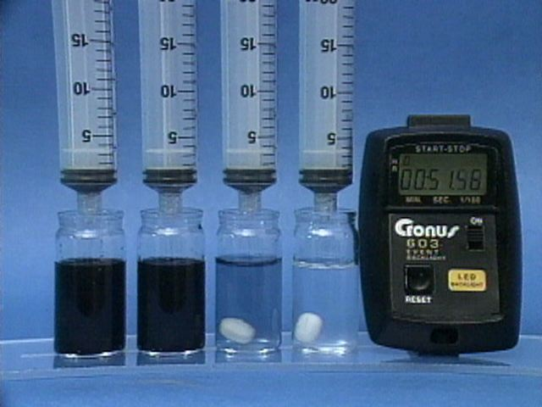
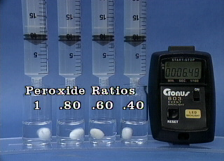
Measuring rates of reaction: different techniques depending on reaction
Non-continuous methods of detecting change during a reaction: “clock reactions”
  Ex: iodine clock reaction
Click here to see clock rxn demo
Click here if you wish to see the chemical equations

Slide 27
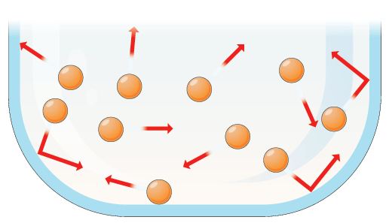
Kinetic energy and temperature
Particles in a substance move randomly as a result of the kinetic energy they possess.
Due to random nature of movements and collisions, not all particles in a substance have the same values of kinetic energy, but instead a range of values.

Slide 28
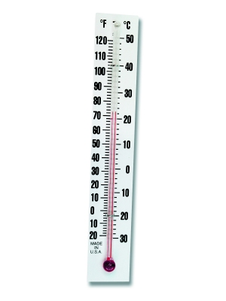
Kinetic energy and temperature
The average kinetic energy is directly proportional to absolute temperature (measure in Kelvin).
When a substance is heated, the absorbed energy leads to an increase in average kinetic energy (and therefore temperature increases).

Slide 29
Maxwell-Boltzman Distribution Curve
Shows # particles that have a particular KE (or probability of that value occurring) plotted against the values of KE

Slide 30
Maxwell-Boltzman Distribution Curve
temp, T₁
number of particles with kinetic energy, E
avg. KE @ T₁
AUC (area under the curve) = total # particles
kinetic energy

Slide 31
Maxwell-Boltzman Distribution Curve
temp, T₁
T₂ > T₁
temp, T₂
number of particles with kinetic energy, E
avg. KE
@ T₁
avg. KE
@ T₂
AUC_{T1} = AUC_{T2}
(amt. or #particles is constant)
kinetic energy

Slide 32
Maxwell-Boltzman Distribution Curve
temp, T₁
T₂ > T₁
temp, T₂
Area (AUC) =
# particles w/ sufficient energy to react
number of particles with kinetic energy, E
avg. KE
@ T₁
avg. KE
@ T₂
E_{a}
Note: E_{a}= activation energy (minimum energy particles must possess to react in a collision)
kinetic energy

Slide 33
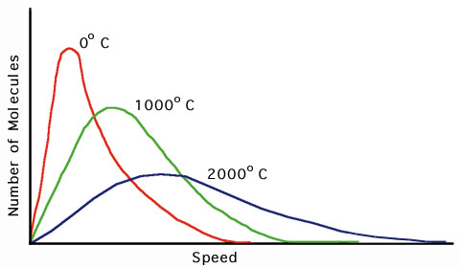
Maxwell-Boltzman Distribution Curve
What if there were a sample of even higher temp?

Slide 34
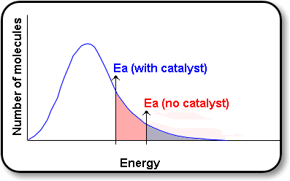
Maxwell-Boltzman Distribution Curve
What if you added a catalyst?

Slide 35
How reactions happen:
For a reaction to occur, three conditions must be met:
Atoms, ions and/or molecules must collide.
Must collide with the correct orientation.
Must collide with sufficient energy to form the activated complex.

Slide 36
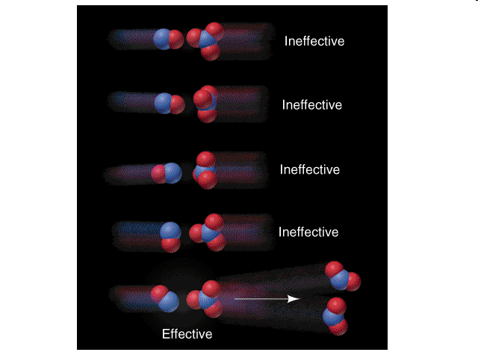
Orientation and the activated complex
Analogy: if you start with two separate paperclips (reactants) and you wish to link them together (products), not only must the paperclips come into contact, but they also must collide with a specific orientation.

Slide 37
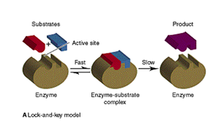
Orientation and the activated complex
Biological example: ENZYMES

Slide 38
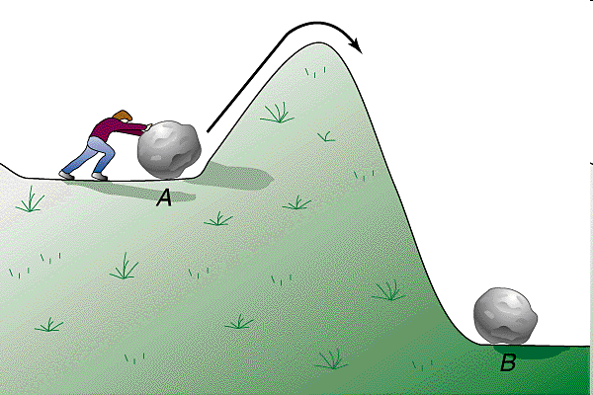
Activation energy and reaction
Only collisions with enough energy to react form products

Slide 39
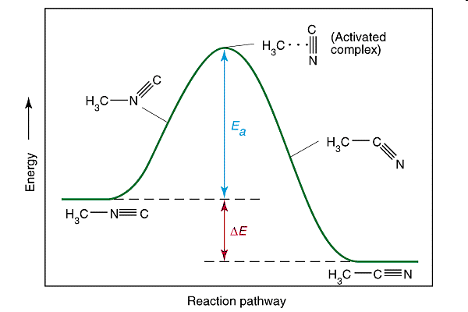
Activation energy and reaction
Demo: transition state/ activated complex ball

Slide 40
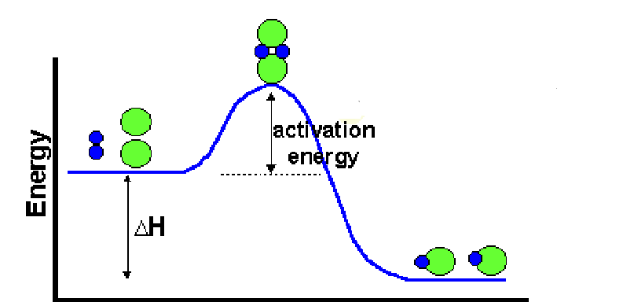
Activation energy and reaction
Another example
Activated complex (also called transition state)
reactants
products

Slide 41
Factors affecting reaction rates
The nature of the reactants
Concentration
Pressure (gases only)
Surface area
Temperature
Catalysts

Slide 42
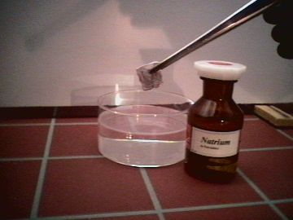
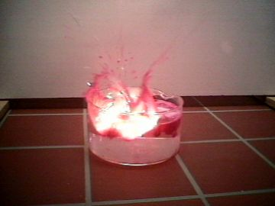
NATURE OF REACTANTS
Some elements/compounds are more reactive than others
FAST
sodium in water (alkali metals are VERY reactive)

Slide 43
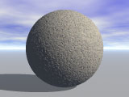
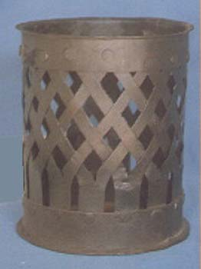
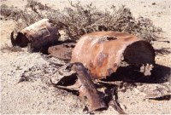
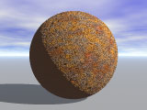
NATURE OF REACTANTS
Some elements/compounds are more reactive than others
SLOW
Rusting of iron (it takes time for moisture in the air to oxidize the metal… process can be sped up if salt is present, but will still not react as fast as sodium and water)

Slide 44
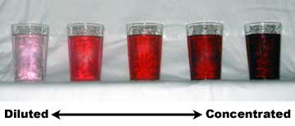
CONCENTRATION
As concentration ↑, frequency of collisions ↑, and therefore rxn rate ↑

Slide 45
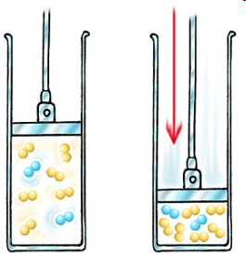
PRESSURE (gases)
For gases, increasing pressure creates the same effect as increasing concentration

Slide 46
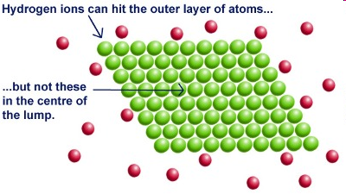
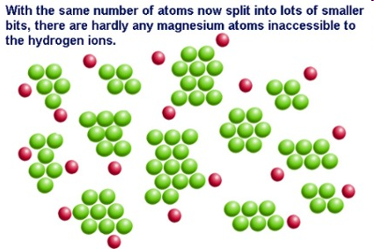
SURFACE AREA
As surface area ↑, rxn rate ↑
← slow
fast→
Demo: dragon’s breath

Slide 47
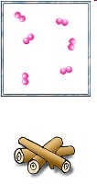
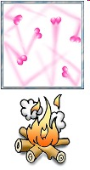
TEMPERATURE:
Generally, ↑ temp = ↑ rate
  Why?
  Higher temp = faster molecular motion = more collisions and more energy per collision = faster rxn
Analogy: imagine that you are baby-sitting a bunch of 6 year olds. You put them in a yard and you let them run around. Every now and then a couple of kids will run into each other. Now imagine that you decide to feed them some sugar. What happens? They run around faster and of course there are many more collisions. Not only that, the collisions are likely to be a lot harder/more intense.

Slide 48

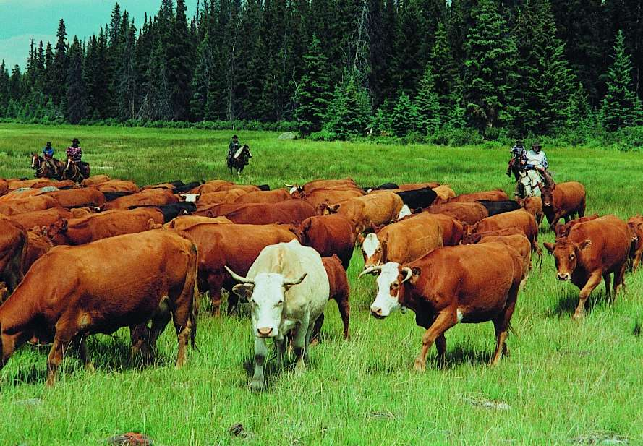
Daisy
BETsy
MAGGIE
KOBE
GERTRUDE
Adding a “cattle list”…

Slide 49
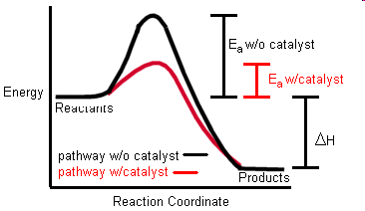
CATALYST
Catalyst: a substance that speeds up the rate of a reaction without being consumed in the reaction.
  Provides an easier way to react
  Lowers the activation energy
Enzyme = biological catalyst

