Slide 1
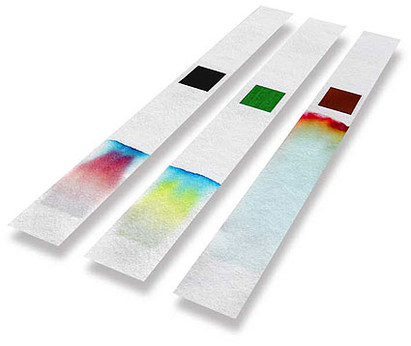
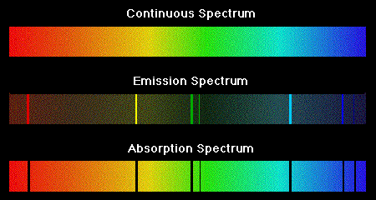
Analytical Chemistry
Option A
Part 3: AA and Chromatography

Slide 2
Atomic Absorption (AA)

Slide 3
Atomic Absorption (AA)
Measures energy absorbed as electrons are promoted to higher energy level.
Extremely sensitive – measures concentrations as low as 1 ppb
Used to measure concentrations of metals in water, blood, soils, etc.

Slide 4
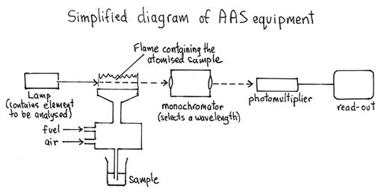
AA – How it Works

Slide 5
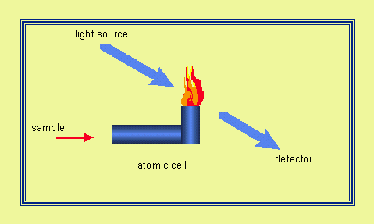
AA – How it Works

Slide 6
Analyzing AA Spectra
Recall that Beer-Lambert’s law only applies strictly to dilute sol’ns, so it is not generally used directly.
In practice, known concentrations are used to produce calibration curves.
Absorbance of unknown is then measured and concentration can be read by interpolation of the calibration curve.

Slide 7
Chromatography

Slide 8
Chromatography
A technique for separating and identifying components in a mixture.
Components have different affinities for two phases: a stationary phase and a mobile phase
A component which has a strong attraction for the mobile phase will move quickly, while a component with a strong attraction for the stationary phase will be held back.

Slide 9
Chromatography
Stationary and mobile phases are carefully selected so that the different components of the mixture will move at different speeds and thus be separated effectively.
For example, if the stationary phase is nonpolar and a polar mobile phase is employed, components will separate out based on their relative polarities (most polar will travel fastest).

Slide 10
Partition chromatography
Non-volatile liquid stationary phase
Inert solid surface
Components distribute themselves between the two phases according to their relative solubility.
Most soluble = fastest
Examples: Paper, GLC and TLC

Slide 11
Adsorption chromatography
Solid stationary phase
Mobile liquid or gas phase
Components distribute themselves between the two phases according to their relative polarity.
Most polar = fastest (if stationary phase is a polar solid)
Example: LC, HPLC and at times TLC

Slide 12
Main types of chromatography
Paper chromatography
Thin layer chromatography (TLC)
Column chromatography
Gas-liquid chromatography (GLC)
Gas chromatography – mass spectrometry (GCMS)
High Performance Liquid Chromatography (HPLC)

Slide 13
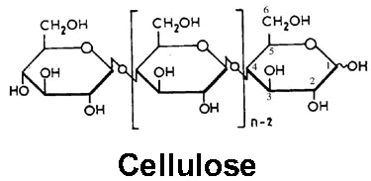
Paper chromatography
Paper composed mostly of cellulose.
Polar due to hydroxyl groups
“Dry” paper is actually ~10% water (H-bonded to –OH) groups
Polar water bonded to paper = stationary phase
Added solvent (eluent) = mobile phase

Slide 14
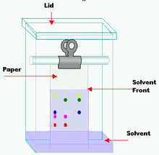
Paper chromatography
Small amt. mixture spotted onto paper
Starting point marked
Paper suspended in small quantity of solvent (eluent)
Closed container (prevents solvent evaporation & speeds process)
As solvent rises, components partition between two phases bases on relative solubility.
Solvent front is marked at end of separation
Colored components can be seen/measured
Other components may be made visible with stain (i.e. iodine or ninhydrin) or UV light

Slide 15
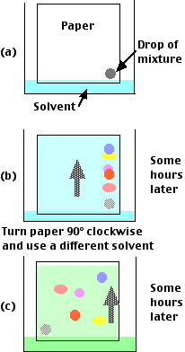
Paper chromatography
Each solute will have a constant retention factor (R_{f}) for a given eluent.
If two substances have similar R_{f} values in one solvent, the paper can be turned 90° and eluted with a different solvent for further separation.
Known as two-way chromatography
Often used to separate amino acids

Slide 16
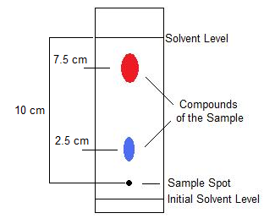
Paper chromatography
Calculating solute retention factors:

Slide 17
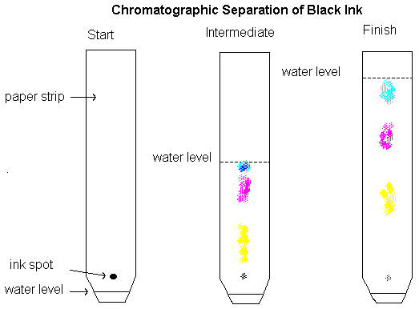
Paper chromatography
You try it… (caluclate the R_{f} values)

Slide 18
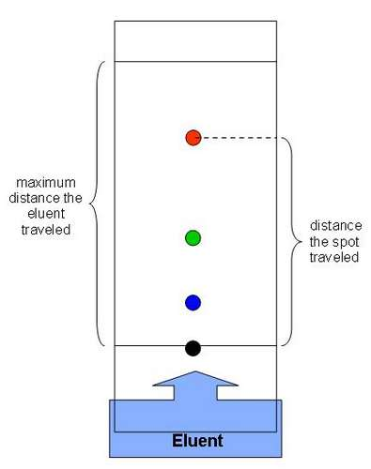
Thin layer chromatography (TLC)
Similar to paper chromatography
Thin layer of a solid is painted onto an inert support, such as glass
Common solids:
Alumina (Al₂O₃)
Silica (SiO₂)

Slide 19
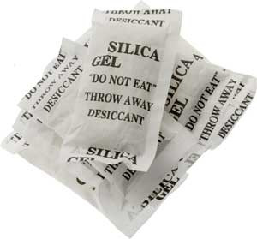
Thin layer chromatography (TLC)
When absolutely dry works by adsorption
However, like paper, silica and alumina are very hygroscopic (water-loving) and therefore separation occurs more by partition, with water as the stationary phase.
Separated components can be recovered by scraping off the section containing the component and dissolving it in a suitable solvent.

Slide 20
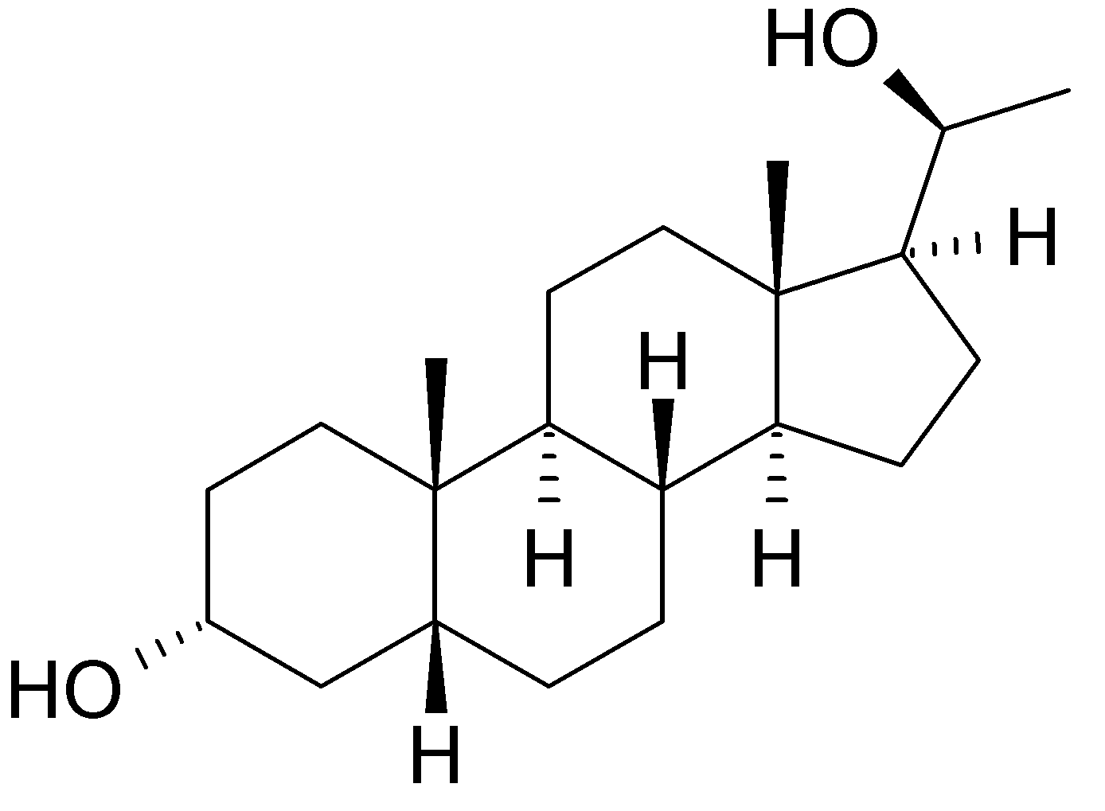
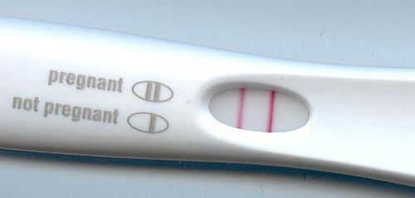
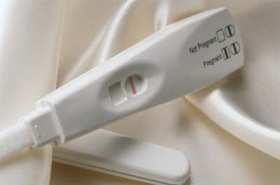
Thin layer chromatography (TLC)
Pregnancy tests may use TLC to detect pregnanediol in urine.

Slide 21
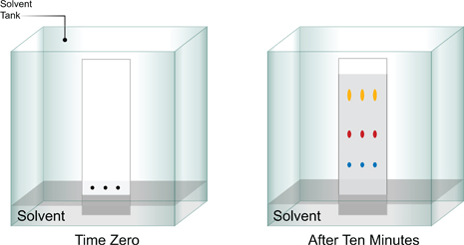
Thin layer chromatography (TLC)
Advantages of TLC over paper chromatography:
Approx. three times faster
More efficient – small samples can be separated and components can easily be recovered in pure form
Results are more easily reproduced
Range of mixtures can be separated by changing mobile and stationary phases

Slide 22
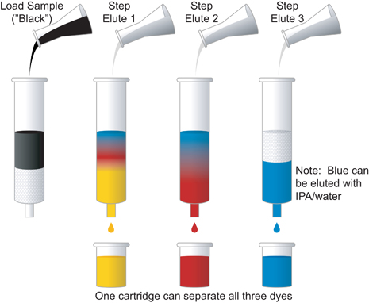
Column chromatography
Essentially large-scale TLC
Usually used to separate mixture components for further use rather than simple ID.
Stationary phase often alumina or silical gel (SiO₂⋅xH₂O)

Slide 23
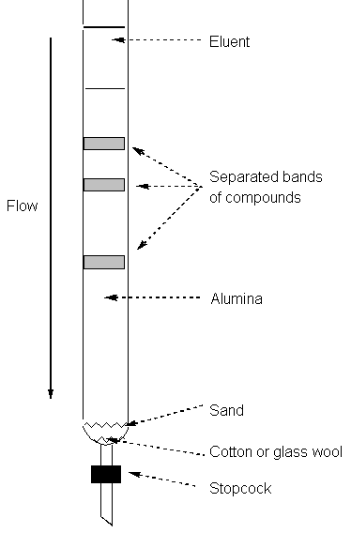
Column chromatography
Mixture dissolved in minimum volume of solvent
Added to top of column
Sample is eluted (fresh solvent added to the top to wash sample down the stationary phase)
Components separated as they travel at different rates – collected at bottom as different fractions.
Solvent can also be changed to elute more tightly held components.

Slide 24
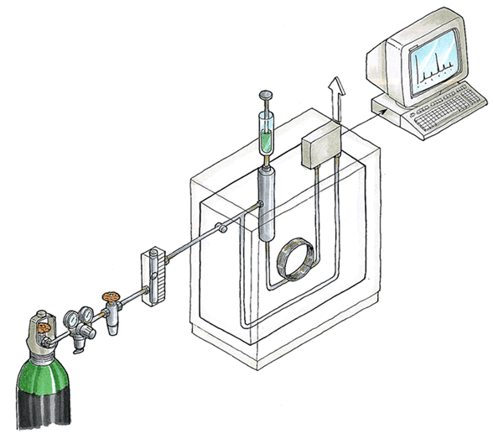
Gas-liquid chromatography (GLC)
Used to separate and ID gases and volatile liquids

Slide 25
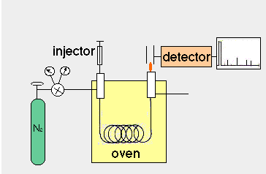
Gas-liquid chromatography (GLC)
Sample injected into oven where it is vaporized
Vapor carried by inert gas (mobile phase) over a non-volatile liquid (stationary phase).
N₂ and He are typical carrier gases
Long-chain alkanes w/ high b.p.’s supported on a SiO₂ (glass) surface typically act as stationary phase

Slide 26
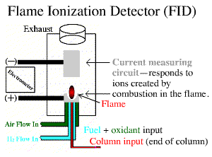
Gas-liquid chromatography (GLC)
Components generally exit to a flame ionization detector connected to a chart recorder.
The less volatile (lower b.p.) the component, the greater the retention time.

Slide 27
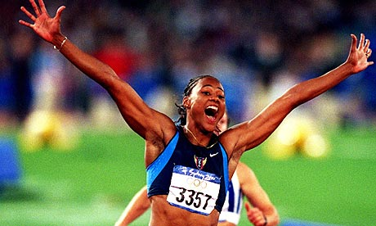
Gas-liquid chromatography (GLC)
Used to identify components that can vaporize without decomposition
Examples:
Illegal steroids and stimulants in urine
Blood-alcohol levels
Underground mine gases

Slide 28
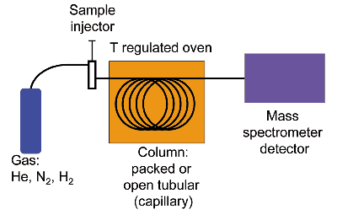
Gas chromatography – mass spectrometry (GCMS)
Like GLC, but employs mass spectrometry instead of flame ionization detector at exit point.

Slide 29
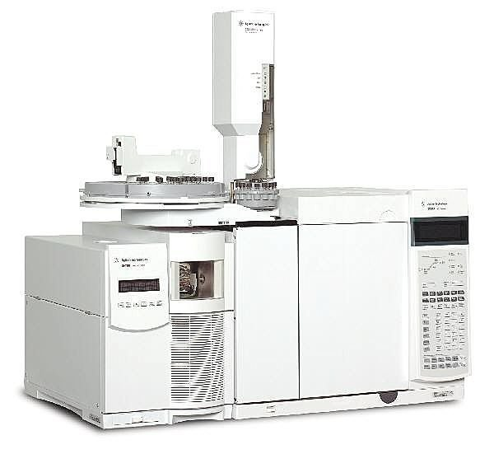
Gas chromatography – mass spectrometry (GCMS)
Computer matches the spectra and gives a printout of all components and their concentrations.
Very powerful tool and used extensively in forensic science, medicine, etc.
Mass spectrometer is connected to a computer which contains a library of the spectra of all known compounds.

Slide 30
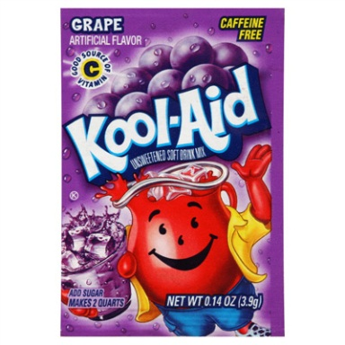
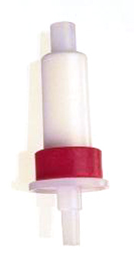
High Performance Liquid Chromatography (HPLC)
Like LC (column chromatography) but employs pressure instead of just gravity to force mobile phase through column.
Stationary phase is typically silica with long-chain alkanes adsorbed to surface,
Efficient separation, so long columns not needed.
Remember your liquid chromatography lab with grape Kool-Aid?
sep-pak C18 cartridge

Slide 31
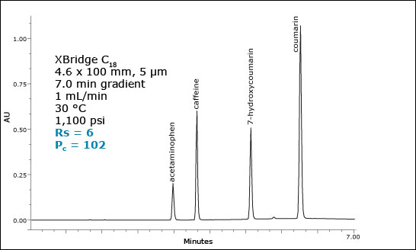
High Performance Liquid Chromatography (HPLC)
Separated components often detected via IR spectroscopy.
Like GLC, results recorded onto chart showing different retention times.

Slide 32
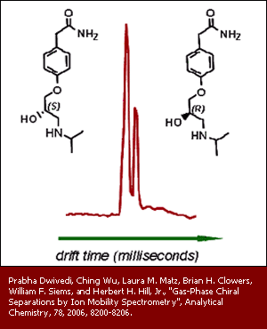
High Performance Liquid Chromatography (HPLC)
Can be used for ID as well as for separation
Can also be used to separate enantiomers (chiral separation) using columns containing optically active material.
Other uses include analysis of oil pollutants, alcoholic beverages, food (antioxidants, sugars and vitamins), pharmaceuticals, polymers, quality control of insecticides and herbicides.

