Slide 1
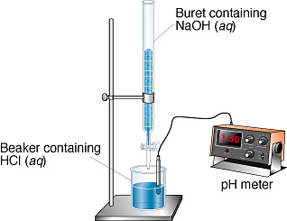
Unit 8: Acids and Bases
Part 5:
Titrations &
Indicators

Slide 2
Titrations
Commonly used to determine the amount of acid or base in a solution.
Complete by adding a solution of known concentration until the substance being tested is consumed.
This is called the equivalence point (a.k.a. stoichiometric point)
Titration curve - graph of pH vs. volume of added acid/base

Slide 3
Titration Units
millimole (mmol) = 1/1000 mol = 10⁻³ mol
Molarity = mol/L = mmol/mL
This makes calculations easier because we will rarely add liters of solution.

Slide 4
Types of Titrations
Strong Acid – Strong Base Titrations
Titrations of Weak Acids with Strong Bases
Titrations of Weak Bases with Strong Acids

Slide 5
Strong acid with Strong Base
Do the stoichiometry.
There is no equilibrium.
They both dissociate completely.
Ex: The titration of 50.0 mL of 0.200 M HNO₃ with 0.100 M NaOH
Analyze the pH

Slide 6
Weak acid with Strong base
There is an equilibrium.
Do stoichiometry.
Then do equilibrium.
Ex: Titrate 50.0 mL of 0.10 M HF (Ka = 7.2 x 10⁻⁴) with 0.10 M NaOH

Slide 7
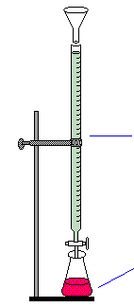
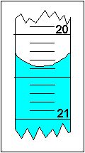
Titration Curves
Buret
Solution with Indicator

Slide 8
Titration Curves: Analytical Determination of Birth Year
From How I Met Your Mother (Season 7, Episode 4 – “Field Trip”): It’s hard to argue with Barney’s logical basis of the Ewok Line. If you were older than ten years old when Return of the Jedi was released (1983), you’re not going to remember your first Ewok experience as all cute and cuddly. I was born on the correct side of the line, and find the Ewoks adorable.

Slide 9
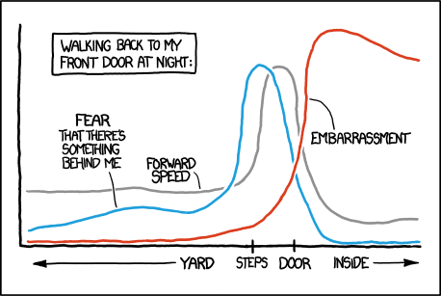
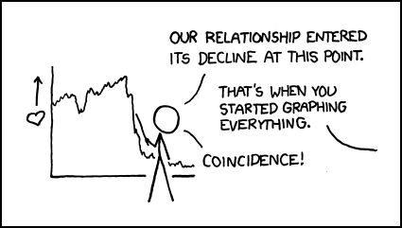
More silly graphs…

Slide 10
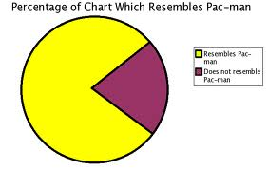

Slide 11
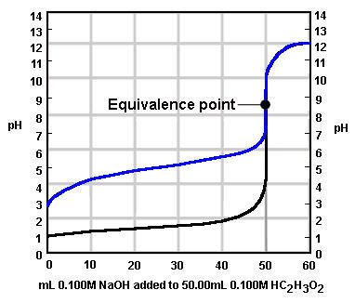
The pH of the Equivalence point is influenced by the nature of the salt formed in the titration.
Buffer Region
Weak Acid Curve
Strong Acid Curve

Slide 12
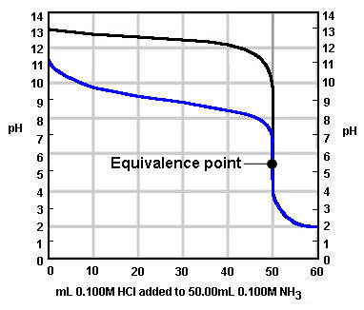

Slide 13
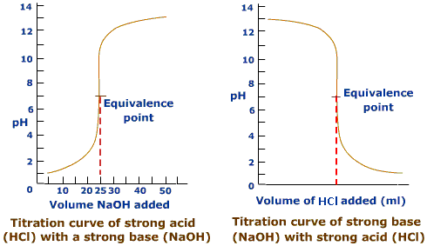
Strong acid and strong base
Equivalence at pH 7

Slide 14
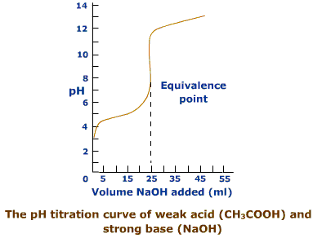
Weak acid and strong base
Equivalence at pH >7

Slide 15
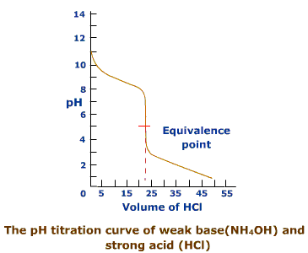
Weak base and strong acid
Equivalence at pH <7

Slide 16
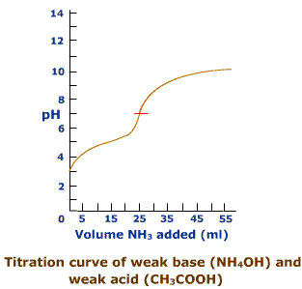
Weak acid and weak base
Equivalence pH depends on relative strengths
Not used for analytical purposes

Slide 17
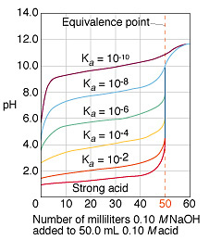
Titration Curves:
Weak Acids/Strong Base
1. The solution of a weak acid has a higher initial pH than a solution of a strong acid of the same concentration
2. The weaker the acid the more rapidly the pH rises in the early part of the titration, but more slowly near the equivalence point. This is because of the buffering action of the formed salt.
3. The pH at the equivalence point is not 7.00. The weaker the acid, the higher the pH at the EQ point.

Slide 18
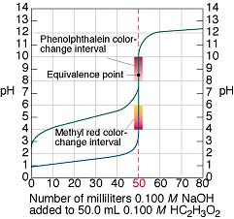
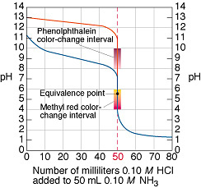
Indicators must be chosen based on the pH of the equivalence point

Slide 19
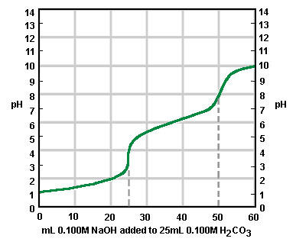
Curve of a diprotic acid (eg. H₂CO₃ or H₂SO₄): two equivalence points

Slide 20
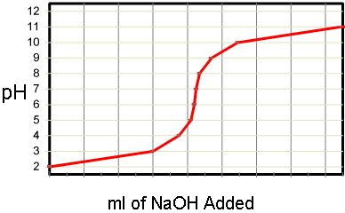
Calculations involving Titrations of Weak Acids/Bases
Divide the titration into the following points:
1. Starting point: No acid/base added (acid/base in water problem)
Starting Point

Slide 21
2. Before the equivalence point (Note: for weak a/b at the half-equivalence pt., this is a buffer problem where pH = pK_{a})
Use a two step procedure when calculating pH prior to the equivalence point whenever a strong acid/base is added to a weak acid/base.
A. Stoichiometric Calculation: Allow the strong acid/base to react to completion with the weak acid/base, producing a solution that contains the weak acid and its common ion. (its conjugate base/acid)
Before Equivalence Point
B. Equilibrium Calculation: Use the value of Ka/Kb and the equilibrium expression to calculate the equilibrium concentrations of the weak acid/base, and the common ion, and H+ (ICE notation or HH Eq’n)

Slide 22
3. At the equivalence point (where mol_{A} = mol_{B} and M_{A}V_{A} = M_{B}V_{B})
4. Beyond the equivalence point (excess strong acid/base in water)
Beyond the EQ point
Equivalence Point

Slide 23
Example: Titration of a Strong Base and a Weak Acid
Calculate the pH when the following quantities of 0.050M KOH solution have been added to 50.0 ml of a 0.025M solution of benzoic acid (HC₇H₅O₂ Ka = 6.5x10⁻⁵). A) 20.0ml B) 25.0ml C) 30.0ml
Step 0: Find the equivalence point
mol_{acid present} = mol_{base added}
M_{A}V_{A} = M_{B}V_{B}
(50.0ml)(0.0250M) = (0.0500M)(V_{B})
Volume base = 25 ml at the equiv. point

Slide 24
Example: Titration of a Strong Base and a Weak Acid
Calculate the pH when the following quantities of 0.050M KOH solution have been added to 50.0 ml of a 0.025M solution of benzoic acid (HC₇H₅O₂ Ka = 6.5x10⁻⁵). A) 20.0ml B) 25.0ml C) 30.0ml
Step 1: Starting point
This is just a “weak acid in water” problem…..
C₆H₅COOH ⇔ H⁺ + C₆H₅COO⁻
I
C
E
0.025M 0 0
-x +x +x
0.025-x x x
≈0.025 (assume x << 0.025)
x = [H⁺] = 0.0013 M
pH = -log (0.0013)
pH = 2.89

Slide 25
Example: Titration of a Strong Base and a Weak Acid
Calculate the pH when the following quantities of 0.050M KOH solution have been added to 50.0 ml of a 0.025M solution of benzoic acid (HC₇H₅O₂ Ka = 6.5x10⁻⁵). A) 20.0ml B) 25.0ml C) 30.0ml
Step 2: Before the equiv. point (20.0 ml KOH added)
First perform stoichiometric caclulations…
moles of OH- = (20.0 mL)(0.050 mmol/mL) = 1.0 mmol
moles HC₇H₅O₂ = (50.0 mL)(0.025 mmol/mL) = 1.25 mmol
Limiting Reagent
C₆H₅COOH + OH- → C₆H₅COO- + H₂O
Before rxn
1.25 mmol 1.0 mmol 0.0
Change -1.0 mmol -1.0 mmol +1.0mmol
After rxn 0.25 mmol 0.0 mmol 1.0 mmol

Slide 26
Example: Titration of a Strong Base and a Weak Acid
Calculate the pH when the following quantities of 0.0500M KOH solution have been added to 50.0 ml of a 0.0250M solution of benzoic acid (HC₇H₅O₂ Ka = 6.5x10⁻⁵). A) 20.0ml B) 25.0ml C) 30.0ml
Step 2: Before the equiv. point (20.0 ml KOH added)
Next, using these values, perform equilibrium calculations…

Slide 27
OR solve convert to concentration (M) and perform ICE equilibrium calculations…
HC₇H₅O₂ ⇔ H⁺ + C₇H₅O₂⁻
I
C
E
.00357 ≈0 .0143
-x + x + x
.00357-x x .0143 + x
≈.00357
≈.0143
X = [H⁺] = 1.60x10⁻⁵
pH = 4.80

Slide 28
Example: Titration of a Strong Base and a Weak Acid
Calculate the pH when the following quantities of 0.050M KOH solution have been added to 50.0 ml of a 0.025M solution of benzoic acid (HC₇H₅O₂ Ka = 6.5x10⁻⁵). A) 20.0ml B) 25.0ml C) 30.0ml
Step 3: At the equivalence point (25.0 ml KOH added)
(50.0ml)(0.025M HC₇H₅O₂) = 1.25 mmol acid
(25.0ml)(0.050M KOH) = 1.25 mmol base
C₆H₅COOH + KOH → KC₆H₅COO + H₂O
Before rxn
1.25 mmol 1.25 mmol 0.00 mmol
Change -1.25 mmol -1.25 mmol +1.25mmol
After rxn 0.00 mmol 0.00 mmol 1.25 mmol
This solution is identical to one that contains .00125 mol KC₇H₅O₂

Slide 29
This is the same as asking “what is the pH of a .0167M solution of KC₇H₅O₂?”
KC₇H₅O₂ → K⁺ + C₇H₅O₂⁻
Now, the C₇H₅O₂⁻ ion reacts with water to form a base (remember, it the salt of a strong base and a weak acid)
C₆H₅COO⁻ + H₂O ⇔ C₆H₅COOH + OH⁻
I
C
E
.0167M 0 ≈0
-x + x + x
≈.0167
.0167-x x x
K_{a} x K_{b} = 10⁻¹⁴ (at 298K)
K_{b} = 10⁻¹⁴/6.5x10⁻⁵
K_{b} = 1.54 x 10⁻¹⁰
x = 1.60x10⁻⁶ = [OH⁻]
pH = 8.21

Slide 30
Example: Titration of a Strong Base and a Weak Acid
Calculate the pH when the following quantities of 0.050M KOH solution have been added to 50.0 ml of a 0.025M solution of benzoic acid (HC₇H₅O₂ Ka = 6.5x10⁻⁵). A) 20.0ml B) 25.0ml C) 30.0ml
Step 4: Beyond the Eq point (30.0 ml KOH added)
Beyond the equivalence point, there is no longer any benzoic acid to neutralize the additional KOH added. The pH of the solution will be determined by the amount of excess KOH (the effect of the salt is negligible compared to the KOH)
30.0ml x 0.050M = 1.50 mmol KOH added
50.0ml x 0.025M = 1.25 mmol HC₇H₅O₂
0.25 mmol excess OH-
pOH = 2.51
pH = 11.49

Slide 31
We have used three different methods of calculating the pH during a titration….
1. Before the equivalence point has been reached. (weak acid/base + common ion, buffered region)
2. At the equivalence point. (hydrolysis of a salt)
3. Beyond the equivalence point.
(strong acid/base in water)

Slide 32
INDICATORS
Indicators signal change in pH
Indicators change color when the pH is equal to their pKa
Indicators can be used to signal the equivalence point in titrations

Slide 33
INDICATORS
An indicator is a weak acid (or base) in which the dissociated form is a different color than the undissociated form.
HIn(aq) ⇔ H⁺(aq) + In⁻(aq)
color A color B
(color in acid sol’n) (color in alkali sol’n)
Color changes when [In⁻] = [HIn].
Thus, indicator changes color when K_{in} = [H⁺]
…or when pK_{in} = pH

Slide 34
How do you choose an indicator?
Indicator | pK_{in} | pH range | Use
methyl orange | 3.7 | 3.1-4.4 | Titrations with strong acids
phenolphthalein | 9.6 | 8.3-10.0 | Titrations with strong bases

