Slide 1
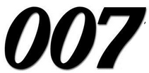
Unit 04: BONDING
IB Topics 4 & 14 Text: Ch 8 (all except sections 4,5 & 8) Ch 9.1 & 9.5 Ch 10.1-10.7
My Name is Bond. Chemical Bond

Slide 2
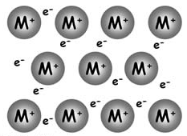
PART 5: Giant Covalent Structures, Metallic Bonding & Physical Properties

Slide 3
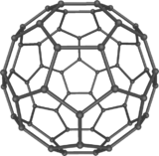
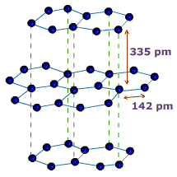
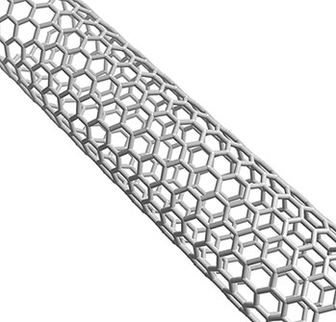
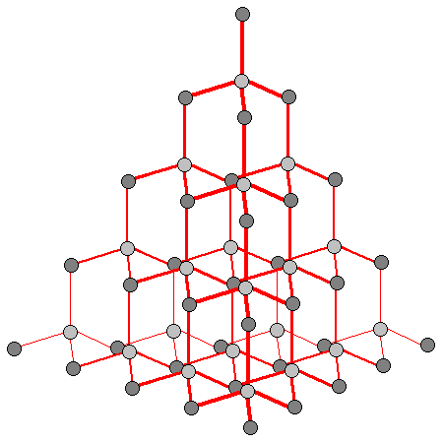
Giant Covalent Structures
Allotropes of carbon: allotropes occur when an element can exist in different crystalline forms.

Slide 4
Graphite
Hybridization: sp²; bonded to 3 other C-atoms; parallel layers of hexagons
Density: 2.26 g cm⁻³
Conductivity: conductor (contains 1 non-bonded delocalized e- per atom)
Appearance: non-lustrous, grey solid
Uses: lubricant; pencils

Slide 5
Diamond
Hybridization: sp³; bonded to 4 other C-atoms; (hardest known natural substance)
Density: 3.51 g cm⁻³
Conductivity: nonconductor (all e’s bonded; no mobile e’s)
Appearance: lustrous crustal
Uses: jewelry; ornamentation; tools & machinery for grinding and cutting

Slide 6
Buckminsterfullerene (C₆₀)
Look familiar???

Slide 7
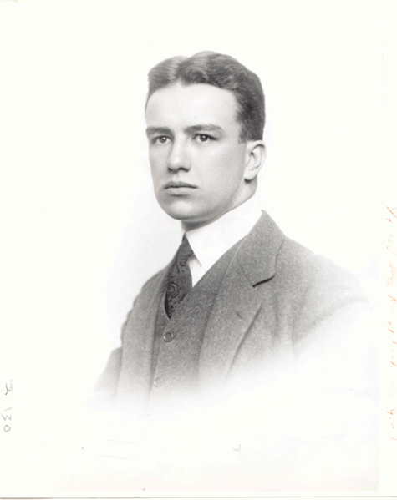
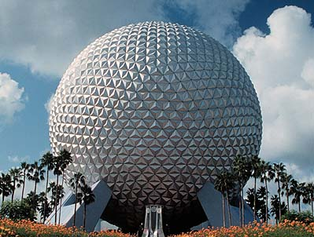
Buckminsterfullerene (C₆₀)
Named for the architect…
Richard Buckminster “Bucky” Fuller (July 12, 1895 – July 1, 1983)

Slide 8
Buckminsterfullerene (C₆₀)
Hybridization: sp²; bonded to 3 other C-atoms; sphere of 60 atoms (12 pentagons & 20 hexagons)
Density: 1.72 g cm⁻³
Conductivity: semiconductor; some e- mobility; (easily accepts e’s to form neg. ions)
Appearance: yellow crystalline solid
Uses: Reacts w/ K to make superconducting crystalline material; related forms are used to make nanotubes for the electronics industry; catalysts and lubricants

Slide 9
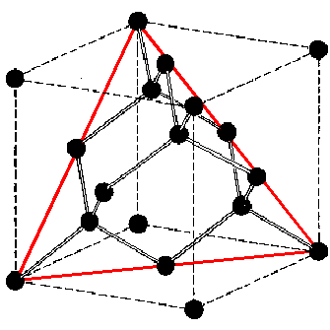
Silicon
Group 4 element (like C)
4 valence shell electrons
In the elemental state, each silicon atom is covalently bonded to four others in a tetrahedral arrangement. This results in a giant lattice structure much like diamond.

Slide 10
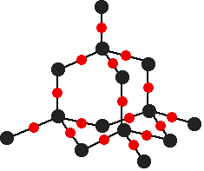
Silica
Silicon dioxide (SiO₂), commonly known as silica or quartz, also forms a giant covalent structure.
This is a similar tetrahedrally bonded structure, but here the bonds are between Si and O.
Each Si atom is covalently bonded to four oxygen atoms, and each O to two Si atoms.

Slide 11
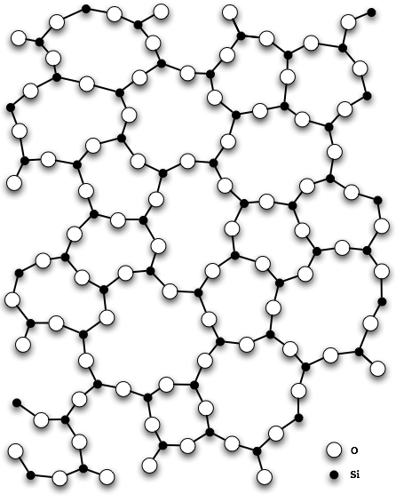
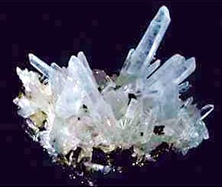
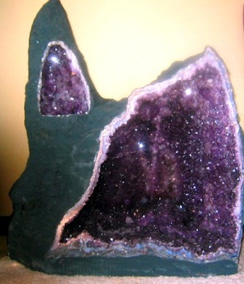
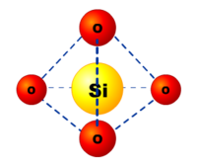
SiO₂
Si: geology :: C : biology
Silica, quartz, glass

Slide 12
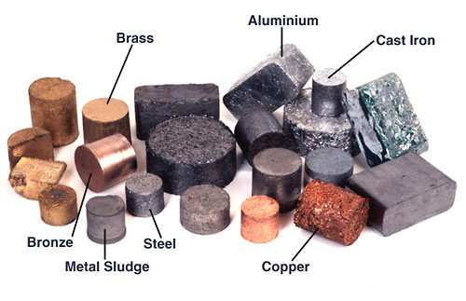
Metallic Bonding

Slide 13
Metallic Bonding
The valence electrons in metals become detached from the individual atoms so that metals consist of a close packed lattice of positive ions in a sea of delocalized electrons.

Slide 14
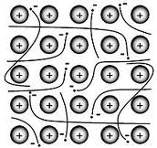
Metallic Bonding
A metallic bond is the attraction that two neighboring positive ions have for the delocalized electrons between them.

Slide 15
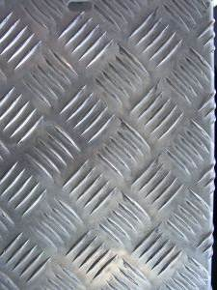
Metallic Bonding
Metals are malleable --- they can be bent and reshaped under pressure.
They are also ductile --- they can be drawn out into a wire.
Metals are malleable and ductile because the close-packed layers of positive ions can slide over each other without breaking more bonds than are made.

Slide 16
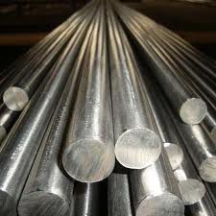
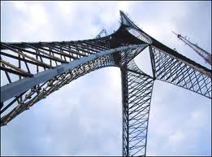
Metallic Bonding
Impurities added to the metal disturb the lattice and make the metal less malleable and ductile. This is why alloys are harder than the pure metals from which they are made.
Steel mostly iron & carbon (and some other elements such as Mn, Cr, V, W)

Slide 17
Type of Bonding and Physical Properties
Melting and boiling points

Slide 18
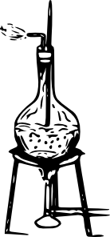
Boiling point
When a liquid turns into a gas the attractive forces between the particles are completely broken, so boiling point is a good indication of the strength of intermolecular forces.

Slide 19
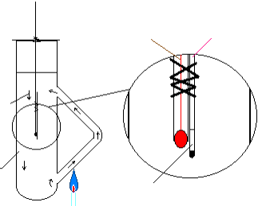
Melting point
When solids melt the crystalline structure is broken down, but there are still some attractive forces between the particles.
thermometer
capillary tube
convection currents
Thiele
tube
sample

Slide 20
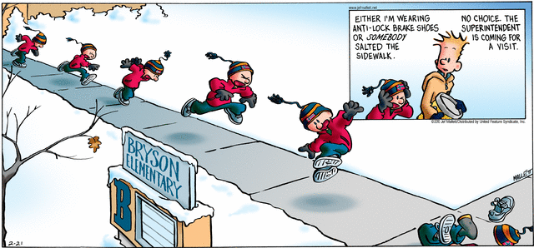
Melting point
Melting points are affected by impurities. These weaken the structure and result in lower melting points.

Slide 21
Melting points and boiling points
Covalent macromolecular structures have extremely high m.pts. and b.pts.
Metals and ionic compounds also tend to have relatively high b.pts. due to ionic attractions.
H-bonds are in the order of 1/10 the strength of a covalent bond.
London dispersion forces are in the order of less than 1/100 of a covalent bond.

Slide 22
Melting points and boiling points
The weaker the attractive forces, the more volatile the substance.
Intermolecular forces will increase with
Increasing molecular size
The extent of polarity within the bonds of the structure

Slide 23
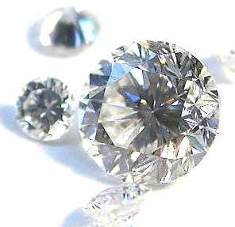
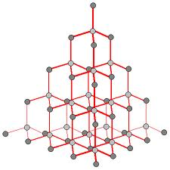
Example: diamond
m.pt. over 4000°C!!!
All bonds in covalently-bonded macromolecular structure

Slide 24
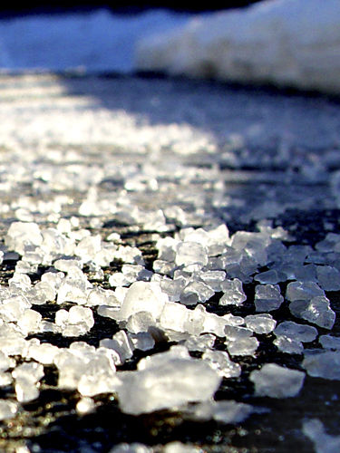
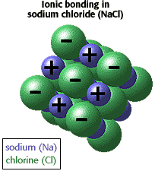
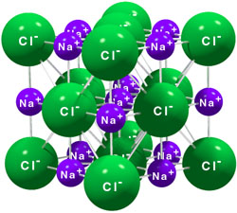
Example: sodium chloride (NaCl)
m.pt. 801°C
Ions held strongly in ionic lattice

Slide 25
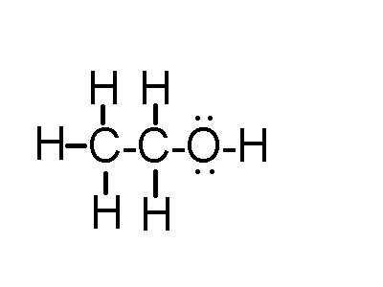
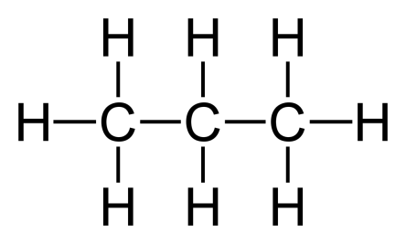
Example: Structure & M.P.
Compound | Propane (C₃H₈) | Ethanal (CH₃COH) | Ethanol (C₂H₅OH)
Lewis structure
M_{r}
Polarity
Intermolecular bonding type
Melting Point (°C)
44
44
46
nonpolar
polar
polar
dispersion
dipole-dipole
H-bonding
-42.2
20.8
78.5

Slide 26
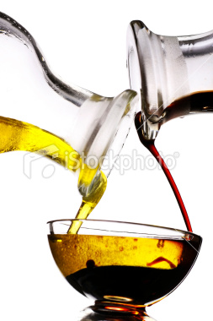
Solubility
“Like dissolves like”
Polar substances tend to dissolve in polar solvents, such as H₂O.
Nonpolar substances tend to dissolve in non-polar solvents, such as heptane or tetrachloromethane.

Slide 27
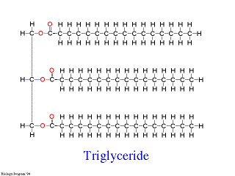
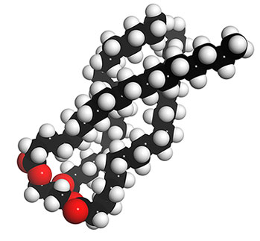
Solubility
Organic molecules often have a polar head and a nonpolar carbon chain tail.

Slide 28
For example, SOAP…
O⁻
CH₂
P
O⁻
CH₂
CH₃
CH₂
CH₂
CH₂
O⁻
CH₂
CH₂

Slide 29
Soap
O⁻
CH₂
P
O⁻
CH₂
CH₃
CH₂
CH₂
CH₂
O⁻
CH₂
CH₂
Hydrophobic non-polar end

Slide 30
Soap
O⁻
CH₂
P
O⁻
CH₂
CH₃
CH₂
CH₂
CH₂
O⁻
CH₂
CH₂
Hydrophilic polar end

Slide 31
O⁻
CH₂
P
O⁻
CH₂
CH₃
CH₂
CH₂
CH₂
O⁻
CH₂
CH₂
_

Slide 32
Think of a drop of grease in water
Grease is non-polar
Water is polar
Soap lets you dissolve the non-polar in the polar
Soap is an emulsifier

Slide 33
Hydrophobic ends dissolve in grease

Slide 34
Hydrophilic ends dissolve in water

Slide 35
Running water washes it all away.

Slide 36
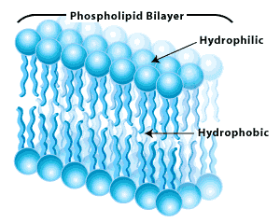
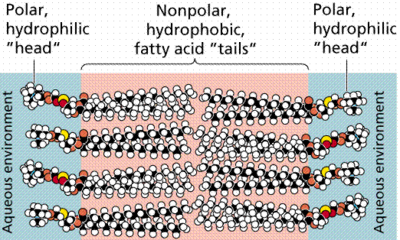
Remember Biology?
Remember something about a phospholipid bilayer making up cell walls?

Slide 37
Solubility
As the nonpolar carbon chain length increases in a homologous series, the molecules become less soluble in water.
CH₃OH
CH₃CH₂OH
CH₃CH₂CH₂OH
Decreasing solubility
CH₃CH₂CH₂CH₂OH
CH₃CH₂CH₂CH₂CH₂OH

Slide 38
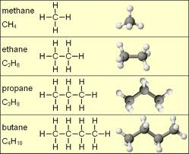
What’s a homologous series
Organic compounds with a similar general formula, possessing similar chemical properties due to the presence of the same functional group, and shows a gradation in physical properties as a result of increase in molecular size and mass.
Another example of a homologous series

Slide 39
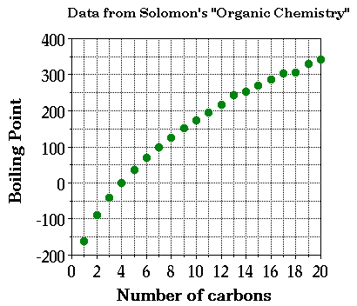
What’s a homologous series
Organic compounds with a similar general formula, possessing similar chemical properties due to the presence of the same functional group, and shows a gradation in physical properties as a result of increase in molecular size and mass.

Slide 40
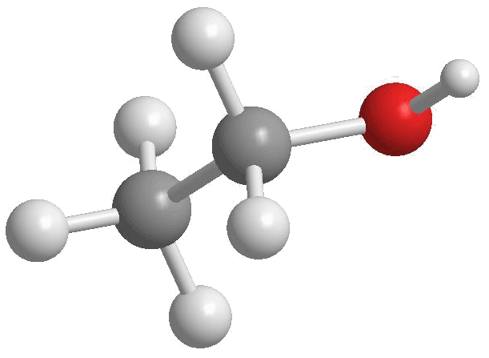
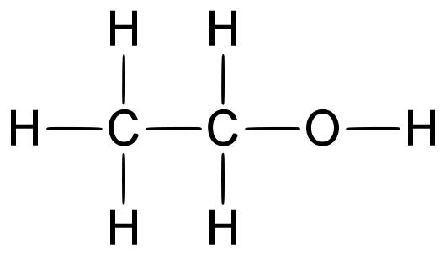
Solubility
Ethanol (C₂H₅OH) is a good solvent for other substances as it contains both polar and nonpolar ends.

Slide 41
Solubility
Example: Put the following substances in order of decreasing solubility in water: methanol, butanol, propanol, ethanol.
CH₃OH
CH₃CH₂CH₂OH
CH₃CH₂CH₂CH₂OH
CH₃CH₂OH
Decreasing solubility
methanol <
ethanol <
propanol <
butanol

Slide 42
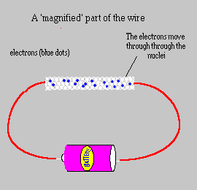
Conductivity
Electricity = electrons moving from atom to atom.
For conductivity to occur, the substance must possess electrons or ions that are free to move.

Slide 43
Conductivity
Metals (and graphite) contain delocalized electrons and are excellent conductors.
Molten ionic salts also conduct electricity, but are chemically decomposed in the process.
When all electrons are held in fixed positions, such as in diamond and in simple molecules, no electrical conductivity occurs.

