Slide 1
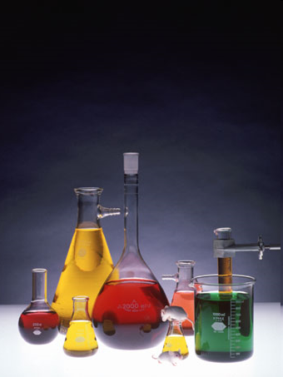
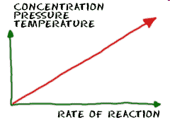
Unit 6: Kinetics
IB Topics 6 & 16
Part 2: Reaction
Order & Half Life

Slide 2
Expressing rxn rates in quantitative terms:

Slide 3
Example: Reaction data for the reaction between butyl chloride (C₄H₉Cl) and water is given below. Calculate the average reaction rate over this time period expressed as moles of C₄H₉Cl consumed per liter per second.
rate
Table 17-1: Molar Concentration
[C₄H₉Cl] at t=0.00 s | [C₄H₉Cl] at t=4.00 s
0.220 M | 0.100 M

Slide 4
Reaction Rate Laws
The equation that expresses the mathematical relationship between the rate of a chemical reaction and the concentration of reactants is a rate law/rate expression.
*where k is a constant specific to this reaction

Slide 5
Two forms of rate laws/expressions:
Differential rate laws: Show how rate depends on concentration.
Sometimes called just the “rate law”.
Integrated rates laws: Shows how the concentration depends on time.

Slide 6
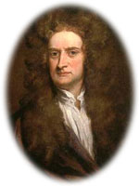
Two forms of rate laws/expressions:
The choice of which rate law to use depends on the type of data that can be collected conveniently and accurately. Once you know one type, the other can be calculated.
Integrated
Differential
This of course requires the use of my calculus.
IB focuses mostly on differential rate laws.
AP students will come back to re-examine integrated rate laws in greater depth later in this course (when we get to IB options)

Slide 7
Reaction Order
The reaction order for a reactant defines how the rate is affected by the concentration of that reactant.
The overall reaction order of a chemical reaction is the sum of the orders for the individual reactants in the rate law.

Slide 8
Reaction Order
In general, the rate is proportional to the product of the concentrations of the reactants, each raised to a power.
For the reaction aA + bB → products,
Rate = k[A]^{m}[B]^{n}

Slide 9
Reaction Order
Rate = k[A]^{m}[B]^{n}
The exponents m and n are called reaction orders.
The value of m is the order of the rxn with respect to A.
The value of n is the order of the rxn with respect to B.
The sum (m + n) is called the overall reaction order.

Slide 10
Reaction Order
For the reaction aA + bB →products,
Rate = k[A]^{m}[B]^{n}
Only if the rxn between A and B happens in a single step (with a single activated complex… which is unlikely) does m=a and n=b.
Thus, the values of m and n must be determined experimentally!!!

Slide 11
Reaction Order
Rate laws cannot be predicted by looking at a balanced chemical equation.

Slide 12
Finding the rate law
The most common method for experimentally determining the differential rate law is the method of initial rates.
In this method several experiments are run at different initial concentrations and the instantaneous rates are determined for each at the same value of time (as near t = 0 as possible)

Slide 13
Using Initial Rates to Determine the Form of the Rate Law
A + B → C
Exp # [A] [B] Initial Rate (M/s)
.100M .100M 4x10⁻⁵
.100M .200M 4x10⁻⁵
.200M .100M 16x10⁻⁵
From this data, find the form of the rate law..
Rate = k[A]^{m}[B]^{n}

Slide 14
Exp # [A] [B] Initial Rate (M/s)
.100M .100M 4x10⁻⁵
.100M .200M 4x10⁻⁵
.200M .100M 16x10⁻⁵
Rate = k[A]^{m}[B]^{n}
n = 0

Slide 15
Exp # [A] [B] Initial Rate (M/s)
.100M .100M 4x10⁻⁵
.100M .200M 4x10⁻⁵
.200M .100M 16x10⁻⁵
Rate = k[A]^{m}[B]^{n}
m = 2

Slide 16
Exp # [A] [B] Initial Rate (M/s)
.100M .100M 4x10⁻⁵
.100M .200M 4x10⁻⁵
.200M .100M 16x10⁻⁵
Rate = k[A]^{m}[B]^{n}
Rate = k[A]²[B]⁰
Rate = k [A]²

Slide 17
Exp # [A] [B] Initial Rate (M/s)
.100M .100M 4x10⁻⁵
.100M .200M 4x10⁻⁵
.200M .100M 16x10⁻⁵
Now, solve for k…
rate = k [A]²
Units of k???
rate = 4x10⁻³ [A]²

Slide 18
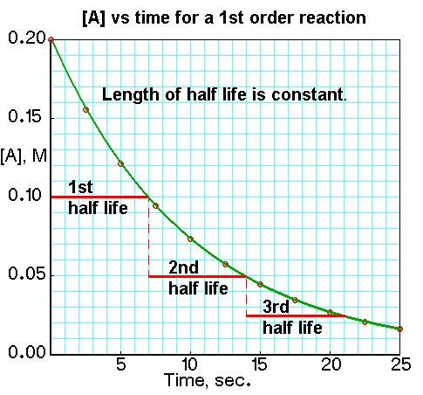
Knowing rate laws and rxn orders helps us predict how the reaction will proceed over time
Application:
Radioactive decay is a first order reaction
Half life is constant over time
Allows us to date fossils, etc.

Slide 19
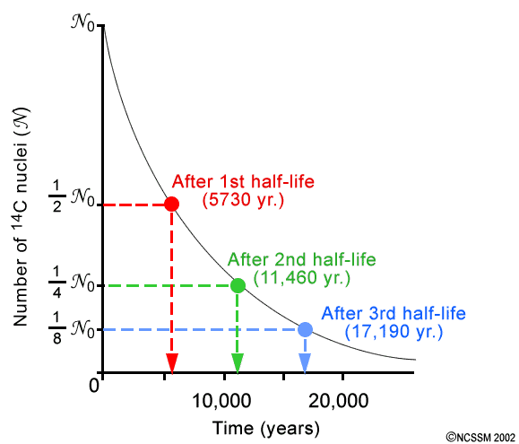
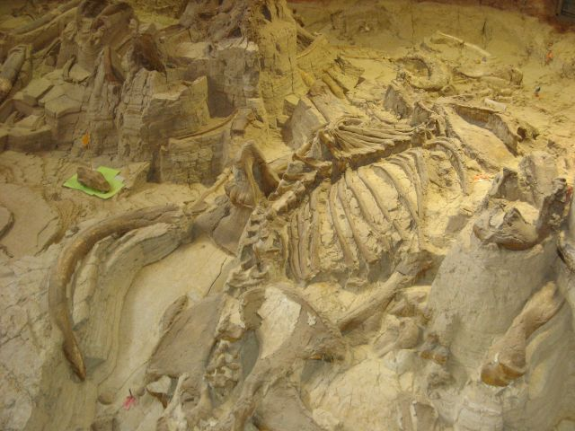
C-14 decay

Slide 20
Deriving a rate expression by inspection of data
While being so thorough is nice, you will have very limited time on your exams, so instead of showing all that work you may wish to solve by inspection and justify your answer in words…

Slide 21
Example: Experimental data obtained from the reaction between hydrogen and nitrogen monoxide at 1073 K is listed below. Determine the rate expression and the value of the rate constant, k.
2H₂(g) + 2NO(g) → 2H₂O(g) + N₂(g)
Experiment | Initial conc. of H₂(g) (mol dm⁻³) | Initial conc. of NO(g) (mol dm⁻³) | Initial rate of formation of N₂(g) (mol dm⁻³)
1 | 1 x 10⁻³ | 6 x 10⁻³ | 3.0 x 10⁻³
2 | 2 x 10⁻³ | 6 x 10⁻³ | 6.0 x 10⁻³
3 | 6 x 10⁻³ | 1 x 10⁻³ | 0.5 x 10⁻³
4 | 6 x 10⁻³ | 2 x 10⁻³ | 2.0 x 10⁻³

Slide 22
Think about it…
If a reaction is 1st order with respect to a reactant, then the effect of doubling that reactant conc. (while holding the other constant) is a doubling (2¹=2) of the rate. Tripling the reactant conc. will triple (3¹=3) the rate and so on.
If a reaction is 2nd order with respect to a reactant, then the effect of doubling that reactant conc. is a quadrupling (2²=4) of the rate. Tripling the reactant conc. will cause the rate to become 6 times faster (3²=6) and so on.
Note: If a reaction is zeroth order w/ respect to a reactant, then changing its concentration will have no effect on the rate of reaction. (2⁰=1; 3⁰=1, etc., so the rate will remain unchanged even if reactant concentration changes).

Slide 23
Example: Experimental data obtained from the reaction between hydrogen and nitrogen monoxide at 1073 K is listed below. Determine the rate expression and the value of the rate constant, k.
2H₂(g) + 2NO(g) → 2H₂O(g) + N₂(g)
Experiment | Initial conc. of H₂(g) (mol dm⁻³) | Initial conc. of NO(g) (mol dm⁻³) | Initial rate of formation of N₂(g) (mol dm⁻³ s⁻¹)
1 | 1 x 10⁻³ | 6 x 10⁻³ | 3.0 x 10⁻³
2 | 2 x 10⁻³ | 6 x 10⁻³ | 6.0 x 10⁻³
3 | 6 x 10⁻³ | 1 x 10⁻³ | 0.5 x 10⁻³
4 | 6 x 10⁻³ | 2 x 10⁻³ | 2.0 x 10⁻³
From exp. 1 & 2: doubling [H₂] doubles the rate ∴ the rxn is 1st order w/ respect to H₂
From exp. 3 & 4: doubling [NO] quadruples rate ∴ the rxn is 2st order w/ respect to NO
rate = k[H₂][NO]²

Slide 24
Example: Experimental data obtained from the reaction between hydrogen and nitrogen monoxide at 1073 K is listed below. Determine the rate expression and the value of the rate constant, k.
2H₂(g) + 2NO(g) → 2H₂O(g) + N₂(g)
Experiment | Initial conc. of H₂(g) (mol dm⁻³) | Initial conc. of NO(g) (mol dm⁻³) | Initial rate of formation of N₂(g) (mol dm⁻³ s⁻¹)
1 | 1 x 10⁻³ | 6 x 10⁻³ | 3.0 x 10⁻³
2 | 2 x 10⁻³ | 6 x 10⁻³ | 6.0 x 10⁻³
3 | 6 x 10⁻³ | 1 x 10⁻³ | 0.5 x 10⁻³
4 | 6 x 10⁻³ | 2 x 10⁻³ | 2.0 x 10⁻³
rate = k[H₂][NO]²
3.0E-3 mol dm⁻³ s⁻¹ = k(1E-3 mol dm⁻³)(6E-3 mol dm⁻³)²
k = 8.33 x 10⁻⁴ dm⁶ mol⁻² s⁻¹

Slide 25
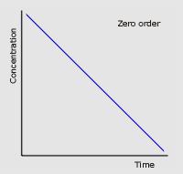
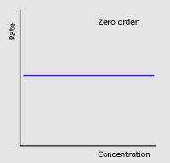
Graphical representations of reaction kinetics
Zero-order reaction
rate = k[A]⁰ or rate = k
Concentration of reactant A does not affect the rate of rxn.

Slide 26
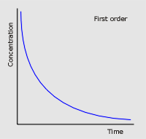
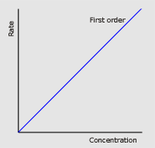
Graphical representations of reaction kinetics
First-order reaction
rate = k[A]
Rate is directly proportional to the concentration of reactant A.

Slide 27
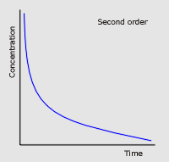
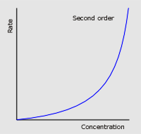
Graphical representations of reaction kinetics
Second-order reaction
rate = k[A]²
Rate is directly proportional to the concentration of reactant A.

Slide 28
To review (know these)…

Slide 29
Half-life, t_{½}
First order reactions have a constant half-life.
See 12.4 if you are interested in the derivation of this equation.
This equation is in the IB data booklet.

Slide 30
Half-life, t_{½}
Constant half-life is a feature of only first order reaction kinetics, so it can be used to establish that a reaction is first order with respect to that reactant.

Slide 31
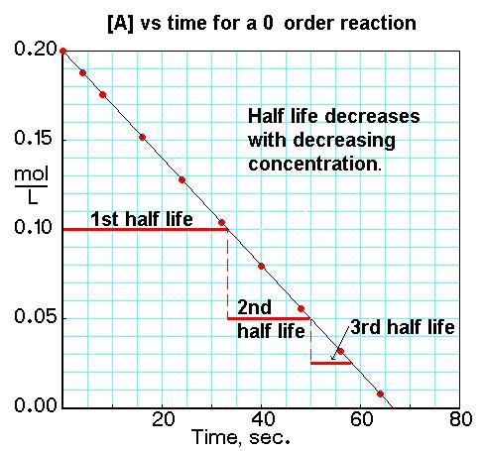
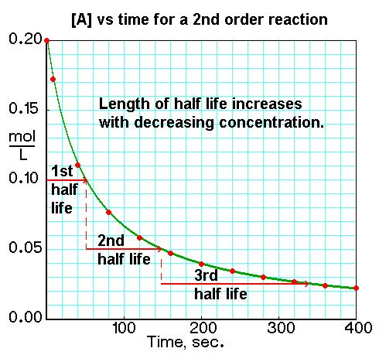
Half-life, t_{½}

Slide 32
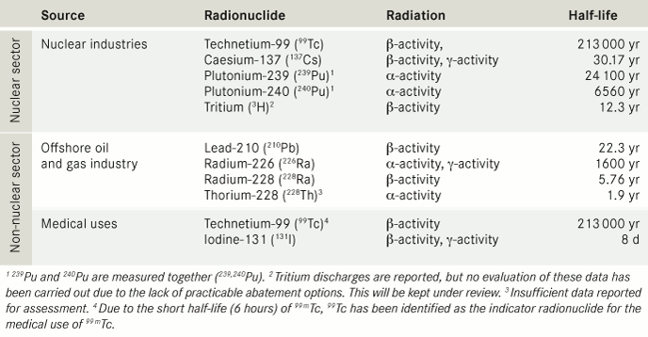
Half-life, t_{½}
The shorter the value of the half-life, the faster the reaction.

Slide 33
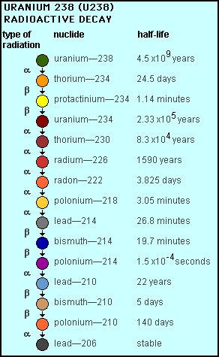
Half-life, t_{½}
Radioactive decay reactions follow first-order kinetics and are often described in terms of the half-life of the isotopes involved.

Slide 34
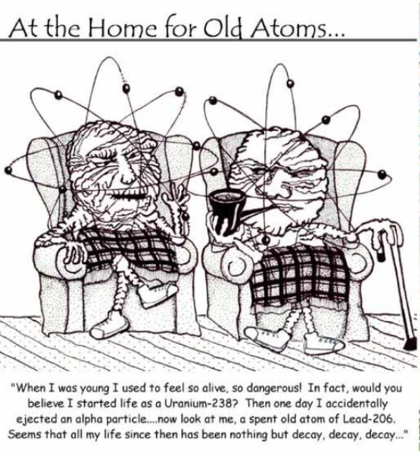

Slide 35
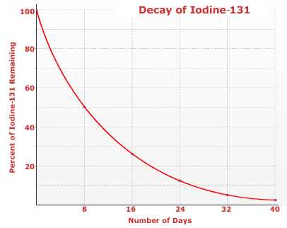
Half-life, t_{½}
For example, iodine-131, a radioisotope used in the diagnosis and treatment of thyroid cancer, has a constant half-life of 8 days.

