Slide 1
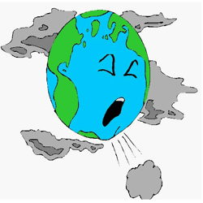

Environmental Chemistry
IB Option E
Part 1: Atmospheric Pollution

Slide 2

Unpolluted Air
78% N₂
21% O₂
1.0% Ar
0.03% CO₂

Slide 3

AIR POLLUTION
Primary air pollutants – harmful substances released into the air that are not normally present
Secondary air pollutants – harmful compounds formed when primary pollutants react in air

Slide 4
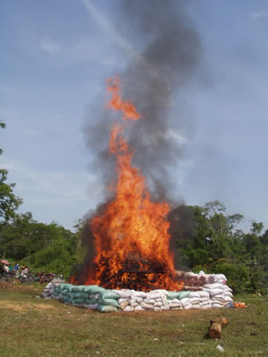
Carbon monoxide (CO)
Natural Source:
  Incomplete oxidation of methane
  CH₄ + 1½O₂ → CO + 2H₂O

Slide 5
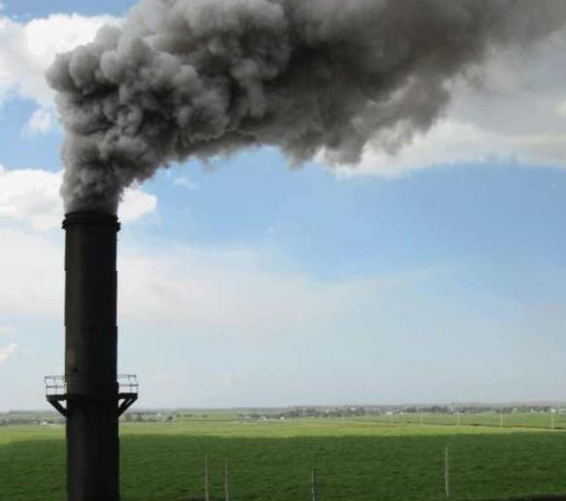
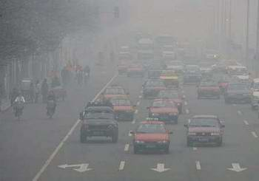
Carbon monoxide (CO)
Anthropogenic (man-made) Source:
  Incomplete combustion of fossil fuels
  Ex: C₈H₁₈ + 8½O₂ → 8CO + 9H₂O

Slide 6

Carbon monoxide (CO)
Effect on health:
  Prevents hemoglobin from carrying oxygen by forming carboxyhemoglobin

Slide 7
Carbon monoxide (CO)
Methods of reduction:
  Use of lean burn engine
  Thermal exhaust reactor
  Catalytic converter

Slide 8
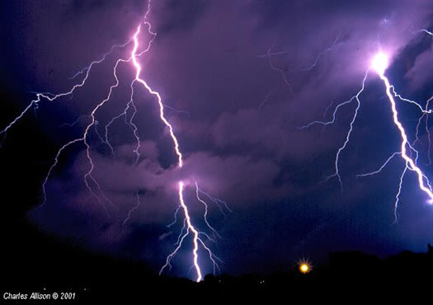
Oxides of nitrogen - NO_{x}
Natural Source:
  Electrical storms and biological processes

Slide 9
Oxides of nitrogen - NO_{x}
Anthropogenic (man-made) Source:
  At high temperatures inside internal combustion engines
  N₂ + O₂ → 2NO

Slide 10
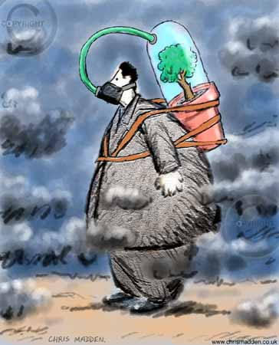
Oxides of nitrogen - NO_{x}
Effect on health:
  Respiratory irritant leading to respiratory tract infections

Slide 11
Oxides of nitrogen - NO_{x}
Methods of reduction:
  Use of lean burn engine
  Recirculation of exhaust gases
  Catalytic converter

Slide 12
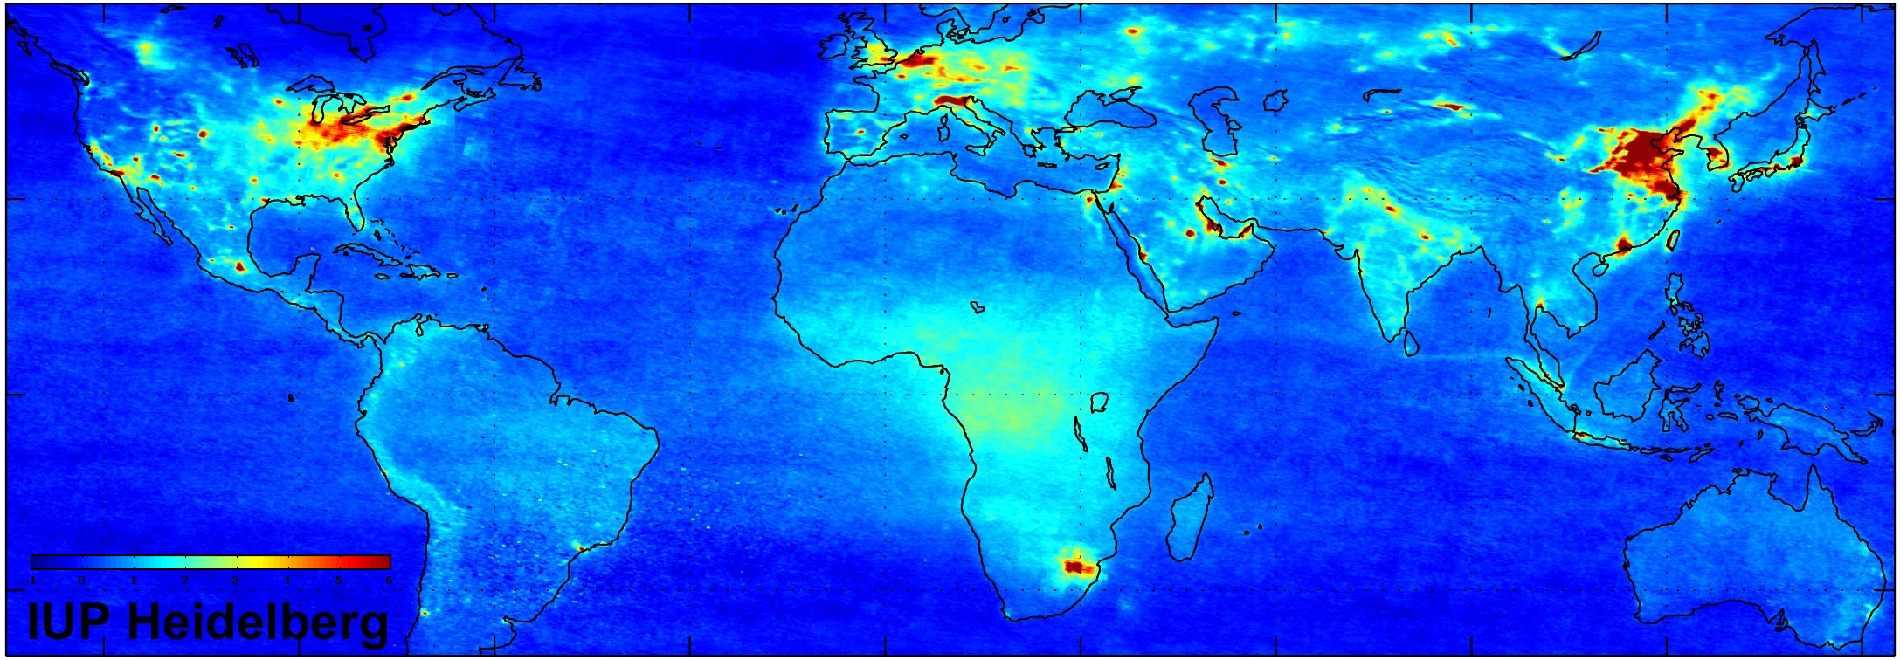
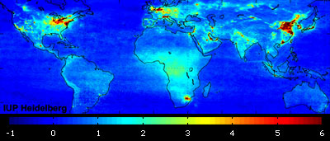
Global air pollution (NASA)

Slide 13
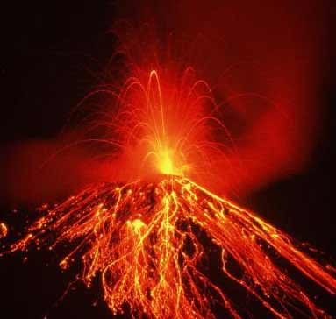
Oxides of sulfur - SO_{x}
Natural Source:
  Oxidation of H₂S produced by volcanoes
  Decay of organic matter

Slide 14
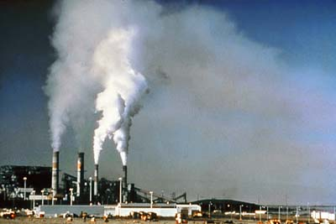
Oxides of sulfur - SO_{x}
Anthropogenic (man-made) Source:
  Combustion of sulfur-containing coal
  Smelting of sulfide ores
  S + O₂ → SO₂

Slide 15
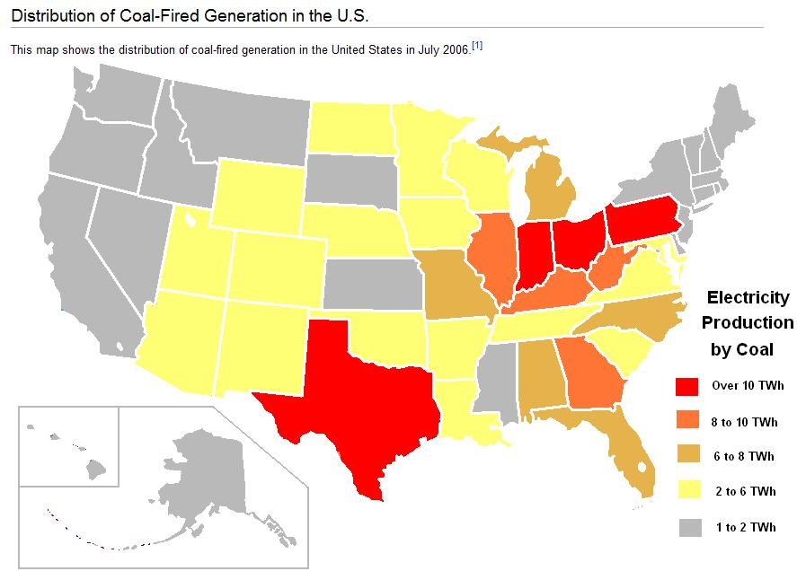

Slide 16

Oxides of sulfur - SO_{x}
Effect on health:
  Respiratory irritant leading to respiratory tract infections

Slide 17
Oxides of sulfur - SO_{x}
Methods of reduction:
  Removal of sulfur from fossil fuels before combustion
  Alkaline scrubbing
  Fluidized bed combustion

Slide 18
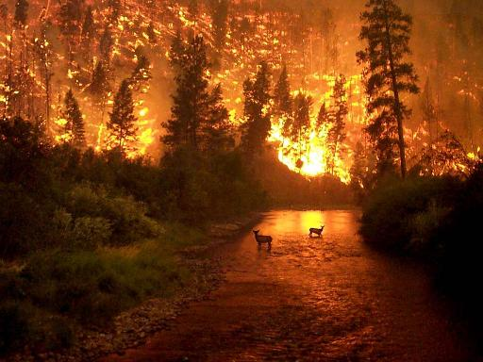
Particulates
Natural Sources:
  Soot
  Ash
  Dust
  Asbestos
  Sand
  Smoke
  Pollen
  Bacterial & fungal spores

Slide 19
Particulates
Anthropogenic (man-made) Source:
  Burning of fossil fuels, particularly coal and diesel

Slide 20
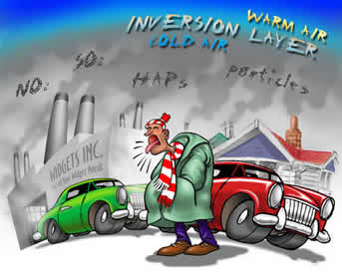
Particulates
Effect on health:
  Can affect the respiratory system and cause lung diseases, such as emphysema, bronchitis, and cancer

Slide 21
Particulates
Methods of reduction:
  Sedimentation chambers
  Electrostatic precipitation

Slide 22

Volatile organic compounds - VOCs
Natural Source:
  Plants (i.e. rice)
    Many plants emit unsaturated hydrocarbons called terpenes

Slide 23

Volatile organic compounds - VOCs
Anthropogenic (man-made) Source:
  Unburned or partially burned gasoline and other fuels
  Industrial solvents

Slide 24
Volatile organic compounds - VOCs
Effect on health:
  Some (i.e. benzene) are carcinogenic.
  Can form toxic secondary pollutants (i.e. PANs, a.k.a. peroxyacyolnitrates)

Slide 25
Volatile organic compounds - VOCs
Methods of reduction:
  Catalytic converter

Slide 26
Thermal exhaust reactor
Exhaust from the car engine is combined with more air and reacts due to the heat of the exhaust gases. CO is converted into CO₂ and unburned hydrocarbons are also combusted.
2CO(g) + O₂(g) → 2CO₂(g)

Slide 27
Lean burn engines
By adjusting the carburetor the ratio of air:fuel can be altered. The higher the ratio the less CO emitted as more complete combustion occurs.
Unfortunately, this produces higher temperatures so more NO_{x} is produced.
At lower ratios less NO_{x} but more CO will be emitted.

Slide 28
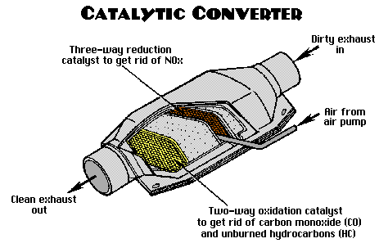
Catalytic converter
The hot exhaust gases are passed over a catalyst of platinum, rhodium or palladium. These fully oxidize CO and unburned VOCs, and also catalyze the rxn between CO and NO.
2CO(g) + 2NO(g) → 2CO₂(g)

Slide 29
Alkaline scrubbing & limestone-based fluidized beds
Some sulfur is present in coal as metal sulfides (i.e. FeS) and can be physically removed by crushing coal and mixing with water. The more dense sulfides sink to the bottom and the cleaned coal can be skimmed off. Sulfur is also removed from oil before it is refined by converting it into hydrogen sulfide (H₂S).

Slide 30
Alkaline scrubbing & limestone-based fluidized beds
Sulfur dioxide (SO₂) can be removed from the exhaust of coal burning plants by “scrubbing” with an alkaline slurry of limestone (CaCO₃) and lime (CaO). The resulting sludge is used for landfill or as gypsum (CaSO₄⋅2H₂O) to make plasterboard (drywall).
CaCO₃(s) + SO₂(g) → CaSO₃(s) + CO₂(g)
CaO(s) + SO₂(g) → CaSO₃(s)
2CaSO₃(s) + O₂(g) + 4H₂O(g) →2CaSO₄⋅2H₂O(s)

Slide 31
Alkaline scrubbing & limestone-based fluidized beds
CaCO₃(s) + SO₂(g) → CaSO₃(s) + CO₂(g)
CaO(s) + SO₂(g) → CaSO₃(s)
2CaSO₃(s) + O₂(g) + 4H₂O(g) →2CaSO₄⋅2H₂O(s)

Slide 32
Wet alkaline scrubber

Slide 33
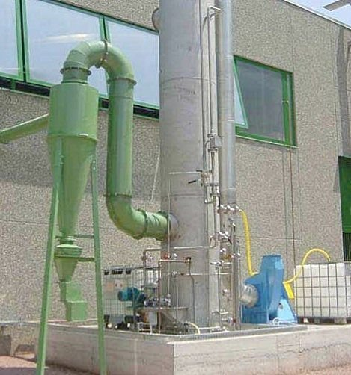
Wet scrubber

Slide 34
Alkaline scrubbing & limestone-based fluidized beds
A more modern method known as fluidized bed combustion involves burning the coal on a bed of limestone which removes the sulfur as CaSO₃ or CaSO₄ as the coal burns.

Slide 35
Electrostatic precipitation
Particulates are solid or liquid particles suspended in the air. Larger particles can be allowed to settle under the influence of gravity in sedimentation chambers.
For smaller particles, an electrostatic precipitation chamber can be used. The charged particulates are attracted to the oppositely charged electrodes, which are shaken periodically so that aggregated particulates fall to the bottom of the precipitator where they can be removed.

Slide 36
Electrostatic precipitator
(dry scrubber)

Slide 37
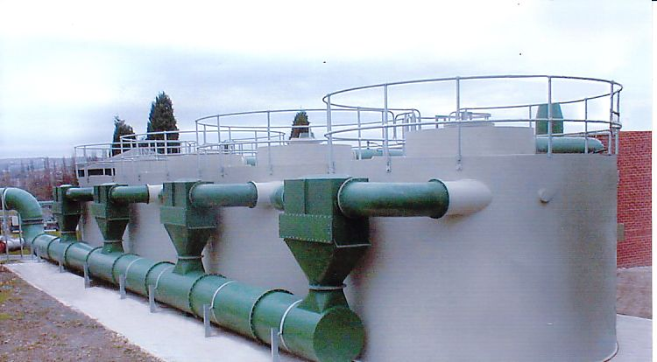
Dry scrubbers

Slide 38


Acid deposition
Acid deposition refers to the process by which acidic particles, gases and precipitation leave the atmosphere.

Slide 39
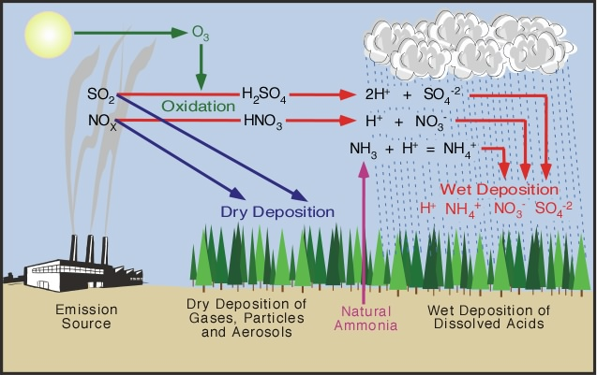
Acid deposition
Both wet deposition (acid rain, fog and snow) and dry deposition (acidic gases and particles) occur.

Slide 40
Acid deposition
Rain is naturally acidic because of dissolved CO₂, but acid rain has a pH of <5.6.
True acid deposition is caused by oxides of nitrogen and oxides of sulfur

Slide 41
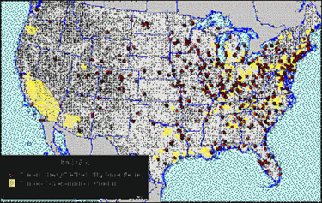
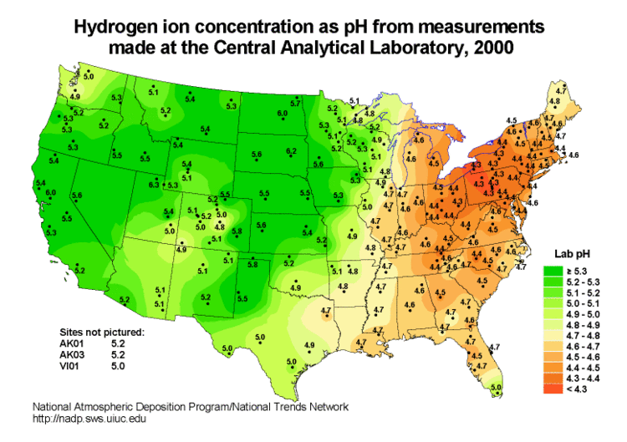
Acid deposition
Coal plants
True acid deposition is caused by oxides of nitrogen and oxides of sulfur (NO_{x} & SO_{x})

Slide 42
Oxides of Sulfur (SO_{x})
(Memorize rxns.)
Sulfur dioxide occurs naturally from volcanoes and is produced industrially from the combustion of sulfur-containing fossil fuels and the smelting of sulfide ores.
  S(s) + O₂(g) → SO₂(g)
In the presence of sunlight, sulfur dioxide is oxidized to sulfur trioxide.
  SO₂(g) + ½O₂(g) → SO₃(g)
The oxides can react with water in the air to form sulfurous acid and sulfuric acid:
  SO₂(g) + H₂O(l) → H₂SO₃(aq) and
  SO₃(g) + H₂O(l) → H₂SO₄(aq)

Slide 43
Oxides of Nitrogen (NOx)
(Memorize rxns.)
Nitrogen oxides occur naturally from electrical storms and bacterial action. Nitrogen monoxide is produced in the internal combustion engine and in jet engines.
  N₂(g) + O₂(g) → 2NO(g)
Oxidation to nitrogen dioxide occurs in the air.
  NO(g) + ½O₂(g) → NO₂(g)
The nitrogen dioxide then reacts with water to form nitric acid and nitrous acid:
  2NO₂(g) + H₂O(l) → HNO₃(aq) + HNO₂(aq)
…or is oxidized directly to nitric acid by oxygen in the presence of water:
  4NO₂(g) + O₂(g) + 2H₂O(l) → 4HNO₃(aq)

Slide 44
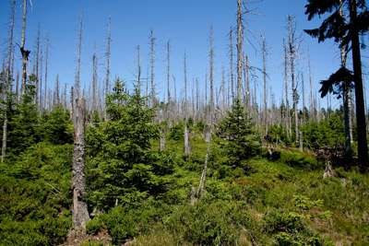
Environmental Effects on Vegetation
Increased acidity in soil leaches important nutrients (Ca²⁺, Mg²⁺ and K⁺).
Reduction of Mg²⁺ can cause reduction in chlorophyll (lowers the ability of plants to photosynthesize).
Many trees have been seriously affected by acid rain. Symptoms include stunted growth, thinning of tree tops, and yellowing and loss of leaves.
The main cause is the aluminum leached from rocks into the groundwater. The Al³⁺ ion damages the roots and prevents the tree from taking up enough water and nutrients to survive.

Slide 45
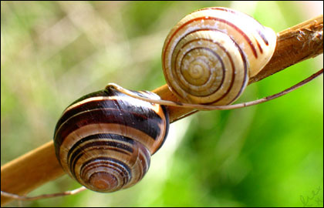
Environmental Effects on Lakes/Rivers
Increased levels of Al³⁺(aq) can kill fish.
Aquatic life is also highly sensitive to pH. Below pH 6 the number of sensitive fish, such as salmon and minnow, decline as do insect larvae and algae.
Snails cannot survive a pH less than 5.2

Slide 46
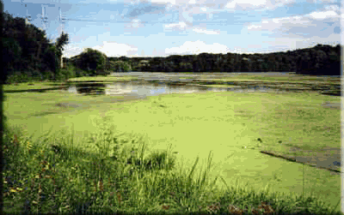
Environmental Effects on Lakes/Rivers
Below pH 5.0 many microscopic animal species disappear.
Below pH 4.0 lakes are effectively dead.
The nitrates present in acid rain can also lead to eutrophication.

Slide 47
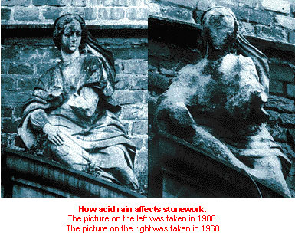
Environmental Effects on Buildings
Stone, such as marble, that contains calcium carbonate is eroded by acid rain.

Slide 48
Environmental Effects on Buildings
With the sulfuric acid the calcium carbonate reacts to form calcium sulfate, which can be washed away by rainwater thus exposing more stone to corrosion.
CaCO₃(s) + H₂SO₄(aq) → CaSO₄(aq) + CO₂(g) + H₂O(l)
Salts can also from within the stone that can cause the stone to crack and disintegrate.

Slide 49
Environmental Effects on Human Health
Acids formed when NOx and SOx dissolve in water
  irritate mucus membranes
  increase the risk of respiratory illness (asthma, bronchitis, emphysema)
In acidic water there is more probability of poisonous ions, such as Cu²⁺ and Pb²⁺, leaching from pipes
High levels of aluminum in water may be linked to Alzheimer’s disease

Slide 50
Methods to lower or counteract the effects of acid deposition
Lower the amounts of NOx and SOx formed (i.e. by improved engine design, use of catalytic converters, and removing sulfur before, during and after combustion of sulfur-containing fuels.)

Slide 51
Methods to lower or counteract the effects of acid deposition
Switch to alternative methods of energy (i.e. wind and solar power) and reducing the amount of fuel burned (i.e. by reducing private transport and increasing public transport and designing more efficient power stations)

Slide 52
Methods to lower or counteract the effects of acid deposition
Liming of lakes – adding calcium oxide or calcium hydroxide (lime) neutralizes acidity, increases the amount of calcium ions and precipitates aluminum from solution. This has been shown to be effective in many, but not all, lakes where it has been tried.

Slide 53

Mechanism of acid deposition caused by NOx and SOx (memorize these rxns.)
In the atmosphere, NOx and SOx are converted into acids by a free radical mechanism involving hydroxyl free radicals, OH•.

Slide 54
Mechanism of acid deposition caused by NOx and SOx (memorize these rxns.)
These hydroxyl free radicals are formed either by the reaction of water vapor with ozone
  H₂O(g)+ O₃(g) → 2HO•(g) + O₂(aq)
…or by the reaction of water vapor with oxygen free radicals that are formed when ozone decomposes.
  H₂O(g)+ O•(g) → 2HO•(g)

Slide 55
Mechanism of acid deposition caused by NOx and SOx (memorize these rxns.)
The hydroxyl radicals then react directly with NOx and SOx in the presence of water to give the dissolved acids.
  HO•(g)+ NO₂(g) → HNO₃(aq)
  HO•(g)+ NO(g) → HNO₂(aq)
  HO•(g)+ SO₂(g) → HOSO₂•(g)

Slide 56
Mechanism of acid deposition caused by NOx and SOx (memorize these rxns.)
Then…
  HOSO₂•(g) + O₂(g) → HO₂•(g)+ SO₃(g)
Followed by…
  SO₃(g) + H₂O(l) → H₂SO₄(aq)

Slide 57
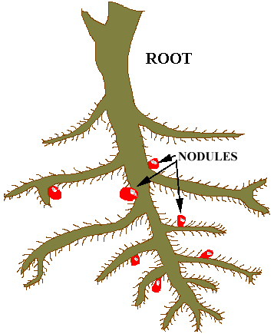
The role of ammonia in acid deposition
The atmosphere contains trace amounts of ammonia.
Ammonia can also be found in the soil due to the action of certain bacteria known as rhizobia.
  These can be found in the root nodules of leguminous plants such as peas, beans, soy and clover.

Slide 58
The role of ammonia in acid deposition
The ammonia in the atmosphere can to some extent neutralize the acids to form ammonium sulfate, (NH₄)₂SO₄, and ammonium nitrate, NH₄NO₃.
  These ammonium salts, which are the product of a weak base and a strong acid, are slightly acidic.
  As they sink to the ground or are washed out by precipitation the ammonium ion is deposited and enters the soil where acidification and nitrification can occur.

