Slide 1
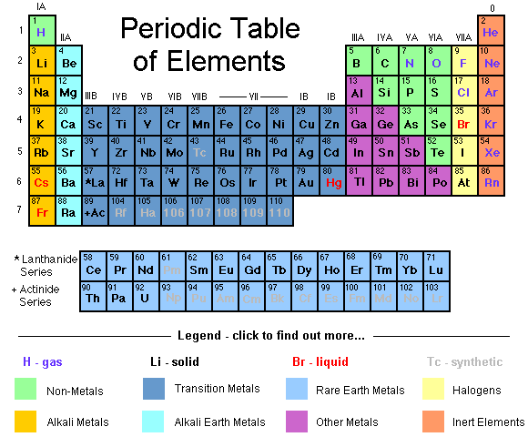
UNIT 3: Periodicity
IB Topics 3 & 13

Slide 2
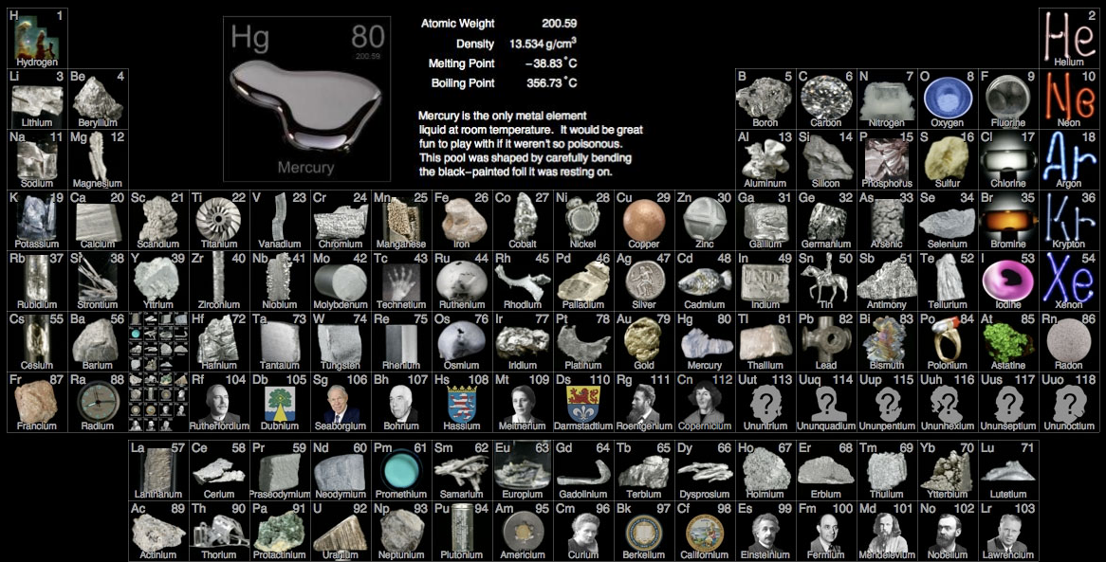
Part 1: The Periodic Table and Physical Properties

Slide 3
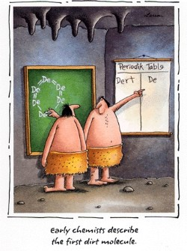

Slide 4
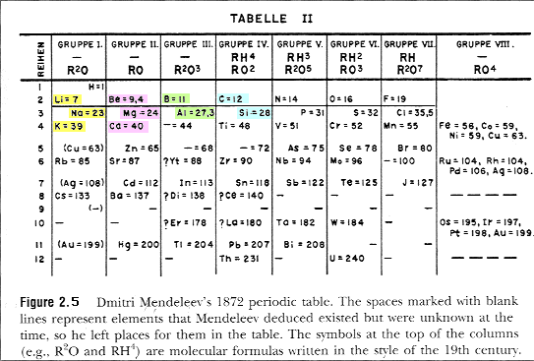
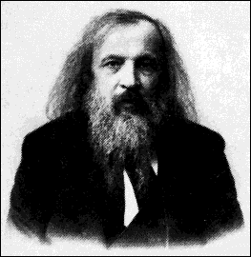
Mendeleev’s Periodic Table
Dmitri Mendeleev

Slide 5
Modern Russian Table

Slide 6
Chinese Periodic Table

Slide 7
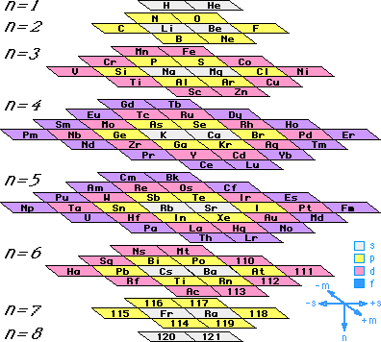
Stowe Periodic Table
This is Timothy Stowe's physicists’ periodic table. This table depicts periodicity in terms of quantum numbers.

Slide 8
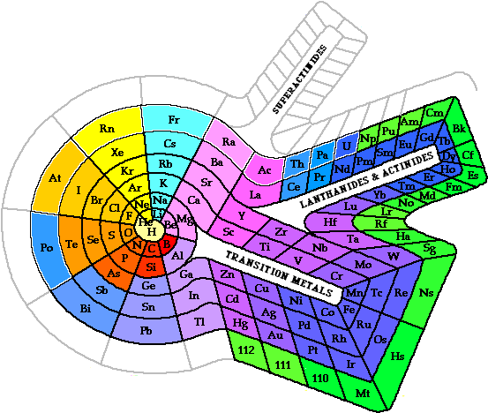
A Spiral Periodic Table
This example was devised by Theodor Benfey and depicts the elements as a seamless series with the main group elements radiating from the center with the d- and f-elements filling around loops.

Slide 9
Triangular Periodic Table
Based on the work of Emil Zmaczynski and graphically reflects the process of the construction of electronic shells of atoms.

Slide 10
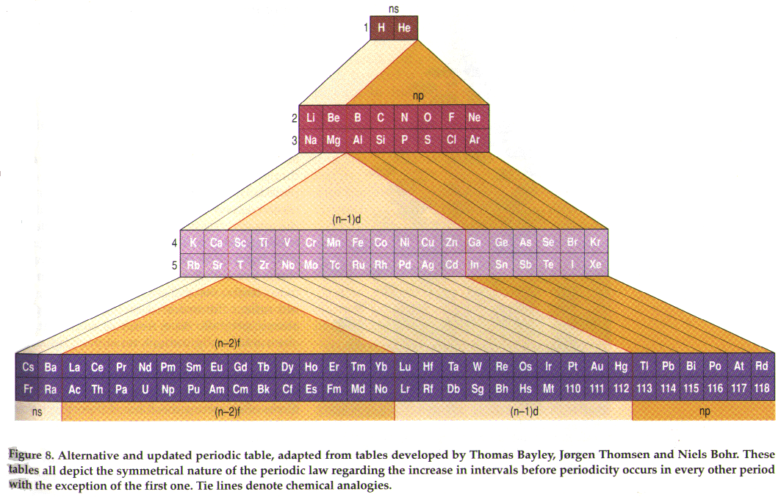

Slide 11
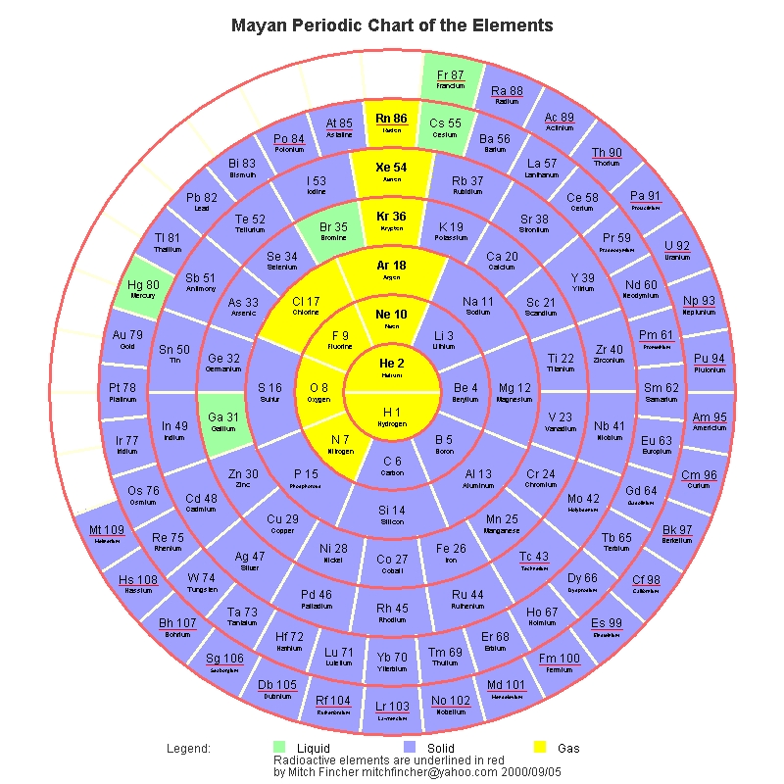
“Mayan” Periodic Table

Slide 12
Giguere Periodic Table
This is a 3-D periodic table constructed by Paul Giguere based primarily on the electronic structure of the atoms. The four main groups of elements are separated according to the type of atomic orbitals being filled. This animated graphic may take a few moments to load.

Slide 13
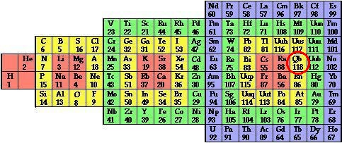

Slide 14
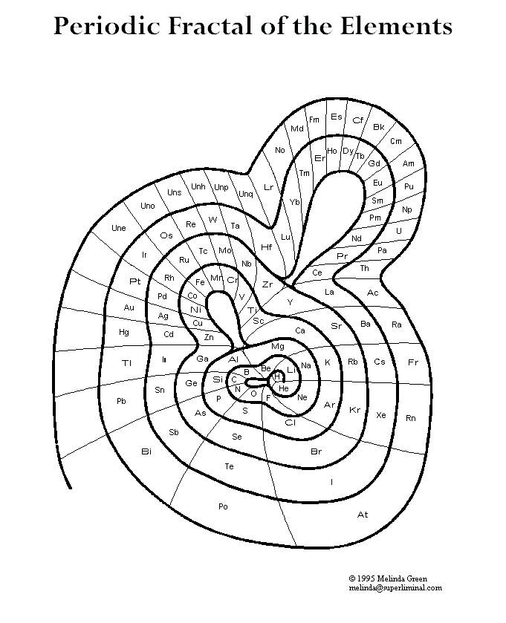

Slide 15
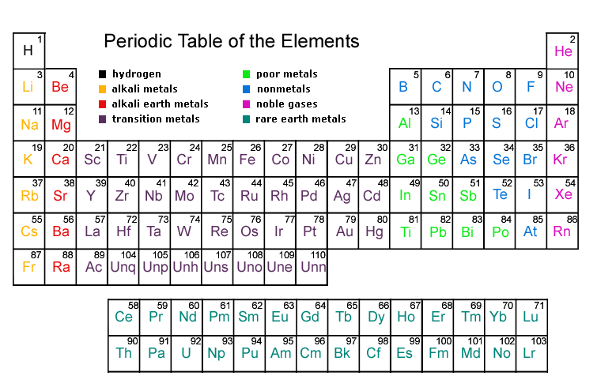
Periodic Table

Slide 16
Periodic Table
Group: elements with same number of valence electrons and therefore similar chemical and physical properties; vertical column of elements (“family”)
Period: elements with same outer shell; horizontal row of elements
Periodicity: regular variations (or patterns) of properties with increasing atomic weight. Both chemical and physical properties vary in a periodic (repeating pattern) across a period.

Slide 17
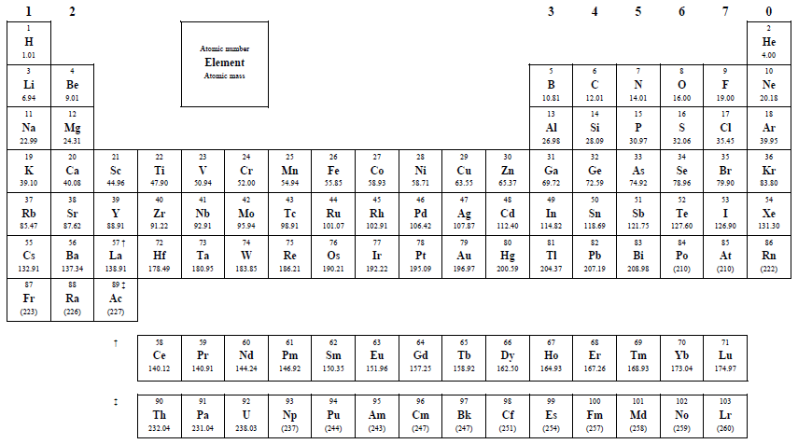
Periodic Table
From the IB Data Booklet…
0 or 8
Transition metals
Lanthanides
Actinides

Slide 18
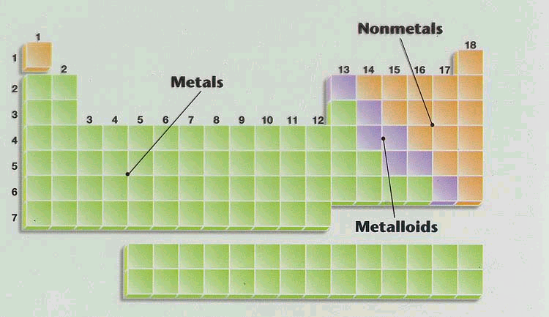
Another name for “metalloid” is “semi-metal”.

Slide 19
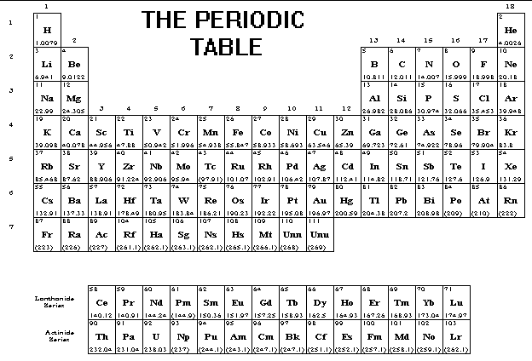
Transition metals
noble gases
alkali metals
halogens
alkaline earth metals
lanthanides
actinides

Slide 20
PERIODIC GROUPS
alkali metals
alkaline earth metals
transition metals
halogens
noble gases
lanthanides
actinides

Slide 21
Alkali Metals
Group 1 on periodic table
Called alkali metals because they all react with water to form an alkali solution of the metal hydroxide and hydrogen gas.
i.e. Na(s) + H₂O(l) → NaOH(aq) + H₂(g)
React by losing outer electron to form the metal ion
Good reducing agents (because they can readily lose an electron)

Slide 22
Alkaline Earth Metals
Group 2 on periodic table
Abundant metals in the earth
Not as reactive as alkali metals
Higher density and melting point than alkali metals

Slide 23
Transition Metals
Variable valency & oxidation state
Forms colored compounds
Forms complex ions
Catalytic behavior
Need to know these well, but more on all this later…

Slide 24
Halogens
Group 7 on periodic table
Referred to as group 17 or group VIIA on other periodic tables
React by gaining one more electrons to from halide ions
Good oxidizing agents (because they readily gain an electron)

Slide 25
Noble Gases
Group 0 (or 8) on periodic table
Referred to as group 18 or group VIIIA on other periodic tables
Sometimes called rare gases or inert gases
Relatively nonreactive
Gases at room temperature

Slide 26
Lanthanides
Part of the “inner transition metals”
Soft silvery metals
Tarnish readily in air
React slowly with water
Difficult to separate because all have two effective valence electrons

Slide 27
Actinides
Radioactive elements
Part of the “inner transition metals”

Slide 28
PERIODIC TRENDS
Properties that have a definite trend as you move through the Periodic Table
Valence Electrons
Atomic radii
Ionic radii
Electronegativity
Ionization energy
Melting points

Slide 29
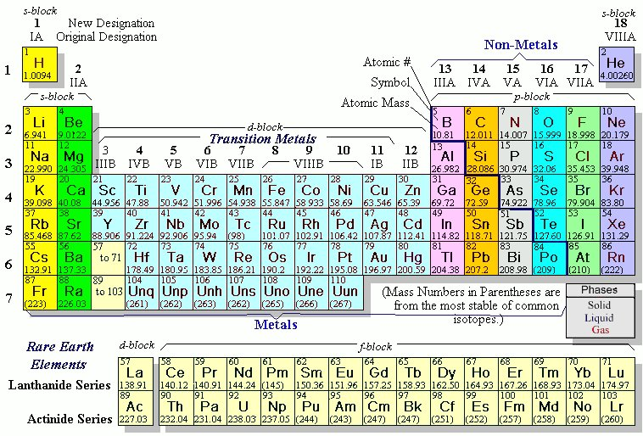
The periodic table is full of repeating patterns.
Hence the name periodic table.

Slide 30
The electrons in the outermost electron shell (highest energy level) are called valence electrons.
“vale” = Latin to be strong
Most chemical reactions occur as valence electrons seek a stable configuration.
(full energy level, and to a lesser extent ½ full)
Non Valence electrons are called “core electrons”. Core electrons are relatively stable.

Slide 31
Valence Electrons
Consider Chlorine: 17 electrons
1s²2s²2p⁶3s²3p⁵

Slide 32
Valence Electrons
Consider Chlorine: 17 electrons
1s²2s²2p⁶3s²3p⁵
Core Electrons
Valence Electrons

Slide 33
Valence Electrons
Consider Chlorine: 17 electrons
1s²2s²2p⁶3s²3p⁵
Core Electrons
Valence Electrons
Consider Cadmium: 48 electrons
1s²2s²2p⁶3s²3p⁶4s²3d¹⁰4p⁶5s²4d¹⁰

Slide 34
Valence Electrons
Consider Chlorine: 17 electrons
1s²2s²2p⁶3s²3p⁵
Core Electrons
7 Valence Electrons
Consider Cadmium: 48 electrons
1s²2s²2p⁶3s²3p⁶4s²3d¹⁰4p⁶5s²4d¹⁰
[Kr]5s²4d¹⁰
2 Valence Electrons

Slide 35
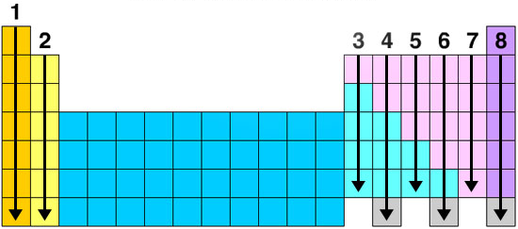
For the tall groups the column number is the number of valence electrons.

Slide 36
General Concepts
Gen. Concepts ret.

Slide 37
Many periodic trends can be explained by…
How many protons are in the nucleus (nuclear charge)
How far the outer electrons are from the nucleus (number of shells)
How many core electrons are between the outer electrons and the nucleus (amount of shielding)

Slide 38
And now for a shameful, but hopefully memorable, Hollywood analogy…

Slide 39
Let’s say, hypothetically speaking, that Tom Cruise was attracted to Katie Holmes.
Katie Holmes
Tom Cruise

Slide 40
Ok… not so hypothetical. We all remember when Tom let Oprah know how enthusiastically he was attracted to her (LOTS of love in his heart)…

Slide 41
Now, if they were in a room, just the two of them, that attraction would be very strong.

Slide 42
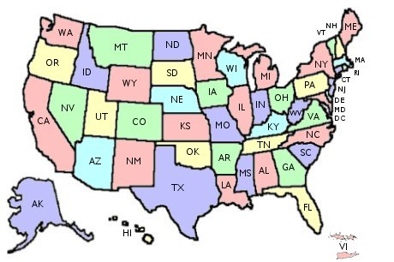
If they’re far apart, he’s still attracted to her, but much less. Let’s say it’s a bit of the “out of site, out of mind” effect.

Slide 43
If there’s lots of other guys between them, they interfere and his attraction is less. Katie gets distracted by the attractive guys that are closer to her, and they shield her attraction to Tom.

Slide 44
Now let’s apply these
concepts to atoms…

Slide 45
Consider Hydrogen v. Helium…
+1
electron
Hydrogen

Slide 46
Consider Hydrogen v. Helium…
+1
electron
Hydrogen
+2
Greater (+) Charge in the nucleus produces stronger attraction.
Helium
All orbitals get smaller as protons are added to the nucleus.

Slide 47
Also…
Repulsion
Repulsion
Attraction
Electrons are attracted to the nucleus, but are repelled by the “screening” core electrons.
+

Slide 48
Attraction
If the electron is further away, the attraction force is much less.
+

Slide 49
Electron attraction to the nucleus depends on…
How many protons are in the nucleus
How far the electron is from the nucleus
How many core electrons are between the electron and the nucleus
(♥How much love is in Tom’s heart♥)
(How far Tom and Katie are apart)
(How many other Hollywood guys come between them)

Slide 50
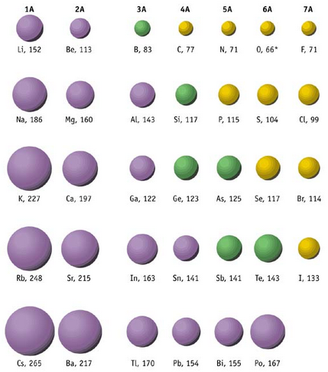
Atomic Radii
The atomic radius is the distance from the nucleus to the outermost electron.
Since the position of the outermost electron can never be known precisely, the atomic radius is usually defined as half the distance between the nuclei of two bonded atoms of the same element.
Thus, values not listed in IB data booklet for noble gases.

Slide 51
Atomic Radii
Trend: increases down a group
WHY???
The atomic radius gets bigger because electrons are added to energy levels farther away from the nucleus.
Plus, the inner electrons shield the outer electrons from the positive charge (“pull”) of the nucleus; known as the SHIELDING EFFECT

Slide 52
Atomic Radii
Trend: decreases across a period
WHY???
As the # of protons in the nucleus increases, the positive charge increases and as a result, the “pull” on the electrons increases.

Slide 53
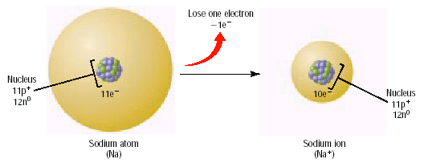
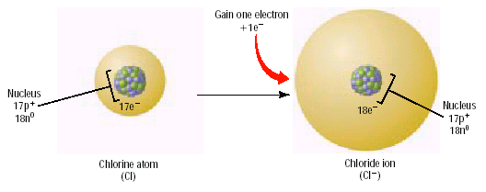
Ionic Radii
Cations (+) are always smaller than the metal atoms from which they are formed. (fewer electrons than protons & one less shell of e’s)
Anions (-) are always larger than the nonmetal atoms from which they are formed. (more electrons than protons)
© 2002 Prentice-Hall, Inc.

Slide 54
Ionic Radii
Trend: For both cations and anions, radii increases down a group
WHY???
Outer electrons are farther from the nucleus (more shells/ energy levels)

Slide 55
Ionic Radii
Trend: For both cations and anions, radii decreases across a period
WHY???
The ions contain the same number of electrons (isoelectronic), but an increasing number of protons, so the ionic radius decreases.

Slide 56
First Ionization Energy

Slide 57
First Ionization Energy
Definition: The energy to remove one outer electrons from a gaseous atom.
+
+ e⁻
Ionization

Slide 58
First Ionization Energy
Ne
Ar
Li
Na
K

Slide 59
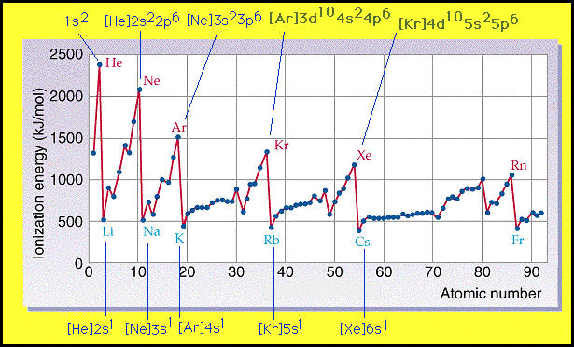
First Ionization Energy
Notice the “lull” in these trends at the transition metals… more on this later in this unit

Slide 60
First Ionization Energy
Trend: decreases down a group
WHY???
Electrons are in higher energy levels as you move down a group; they are further away from the positive “pull” of the nucleus and therefore easier to remove.
As the distance to the nucleus increases, Coulomb force is reduced. (Remember from Physics the inverse square nature of the force)

Slide 61
First Ionization Energy
Trend: increases across a period
WHY???
The increasing charge in the nucleus as you move across a period exerts greater “pull” on the electrons; it requires more energy to remove an electron.

Slide 62
Ionization Energy
Doing work against a Coulomb Force
+
Work - Energy

Slide 63
Ionization Energy
Doing work against a Coulomb Force
Repulsion from other electrons
This of course is the same effect!
+
Work - Energy
Inner electrons tend to “shield” the outer electrons somewhat from the nucleus.
Attraction to the nucleus

Slide 64
element | Na | Mg | Al | Si | P | S | Cl | Ar
# protons | 11 | 12 | 13 | 14 | 15 | 16 | 17 | 18
Electron arrangement | 2.8.1 | 2.8.2 | 2.8.3 | 2.8.4 | 2.8.5 | 2.8.6 | 2.8.7 | 2.8.8
1st I.E. (kj mol⁻¹) | 494 | 736 | 577 | 786 | 1060 | 1000 | 1260 | 1520
Notice the drop between Mg & Al… evidence of sublevels (s and p)
The positive value of the ionization energy reminds us that energy must be put into the atom in order to remove the electron. That is to say, the reaction is endothermic.

Slide 65
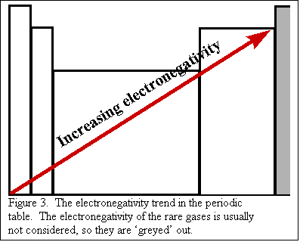
Electronegativity
Definition: a relative measure of the attraction that an atom has for a shared pair of electrons when it is covalently bonded to another atom.

Slide 66
Electronegativity
Trend: decreases down a group
WHY???
Although the nuclear charge is increasing, the larger size produced by the added energy levels means the electrons are farther away from the nucleus; decreased attraction, so decreased electronegativity; plus, shielding effect

Slide 67
Electronegativity
Trend: increases across a period
(noble gases excluded!)
WHY???
Nuclear charge is increasing, atomic radius is decreasing; attractive force that the nucleus can exert on another electron increases.

Slide 68
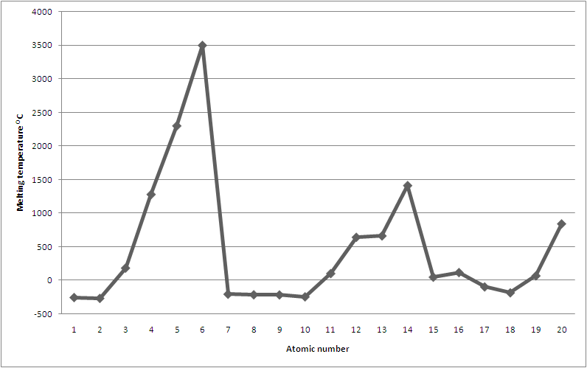
Melting Point
C
B
Si
Be
Ca
Mg
Al
Li
P
S
Na
Cl
K
H
N
O
F
He
Ne
Ar

Slide 69
Melting Point
Melting points depend on both…
The structure of the element
Type of attractive forces holding the atoms together

Slide 70
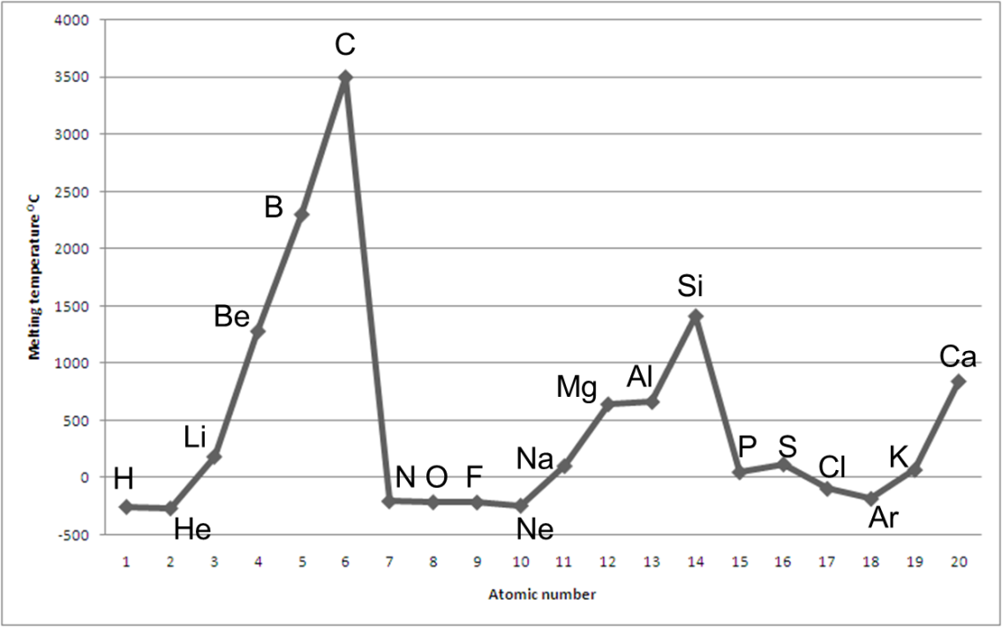
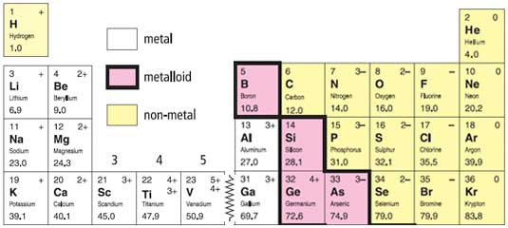
Melting Point
Trend (using per 3 as an example):
Elements on the left exhibit metallic bonding (Na, Mg, Al), which increases in strength as the # of valence electrons increases.

Slide 71
Melting Point
Trend (using per 3 as an example):
Silicon in the middle of the period has a macromolecular covalent structure (network) with very strong bonds resulting in a very high melting point.

Slide 72
Melting Point
Trend (using per 3 as an example):
Elements in groups 5, 6 and 7 (P₄, S₈ and Cl₂) show simple molecular structures with weak van der Waals’ forces (more on that next unit) of attraction between molecules (which decrease with molecular size).

Slide 73
Melting Point
Trend (using per 3 as an example):
The noble gases (Ar) exist as single individual atoms with extremely weak forces of attraction between the atoms.

Slide 74
Melting Point
Within groups there are also clear trends:
element | Li | Na | K | Rb | Cs
m.p. (K) | 454 | 371 | 336 | 312 | 302
In group 1 the m.p. decreases down the group as the atoms become larger and the strength of the metallic bond decreases.

Slide 75
Melting Point
Within groups there are also clear trends:
element | F₂ | Cl₂ | Br₂ | I₂
m.p. (K) | 53.53 | 171.60 | 265.80 | 386.85
In group 7 the van der Waals’ attractive forces between the diatomic molecules increase down the group so the melting points increase. As the molecules get bigger there are obviously more electrons which can move around and set up the temporary dipoles which create these attractions.
The stronger intermolecular attractions as the molecules get bigger means that you have to supply more heat energy to turn them into either a liquid or a gas - and so their melting and boiling points rise.

