Slide 1
Energetics
IB Topics 5 & 15
PART 4:
Entropy & Spontaneity

Slide 2
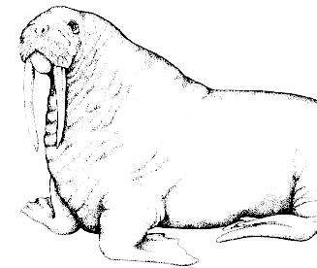
“The time has come,” the Walrus said,
“To speak of many things:
Of shoes--and ships--and sealing wax—
Of Entropy, Enthalpy, and Free Energy…”

Slide 3
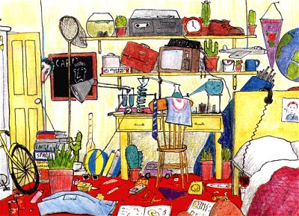
Is this your room?
Then you already know about entropy.

Slide 4
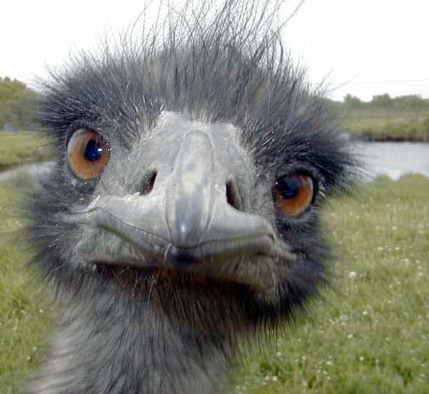
Why do things happen the way they do, and not in reverse?
The answer is entropy.
So, what’s the question?

Slide 5
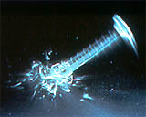
Glassware breaks spontaneously when it hits the floor. Yet you can’t drop broken glass and have it form a graduated cylinder.

Slide 6
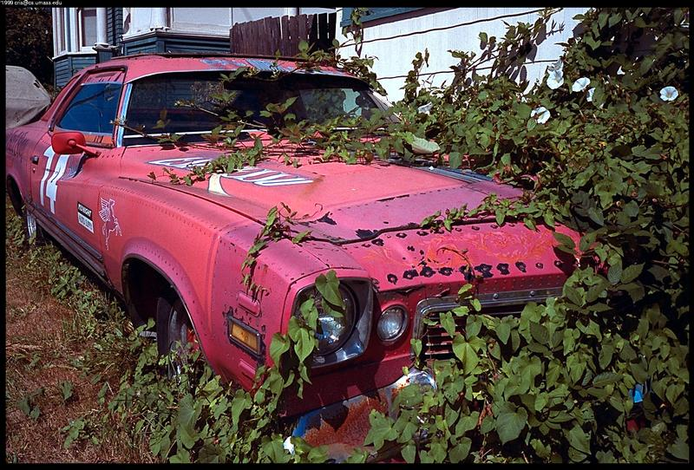
Why is it that….
a parked new car left to itself will become junk over time…
but the junk car will never become like new over time?

Slide 7
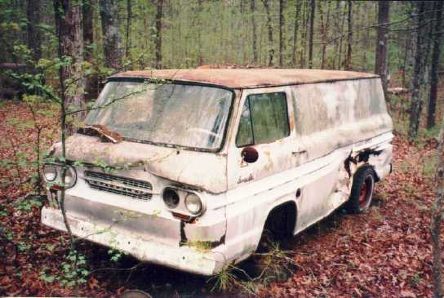

Slide 8
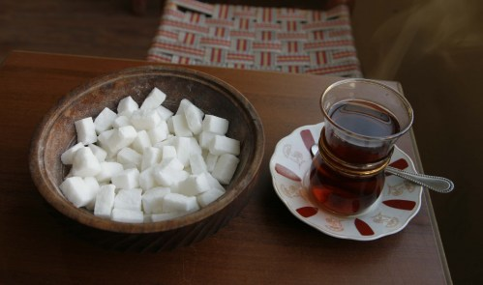
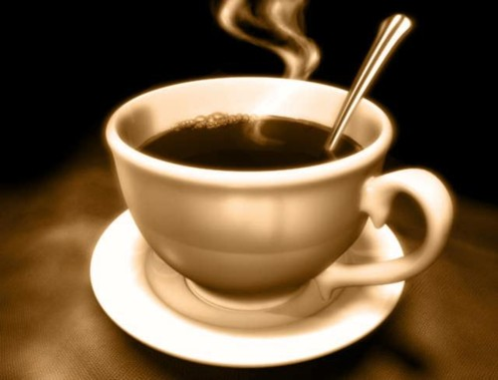
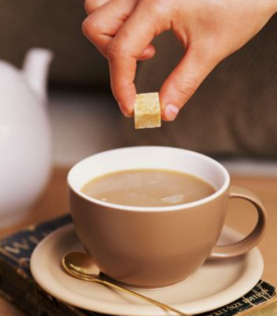
A sugar cube dissolves spontaneously in hot coffee or tea, but dissolved sugar never precipitates out of it to form a sugar cube?

Slide 9
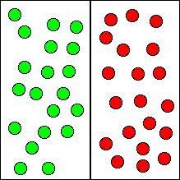
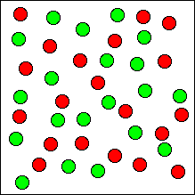
x

Slide 10
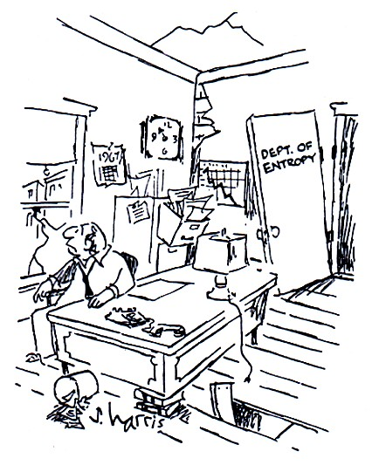
ENTROPY (S):
a measure of the degree of disorder in a system.
In nature, things tend to increase in entropy, or disorder.

Slide 11
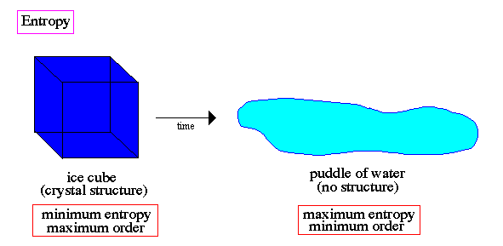

Slide 12
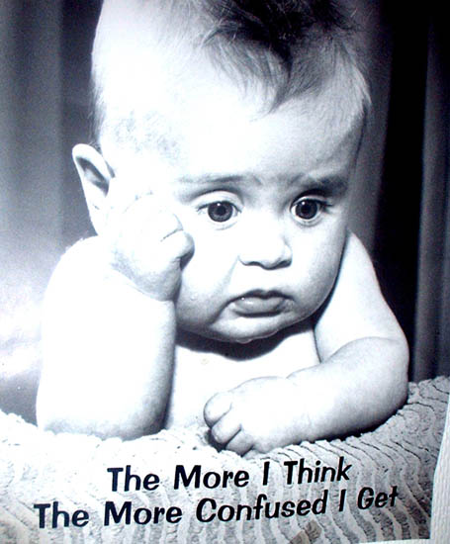
So WHY do things tend toward states of higher entropy???

Slide 13
Think of your room again..
If you were to throw everything up in the air and then just wait for it all to land, there is a much greater probability that things will end up disordered. It’s unlikely that things will land in an orderly fashion, because there are fewer “ordered” arrangements than there are “disordered” arrangements.

Slide 14
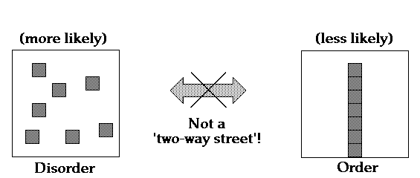

Slide 15
There are more ways that gas molecules can be mixed together than there are ways they can be separated.

Slide 16
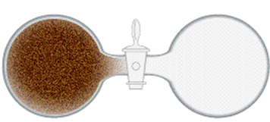
Once this valve is opened, it is more likely that the gas molecules will spread out than stay as is.
Again, this is because there are more ways for them to be dispersed than to stay on one side.

Slide 17
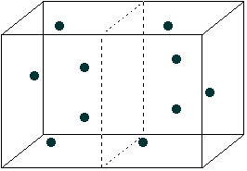
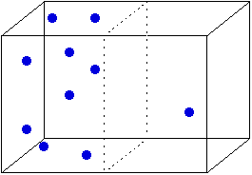
Probably Not!

Slide 18
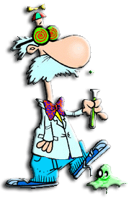
So, next time you’re thirsty, go ahead, wander into the kitchen and get yourself a drink of water. There’ll be plenty of air to breath when you get there. Probably!

Slide 19
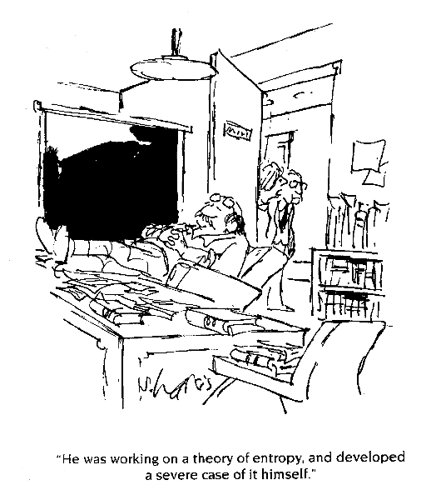

Slide 20
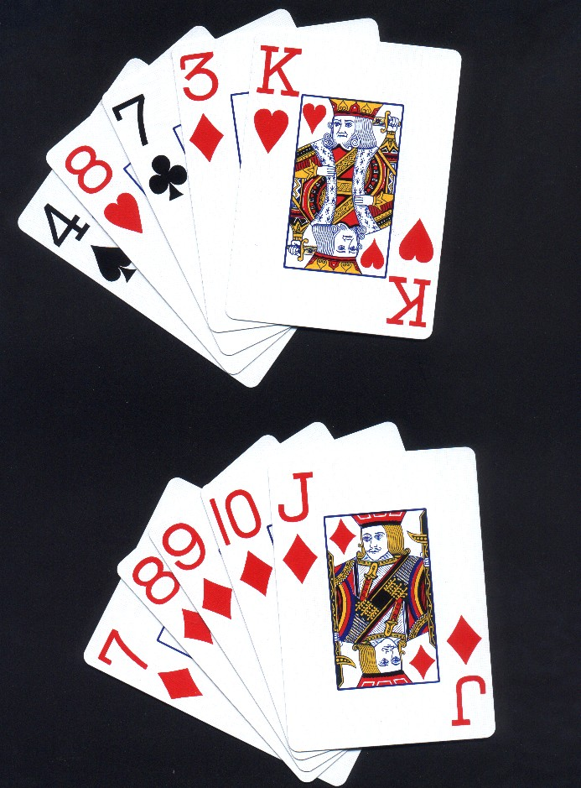
One last example…
Dave’s Hand
2.6 million to one
What are the odds?
John’s Hand
2.6 million to one

Slide 21
Johns hand is one of a very select group of hands called a straight flush. Out of the 2.6 million possible hands, there are only 40 straight flushes.
Dave has junk. There are over a million hands that are junk.
In other words, there are very few combinations of five cards that form a straight flush, and very many combinations that result in junk.

Slide 22
Entropy can be defined in terms of microstates and macrostates.
Microstate Macrostate
John’s Hand 7♦ 8♦ 9♦ 10♦ J♦ Straight Flush
Dave’s Hand 4♠ 8 ♥ 7♣ 3♦ K♥ Junk

Slide 23
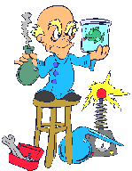
The more microstates a macrostate can have, the higher its entropy.

Slide 24
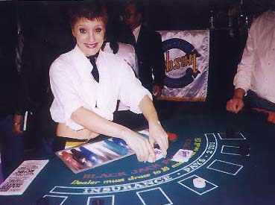
Hey, wake up! The law of entropy says you’re probably going to get junk.

Slide 25
ENTROPY (S)
2 mol gas
1 mol solid

Slide 26
Increasing Entropy
Solids Liquids Solutions Gases
Fewer Particles More Particles

Slide 27
An increase in disorder (entropy) can result from:
Mixing different types of particles (e.g. the dissolving of sugar in water)
A change in state where the distance between particles increases (e.g. liquid water → steam)
The increased movement of particles (e.g. heating a liquid or gas)
Increasing the number of particles, e.g. 2H₂O₂(l) → 2H₂O(l) + O₂(g)
Note: The greatest increase in disorder is usually found where the number of particles in the gaseous state increases.

Slide 28
ABSOUTE ENTROPY VALUES
The standard entropy of a substance is the entropy change per mole that results from heating the substance from 0 K to the standard temperature of 298 K.
Unlike enthalpy, absolute values of entropy can be measured.
The standard entropy change for a reaction can then be determined by calculating the difference between the entropy of the products and the reactants.

Slide 29
Example: Determine the entropy change for the formation of ammonia from hydrogen and nitrogen.
3H₂(g) + N₂(g) ↔ 2NH₃(g)
S° for hydrogen, nitrogen and ammonia are respectively 131, 192 and 192 J mol⁻¹ K⁻¹
Therefore per mole of reaction
∆ S° = [2(192)] – [3(131) + 192]
∆ S° = -201 J mol⁻¹ K⁻¹
Or per mole of ammonia
∆ S° = -201/2 =-100.5 ≈ -101 J mol⁻¹ K⁻¹

Slide 30
SPONTANEITY
a reaction is said to be spontaneous if it causes a system to move from a less stable to a more stable state.

Slide 31
SPONTANEITY
Enthalpy and entropy are DRIVING FORCES for spontaneous reactions (rxns that happen at normal conditions)
It is the interplay of these 2 driving forces that determines whether or not a physical or chemical change will actually happen.

Slide 32
Free Energy Change (ΔG)
a.k.a. Gibbs Energy Change
relates enthalpy and entropy in a way that indicates which predominates; the quantity of energy that is available or stored to do work or cause change.
ΔG° = ΔH° - TΔS°

Slide 33
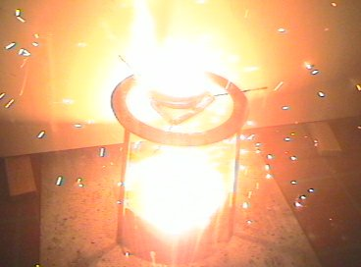
Free Energy Change (ΔG)
Spontaneous: ΔG = (–)
Non-spontaneous: ΔG = (+)
Reaction is at Equilibrium: ΔG = 0
Ex: thermit rxn (ΔG=neg)

Slide 34
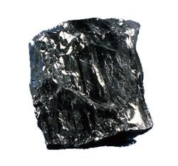
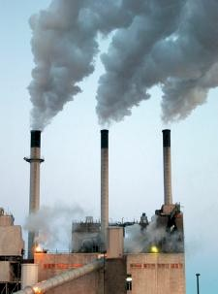
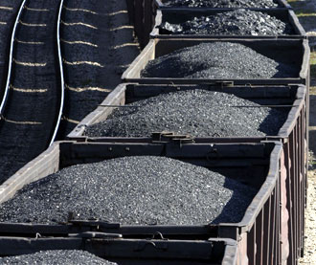
Free Energy Change (ΔG)
Note: the fact that a reaction is spontaneous does not necessarily mean that it will proceed without any input of energy. For example, the combustion of coal is a spontaneous reaction and yet coal is stable in air. It will only burn on its own accord after it has received some initial energy so that some of the molecules have the necessary activation energy for the reaction to occur.

Slide 35
Relating Enthalpy and Entropy to Spontaneity
Example of reaction | ΔH | ΔS | Spontaneity
2K + 2H₂O → 2KOH + H₂ | - | +
H₂O(g) → H₂O(l) | - | -
H₂O(s) → H₂O(l) | + | +
16CO₂+18H₂O→2C₈H₁₈+25O₂ | + | -
always spon.
spon. at low temp.
spon. at high temp.
never spon.

Slide 36
Calculating ΔG values
Calculating ΔG_{rxn} from ΔG_{f}
Using ΔS_{rxn} and ΔH_{rxn} values to calculate ΔG_{rxn} at all temperatures
Or via energy cycles / Hess’ Law
ΔG° = ΔH° - TΔS°

Slide 37
Example: Find the standard free energy of combustion of methane given the standard free energies of formation of methane, carbon dioxide, water and oxygen.
reactants
products
elements

Slide 38
Example: Find the standard free energy of combustion of methane given the standard free energies of formation of methane, carbon dioxide, water and oxygen.
CH₄(g) + 2O₂(g)
CO₂(g) + 2H₂O(l)
C(s) + 2O₂(g) + 2H₂(g)

Slide 39
Example: Find the standard free energy of combustion of methane given the standard free energies of formation of methane, carbon dioxide, water and oxygen.
∆G_{f} (CH₄) = -50 kJ/mol
∆G_{f} (CO₂) = -394 kJ/mol
∆G_{f} (H₂O) = -237 kJ/mol
0

Slide 40
Example: Determine whether or not the decomposition of calcium carbonate is spontaneous at all temperatures. If not, provide conditions of temperatures (if any) at which the reaction is spontaneous.
CaCO₃(s) → CaO(s) + CO₂(g)
∆H°=+178 kJ mol⁻¹; ∆S°=+165.3 J mol⁻¹K⁻¹
Note that the units of ∆S° are different from ∆H°
At 25°C (298K):
∆G° = ∆H° - T∆S°
∆G° = 178 kJ/mol – (298K)(0.1653kJ/mol⋅K)
∆G° = +129 kJ mol⁻¹
Thus the rxn is not spontaneous at this temp.

Slide 41
Example: Determine whether or not the decomposition of calcium carbonate is spontaneous at all temperatures. If not, provide conditions of temperatures (if any) at which the reaction is spontaneous.
CaCO₃(s) → CaO(s) + CO₂(g)
∆H°=+178 kJ mol⁻¹; ∆S°=+165.3 J mol⁻¹K⁻¹
∆G° = ∆H° - T∆S°
∆G° = (+) – (+)(+)
This rxn is spontaneous only at high temps.

Slide 42
Example: Determine whether or not the decomposition of calcium carbonate is spontaneous at all temperatures. If not, provide conditions of temperatures (if any) at which the reaction is spontaneous.
CaCO₃(s) → CaO(s) + CO₂(g)
∆H°=+178 kJ mol⁻¹; ∆S°=+165.3 J mol⁻¹K⁻¹
Thus the reaction will become spontaneous when T∆S° > ∆H°
T∆S° = ∆H° when T = ∆H°/ ∆S°
T = 178/0.1653
T = 1077K (804 °C)
Therefore, the rxn will be spon. above 804 °C.

Slide 43
Example: Determine whether or not the decomposition of calcium carbonate is spontaneous at all temperatures. If not, provide conditions of temperatures (if any) at which the reaction is spontaneous.
Note, this solution assumes that the entropy value is independent of temp., which is not strictly true.

Slide 44
More practice problems: Example #1
For the decomposition of O₃(g) to O₂(g):
2O₃(g) → 3O₂(g)
ΔH = -285.4 kJ/mol
ΔS = 137.55 J/mol·K @25 °C
a) Calculate ΔG for the reaction.
ΔG = (-285.4 kJ/mol) – (298K)(0.13755KJ/mol·K)
ΔG = -326 kJ

Slide 45
More practice problems: Example #1
For the decomposition of O₃(g) to O₂(g):
2O₃(g) → 3O₂(g)
ΔH = -285.4 kJ/mol
ΔS = 137.55 J/mol·K @25 °C
b) Is the reaction spontaneous?
YES

Slide 46
More practice problems: Example #1
For the decomposition of O₃(g) to O₂(g):
2O₃(g) → 3O₂(g)
ΔH = -285.4 kJ/mol
ΔS = 137.55 J/mol·K @25 °C
c) Is ΔH or ΔS (or both) favorable for the reaction?
Both ΔS and ΔH are favorable
(both are driving forces… enthaply = - & entropy = +)

Slide 47
More practice problems: Example #2
What is the minimum temperature (in °C) necessary for the following reaction to occur spontaneously?
Fe₂O₃(s) + 3CO(g) → 2Fe(s) + 3CO₂(g)
ΔH = +144.5 kJ/mol; ΔS = +24.3 J/K·mol
ΔG = ΔH – TΔS
0 = (144.5) – (T)(0.0243)
T = 5947 K
T = 5674 °C ≈ 5670 °C
Thus, the rxn will be spon. @ temp > 5670 °C

