Slide 1

Atomic Structure

Slide 2
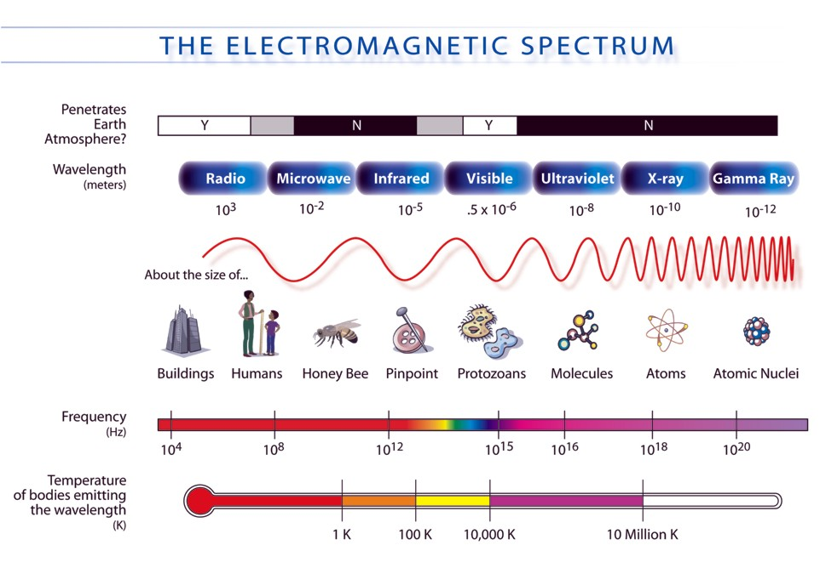
Part 3
Emission Spectra

Slide 3
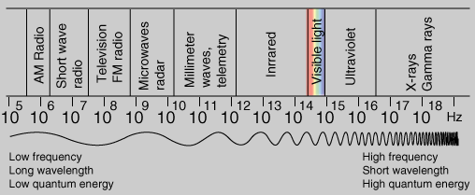
You need to know this
(don’t memorize numbers, but you need to know order of things and trends)
R O Y G B I V
microwave
X-ray
radio
gamma
IR
UV

Slide 4
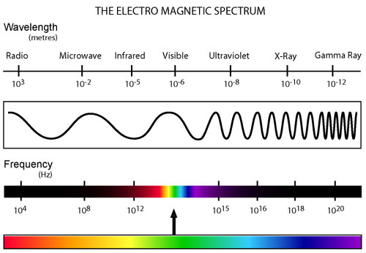
Electromagnetic Radiation
Electromagnetic radiation (radiant energy) is characterized by its wavelength, λ, and frequency, f.

Slide 5
Electromagnetic Radiation
Related by these equations:
where
c = 299 792 458 m/s, or approx.. 3.00 x 10⁸ m s⁻¹
(the speed of light in a vacuum) and
h = 6.626 x 10⁻³⁴ J s (Plank’s constant)

Slide 6
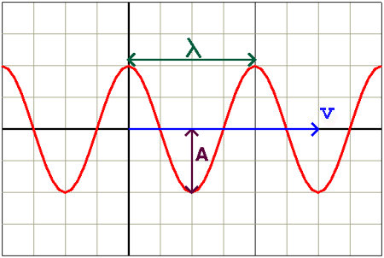
Waves
Wavelength = distance between successive “crests”
Frequency = the # of crests passing a given point per second (unit Hz = s⁻¹)

Slide 7
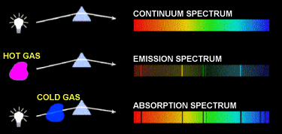
Atomic Emission Spectra
When sunlight or white light is passed through a prism, it gives the continuous spectrum observed in a rainbow.
When energy is supplied to individual elements they emit a spectrum which only contains emissions at particular wavelengths.

Slide 8
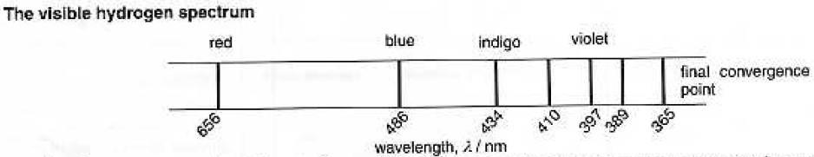
Atomic Emission Spectra
Each element has its own characteristic spectrum known as a line spectrum as it is not continuous.
Example: Hydrogen (H)
  NOTE: the line spectrum consists of discrete lines that converge toward the high energy (violet) end of the spectrum. A similar series of lines at higher energies (UV) and several other series of lines at lower energy can be found in the IR region of the spectrum.

Slide 9
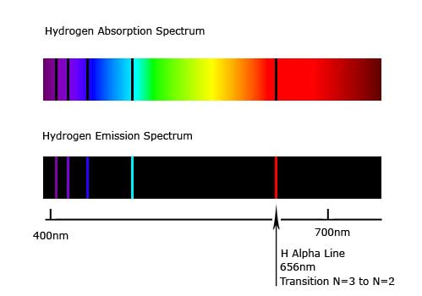

Slide 10
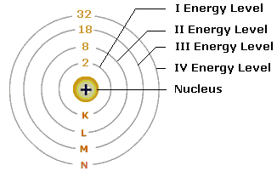
Explanation of emission spectra
Electrons can only exist in certain fixed energy levels.

Slide 11
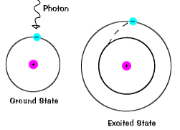
Explanation of emission spectra
When all electrons are in the lowest possible energy levels, an atom is said to be in its GROUND STATE.
When an atom absorbs energy so that its electrons are “boosted” to higher energy levels, the atom is said to be in an EXCITED STATE.

Slide 12
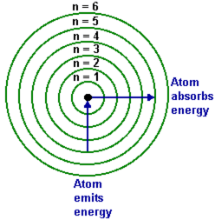
Explanation of emission spectra
When an electron moves from a lower energy level to a higher energy level in an atom, energy of a characteristic frequency (and corresponding wavelength) is absorbed.
When an electron falls from a higher energy level back to the lower energy level, then radiation of the same frequency (and corresponding wavelength) is emitted.

Slide 13
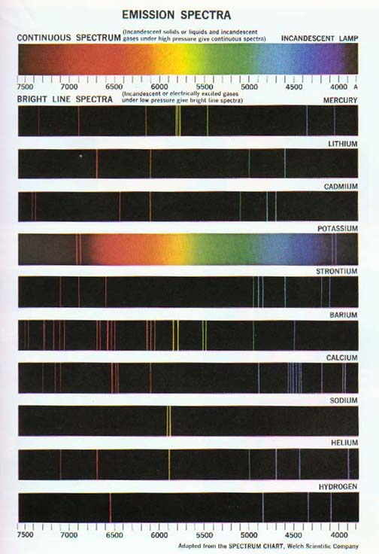
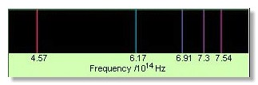
Bright Line Emission Spectrum
The light emitted by an element when its electrons return to a lower energy state can be viewed as a bright line emission spectrum.

Slide 14
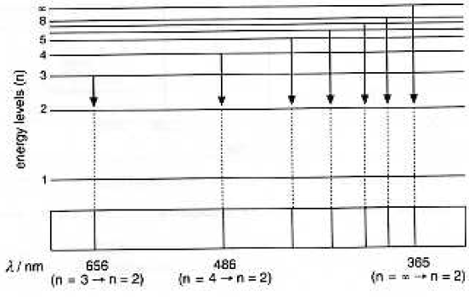
For example: transition to n=2
What portion of the EM spectrum is this?
visible light
Note: the lines in the spectrum converge because the energy levels themselves converge.

Slide 15
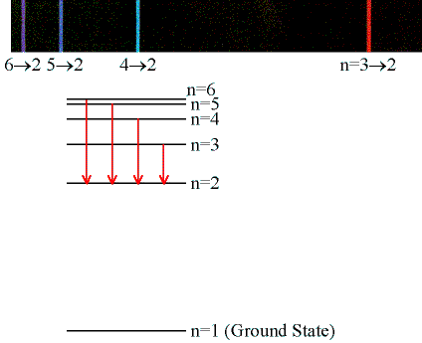

Slide 16
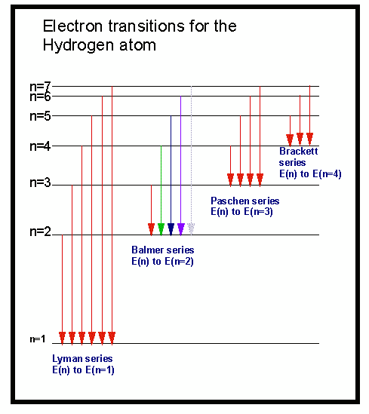
Energy level (n) electrons are returning to… | Part of the spectrum the series of lines will show up in…
n=1
n=2
n=3
UV
visible
IR

Slide 17
Energy levels available to the electron in the hydrogen atom
(p. 286; Zumdahl, 7th ed.)
n = principal energy level
Z = nuclear charge

Slide 18
Example: Calculate the energy required to excite the hydrogen electron from level n=1 to n=2. What wavelength of light and portion of the electromagnetic spectrum is capable of supplying this amount of energy.

Slide 19
Example: Calculate the energy required to excite the hydrogen electron from level n=1 to n=2. What wavelength of light and portion of the electromagnetic spectrum is capable of supplying this amount of energy.
UV light

Slide 20
Example: Calculate the energy required to remove the electron from a hydrogen atom in its ground state.
See page 289 for derivation

Slide 21


Part 4
Electron Arrangement
“Any one who is not shocked
by Quantum theory does
not understand it.”
Niels Bohr

Slide 22
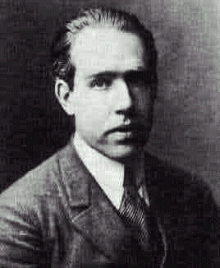
NIELS BOHR
Neils Bohr
(1885 - 1962)
1922 Nobel
In 1913, this Danish scientist suggested that electrons “orbit” the nucleus.
In Bohr’s model, electrons are placed in different energy levels based on their distance from the nucleus.

Slide 23


Electrons are like books in a book case. They can only exist on certain levels.

Slide 24
Only certain “orbits” are allowed

Slide 25

MODERN ATOMIC MODEL
By 1925, Bohr’s model of the atom no longer explained all observations. Bohr was correct about energy levels, but wrong about electron movement.
Electrons occupy the lowest energy levels available.
Energy increases as distance from the nucleus increases.
Electrons move in patterns of “wave functions” around the nucleus.

Slide 26
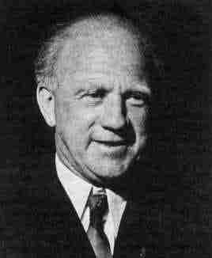
MODERN ATOMIC MODEL
Heisenberg’s Uncertainty Principle:
It has been mathematically proven that it is impossible to know an electron’s momentum and position in space at any moment in time.
As uncertainty of position decreases, uncertainty of momentum increases, and vice versa.
Werner Heisenberg
(1901 - 1976)

Slide 27
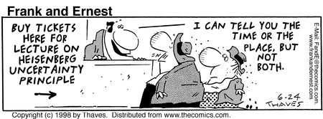

Slide 28
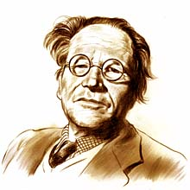
Schrödinger
This is very difficult stuff!
In 1926 Schrodinger proposes an equation that gives the probability of finding an electron at any place in the atom.
Don’t worry, this won’t be on the test.

Slide 29
Evidence from Ionization Energies
Much of our understanding of electron arrangement comes from ionization energy data…

Slide 30
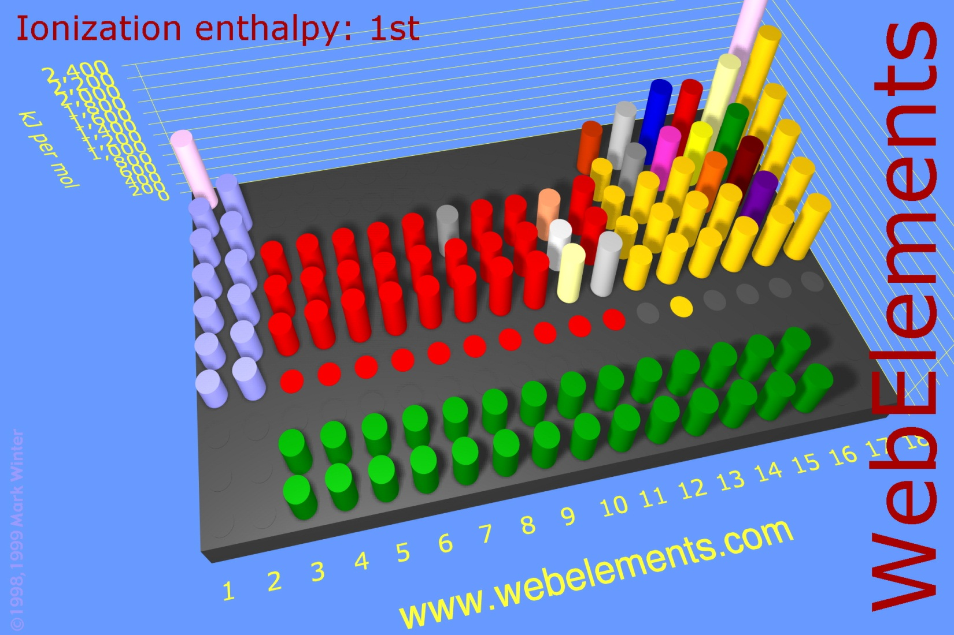
First Ionization Energy

Slide 31


First Ionization Energy
Definition: energy required to remove one electron from an atom in its gaseous state.
+
+ e⁻
Ionization

Slide 32
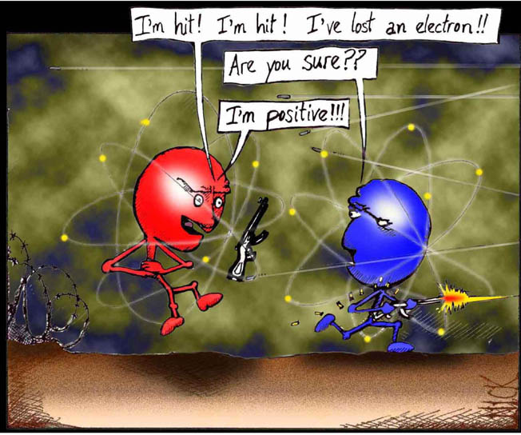
First Ionization Energy

Slide 33
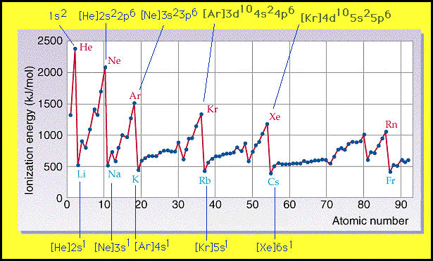
First Ionization Energy

Slide 34
This graph provides evidence that the levels can contain different numbers of electrons before they become full.
Ne
Ar
Li
Na
K
Level | Max # electrons
1 (K shell)
2 (L shell)
3 (M shell)
2
8
8 (or 18)

Slide 35
Second ionization energy
energy required to remove the second electron.

Slide 36
Successive ionization energies…
Al _{(g)} → Al⁺_{(g)} + e⁻
I₁ = 580 kj/mol
Al⁺ _{(g)} → Al²⁺_{(g)} + e⁻
I₂ = 1815 kj/mol
Al²⁺ _{(g)} → Al³⁺_{(g)} + e⁻
I₃ = 2740 kj/mol
Al³⁺ _{(g)} → Al⁴⁺_{(g)} + e⁻
I₄ = 11,600 kj/mol

Slide 37
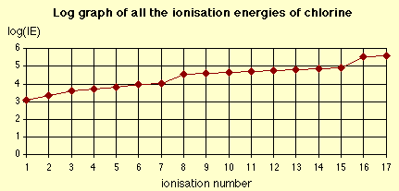
Graph of successive ionization energies
What does this graph show?
As e⁻’s are removed, nucleus holds remaining more tightly (less shielding, outer e⁻’s first)
First “large jump” reveals # valence e⁻’s of element (group)
Does not increase regularly (evidence for sublevels)

Slide 38
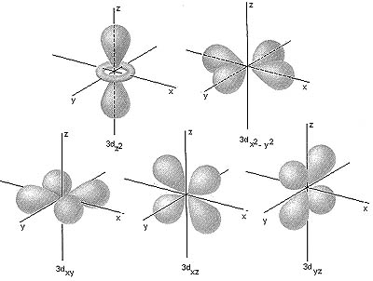
Electron Configurations
The quantum mechanical model of the atom predicts energy levels for electrons; it is concerned with probability, or likelihood, of finding electrons in a certain position.

Slide 39
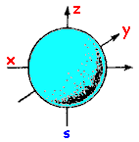
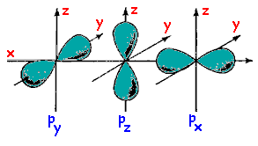
ORBITALS
ORBITAL: the regions in an atom where there is a high probability of finding electrons.
s is the lowest energy orbital, and p is slightly higher
d and f are the next two orbitals. They occupy even higher energy levels and take on more complex shapes than s & p
s orbital
p orbitals

Slide 40
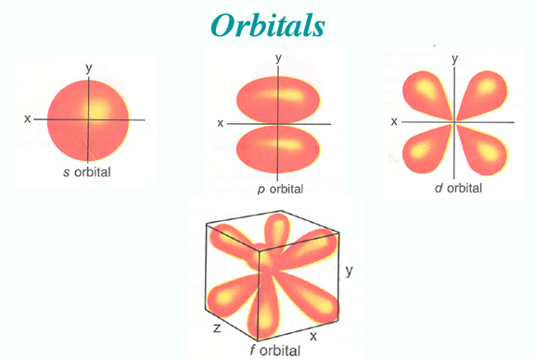
Electron Configurations
Regions where electrons are likely to be found are called orbitals. EACH ORBITAL CAN HOLD UP TO 2 ELECTRONS!

Slide 41

Electron Configurations
In quantum theory, each electron is assigned a set of quantum numbers
  analogy: like the mailing address of an electron

Slide 42
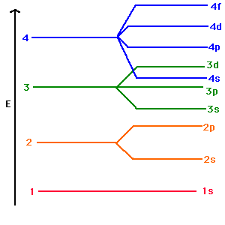
Electron Configurations

Slide 43
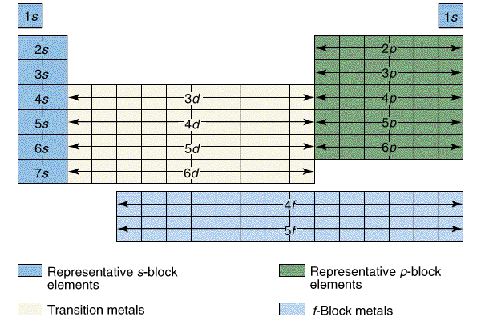
Electron Configurations

Slide 44




Playing Chopin with Boxing Gloves
“Trying to capture the physicists’ precise mathematical description of the quantum world with our crude words and mental images is like playing Chopin with a boxing glove on one hand and a catcher’s mitt on the other.”
(1996). Johnson, George. On skinning Schrodinger’s Cat.
New York Times.

Slide 45
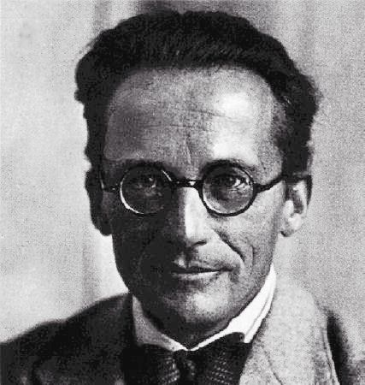
Erwin Schrödinger
I don’t like it, and
I’m sorry I ever had
anything to do with
it.

Slide 46
Principal Quantum Number (n)
Describes the energy level that the electron occupies
n=1, 2, 3, 4
The larger the value of n, the farther away from the nucleus and the higher the energy of the electron.
n = 1
n = 2
n = 3
n = 4

Slide 47
Sublevels (l)
The number of sublevels in each energy level is equal to the quantum number, n, for that energy level.
Sublevels are labeled with a number that is the principal quantum #, and a letter: s, p, d, f (ex: 2 p is the p sublevel in the 2nd energy level)

Slide 48
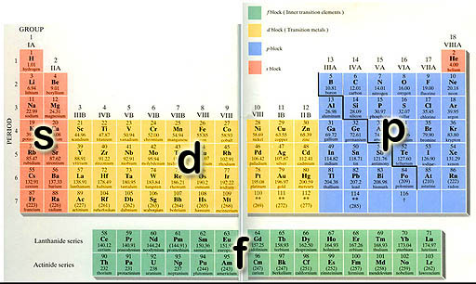

Slide 49
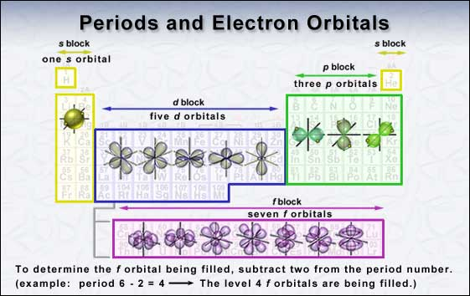

Slide 50
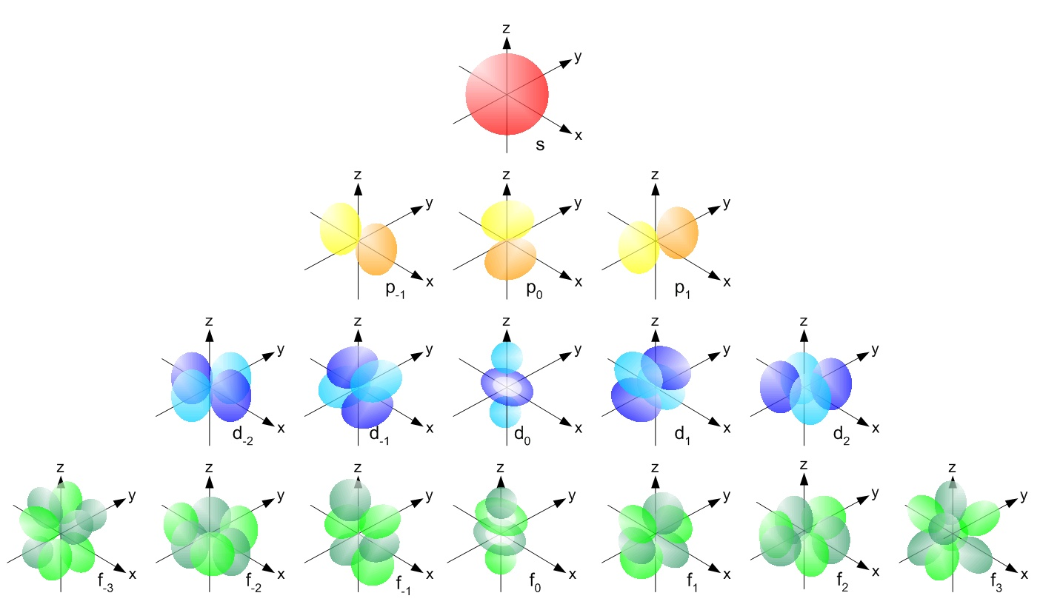

Slide 51
Sublevels (l)
Principal Energy Level | Sublevels | Orbitals
n = 1
1s
one (1s)
n = 2
2s 2p
one (2s) three (2p)
n = 3
3s 3p 3d
one (3s) three (3p) five (3d)
n = 4
4s 4p 4d 4f
one (4s) three (4p) five (4d) seven (4f)

Slide 52
Sublevels (l)
Sublevel | # of orbitals | Max # of electrons
s
1
2
p
3
6
d
5
10
f
7
14

Slide 53
Spin quantum number (m_{s})
Labels the orientation of the electron
Electrons in an orbital spin in opposite directions; these directions are designated as +1/2 and -1/2

Slide 54
Pauli Exclusion Principle
States that no 2 electrons have an identical set of four quantum #’s to ensure that no more than 2 electrons can be found within a particular orbital.

Slide 55
Hund’s Rule
Orbitals of equal energy are each occupied by one electron before any pairing occurs.
  Repulsion between electrons in a single orbital is minimized
All electrons in singly occupied orbital must have the same spin.
When 2 electrons occupy an orbital they have opposite spins.

Slide 56
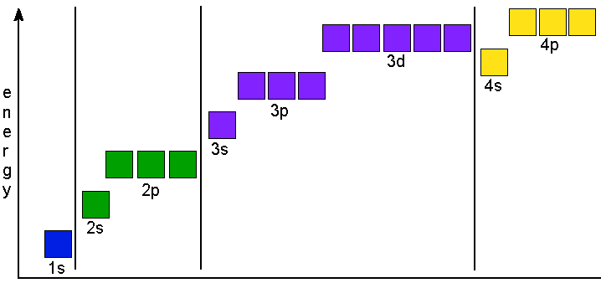
Aufbau Principle
orbitals of lowest energy are filled first (building-up principle).

Slide 57
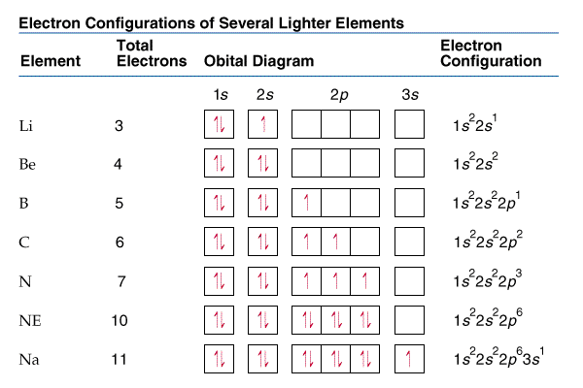
Orbital Diagrams
Each orbital is represented by a box.
Each electron is represented by an arrow.

Slide 58
Orbital Diagrams
hydrogen
helium
carbon
1s
1s
1s
2s
2p

Slide 59
Complete electron configurations
helium
boron
neon
aluminum
uranium
1s²
1s²2s²2p¹
1s²2s²2p⁶
1s²2s²2p⁶3s²3p¹
1s²2s²2p⁶3s²3p⁶4s²3d¹⁰4p⁶5s²4d¹⁰- 5p⁶6s²4f¹⁴5d¹⁰6p⁶7s²5f⁴

Slide 60
Abbreviated electron arrangements
helium
boron
aluminum
cobalt
uranium
1s²
[He]2s²2p¹
[Ne]3s²3p¹
[Ar]4s²3d⁷
[Rn]7s²5f⁴

Slide 61
IB sometimes uses another form of notation for this…
1s²2s²2p⁶3s²3p¹ becomes…
2e⁻) 8e⁻ ) 3e⁻
Electrons in 1st energy level (shell)
Electrons in 2nd energy level (shell)
Electrons in 3rd energy level (shell)
2.8.3 or 2,8,3

Slide 62
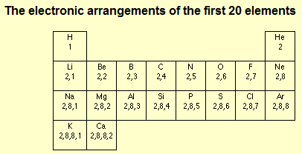
IB will only use this notation for the first 20 elements

Slide 63
Exceptions you should know:
Copper:
Chromium:
1s² 2s² 2p⁶ 3s² 3p⁶4s¹3d¹⁰ or [Ar]4s¹ 3d¹⁰
1s² 2s² 2p⁶ 3s² 3p⁶4s¹3d⁵ or [Ar]4s¹ 3d⁵
Why do these elements do this?
Lower energy arrangement of electrons: this configuration allows for half-filled (less electron repulsion because no pairing in the 3d sublevel) or filled d-sublevel.

Slide 64
Electron configurations of Ions
[He]2s²2p⁶
N³⁻
Se²⁻
Mg²⁺
Al⁶⁺
Cr³⁺
Cu⁺
1s²2s²2p³
= [Ne]
[Kr]
[Ar]3d³
[Ne]
[Ar]3d¹⁰

