Slide 1



Unit 04: BONDING
IB Topics 4 & 14
Text: Ch 8 (all except sections 4,5 & 8)
Ch 9.1 & 9.5
Ch 10.1-10.7
My Name is Bond. Chemical Bond

Slide 2
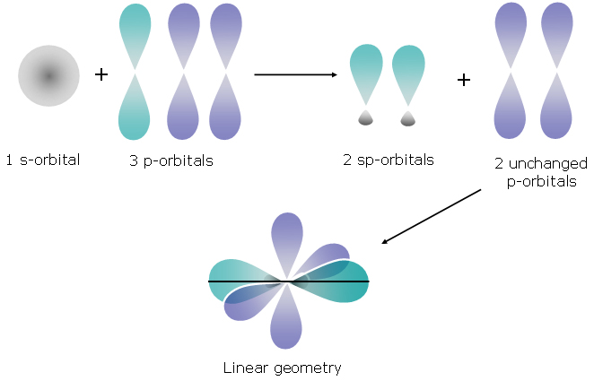
PART 3: Hybridization &
Delocalization of Electrons

Slide 3
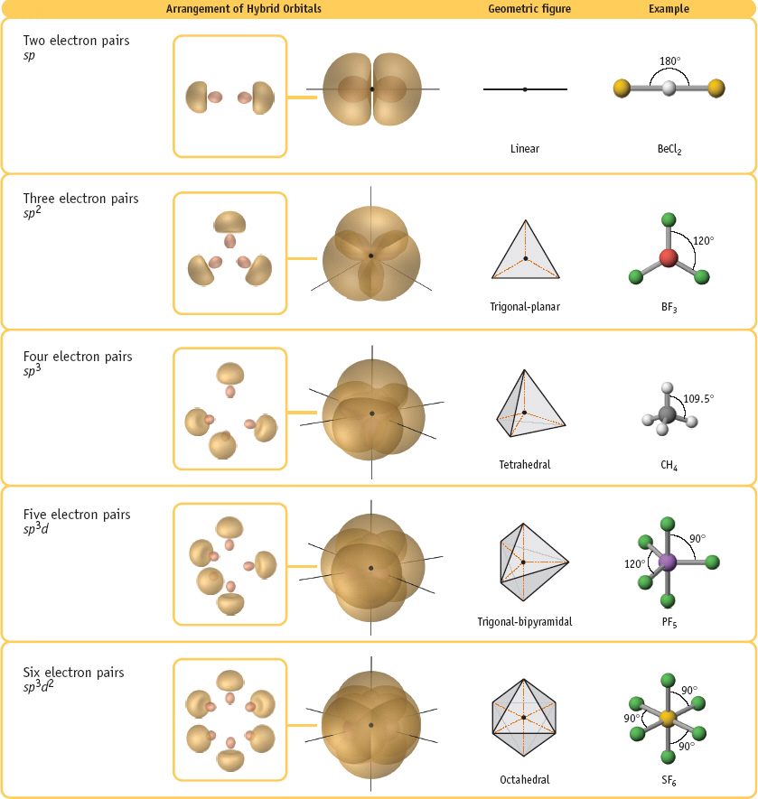
Hybridization
Hybridization: a modification of the localized electron model to account for the observation that atoms often seem to use special atomic orbitals in forming molecules. This is part of both IB and AP curricula.

Slide 4
BeF₂
F – Be - F
The VSEPR model predicts that this molecule is linear --- which of course it is.
In fact, it has two identical Be-F bonds.

Slide 5

BeF₂
Be
1s²2s²
F – Be - F
ENERGY
OK, so where do the fluorine atoms bond?
2p
↑↓
2s
↑↓
1s

Slide 6
BeF₂
Be
1s²2s²
F – Be - F
ENERGY
↑
2p
2p
↑↓
↑
2s
excitation
2s
↑↓
↑↓
1s
1s

Slide 7
BeF₂
Be
1s²2s²
F – Be - F
ENERGY
↑
2p
2p
↑
↑
2p
↑↓
↑
two
sp
hybrid orbitals
2s
excitation
2s
hybridization
↑↓
↑↓
1s
1s

Slide 8
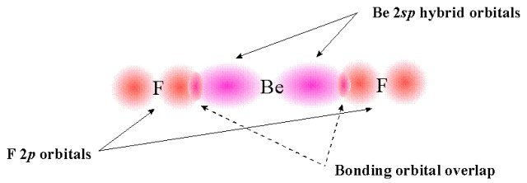
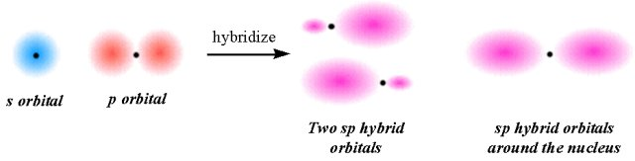
BeF₂ → sp hybridization

Slide 9
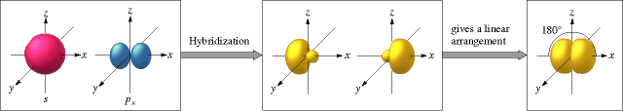
sp hybrid orbitals

Slide 10
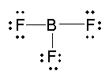
BF₃
B
1s²2s²2p¹
ENERGY
↑
↑
↑
2p
2p
↑
↑
↑
2p
↑↓
↑
three
sp²
hybrid orbitals
2s
excitation
2s
hybridization
↑↓
↑↓
1s
1s

Slide 11
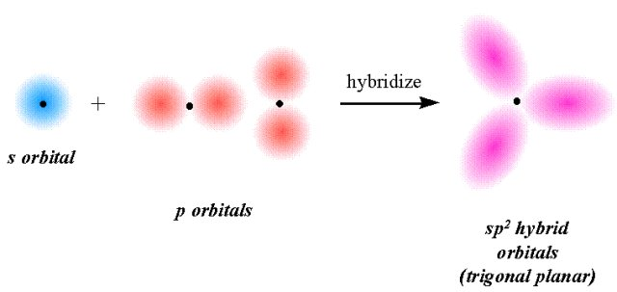
BF₃ → sp² hybridization

Slide 12
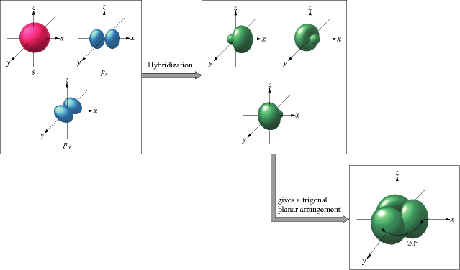
sp² hybrid orbitals

Slide 13

CH₄
C
1s²2s²2p²
ENERGY
↑
↑
↑
↑
↑
2p
2p
↑
↑
↑
↑
↑↓
↑
four
sp³
hybrid orbitals
2s
excitation
2s
hybridization
↑↓
↑↓
1s
1s

Slide 14
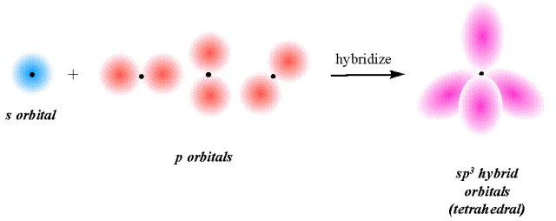
CH₄ → sp³ hybridization

Slide 15
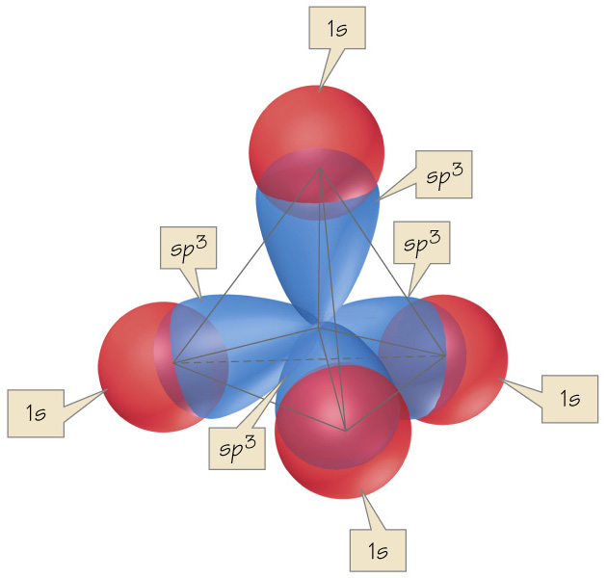
CH₄ → sp³ hybridization

Slide 16
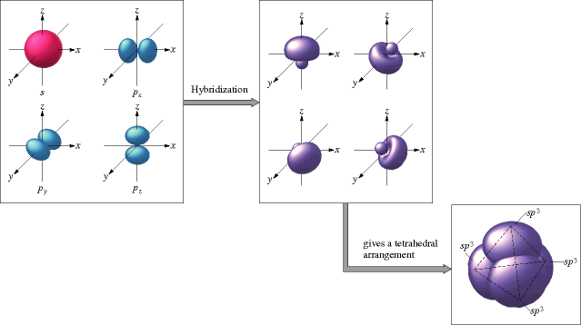
sp³ hybrid orbitals

Slide 17
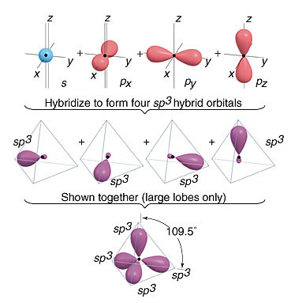
sp³ hybrid orbitals

Slide 18

H₂O
O
1s²2s²2p⁴
ENERGY
lone
pairs
available for bonding
↑↓
↑
↑
2p
↑↓
↑↓
↑
↑
↑↓
four
sp³
hybrid orbitals
2s
hybridization
↑↓
1s

Slide 19
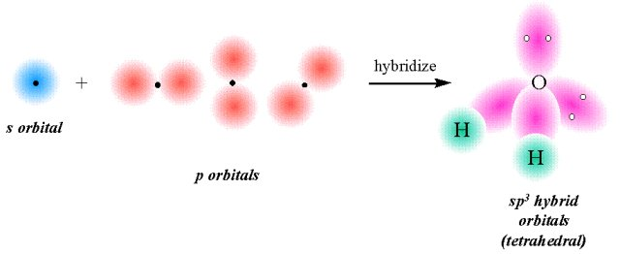
H₂O → sp³ hybridization

Slide 20
What about hybridization involving d orbitals?

Slide 21

PF₅
P
1s²2s²2p⁶3s²3p³
ENERGY
To simplify things, only draw valence electrons…
↑
3d
3d
↑
↑
↑
↑
↑
↑
↑
↑
↑
↑
↑
3p
3p
five
sp³d
hybrid orbitals
excitation
hybridization
↑↓
↑
3s
3s

Slide 22
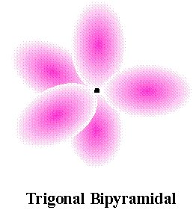
PF₅ → sp³d hybridization
3sp³d hybrid
orbitals

Slide 23

NH₃
N
1s²2s²2p³
ENERGY
lone
pair
available for bonding
↑
↑
↑
2p
↑↓
↑
↑
↑
↑↓
four
sp³
hybrid orbitals
2s
hybridization
↑↓
1s

Slide 24
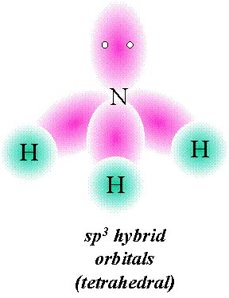
NH₃ → sp³ hybridization

Slide 25

Something to think about: is hybridization a real process or simply a mathematical device (a human construction) we’ve concocted to explain how electrons interact when new chemical substances are formed?

Slide 26
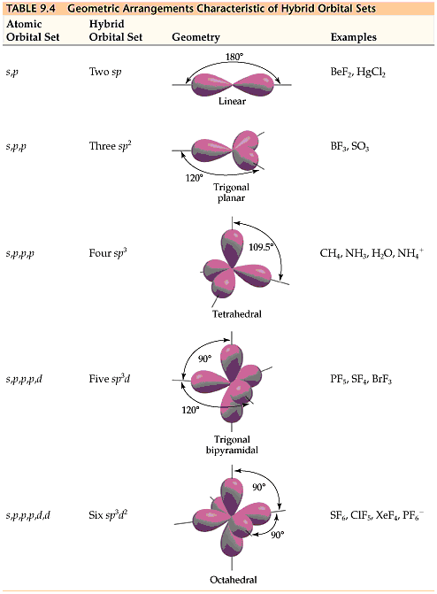

Valence electron pair geometry | # of orbitals | Hybrid orbitals | Electron density diagram | Examples
Linear | 2
Trigonal planar | 3
Tetrahedral | 4
Trigonal bipyramidal | 5
Octahedral | 6
BF₂
HgCl₂
CO₂
sp
sp²
BF₃
SO₃
CH₄
H₂O
NH₄⁺
sp³
PF₅
SF₄
BrF₃
sp³d
SF₆
XeF₄
PF₆⁻
sp³d²

Slide 27
σ and π bonds
In Hybridization Theory there are two names for bonds, sigma (σ) and pi (π).
Sigma bonds are the primary bonds used to covalently attach atoms to each other.
Pi bonds are used to provide the extra electrons needed to fulfill octet requirements.

Slide 28
σ and π bonds
Every pair of bonded atoms shares one or more pairs of electrons. In every bond at least one pair of electrons is localized in the space between the atoms, in a sigma (σ) bond.
The electrons in a sigma bond are localized in the region between two bonded atoms and do not make a significant contribution to the bonding between any other atoms.

Slide 29
σ and π bonds
In almost all cases, single bonds are sigma (σ) bonds. A double bond consists of one sigma and one pi (π) bond, and a triple bond consists of one sigma and two pi bonds.
  Examples:
One σ bond and one π bond.
H H
H ⎯ H
C = C
:N ≡ N:
One σ bond
H H
One σ bond and two π bonds.

Slide 30
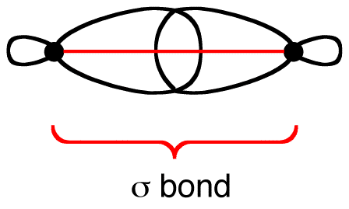
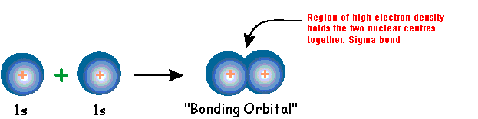
σ bonds
A Sigma bond is a bond formed by the overlap of two hybrid orbitals through areas of maximum electron density. This corresponds to the orbitals combining at the tips of the lobes in the orbitals.

Slide 31
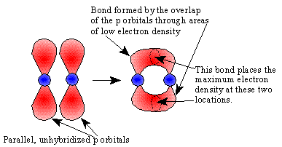
π bonds
A Pi bond is a bond formed by the overlap of two unhybridized, parallel p orbitals through areas of low electron density. This corresponds to the orbitals combining at the sides of the lobes and places stringent geometric requirements on the arrangement of the atoms in space in order to establish the parallel qualities that are essential for bonding.

Slide 32
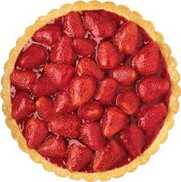
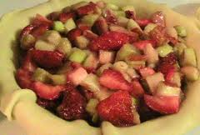
Remember – π bonds are unhybridized
strawberry pie
X
rhubarb pie
strawberry-rhubarb pie

Slide 33
Bond Strength
Sigma bonds are stronger than pi bonds.
A sigma plus a pi bond is stronger than a sigma bond. Thus, a double bond is stronger than a single bond, but not twice as strong.

Slide 34
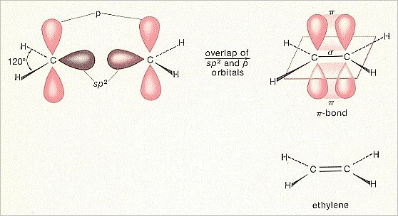
σ and π bonds
When atoms share more than one pair of electrons, the additional pairs are in pi (π) bonds. The centers of charge density in a (π) is above and below (parallel to) the bond axis.

Slide 35
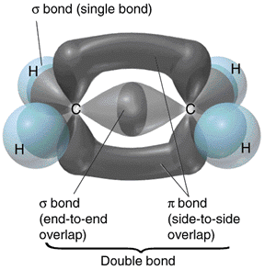
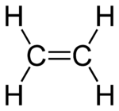
Ethene: C₂H₄

Slide 36
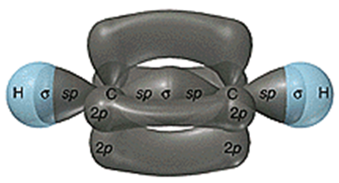
Ethyne: C₂H₂
H – C ≡ C - H

Slide 37
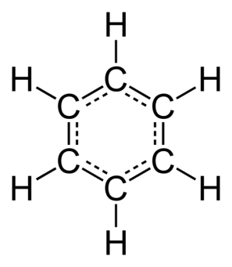
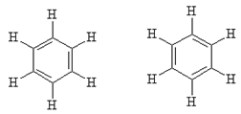
Delocalized Electrons
Molecules with two or more resonance structures can have bonds that extend over more than two bonded atoms. Electrons in pi (π) bonds that extend over more than two atoms are said to be delocalized.
  Example: Benzene (C₆H₆)

Slide 38
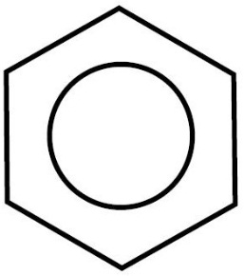
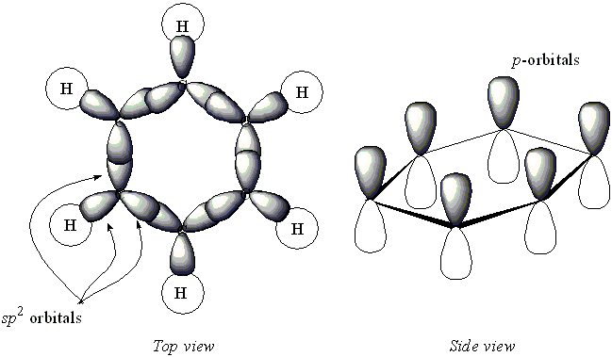
Example: Benzene
σ bonds (12) –electrons in sp² hybridized orbitals
π bonds (3) – electrons in unhybridized p-orbitals
Close enough to overlap

Slide 39
Delocalization of Electrons
Delocalization is a characteristic of electrons in pi bonds when there’s more than one possible position for a double bond within the molecule.

Slide 40
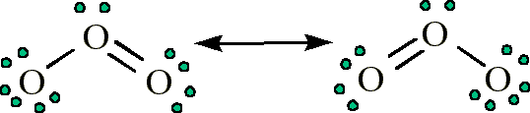
Example: ozone (O₃)
  These two drawn structures are known as resonance structures.

Slide 41
Example: ozone (O₃)
  They are extreme forms of the true structure, which lies somewhere between the two.
  Evidence that this is true comes from bond lengths, as the bond lengths for oxygen atoms in ozone are both the same and are an intermediates between an O=O double bond and an O-O single bond.

Slide 42
Example: ozone (O₃)
Resonance structures are usually drawn with a double headed arrow between them.

Slide 43
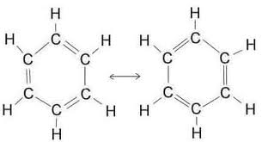
Note that benzene (C₆H₆) has six delocalized electrons. Since the p-orbitals overlap (forming three pi bonds, every-other-bond around the ring) all six electrons involved in pi bonding are free to move about the entire carbon ring.

Slide 44
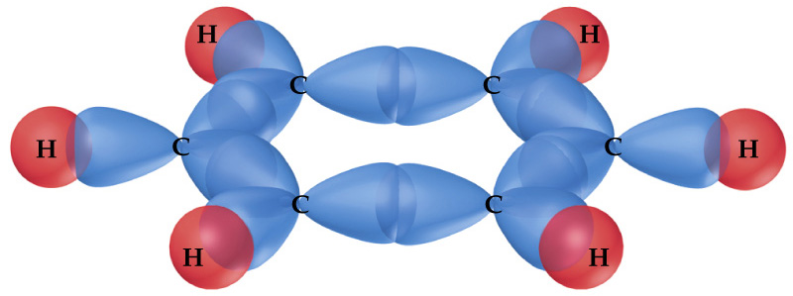
sigma bonding in benzene
(sp² hybrid orbitals)

Slide 45
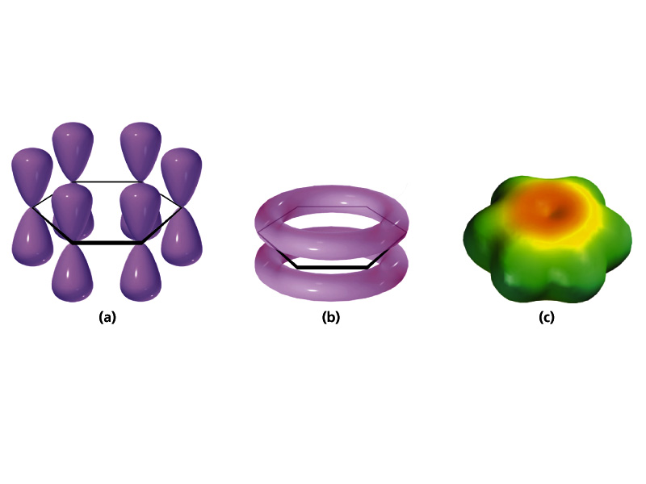
p orbitals
6 delocalized electrons
pi bonding in benzene
(unhybridized p orbitals)

Slide 46
Formal Charge
A concept know as formal charge can help us choose the most plausible Lewis structure where there are a number of possible structures.
This is not part of the IB curriculum, but it is part of the AP curriculum.
This theory certainly has its critics; however, it has been included in this section of the course as it may help you in determining the most likely structure.

Slide 47
Formal Charge
Definition of formal charge:
# valence e’s on the free atom
# valence e’s assigned to the atom in the structure

Slide 48
Rules Governing Formal Charge
To calculate the formal charge on an atom:
  Take the sum of the lone pair electrons and one-half the shared electrons. This is the number of valence electrons assigned to the atom in the molecule.
  Subtract the number of assigned electrons from the number of valence electrons on the free, neutral atom to obtain formal charge.
The sum of the formal charges of all atoms in a given molecule or ion must equal the overall charge on that species.
If nonequivalent Lewis structures exist for a species, those with formal charges closest to zero and with any negative formal charges on the most electronegative atoms are considered to best describe the bonding in the molecule or ion.

Slide 49
Example: CO₂
Possible Lewis structures of carbon dioxide:
.. ..
..
O = C = O :O – C ≡ O:
.. ..
..
Valence e⁻ 6 4 6 6 4 6
(e⁻ assigned
to atom)
6 4 6 7 4 5
Formal Charge
0 0 0 -1 0 +1

Slide 50
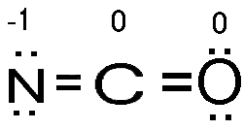
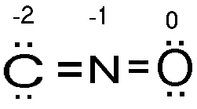
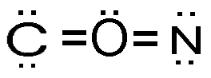
Example: NCO⁻
For example if we look at the cyanate ion, NCO⁻, we see that it is possible to write for the skeletal structure, NOC⁻, CNO⁻, or CON⁻.
Using formal charge we can choose the most plausible of these three Lewis structures.

Slide 51
Example: NCO⁻
Find formal charge…
Valance Electrons
5
4
6
# electrons assigned to atom
6
4
6
-1
0
0

Slide 52
Example: NCO⁻
Find formal charge…
Valance Electrons
4
5
6
# electrons assigned to atom
6
4
6
-2
+1
0

Slide 53
Example: NCO⁻
Find formal charge…
Valance Electrons
4
6
5
# electrons assigned to atom
6
6
6
-2
0
-1

Slide 54
Example: NCO⁻
-1 0 0
-2 +1 0
-2 +2 -1
Thus, the first structure is the most likely

