Slide 1
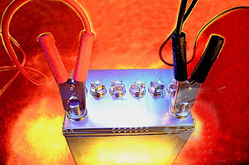
Unit 09: Oxidation and Reduction
PART 2: Electrochemistry

Slide 2
Voltaic Cells
Spontaneous redox rxns can be used to generate an electric current.
Half-reactions can be separated so that energy released during a reaction is available as electrical energy instead of being lost as heat.
Half-reactions are separated into half-cells, allowing the electrons to flow between them only through an external circuit.
This is known as an elecrochemical, galvanic or a voltaic cell.

Slide 3
Half-cells
A simple half-cell is a metal submerged in an aqueous sol’n of it’s own ions.

Slide 4
Half-Cells
In each half-cell, there is a charge separation (because the metal strip of atoms will forms ions by releasing elections that make the surface of the metal negatively charged with respect to the solution), known as electrode potential.
At the same time, ions in the sol’n gain electrons to form metal atoms, so an equilibrium exists.
Zn half-cell: Zn²⁺(aq) + 2e⁻ ↔ Zn(s)

Slide 5
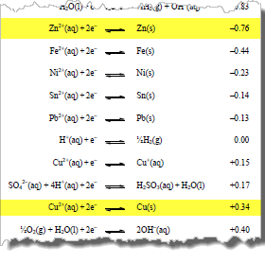
Half-Cells
Consider the Zn/Cu battery…
The eq’m position of each determines the size of the electrode potential in the half-cell and depends on the reactivity of the metal.

Slide 6
Half-Cells
Copper is the less reactive metal, so in its half-cell, the eq’m position lies further to the right; thus Cu has less of a tendency to lose electrons than Zn.
Zn half-cell: Zn²⁺(aq) + 2e⁻ ↔ Zn(s)
Cu half-cell: Cu²⁺(aq) + 2e⁻ ↔ Cu(s)
-0.76V
+0.34V

Slide 7
Half-Cells
Thus there are fewer electrons on the copper metal strip, so it will develop a larger (or less negative) electrode potential than the zinc half-cell.
Zn half-cell: Zn²⁺(aq) + 2e⁻ ↔ Zn(s)
Cu half-cell: Cu²⁺(aq) + 2e⁻ ↔ Cu(s)
-0.76V
+0.34V

Slide 8
Diagram of a voltaic cell: zinc/copper
When the copper and zinc half-cells are connected by an external wire, electrons will have a tendency to flow spontaneously from the zinc half-cell to the copper half-cell because of their different electrode potentials (a.k.a. potential difference).
Zn(s) → Zn²⁺(aq) + 2e⁻
Cu²⁺(aq) + 2e⁻ → Cu(s)

Slide 9
Diagram of a voltaic cell: zinc/copper
When the copper and zinc half-cells are connected by an external wire, electrons will have a tendency to flow spontaneously from the zinc half-cell to the copper half-cell because of their different electrode potentials (a.k.a. potential difference).
Zn(s) → Zn²⁺(aq) + 2e⁻
Cu²⁺(aq) + 2e⁻ → Cu(s)

Slide 10
Diagram of a voltaic cell: zinc/copper
When the copper and zinc half-cells are connected by an external wire, electrons will have a tendency to flow spontaneously from the zinc half-cell to the copper half-cell because of their different electrode potentials (a.k.a. potential difference).
Zn(s) → Zn²⁺(aq) + 2e⁻
Cu²⁺(aq) + 2e⁻ → Cu(s)

Slide 11
Diagram of a voltaic cell: zinc/copper
When the copper and zinc half-cells are connected by an external wire, electrons will have a tendency to flow spontaneously from the zinc half-cell to the copper half-cell because of their different electrode potentials (a.k.a. potential difference).
Zn(s) → Zn²⁺(aq) + 2e⁻
Cu²⁺(aq) + 2e⁻ → Cu(s)

Slide 12
Diagram of a voltaic cell: zinc/copper
When the copper and zinc half-cells are connected by an external wire, electrons will have a tendency to flow spontaneously from the zinc half-cell to the copper half-cell because of their different electrode potentials (a.k.a. potential difference).
Zn(s) → Zn²⁺(aq) + 2e⁻
Cu²⁺(aq) + 2e⁻ → Cu(s)

Slide 13
Diagram of a voltaic cell: zinc/copper
When the copper and zinc half-cells are connected by an external wire, electrons will have a tendency to flow spontaneously from the zinc half-cell to the copper half-cell because of their different electrode potentials (a.k.a. potential difference).
Zn(s) → Zn²⁺(aq) + 2e⁻
Cu²⁺(aq) + 2e⁻ → Cu(s)

Slide 14
Mnemonic device for you…
Big fat
red cat!
The big fat # (greatest reduction potential) is the site of reduction (cathode)

Slide 15
Standard Electrode Potentials
A voltaic cell generates an electromotive force (emf) as electrons flow from the half-cell with more negative potential to the half-cell with the more positive potential.
Magnitude of voltage depends on the difference in the tendencies of these two half-cells to undergo reduction.
Electrode potential of a single half-cell cannot be measured in isolation, but only when electrons flow as it is linked to another half-cell.

Slide 16
Standard Electrode Potentials
Thus, to create a list of relative reducing powers of different half-cells, it is necessary to compare them all with some fixed reference point that acts as a standard for measurement.

Slide 17
Why do we need a standard???
Analogy: heights of mountains can be compared with each other because each is given a height relative to an agreed zero point (sea level)

Slide 18
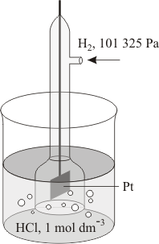
Standard Electrode Potentials
Reference standard in electrochemistry = standard hydrogen electrode.
H₂(g) 2H⁺(aq) + 2e⁻
The hydrogen half-cell is arbitrarily assigned electrode potential = 0 V
This gives us a means to measure and compare the electrode potential of any other half-cell to which it is connected.

Slide 19
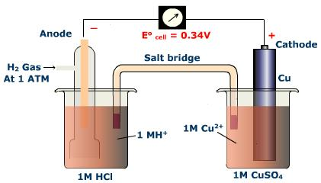
Measuring standard electrode potentials
Half-cells are connected with hydrogen electrode under standard conditons:
Concentration of all sol’ns = 1.0 mol dm⁻³
Pressure of all gases = 100 kPa
All substances used must be pure
Temp = 298 K / 25 °C
If half-cell does not include a solid metal, platinum (Pt) is used as the electrode.

Slide 20
Measuring standard electrode potentials
Shorthand/line notation:

Slide 21
Calculations involving standard electrode potentials
Keep the following in mind:
All E° values refer to the reduction rxn.
The E° value for the oxidation rxn will be of equal magnitude and opposite sign.
The E° values do not depend on the total number of electrons, so do not have to be scaled up or down according to the stoichiometry of the eq’n.
The more positive the E° value for a half-cell, the more readily it is reduced.
More negative reduction potential = anode
More positive reduction potential = cathode

Slide 22
1. Calculating the cell potential, E°_{cell}
E°_{cell} = E°_{cathode} - E°_{anode}
E°_{cell} = E°half-cell where reduction occurs - E°half-cell where oxidation occurs
Example: Calculate the emf for a voltaic cell constructed from a copper half-cell and a silver half-cell.
E°_{cell} = +0.34 V – (-0.76V)
E°_{cell} = +1.10 V

Slide 23
2. Determining spontaneity of a rxn – plug in values based on way rxn is written.
Spontaneous if E°_{cell} = positive
E°_{cell} = E°half-cell where reduction occurs - E°half-cell where oxidation occurs
Example: Determine whether the following rxn will be spontaneous under standard conditions:
Ni(s) + Mn²⁺(aq) → Ni²⁺(aq) + Mn(s)
Oxidation:
Ni(s) → Ni²⁺(aq) + 2e⁻
Reduction:
Mn²⁺(aq) + 2e⁻ → Mn(s)
E°_{cell} = -1.19 V – (-0.26V)
E°_{cell} = -0.93 V
Nonspontaneous (negative)

Slide 24
3. Comparing relative oxidizing and reducing power of half-cells
Can be used to confirm order of the reactivity series.
Metals with low E° values (most negative) are the strongest reducing agents.
Non-metals with high E° values are the strongest oxidizing agents.

Slide 25
Units
SI unit of electric current (I): ampere (A)
SI unit of electric charge (Q): Coulomb (C) → amt. of charge transported in 1 sec by a current of 1 amp
Q = I x t
C = A x s
Charge of a single electron = 1.602 x 10⁻¹⁹ C
Charge of one mole of electrons = 96, 485 C mol⁻¹ (Farraday’s constant)
SI unit of potential difference: volt (V) → equal to the difference in electric potential between two points on a conducting wire, and defined as the amount of energy (J) that can be delivered by a Coulomb of electric charge (C).
V = J / C

Slide 26
Units
Charge of a single electron = 1.602 x 10⁻¹⁹ C
Charge of one mole of electrons = 96, 485 C mol⁻¹ (Farraday’s constant)
Value provided on IB test
Constant given on AP test

Slide 27
Electrolytic Cells
An external source of electricity drives non-spontaneous redox rxns.
Electricity is passed through an electrolyte and electrical energy is converted into chemical energy.
Electrolyte: substance which does not conduct electricity when solid, but does conduct electricity when molten or in aqueous solution and is chemically decomposed in the process.

Slide 28
Electrolytic Cells

Slide 29
Electrolytic Cells
Example: electrolysis of molten sodium chloride

Slide 30
Electrolytic Cells
Example: electrolysis of molten sodium chloride

Slide 31
Electrolytic Cells
Example: electrolysis of molten sodium chloride

Slide 32
Electrolytic Cells
Note: electrode terminology flips from voltaic to electrolytic (because oxidation always occurs at the anode and reduction at the cathode) as we are forcing the current to flow in the nonspontaneous direction in the electrolytic cell.
 | Voltaic Cell |  | Electrolytic Cell
Anode | oxidation occurs here | negative | oxidation occurs here | positive
Cathode | reduction occurs here | positive | reduction occurs here | negative

Slide 33
Electrolysis of aqueous solutions: be familiar with the following examples – see handout, pp. 350-352 of HL Chemistry (Pearson)
Electrolysis of water
Electrolysis of NaCl(aq)
Electrolysis of CuSO₄(aq)

Slide 34
Factors influencing selective discharge during electrolysis see handout, pp. 350-352 of HL Chemistry (Pearson)
Relative E° values of the ions
Concentrations of the ions in the electrolyte
Nature of the electrode

Slide 35
Factors affecting the amount of product in electrolysis
Charge of the ion
Current
Duration of the electrolysis

Slide 36
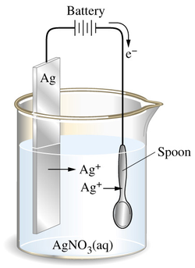
Electroplating: the process of using electrolysis to deposit a layer of metal on top of another metal or other conductive substance. An electrolytic cell used for electroplating has the following features:
An electrolyte containing the metal ions which are to be deposited.
The cathode made of the object to be plated.
Sometimes the anode is made of the same metal which is to be coated because it may be oxidized to replenish the supply of ions in the electrolyte.
Reduction of the metal ions at the cathode leads to their deposition on its surface. The process can be controlled by altering the current and the time according to how thick a layer of metal is desired.

Slide 37
Electroplating
Example: How long must a current of 5.00 A be applied to a solution of Ag⁺ to produce 10.5 g of silver metal?
(Sample exercise 17.9, p. 818)
Ag⁺ + 1e⁻ → Ag(s)
5.00 A = 5.00 C/sec
= 1.88 x 10³ sec
= 31.3 min

Slide 38
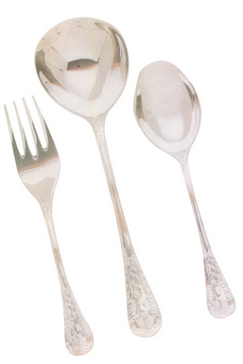
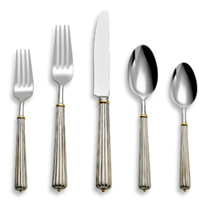
Uses of electroplating
Decorative purposes (gold over silver jewelry; nickel plating of cutlery)

Slide 39
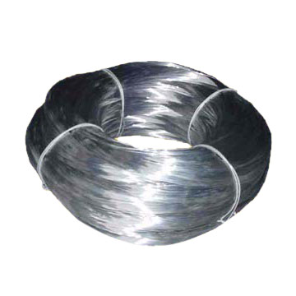
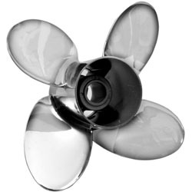
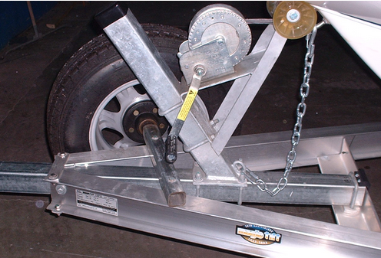
Uses of electroplating
Corrosion control (galvanized iron – zinc deposited on iron to be preferentially oxidized)

Slide 40
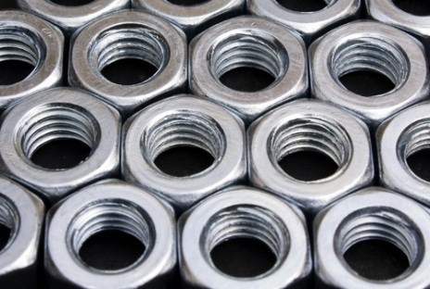
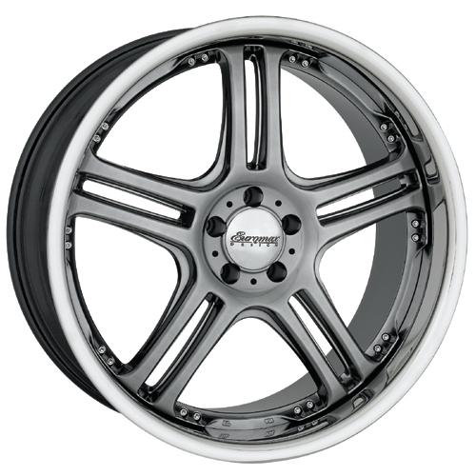
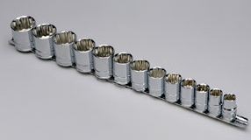
Uses of electroplating
Improvement of function (chromium on steel reduces wear of tools, for example)

Slide 41
Summary of voltaic and electrolytic cells
Type of cell | E_{cell} | ∆G | Type of rxn
voltaic | >0 | <0 | spontaneous
electrolytic | <0 | >0 | non-spontaneous
equilibrium | 0 | 0 | dead battery

