Slide 1
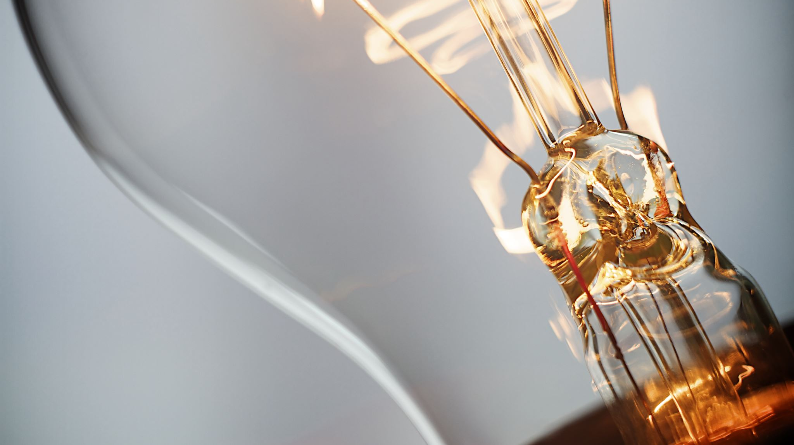
Momentum and Impulse
https://scienceknowledge.webador.com/

Slide 2
Learning Objectives
Understand what momentum is
Defintion, SI unit, calculation
Understand the connection between Newton’s second law and momentum
Net force F=ma
Momentum p=mv
Understand that change in momentum is equal to impulse
Basic diagram
Momentum and force-time graph
Understand conservation of momentum
Problem Solving
Collision and momentum

Slide 3
What is Momentum?

Slide 4
Momentum and Newton’s Law

Slide 5
Impulse

Slide 6
Example 1
A ball is thrown rightward at a spped of v. After t seconds, the ball collides with a wall and bounces back with a final speed of v. What is the change in momentum?

Slide 7
Example 2
You've been rowdy and obnoxious in a bar and now are in the process of being thrown out by the bouncer by the scruff of the neck. The bouncer has hold of you for 5.0 s and you are given a final velocity of 2.75 m/s. If your mass is 70.0 kg, what was your final momentum? What impulse and average force did the bouncer exert on you? Assume all motion is in a straight line.
https://www.kpu.ca/sites/default/files/Faculty%20of%20Science%20%26%20Horticulture/Physics/PHYS%201100%20Collision%20%26%20Momentum%20Solutions.pdf

Slide 9
Example 3
A ball of mass 0.25 kg glances of a wall as shown in the diagram. The ball approaches at 15 m/s at θ = 30° and leaves at 12 m/s at φ = 20°. The collision lasts for 15 milliseconds. (a) What are the components of the impulse experienced by the ball? (b) What are the components of the average force acting on the ball?

Slide 11
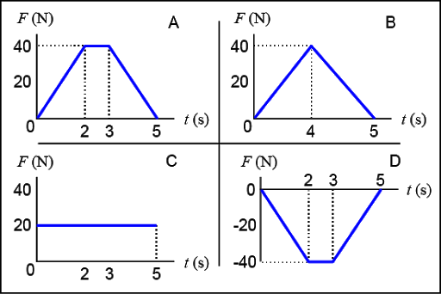
Force and Time Graph

Slide 12
Example 1

Slide 14
Conservation of Momentum

Slide 15
Collision and Momentum

Slide 16
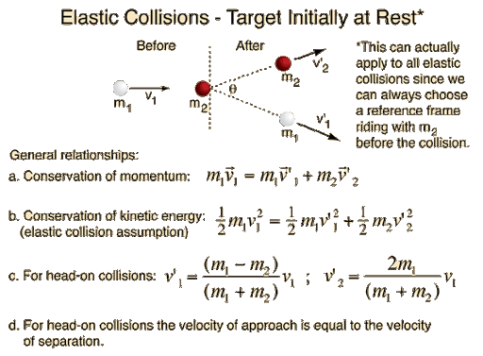

Slide 17
Example 1
While chasing an armed suspect into and onto an ice rink, a police constable is shot. Fortunately, the constable is wearing a bullet­proof vest which absorbs the bullet. If the muzzle velocity of the bullet is 350 m/s and the its mass is 100 g. Find the final velocity of the constable and bullet if her mass is 69.5 kg. Assume all motion is in a straight line and ignore friction. Assume that the constable is at rest.

Slide 19
Example 3
A 3000 kg truck travelling at 50 km/hr strikes a stationary 1000 kg car, locking the two vehicles together. A) What is the final velocity of the two vehicles?

Slide 20
References
http://hyperphysics.phy-astr.gsu.edu/hbase/inecol.html
http://hyperphysics.phy-astr.gsu.edu/hbase/elacol2.html

