Slide 1



Unit 04: BONDING
IB Topics 4 & 14
Text: Ch 8 (all except sections 4,5 & 8)
Ch 9.1 & 9.5
Ch 10.1-10.7
My Name is Bond. Chemical Bond

Slide 2
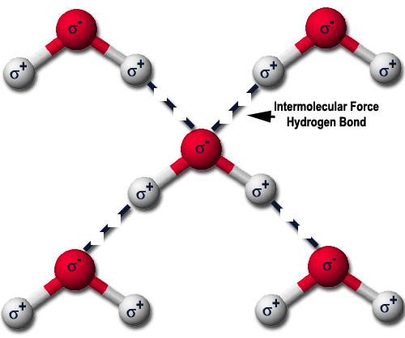
PART 4:
Intermolecular Forces

Slide 3
Intermolecular Forces
Dipole-Dipole
Hydrogen Bonding
  (special case of dipole-dipole)
London Dispersion Forces
Ionic

Slide 4
Intermolecular Forces
The forces that act between different molecules are called intermolecular forces.
These are the forces that make solids and liquids.

Slide 5

Intermolecular Forces
The intermolecular forces (forces between molecules) are weaker than intramolecular forces (the chemical bonds within an individual molecule). This distinction is of course why molecules exist.

Slide 6
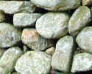
Solids
In solids the intermolecular attractive forces are strong enough not only to hold molecules close together but to virtually lock them in place.
Solids, like liquids, are not very compressible because the molecules have little free space between them. Often the molecules take up positions in a highly regular pattern. Solids that possess highly ordered structures are said to be crystalline.

Slide 7
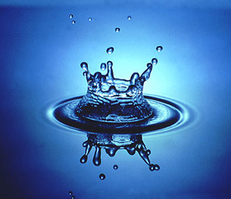
Liquids
In liquids the intermolecular attractive forces are strong enough to hold molecules close together. Thus liquids are much denser & far less compressible than gases.
The attractive forces in liquids are not strong enough, however, to keep the molecules from moving past one another. Thus liquids can be poured, and assume the shapes of their container.

Slide 8
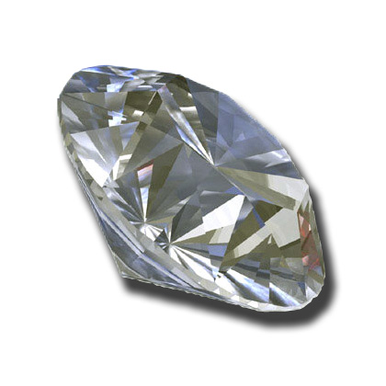
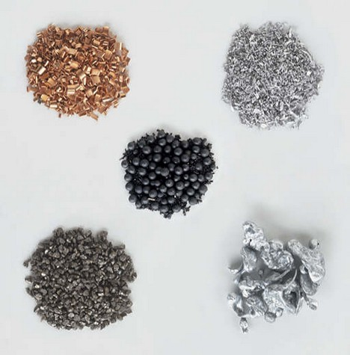
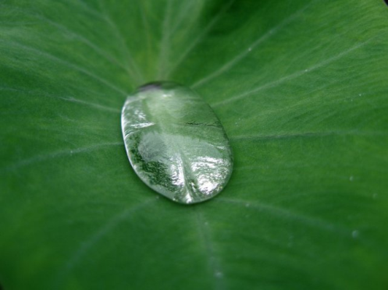

Intermolecular Forces
Many properties of materials, including their boiling and melting points, reflect the strength of the intermolecular forces.

Slide 9

Intermolecular Forces
A liquid boils when bubbles of its vapor form within the liquid. The molecules of a liquid must overcome their attractive forces in order to separate and form a vapor.
  The stronger the attractive forces, the higher the temperature at which the liquid boils.
Similarly, the melting points of solids increase with an increase in the strength of the intermolecular forces.

Slide 10
Kinds of Solids
  Ionic solids
  Covalent-network solids
  Metallic solids
  Molecular solids
    Dipole-dipole
    Hydrogen bonded
    London dispersion force
These forces can also hold molecules together to form liquids.

Slide 11
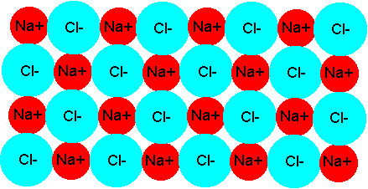
Kinds of Solids
Ionic – high melting points
sodium chloride

Slide 12
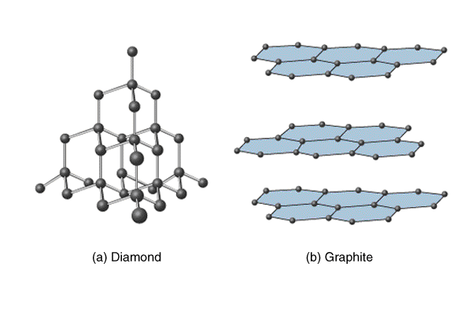
Kinds of Solids
Covalent-network

Slide 13
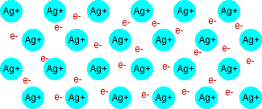
Kinds of Solids
Metallic – delocalized electrons
silver

Slide 14
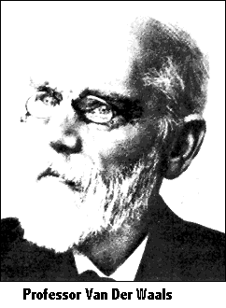
Kinds of Solids
Molecular solids - solids and liquids held together primarily by one or more of the following forces…
  Dipole – Dipole Forces (Interactions)
  Hydrogen Bonding
  London Dispersion Forces
  Colletively these forces are
  called van der Waals Forces

Slide 15
Warning! There's a bit of a problem here with modern A'level text books. Some texts talk as if dipole-dipole interactions are quite distinct from van der Waals forces. Such a text will talk about van der Waals forces (meaning dispersion forces) and, separately, dipole-dipole interactions.
All intermolecular attractions are known collectively as van der Waals forces. The various different types were first explained by different people at different times. Dispersion forces, for example, were described by London in 1930; dipole-dipole interactions by Keesom in 1912.
This oddity in the texts doesn't matter in the least as far as understanding is concerned - but you obviously must know what your particular examiners mean by the terms they use in the questions.

Slide 16
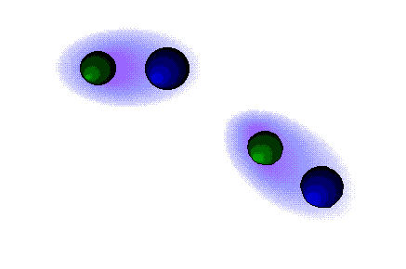
Intermolecular Forces
Molecular
  Dipole-dipole forces - the electrical attractive forces that exist between polar molecules.

Slide 17
Dipole-Dipole Interactions
The attractive forces are stronger than the repulsive forces, so there is an overall attraction between the molecules.
Attractive Forces
++++
----
++++
----
Repulsive Forces

Slide 18
Hydrogen Bonding
Special case of dipole-dipole interactions
  Seen among molecules where H is bonded to a highly electronegative atom, such as N, O or F.
Example: water
H
O
H

Slide 19
Hydrogen Bonding
Special case of dipole-dipole interactions
  Seen among molecules where H is bonded to a highly electronegative atom, such as N, O or F.
Example: water
δ-
δ+
H
O
δ-
Water is a very polar molecule due to its geometry and very polar bonds
H
δ+

Slide 20
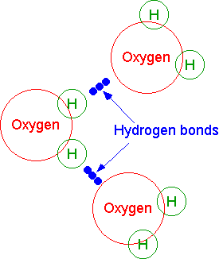
Water
Draw THIS diagram:

Slide 21

Hydrogen Bonding
Remember: “H- bonding” only exists between hydrogen and nitrogen, oxygen or fluorine
H – N
H – O
H - F

Slide 22
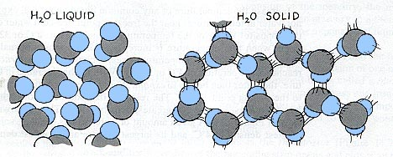
Water

Slide 23
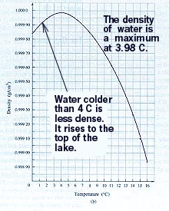
Water

Slide 24
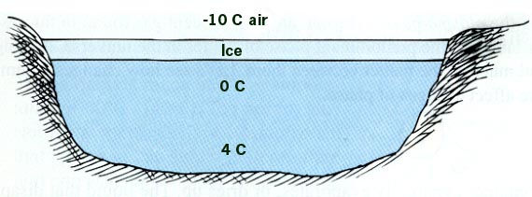

Water
This causes lakes to freeze at the top first. This is very nice for fish.
…and ice skaters!

Slide 25

Water

Slide 26

May the Force be with you, Luke.
Understanding the ways of the intermolecular
forces allows us to understand why substances
are the way they are.

Slide 27

When approaching IB Chemistry…
Do or do not. There is no try.

Slide 28


Why is methane a gas at room temperatures, yet methanol is a liquid?
H-bonding the answer is.

Slide 29
H-bonding
Why is methane a gas at room temperatures, yet methanol is a liquid?
H
H
..
H
H
H
C
..
C
O
H
H
H
Methane
Methanol

Slide 30
H-bonding
Why is methane a gas at room temperatures, yet methanol is a liquid?
Methanol has H-bonding; methane only has weak dispersion forces
..
..
H
O
H
H
H
C
..
..
H
H
H
C
H
H
C
O
H
H
H
Methane
Methanol

Slide 31
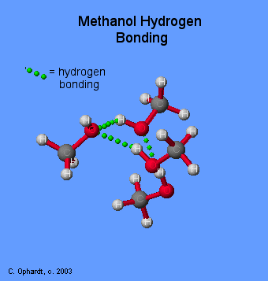
H-bonding in Methanol

Slide 32
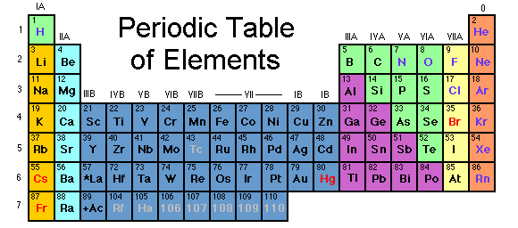
Consider the boiling points of several hydrides…..
100
Normal Boiling Point (ºC)
SnH₄
0
-100
0 50 100 150
Molecular Mass

Slide 33
100
Normal Boiling Point (ºC)
SnH₄
0
GeH₄
-100
0 50 100 150
Molecular Mass

Slide 34
100
Normal Boiling Point (ºC)
SnH₄
0
GeH₄
SiH₄
-100
0 50 100 150
Molecular Mass

Slide 35
100
Normal Boiling Point (ºC)
SnH₄
0
GeH₄
SiH₄
-100
CH₄
0 50 100 150
Molecular Mass

Slide 36
100
Normal Boiling Point (ºC)
H₂Te
SnH₄
0
GeH4
SiH4
-100
CH4
0 50 100 150
Molecular Mass

Slide 37
100
Normal Boiling Point (ºC)
H₂Te
H₂Se
SnH₄
0
GeH4
SiH4
-100
CH4
0 50 100 150
Molecular Mass

Slide 38
100
Normal Boiling Point (ºC)
H₂Te
H₂Se
SnH₄
0
GeH4
H₂S
SiH4
-100
CH4
0 50 100 150
Molecular Mass

Slide 39
H₂O
100
Normal Boiling Point (ºC)
H₂Te
H₂Se
SnH₄
0
GeH4
H₂S
SiH4
-100
CH4
0 50 100 150
Molecular Mass

Slide 40

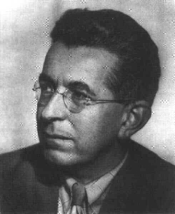
London dispersion forces
X
London City
Fritz London (1900-1954)

Slide 41

Dispersion forces
Attractions are electrical in nature. In a symmetrical molecule like hydrogen, however there doesn’t seem to be any electrical distortion to produce positive or negative parts.
But this is only true when averaged over time.

Slide 42

Dispersion forces
Example: consider a small symmetrical molecule, such as H₂ or Br₂.
The even shading shows that on average there is no electrical distortion.

Slide 43


Dispersion forces
However, the electrons are mobile. At any one instant they might find themselves towards one end of the molecule, making that end (-) and the other end (+). This is called an instantaneous dipole.
δ+
δ-

Slide 44
Dispersion forces
An instant later the electrons may well have moved to the other end, reversing the polarity of the molecule.
δ-
δ+

Slide 45
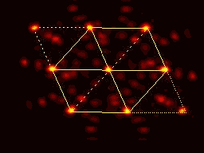

Dispersion forces
This constant “sloshing around” of the electrons in the molecule causes rapidly fluctuating dipoles even in the most symmetrical molecules.

Slide 46

Dispersion forces
This “sloshing” even happens in monatomic atoms --- noble gases, like helium which consist of a single atom.
If both the helium electrons happen to be on one side of the atom at the same time, the nucleus is no longer properly covered by electrons for that instant.

Slide 47
Dispersion forces
Imagine a molecule which has a temporary polarity being approached by one which happens to be entirely non-polar just at that moment.
  (This is actually pretty unlikely, but it makes the diagrams easier to draw. In reality, one of the molecules is likely to have a greater polarity than the other at that time, and so will be the dominant one.)
δ-
δ+
Non-polar

Slide 48
Dispersion forces
As the molecule approaches, its electrons will tend to be attracted by the slightly positive end of the other molecule.
  This sets up an induced dipole in the molecule, and it to becomes polar (at least for the moment).
δ-
δ+
δ-
δ+
induced dipole

Slide 49
Dispersion forces
An instant later the electrons in the left-hand molecule may well have moved to the other end. In doing so, they will repel the electrons in the right hand one.
δ+
δ-
δ-
δ+

Slide 50
Dispersion forces
The polarity of both molecules reverses, but you still have attraction. As long as the molecules stay close to each other the polarities will continue to fluctuate in synchronization so that the attraction is always maintained.
δ+
δ-
δ+
δ-

Slide 51
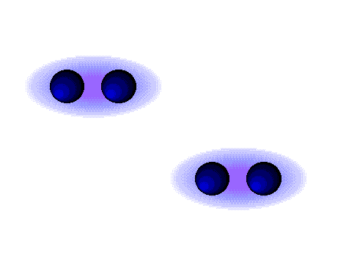
Dispersion forces
(London) Dispersion Forces
Two Nonpolar Molecules

Slide 52
Dispersion forces
There is no reason why this has to be restricted to two molecules. As long as the molecules are close together this synchronized movement of the electrons can occur over huge numbers of molecules.

Slide 53
Dispersion forces
An instant later, of course, you would have to draw a quite different arrangement of the distribution of the electrons as they shifted about—but always in synchronization.

Slide 54
Dispersion forces
It’s important to understand that dispersion forces act between all molecules.
They are usually only important when they are the only force acting.

Slide 55
Dispersion forces
POLARIZABILITY: The ease with which the charge distribution in a molecule can distorted by an external electric field is called its polarizability.
You can think of the polarizability of a molecule as a measure of the “squishiness” of its electron cloud; the great greater the polarizability of a molecule, the more easily its electron cloud can be distorted to give a momentary dipole, which leads to stronger London dispersion forces.

Slide 56
Dispersion forces
In general, larger molecules tend to have greater polarizabilities because they have a greater number of electrons and their electrons are farther from the nuclei.
Dispersion forces tend to increase in strength with increasing molecular weight.

Slide 57
Dispersion forces and molar mass
Gas
Gas
Liquid
Solid
Solid

Slide 58
Dispersion forces
The shapes of molecules can also play a role in the magnitudes of dispersion forces.
Typically, the greater the surface area of the molecule, the greater the dispersion forces.

Slide 59
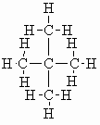
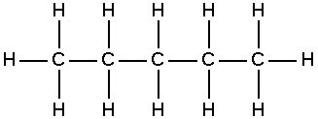


Dispersion forces
Example: Which will have the higher BP,
pentane (C₅H₁₂) or 2,2-dimethylpropane (C₅H₁₂)?
BP = 309.4K
BP = 282.7K

Slide 60

Rules of Thumb…
When the molecules have comparable molecular weights and shapes, dispersion forces are approximately equal.
In this case, differences in the magnitudes of the attractive forces are due to differences in the strengths of dipole-dipole attractions, with the most polar molecules having the strongest attractions.

Slide 61
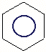
Challenge: benzene v. toluene v. phenol
H
H-C-H
O-H
Benzene Toluene Phenol
Melting Point (ºC) 5 -95 43
Boiling Point (ºC) 80 111 182

Slide 62
Example: benzene v. toluene v. phenol
The properties of molecular solids depend not only on the strength of the forces that operate between molecules but also on the abilities on the molecules to pack efficiently in three dimensions
H
H-C-H
O-H
Benzene Toluene Phenol

Slide 63
Example: benzene v. toluene v. phenol
Benzene is a highly symmetrical planar molecule. It has a higher melting point than toluene. The lower symmetry of toluene molecules prevents them from packing as efficiently as benzene molecules. As a result, the intermolecular forces that depend on close contact are not as effective, and the melting point is lower.
H
H-C-H
O-H
Benzene Toluene Phenol

Slide 64
Example: benzene v. toluene v. phenol
In contrast, the boiling point of toluene is higher than that of benzene, indicating that the intermolecular attractive forces are larger in liquid toluene than in liquid benzene. (greater molecular weight … greater dispersion forces)
H
H-C-H
O-H
Benzene Toluene Phenol

Slide 65
Example: benzene v. toluene v. phenol
For phenol, both the melting and boiling points are higher than those of benzene because of the hydrogen bonding ability of the OH group in phenol.
H
H-C-H
O-H
Benzene Toluene Phenol

Slide 66
Relative strengths of forces:
Covalent bonds > | Hydrogen bonding > | Dipole-dipole interactions > | London forces
400 kcal > | 12-16 kcal > | 2-0.5 kcal > | less than 1 kcal

