Slide 1
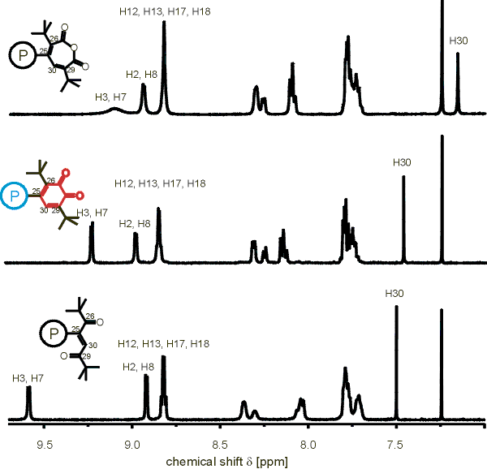
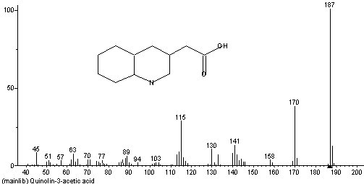
Analytical Chemistry
Option A
Part 1: Mass Spectrometry & H-NMR

Slide 2
Reasons for using analytical techniques:
Structure determination
Analysis of composition of substances
To determine purity of a substance

Slide 3
Examples of analytical techniques
Atomic absorption spectroscopy
Infrared spectroscopy
Mass spectrometry
¹H nuclear magnetic resonance (NMR)
Chromatography

Slide 4
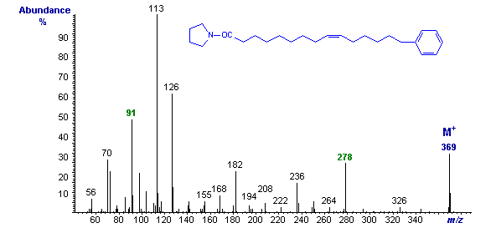
Mass spectrometry
Used to determine relative atomic and molecular masses. The fragmentation pattern can be used as a fingerprint technique to identify unknown substances or for evidence for the arrangements of atoms in a molecule.

Slide 5
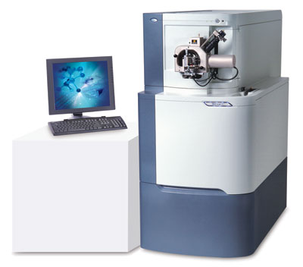
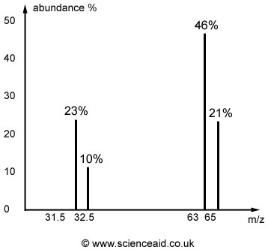
For review…
Mass Spectrometry

Slide 6
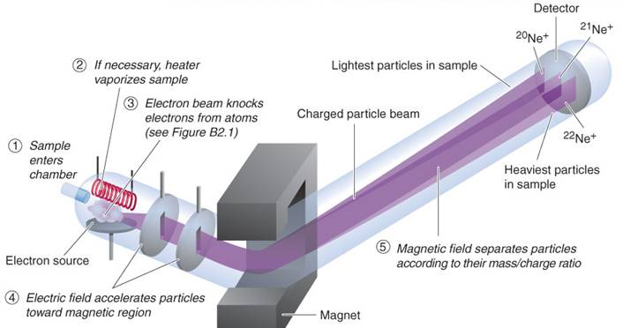
The Mass Spectrometer
Relative atomic masses (among other things we will discuss when we get to organic chemistry) can be determined using this instrument.

Slide 7
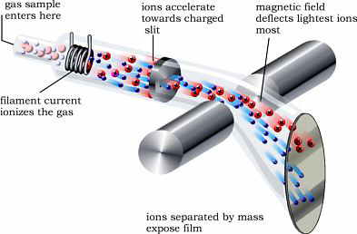
How it works (5 basic steps):
1.
vaporization: if the sample is not already as gas, the sample is heated to this point.

Slide 8
How it works (5 basic steps):
2.
ionization: sample is bombarded with a stream of high energy electons. In practice, the instrument is set so that only ions with a single positive charge are formed (M⁺).

Slide 9
How it works (5 basic steps):
3.
acceleration: resulting unipositive ions pass through slits in parallel plates under the influence of an electric field.

Slide 10
How it works (5 basic steps):
4.
deflection: ions are then passed over an external magnetic field. The magnetic field causes the ions to be deflected, and the amount of deflections is proportional to the charge/mass ratio. Ions with smaller masses are deflected more than heavier ions. Ions with higher charges are deflected more as they interact more effectively with the magnetic field.
Heavier particles
lighter particles

Slide 11
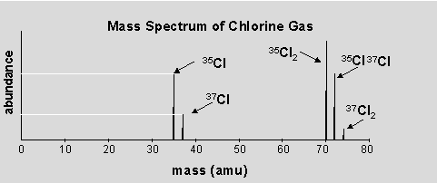
How it works (5 basic steps):
5.
detection: positive ions of a particular mass/charge ratio are detected and a signal is sent to a recorder. The strength of the signal is a measure of the number of ions with that charge/mass ratio that are detected.

Slide 12
Example: Find the relative atomic mass (A_{r}) of naturally occurring lead from the data below. Record your answer to the nearest tenth.
Isotopic mass | Relative abundance | % relative abundance
204 | 0.2 | 2
206 | 2.4 | 24
207 | 2.2 | 22
208 | 5.2 | 52
$$A_{r}=\frac{\left(2×204\right)+\left(24×206\right)+\left(22×207\right)+\left(52×208\right)}{100}$$
$A_{r}=$207.2
Figure: The Mass Spectrum of Naturally Occurring Lead

Slide 13
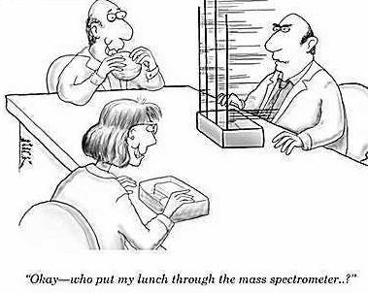

Slide 14
Determining the molecular mass of a compound
Can also use to determine relative molecular mass of a compound (M_{r})
If empirical formula is known, can be used to determine molecular formula.

Slide 15
Fragmentation Patterns
Ionization process involves an e- from an electron gun hitting the incident species and removing an electron:
X(g) + e- → X+(g) + 2e-
This collision can be so energetic that it causes the molecule to break up into different fragments.

Slide 16
Fragmentation Patterns
The largest mass peak corresponds to a parent ion passing through the instrument unscathed, but other ions produced as a result of this break up are also detected.

Slide 17
Fragmentation Patterns
The fragmentation pattern can provide useful evidence for the structure of the compound.

Slide 18
Fragmentation Patterns
A chemist pieces together the fragments to form a picture of the complete molecule, just as the archaeologist finds clues about the past from pieces of artifacts discovered on the ground.

Slide 19
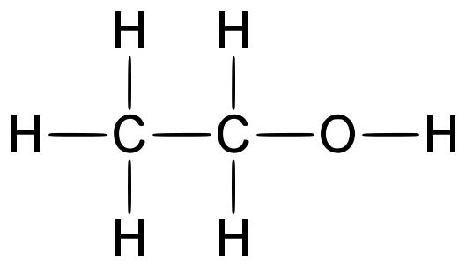
Example: ethanol
100
31
relative abundance
45
15
29
46
0
0
30
60
mass/charge

Slide 20
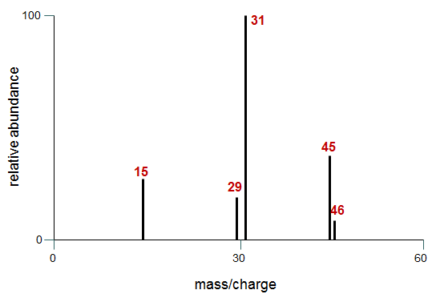
Example: ethanol

Slide 21
Example: ethanol
Note: This fragmentation will yield either CH₃⁺ and CH₂OH or CH₃ and CH₂OH⁺, yielding peaks at both 15 and 31

Slide 22
Example: ethanol
100
31
CH₂OH⁺
relative abundance
C₂H₅O⁺
CH₃⁺
45
15
C₂H₅⁺
29
46
C₂H₅OH⁺
0
0
30
60
mass/charge

Slide 23
So…
The highest mass fragment represents the M_{r} of the compound.
Fragments provide clues about structure because certain numbers correspond to particular groups.

Slide 24
Fragments you will be expected to recognize:
M_{r} | loss of…
15 | CH₃⁺
17 | OH⁺
29 | C₂H₅⁺ or CHO⁺
31 | CH₃O⁺
45 | COOH⁺

Slide 25
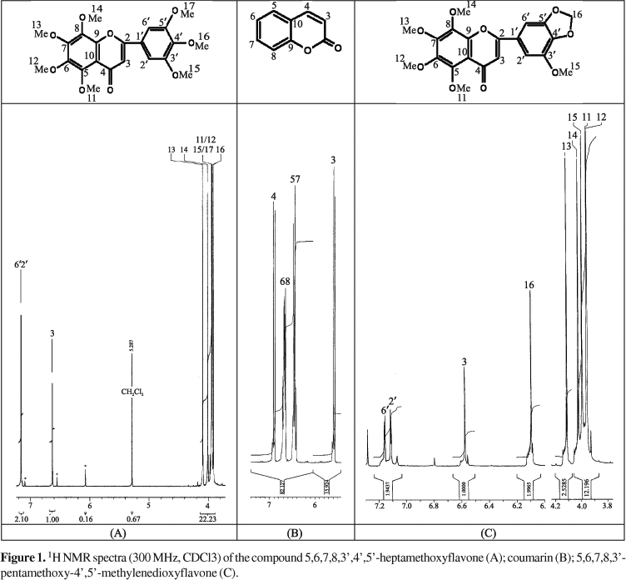
Nuclear magnetic resonance (NMR) spectroscopy
Used to show the chemical environment of certain isotopes (hydrogen, carbon, phosphorous and fluorine) in a molecule and so gives vital structural information.

Slide 26
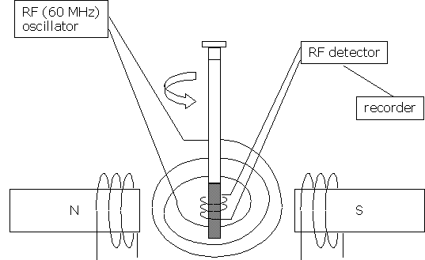
Nuclear magnetic resonance (NMR) spectroscopy
Nuclei of atoms with an odd number of protons spin and behave like tiny bar magnets.
If placed in external magnetic field, some of these nuclei will line up with applied field and, if they have sufficient energy, some will line up against it.
This arrangement leads to two nuclear energy levels; the energy needed for the nuclei to reverse their spin and flip over can be provided by radio waves (RF).

Slide 27
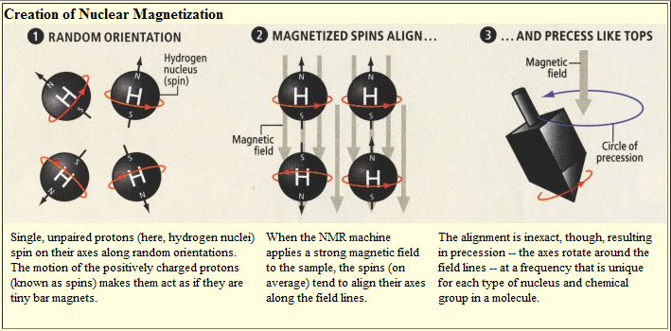
Nuclear magnetization

Slide 28
Hey remember these???

Slide 29
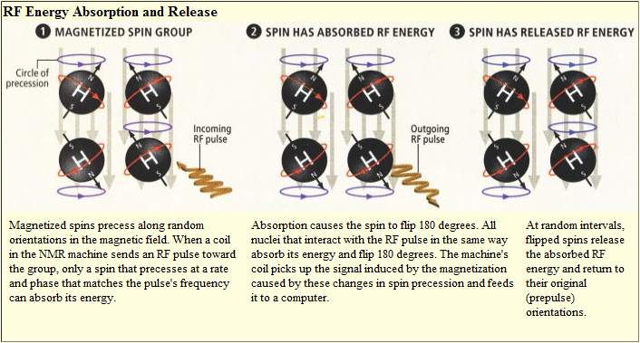
RF energy absorption and release
Resonance: when the radio waves have the exact frequency needed to make the nuclei flip over and spin in the opposite direction

Slide 30
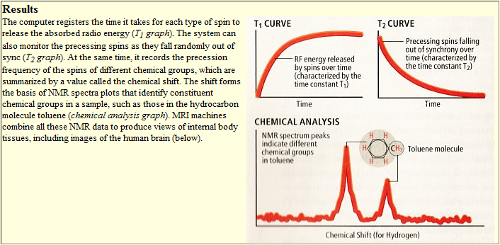
Results

Slide 31
The chemical shift
As electrons shield the nucleus from the full effects of the external magnetic field, differences in electron distribution produce different energy separations between the two spin energy levels.
Nuclei in different chemical environments produce different signals in the spectrum.

Slide 32
The chemical shift
Proton or ¹H NMR is particularly useful.
Hydrogen nuclei are in all organic molecules.
Act as spies and give information about their position in a molecule.

Slide 33
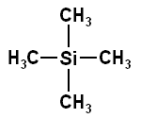
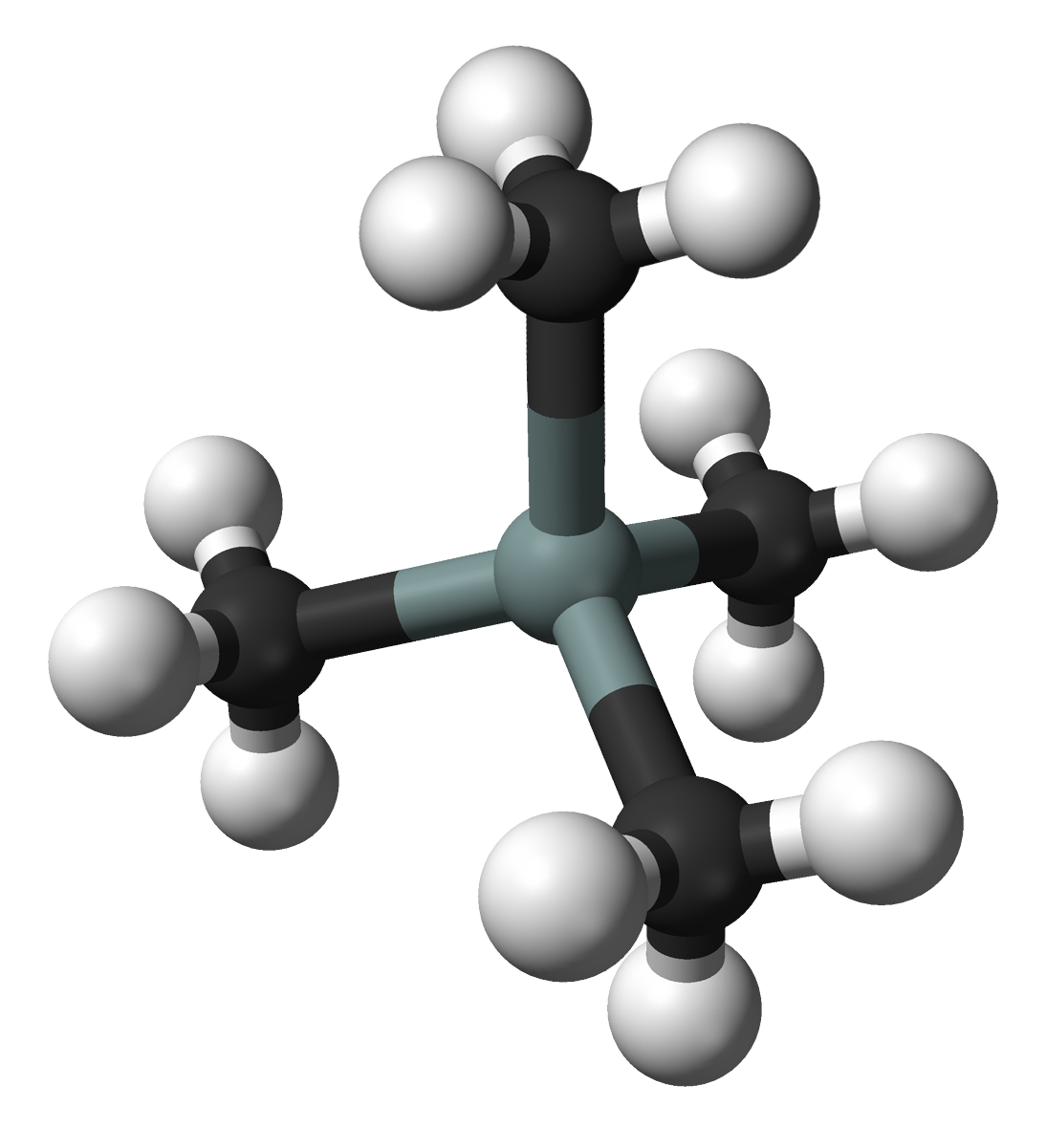
The TMS standard
If we are to measure shift, we need a standard, or point of reference from which to measure.
Tetramethylsilane (TMS) is the perfect standard.

Slide 34
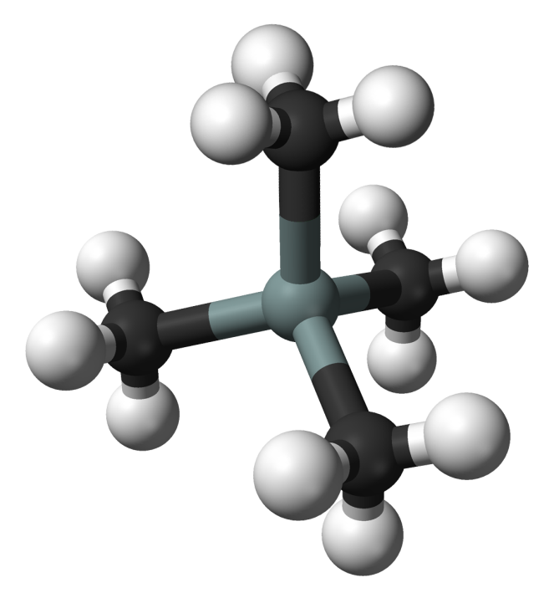
The TMS standard
All 12 H’s are in identical chemical environments, so one signal is recorded.

Slide 35
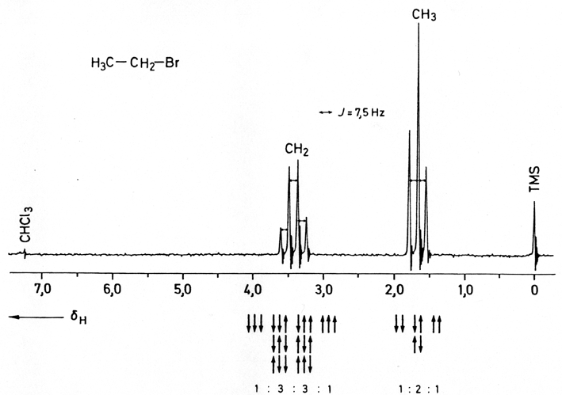
The TMS standard
Because Si is less electronegative than C, TMS absorbs radio waves in a different region from that absorbed by H attached only to C.
This ensures that the signal does not overlap with any signals under investigation

Slide 36
The TMS standard
TMS is also inert.
TMS is soluble in most organic solvents.
TMS can be easily removed from the sample because it has a low boiling point.

Slide 37
The chemical shift
Position of NMR signal relative to the standard.
Mathematically, the chemical shift (δ) of a proton in a molecule is defined as:
$$=\frac{(f −f_{0})}{f_{0}} ×{10}^{6} ppm$$
Where f and f₀ are the frequencies of the radio waves absorbed by the protons in the sample and TMS respectively.

Slide 38
The chemical shift
Why make things so complicated???
While absolute frequency of signal depends on the strength of the magnetic field, the chemical shift relative to the standard is constant.

Slide 39
Interpreting ¹H NMR spectra
CH₃
absorption
CHO
TMS
10
8
6
4
2
0
Chemical shift,δ / ppm

Slide 40
High resolution ¹H NMR spectra
Refer to pp. 88-89 of Option A chapter online

Slide 41
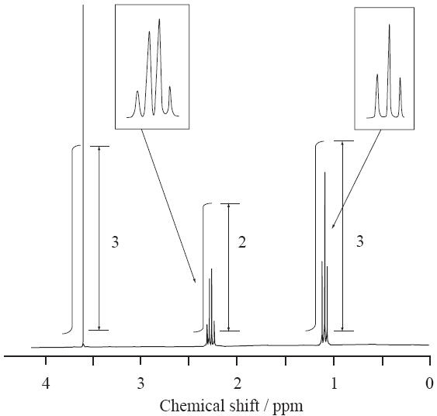
Sample IB Question (2009 HL TZ1)

Slide 42
Sample IB Question (2009 HL TZ1)

Slide 43
NMR is used in body scanners
Protons (¹H) in water molecules within human cells can be detected by magnetic resonance imaging (MRI), giving a three-dimensional view of organs in the human body.
³¹P is useful in determining extent of damage from a heart attack and monitoring the control of diabetes.

Slide 44
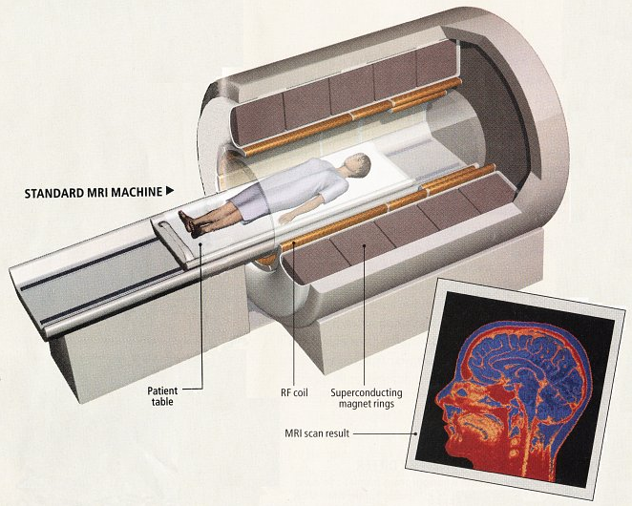
Standard MRI Machine

