Slide 1
Unit 04: BONDING
IB Topics 4 & 14 Text: Ch 8 (all except sections 4,5 & 8) Ch 9.1 & 9.5 Ch 10.1-10.7
My Name is Bond. Chemical Bond

Slide 2
PART 2: Shapes & Polarity

Slide 3
Covalent Bonds
Consider two hydrogen atoms. The electrons are shared by both atoms.
+
+
- -

Slide 4
Covalent Bonds
There are attractive forces between opposite charges.
+
+
- -

Slide 5
Covalent Bonds
There are repulsive forces between like charges.
+
+
- -
At the bond length, the forces are equal, and the molecule is stable.

Slide 6
Average Bond Length
Repulsive
Force
Distance (r)
0
Energy
Attractive
Minimum energy
Attractive & repulsive forces are balanced (at equilibrium)
Bond Length

Slide 7
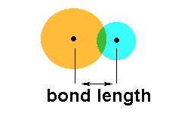
Bond Length and Bond Strength
The strength of attraction that the two nuclei have for the shared electrons affects both the length and strength of the bond.

Slide 8
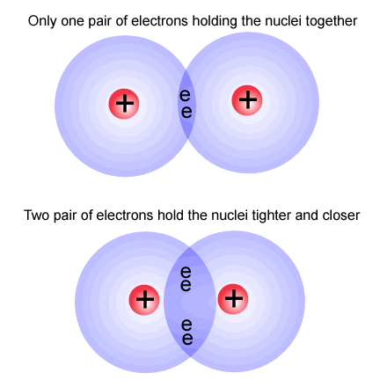
Bond Length and Bond Strength
Although there is a great deal of variation in the bond lengths and strengths of single bonds in different compounds, double bonds are generally much stronger and shorter than single bonds.
The strongest covalent bonds are shown by triple bonds.

Slide 9
Examples:
Bond | Bond Type | Length (nm) | Strength (kJ mol⁻¹)
Cl – Cl |  | 0.199 | 242
C – C |  | 0.154 | 348
C = C |  | 0.134 | 612
O = O |  | 0.121 | 496
C ≡ C |  | 0.120 | 837
N ≡ N |  | 0.110 | 944
single
single
double
double
triple
triple

Slide 10
Examples:
Note: while strength increases and length decreases from C – C → C = C → C ≡ C, the double bond is not twice as strong as the single bond and the triple bond is not three times stronger (or shorter) than the single bond.

Slide 11
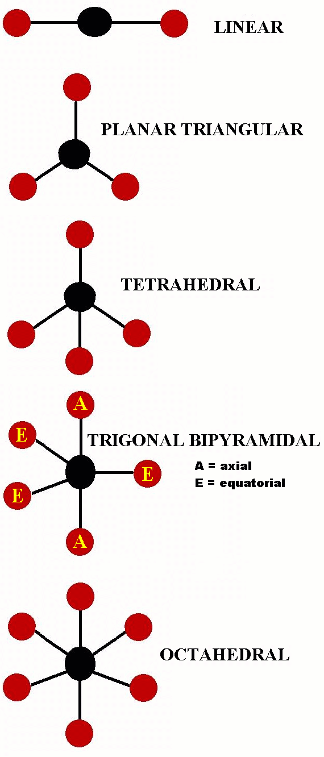
Valence Shell Electron Pair Repulsion (VSEPR) Theory
As the name implies, electron pairs in the outer energy level or valence shell of atoms repel each other and therefore position themselves as far apart as possible.
This allows us to predict molecular SHAPES.

Slide 12
Valence Shell Electron Pair Repulsion (VSEPR) Theory
The following points will help you apply the VSEPR Theory to predict molecular shapes:
Repulsion applies to both bonding and non-bonding pairs of electrons.
Double and triple bonded electron pairs are orientated together and so behave in terms of repulsion as a single unit known as a negative charge center (or electron region).
The total number of charge centers around the central atom determines the geometrical arrangement of the electrons.
Non-bonding pairs of electrons (lone pairs) have a higher concentration of charge than a bonding pair because they are not shared between two atoms and so they cause more repulsion than bonding pairs.

Slide 13
Valence Shell Electron Pair Repulsion (VSEPR) Theory
The repulsion increases in the following order:
bonding pair – bonding pair
<
lone pair – bonding pair
<
lone pair – lone pair
Increasing repulsion

Slide 14
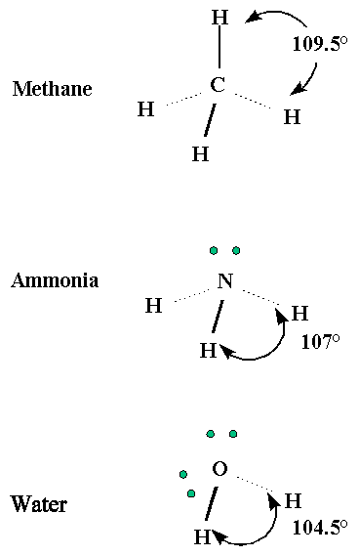
Valence Shell Electron Pair Repulsion (VSEPR) Theory

Slide 15
SHAPES:
Shapes are named based on the geometry of atoms, which is affected by the arrangement of all valence electrons (including bonding and non-bonding pairs, or lone pairs)

Slide 16
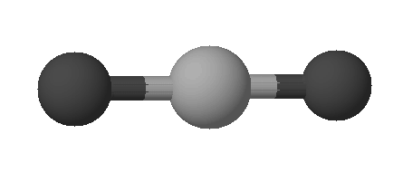
SHAPES:
Linear arrangement of electrons:
bond angle = 180°
180°
linear

Slide 17
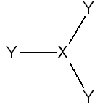
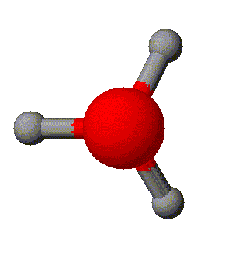
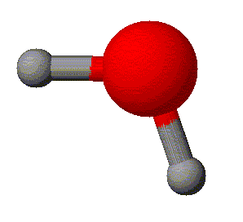
SHAPES:
Triangular planar arrangement of electrons:
bond angle = 120°
<120°
120°
triangular planar
V-shaped

Slide 18
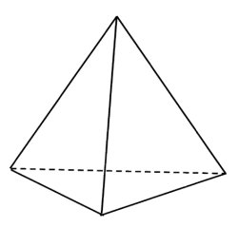
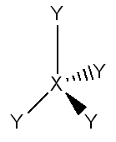
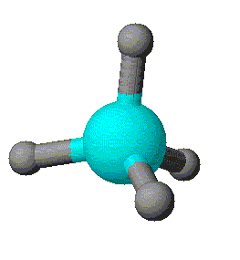
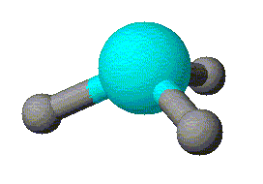
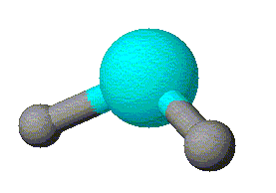
SHAPES:
Tetrahedral arrangement of electrons:
bond angle = 109.5°
109.5°
<109.5°
<109.5°
tetrahedral
pyramidal
V-shaped

Slide 19
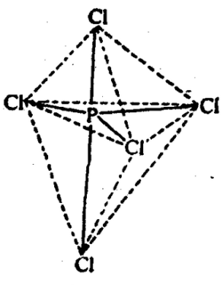
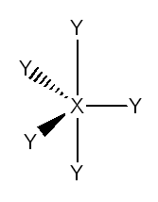
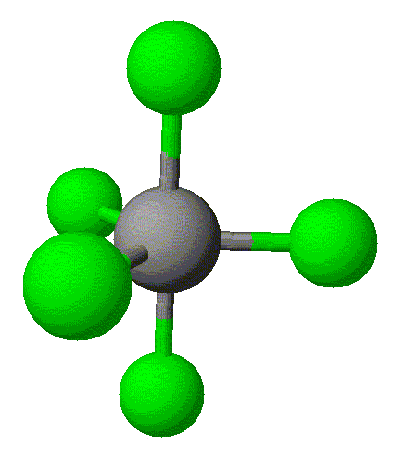
SHAPES:
Bipyramidal arrangement of electrons:
bond angles = 90°, 120°
120°
triangular bipyramidal

Slide 20
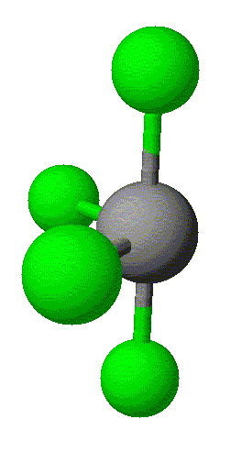
SHAPES:
Bipyramidal arrangement of electrons:
see saw

Slide 21
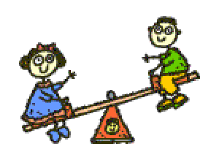
SHAPES:
Bipyramidal arrangement of electrons:
See it now?

Slide 22
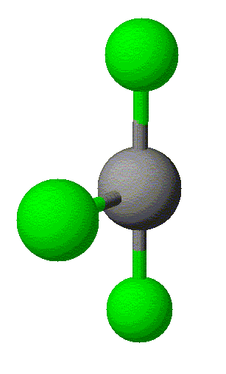
SHAPES:
Bipyramidal arrangement of electrons:
T-shaped

Slide 23
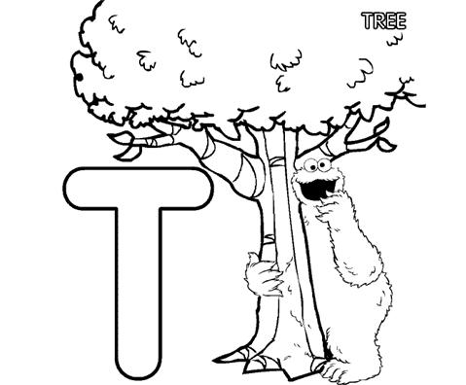
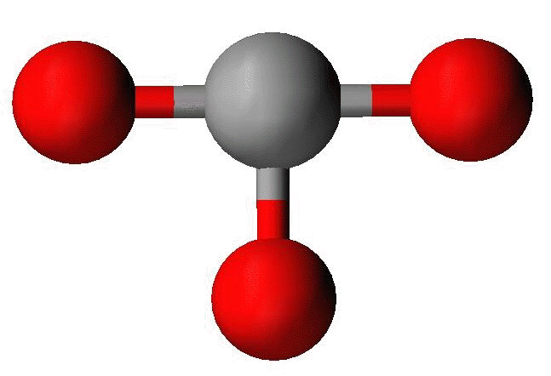
SHAPES:
Bipyramidal arrangement of electrons:
See it now?

Slide 24
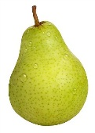
SHAPES:
Bipyramidal arrangement of electrons:
linear

Slide 25
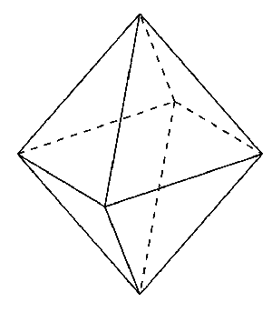
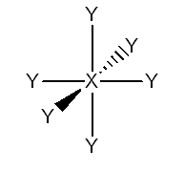
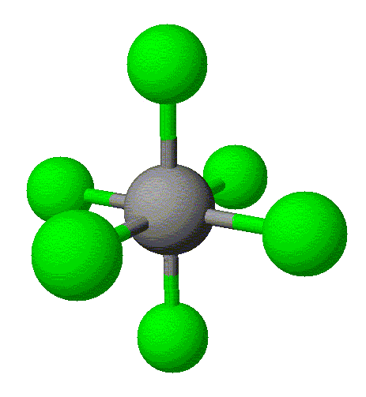
SHAPES:
Octahedral arrangement of electrons:
all angles = 90°
octahedral

Slide 26
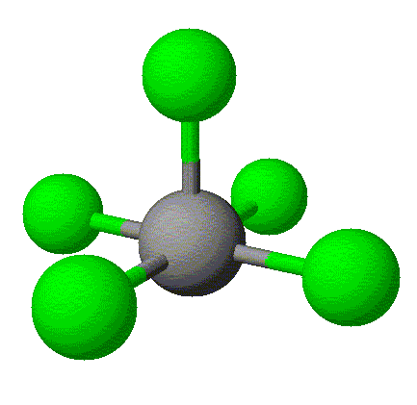
SHAPES:
Octahedral arrangement of electrons:
square pyramidal

Slide 27
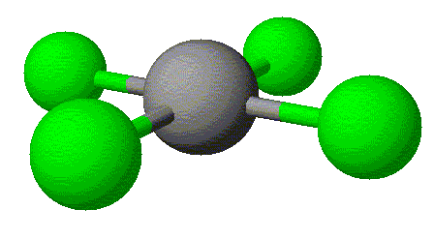
SHAPES:
Octahedral arrangement of electrons:
square planar

Slide 28
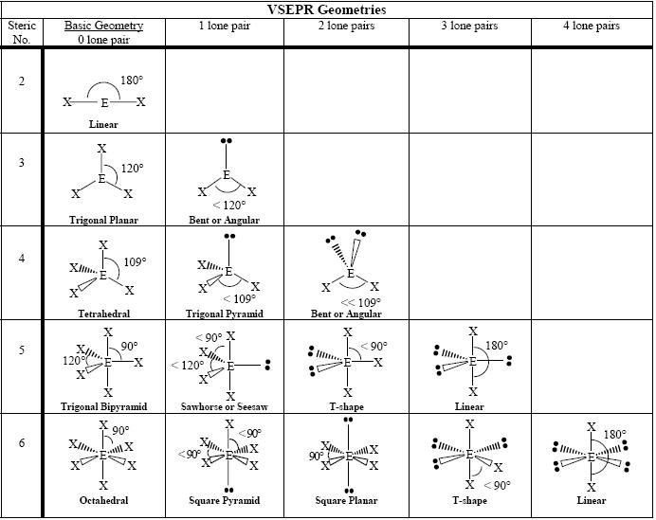

Slide 29
Examples:
BF₃
F
planar triangular
24 electrons
120°
B
F
F

Slide 30
Examples:
SO₂
Lone pair – more repulsion / takes up more space
bent or angular
or
v-shaped
18 electrons
S
O
O
<120°

Slide 31
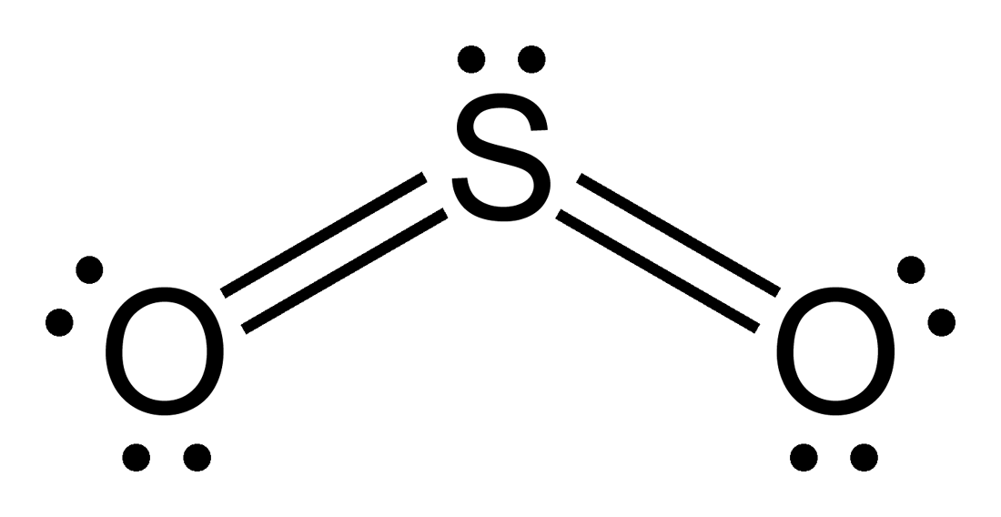
Examples:
SO₂
Also acceptable…
More on why this is a possible structure when we get to “formal charge” (later this unit)

Slide 32
Examples:
H₂O
8 electrons
O
v-shaped
H
H
104.5°

Slide 33
Examples:
BF₄⁻
-
F
32 electrons
109.5°
B
tetrahedral
F
F
F

Slide 34
Examples:
BF₄⁻
-
F
32 electrons
109.5°
B
tetrahedral
F
F
F

Slide 35
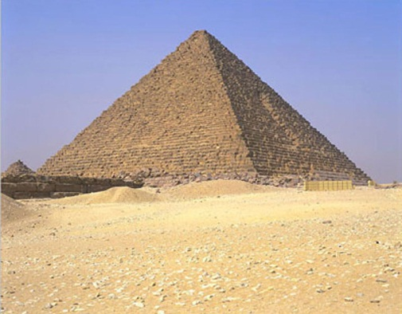
Examples:
NH₃
24 electrons
pyramidal
N
H
H
H
<109.5°
=107°

Slide 36
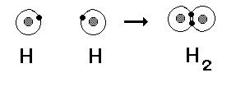
Bond Polarity:
Non-polar bond - equal sharing of electrons; atoms of identical electronegativity
i.e. diatomic molecules such as H₂ and Cl₂

Slide 37
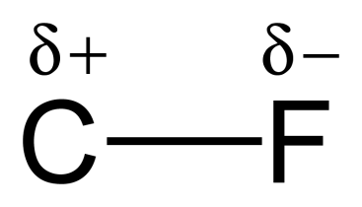
Bond Polarity:
Polar bond: unequal sharing of electrons; different atoms & the more electronegative atom exerts greater attraction for the shared electrons.
We label electron-rich and –poor atoms with partial charges, δ- and δ+.

Slide 38
Molecular Polarity:
When the bonds are arranged geometrically such that one side of the molecule is more electron-rich and the other side is more electron-poor, the molecule is considered polar.
If the entire molecule is polar (or there is a significant polar region), then label this resulting net dipole with an arrow.
H - F

Slide 39
Geometry and polarity
Some shapes can cancel out polarity.
Example: Linear

Slide 40
Geometry and polarity
Some shapes can cancel out polarity.
Example: planar triangular
120º

Slide 41
Geometry and polarity
Some shapes can cancel out polarity.
Example: tetrahedral

Slide 42
Geometry and polarity
Other shapes don’t cancel
Example: V-shaped

Slide 43
Geometry and polarity
Other shapes don’t cancel
Example: pyramidal

Slide 44
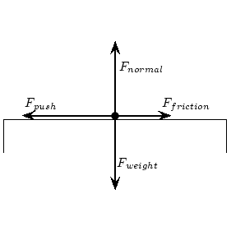
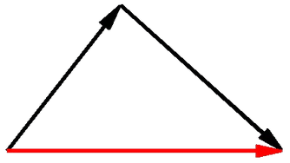
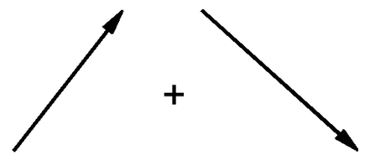
Molecular polarity – How do you figure it out?
Remember physics?
Balanced/unbalanced forces
Remember math?
Adding vectors

Slide 45
Example:
HF
δ+
δ-
..
H - F
:
..
POLAR

Slide 46
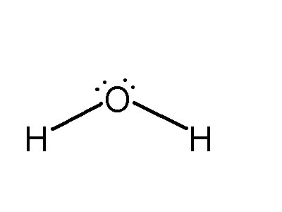
Example:
H₂O
δ-
δ+
δ+
POLAR

Slide 47
Example:
CO₂
δ-
δ+
δ-
NONPOLAR

Slide 48
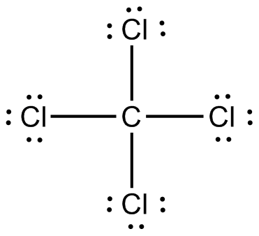
Example:
δ-
CCl₄
δ+
δ-
δ-
δ-
NONPOLAR

Slide 49
Example:
CH₃Cl
δ-
δ+
H
H
H
POLAR

