Slide 1


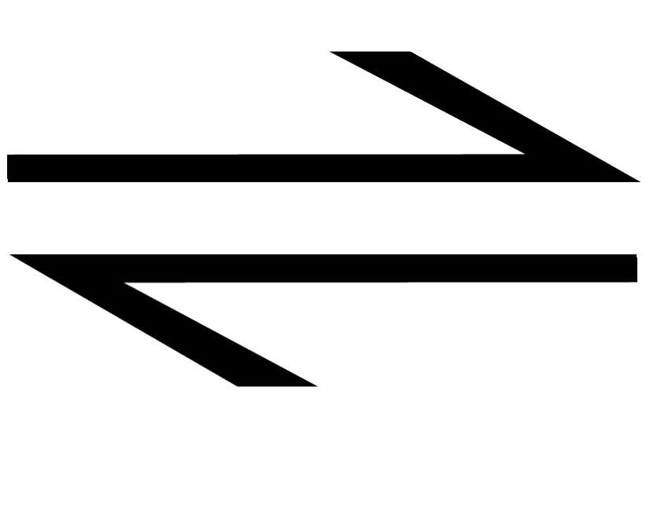
Unit 07: Equilibrium
IB Topics 7 & 17
Notes do not inlclude “k_{p}” gas calculations or heterogeneous eq’m. These are “AP only” concepts that will be revisited later by AP students.

Slide 2
Consider a glass of water…
Evaporation

Slide 3
Consider a glass of water…
Now, put a lid on it….

Slide 4
Consider a glass of water…
Evaporation continues, but condensation also occurs...

Slide 5
Consider a glass of water…
The rates equalize, and the system reaches equilibrium.

Slide 6
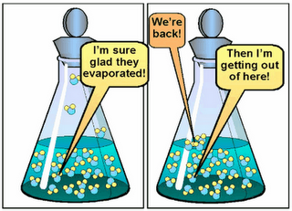

Chemical Equilibrium
H₂O (liquid) → H₂0 (gas)
H₂O (gas) → H₂O (liquid)
H₂O (liquid) H₂O (gas)
Equilibrium Symbol

Slide 7
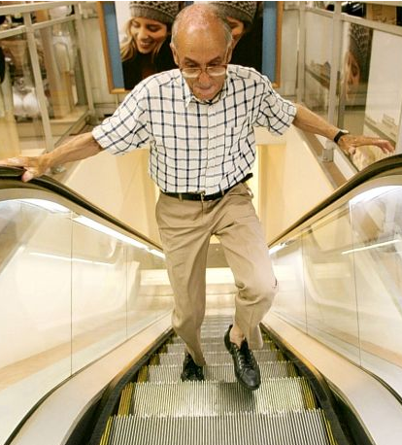
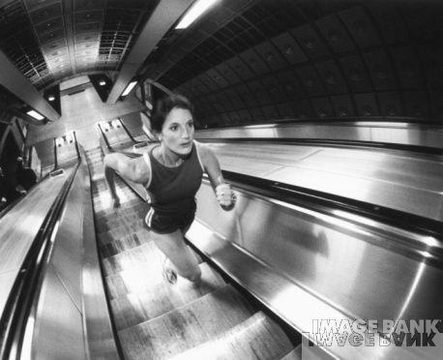
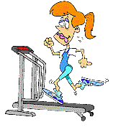
When is going up the down escalator like equilibrium?
When you’re walking up, the stairs are moving down, but your position in space remains constant.

Slide 8
N₂ + 3H₂ ⇔ 2NH₃ + 22 KCal
Forward Reaction

Slide 9
N₂ + 3H₂ ⇔ 2NH₃ + 22 KCal
Reverse/Backwards Reaction

Slide 10
Reversible Reactions
REVERSIBLE REACTIONS do not go to completion and can occur in either direction:
aA + bB ↔ cC + dD

Slide 11
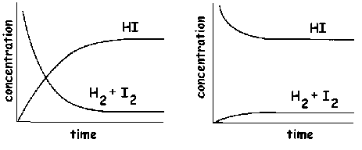
CHEMICAL EQUILIBRIUM exists when the forward & reverse reactions occur at exactly the same rate (thus concentrations become constant).
Example: 2HI(g) H₂(g) + I₂(g)
EQUILIBRIUM

Slide 12
At equilibrium:
If there are more products than reactants, the products are said to be favored.
If there are more reactants than products, the reactants are said to be favored.

Slide 13
Characteristics of the equilibrium state
Feature
Explanation
Dynamic
The rxn has not stopped; the forward and backward rxns are still occurring (same rate).

Slide 14
Characteristics of the equilibrium state
Feature
Explanation
Achieved in a closed system
Prevents exchange of matter with surroundings, so equilibrium is achieved where both reactants and products can react and recombine with each other.

Slide 15
Characteristics of the equilibrium state
Feature
Explanation
Concentrations of reactants and products remain constant
They are being produced and destroyed at an equal rate.

Slide 16
Characteristics of the equilibrium state
Feature
Explanation
No change in macroscopic properties
This refers to observable properties such as color and density; these do not change as they depend on the concentrations of the components in the mixture.

Slide 17
Characteristics of the equilibrium state
Feature
Explanation
Can be reached from either direction
The same equilibrium mixture will result under the same conditions, no matter whether the rxn is started with all reactants, all products, or a mixture of both.

Slide 18
Law of Mass Action
For any reaction: aA + bB ↔ cC + dD at equilibrium at a given temperature, the constant, k_{c}:
k_{c} is a measure of the extent to which a reaction occurs; it varies with temperature (and only with temp) and is UNITLESS.
c
for
“concentration”

Slide 19
Example (a):
Write the equilibrium expression for…
PCl₅(g) ⬅➔ PCl₃(g) + Cl₂(g)
NOTE: [ ] denotes concentration. Gases can be entered as molar volumes (n/V), or moles of gas per liter of mixture.

Slide 20
Example (b):
Write the equilibrium expression for…
4NH₃(g) + 5O₂(g) ⬅➔ 4NO(g) + 6H₂O(g)

Slide 21
Ex: One liter of the equilibrium mixture from example (a) was found to contain 0.172 mol PCl₃, 0.086 mol Cl₂ and 0.028 mol PCl₅. Calculate K.
PCl₅ ↔ PCl₃ + Cl₂

Slide 22
What does k=0.53 mean to me???
When k >> 1, most reactants will be converted to products.
When k << 1, most reactants will remain unreacted.

Slide 23
The equilibrium constant allows us to ….
Predict the direction in which a reaction mixture will proceed to achieve equilibrium.
Calculate the concentrations of reactants and products once equilibrium has been reached.

Slide 24
Reaction Quotient (Q)
Reaction Quotient (Q) is calculated the same as k, but the concentrations are not necessarily equilibrium concentrations.
Comparing Q with k enables us to predict the direction in which a rxn will occur to a greater extent when a rxn is NOT at equilibrium.

Slide 25
Comparing Q to k
Forward rxn predominates – “reaction proceeds to the right”(until equil. is reached)
System is at equilibrium
Reverse reaction predominates – “reaction proceeds to the left”
(until equilibrium is reached)
When Q < k:
When Q = k:
When Q > k:

Slide 26
Ex: H₂(g) + I₂(g) ↔ 2HI(g) k for this reaction at 450 °C is 49. If 0.22 mol I₂, 0.22 mol H₂, and 0.66 mol HI are put into a 1.00-L container, would the system be at equilibrium? If not, what must occur to establish equilibrium.
Q < k  forward reaction predominates until equilibrium is reached.

Slide 27
Ex: PCl₃(g) + Cl₂(g) ⬅➔ PCl₅(g) k=1.9
In a system at equilibrium in a 1.00 L container, we find 0.25 mol PCl₅, and 0.16 mol PCl₃. What equilibrium concentration of Cl₂ must be present?

Slide 28
C’mon… they’ll never ask us such an easy question on an AP/IB test, will they?
Probably not!

Slide 29






Let’s start with a silly, non-chem example…
ASG has a dance, and lets 100 boy-girl couples into the gym. Throughout the evening some couples have fights and break apart, forming single boys and single girls. Of course some of these singles form new couples. At the end of the evening there are 12 single girls. Calculate the equilibrium numbers.
1 Couple ⇔ 1 girl + 1 boy
Initial 100 0 0

Slide 30
ASG has a dance, and lets 100 couples into the gym. Throughout the evening some couples have fights and break apart, forming single boys and single girls. Of course some of these singles form new couples. At the end of the evening there are 12 single girls. Calculate the equilibrium numbers.
1 Couple ⇔ 1 girl + 1 boy
Initial 100 0 0
Equilibrium
12
12

Slide 31
ASG has a dance, and lets 100 couples into the gym. Throughout the evening some couples have fights and break apart, forming single boys and single girls. Of course some of these singles form new couples. At the end of the evening there are 12 single girls. Calculate the equilibrium numbers.
1 Couple ⇔ 1 girl + 1 boy
Initial 100 0 0
Change
-12
+12
+12
Equilibrium
88
12
12

Slide 32
ASG has a dance, and lets 100 couples into the gym. Throughout the evening some couples have fights and break apart, forming single boys and single girls. Of course some of these singles form new couples. At the end of the evening there are 12 single girls. Calculate the equilibrium numbers.
1 Couple ⇔ 1 girl + 1 boy
Equilibrium 88 12 12
= 1.64

Slide 33

The Initial – Change – Equilibrium method of solving these types of problems is affectionately referred to as the ICE method.

Slide 34
Example:
4 moles of H₂ gas and 6 moles of Cl₂ gas are pumped into a 2 liter tank at 30°C. At some time later, it is found that there are 2 moles of HCl gas in the tank. Calculate the Equilibrium Constant.
H₂ + Cl₂ ⇔ 2HCl

Slide 35
Example:
4 moles of H₂ gas and 6 moles of Cl₂ gas are pumped into a 2 liter tank at 30°C. At some time later, it is found that there are 2 moles of HCl gas in the tank. Calculate the Equilibrium Constant.
H₂ + Cl₂ ⇔ 2HCl
Initial Concentration
0

Slide 36
Example:
4 moles of H₂ gas and 6 moles of Cl₂ gas are pumped into a 2 liter tank at 30°C. At some time later, it is found that there are 2 moles of HCl gas in the tank. Calculate the Equilibrium Constant.
H₂ + Cl₂ ⇔ 2HCl
Initial Concentration
[2]
0

Slide 37
Example:
4 moles of H₂ gas and 6 moles of Cl₂ gas are pumped into a 2 liter tank at 30°C. At some time later, it is found that there are 2 moles of HCl gas in the tank. Calculate the Equilibrium Constant.
H₂ + Cl₂ ⇔ 2HCl
Initial Concentration
[2]
[3]
0
Change
Equilibrium Conc.

Slide 38
Example:
4 moles of H₂ gas and 6 moles of Cl₂ gas are pumped into a 2 liter tank at 30°C. At some time later, it is found that there are 2 moles of HCl gas in the tank. Calculate the Equilibrium Constant.
H₂ + Cl₂ ⇔ 2HCl
Initial Concentration
[2]
[3]
0
Change
- ½
- ½
+1
Equilibrium Conc.
[1.5]
[2.5]
[1]
= 0.267 ≈ 0.3

Slide 39
When equilibrium is disrupted…

Slide 40
When a system is at equilibrium, it will stay that way until something changes this condition.

Slide 41
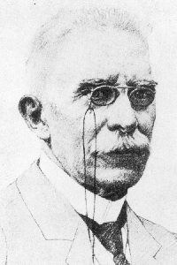
Le Chatelier’s Principal
When a change (“stress”) is applied to a system at equilibrium, the system will shift its equilibrium position to counteract the effect of the disturbance.
Henri Louis le Châtelier, (1850-1936)

Slide 42
Factors affecting equilibrium include changes in:
Concentration (of reactants or products)
Temperature
Pressure (of gases if rxn involves a change in the number of gas molecules)

Slide 43
Changes in Concentration:
Consider this reaction at equilibrium:
H₂(g) + I₂(g) ⬅➔ 2HI(g)
What will happen to the equilibrium if we:
  add some H₂?
Reaction shifts to the right
(forms more product)

Slide 44
Changes in Concentration:
Consider this reaction at equilibrium:
H₂(g) + I₂(g) ⬅➔ 2HI(g)
What will happen to the equilibrium if we:
  remove some H₂?
Reaction shifts to the left
(forms more reactants)

Slide 45
Changes in Concentration:
When a substance is added, the stress is relieved by shifting equilibrium in the direction that consumes some of the added substance.
When a substance is removed, the reaction that produces that substance occurs to a greater extent.

Slide 46
Example:
N₂(g) + 3H₂(g) ↔ 2NH₃(g) ∆H=-93 kJ mol⁻¹
H₂ added here
NH₃ removed here
NH₃
N₂
concentration
H₂
equilibrium
equilibrium
equilibrium
time

Slide 47
Changes in Temperature:
Consider this reaction at equilibrium:
2SO₂(g) + O₂(g) ⬅➔ 2SO₃(g) + 198 kJ
What will happen to the equilibrium if we:
  increase the temperature?
Reaction shifts to the left
(forms more reactants)

Slide 48
Changes in Temperature:
Consider this reaction at equilibrium:
2SO₂(g) + O₂(g) ⬅➔ 2SO₃(g) + 198 kJ
What will happen to the equilibrium if we:
  decrease the temperature?
Reaction shifts to the right
(forms more products)

Slide 49
Changes in Temperature:
Increasing the temperature always favors the reaction that consumes heat, and vice versa.

Slide 50
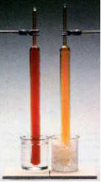
Changes in Pressure:
Consider this reaction at equilibrium:
2NO₂(g) ⬅➔ N₂O₄(g)
What will happen to the equilibrium if we:
  increase the pressure?
Rxn also temp dependent
Reaction shifts to the right
(forms more product)

Slide 51
Changes in Pressure:
Consider this reaction at equilibrium:
2NO₂(g) ⬅➔ N₂O₄(g)
What will happen to the equilibrium if we:
  decrease the pressure?
Reaction shifts to the left
(forms more reactant)

Slide 52
Changes in Pressure:
Increasing the pressure favors the reaction that produces the fewer moles of gas, and vice-versa.

Slide 53
Example: How will an increase in pressure affect the equilibrium in the following reactions:
4NH₃(g) + 5O₂(g) ⬅➔ 4NO(g) + 6H₂O(g)
  RXN SHIFTS LEFT
2H₂(g) + O₂(g) ⬅➔ 2H₂O(g)
  RXN SHIFTS RIGHT

Slide 54
Example: How will an increase in temperature affect the equilibrium in the following reactions:
2NO₂(g) ⬅➔ N₂O₄(g) + heat
  RXN SHIFTS LEFT
H₂(g) + Cl₂(g) ⬅➔ 2HCl(g) + 92 KJ
  RXN SHIFTS LEFT
H₂(g) + I₂(g) + 25 kJ ⬅➔ 2HI(g)
  RXN SHIFTS RIGHT

Slide 55
Applications of the Equilibrium Law
Haber Process
Contact Process

Slide 56
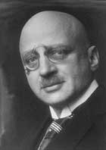
The Haber process: production of ammonia, NH₃
120 million tons produced worldwide each year
  1/3 from China
80% of ammonia produced today is used to make fertilizers
  i.e. ammonium nitrate
Also used in production of plastics (such as nylon), refrigerants and powerful explosives

Slide 57
The Haber process: production of ammonia, NH₃
Ammonia synthesis reaction:
N₂(g) + 3H₂(g) ↔ 2NH₃(g) ∆H=-93 kJ mol⁻¹

Slide 58
N₂(g) + 3H₂(g) ↔ 2NH₃(g) ∆H=-93 kJ mol⁻¹
How would the equilibrium be influenced by:
  Increasing the temp:
  Decreasing the temp:
  Increasing press.(↓vol.):
  Decreasing pressure(↑vol.):
  ↑ press.(adding inert gas):
  Adding more H₂:
  Removing some NH₃:
  Adding a catalyst:
rxn shifts to the left
rxn shifts to the right
rxn shifts to the right
rxn shifts to the left
no change in eq’m position
rxn shifts to the right
rxn shifts to the right
no change in equilibrium position (but will achieve eq’m faster)

Slide 59
Action of a Catalyst
Activation Energy
energy
time
Without a catalyst

Slide 60
Action of a Catalyst
Lower Activation Energy
energy
time
Catalyst lowers the activation energy.

Slide 61
Optimum conditions for Haber process:
(should know general conditions and, more importantly, reasons for each)
N₂(g) + 3H₂(g) ↔ 2NH₃(g) ∆H=-93 kJ mol⁻¹
Concentration:
Pressure:
Temperature:
Catalyst:
N₂ to H₂ supplied in molar ratio (1:3); NH₃ removed as it forms
Forward rxn involves ↓ #molecules, thus high P favors products (200 atm used)
Low T favors forward rxn (exotherm.), but low T makes rxn uneconomically slow; thus moderate T is used (450 °C)
Will not yield of NH₃, but will speed up rxn to compensate for moderate temp. used. Fine powdered iron catalyst used.
Note: even with these optimized conditions, yield is only 15%

Slide 62
The Contact process: production of sulfuric acid, H₂SO₄
Highest production of any chemical in the world
  150 million tons per year globally
Used in production of fertilizers, detergents, dyes, explosives, drugs, plastics and in many other chemical industries
The Contact process gets it’s name from the fact that molecules of the gases O₂ and SO₂ react in contact with the surface of the solid catalyst V₂O₅.

Slide 63
The Contact process: production of sulfuric acid, H₂SO₄
The production of sulfuric acid, known as the Contact process, involves a series of three rxns:
Combustion of sulfur
  S(s) + O₂(g) ↔ SO₂(g)
Oxidation of sulfur dioxide
  2SO₂(g) + O₂(g) ↔ 2SO₃(g)
Combination of sulfur trioxide with water (violent rxn. if SO3 placed directly in H2O, so instead SO3 is first absorbed in flowing solution of sulfuric acid and the product of this rxn is allowed to react with H2O)
  SO₃(g) + H₂SO₄(l) → H₂S₂O₇(l) + H₂O(l) → H₂SO₄(aq)

Slide 64
The Contact process: production of sulfuric acid, H₂SO₄
The overall rate of the process depends on the second reaction above, so Le Chatlier’s principle is applied to this step to determine optimum conditions:
2SO₂(g) + O₂(g) ↔ 2SO₃(g) ∆H = -196 kJ mol⁻¹

Slide 65
Optimum conditions for Contact process:
(should know general conditions and, more importantly, reasons for each)
2SO₂(g) + O₂(g) ↔ 2SO₃(g) ∆H = -196 kJ mol⁻¹
Pressure:
Temperature:
Catalyst:
Forward rxn involves ↓ #molecules, thus high P favors products (2 atm used: high enough for a very high yield)
Low T favors forward rxn (exotherm.), but low T makes rxn uneconomically slow; thus moderate T is used (450 °C)
Increases rate of rxn. V₂O₅(s) used.

Slide 66
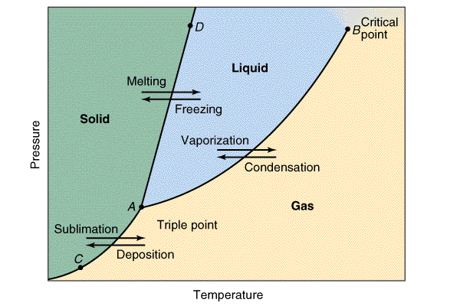
Phase Equilibrium
Note: the IB test is mostly concerned with this portion of the phase diagram

Slide 67
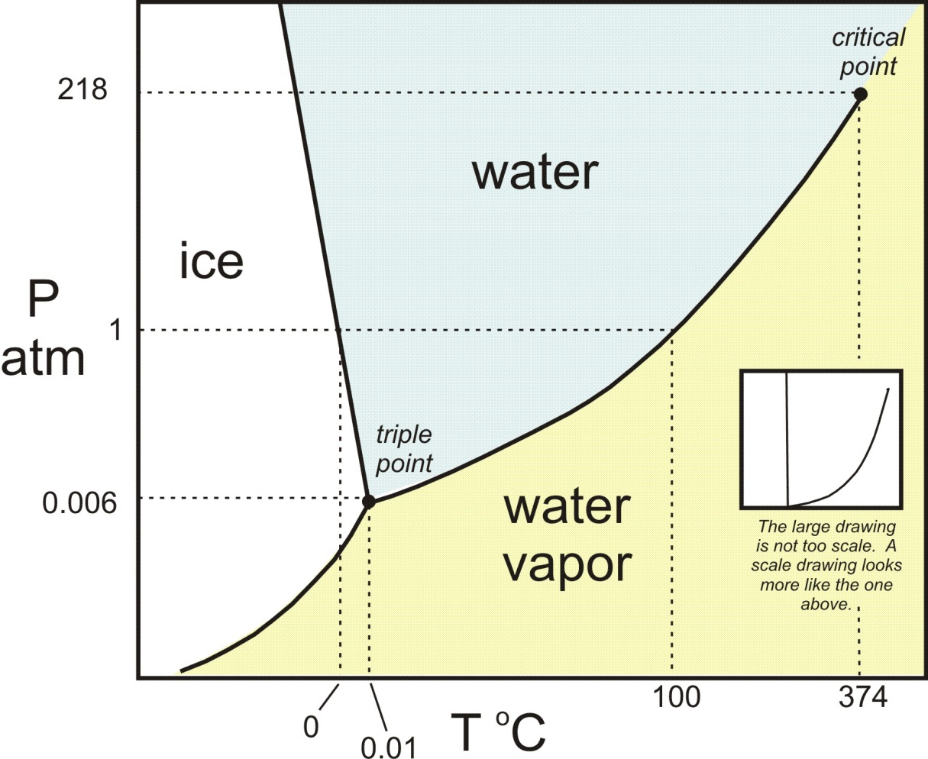
Phase Equilibrium

Slide 68
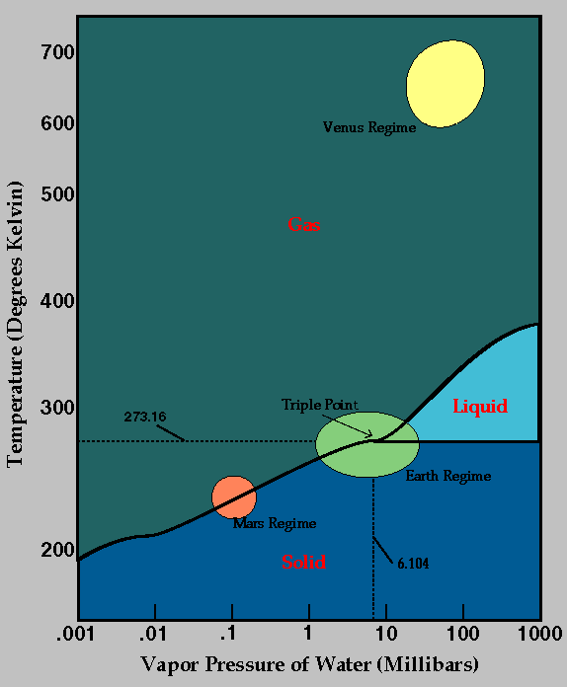
Phase Equilibrium

Slide 69
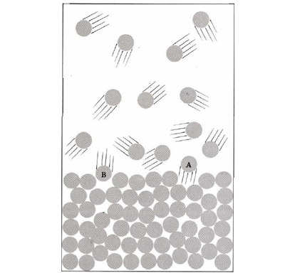
Phase Equilibrium
Dynamic equilibrium between a liquid and its vapor occurs when the rate of vaporization is equal to the rate of condensation.

Slide 70
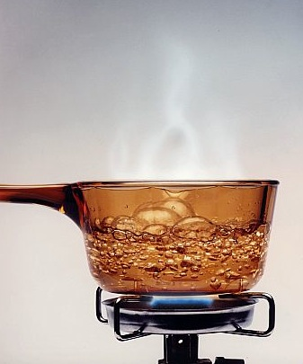
Phase Equilibrium
Vaporization is endothermic as energy must be absorbed to overcome intermolecular forces of attraction.

Slide 71
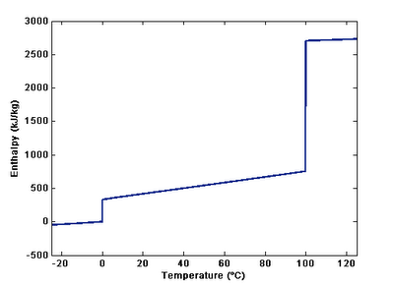
Phase Equilibrium
Enthaply of vaporization: energy required at 298K to convert one mole of a substance in its liquid state into one mole of gas (the enthalpy change required to overcome intermolecular forces).
gas
Enthalpy of vaporization
liquid
solid
Enthalpy of fusion

Slide 72
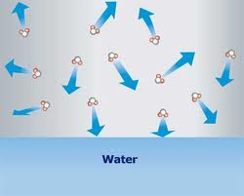
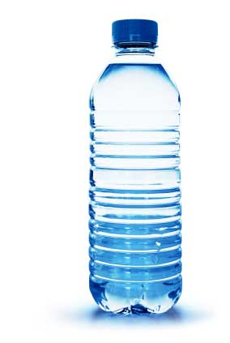
Vapor pressure: pressure exerted by the particles in the vapor phase on it’s liquid at eq’m.
Independent of:
  Surface area of liquid
  Size of container
    although it may take longer for equilibrium to be established in larger container
Dependent on:
  Temperature
  Nature of the substance
    strength of intermolecular forces

Slide 73
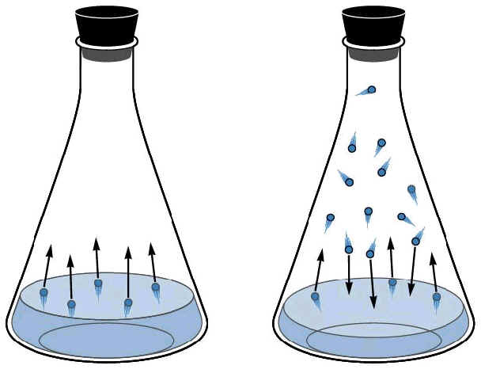
Consider a liquid in a closed container...
At first the liquid level goes down, then it stays constant

Slide 74
Rates are equal.
(Equilibrium Point)
Rate of
Evaporation
Rate
Rate of
Condensation
Time
The pressure in the container at the equilibrium point is the vapor pressure.

Slide 75
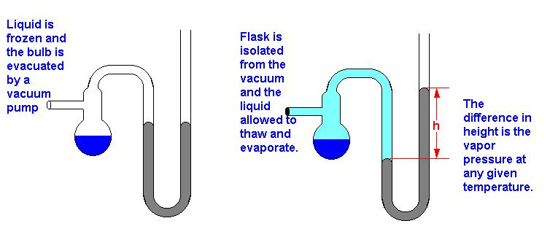
Measuring Vapor Pressure

Slide 76
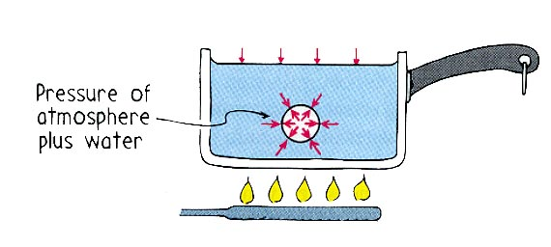

Slide 77
Boiling
A rapid state of evaporation that takes place within the liquid as well as at it’s surface. Like evaporation, cooling of the liquid results.
Boiling takes place when the vapor pressure of the liquid equals the ambient (surrounding) pressure.

Slide 78

Boiling is a Cooling Effect!
Heat Leaving Water
Liquid stays at a constant temp. (100ºC)
Heat Entering Water

Slide 79
Vapor Pressure of Water
110ºC
1074 Torr
100ºC
760
Room Pressure
Room Temp
75ºC
300
20ºC
17
0ºC
4.6

Slide 80
“Normal” Boiling
110ºC
1074 Torr
100ºC
760
Room Pressure
Room Temp
75ºC
300
20ºC
17
0ºC
4.6

Slide 81
Boiling at Room Temperature
110ºC
1074 Torr
100ºC
760
Room Pressure
Room Temp
75ºC
300
20ºC
17
0ºC
4.6

Slide 82
Heat Leaving
Vacuum
Water Cools by boiling

Slide 83
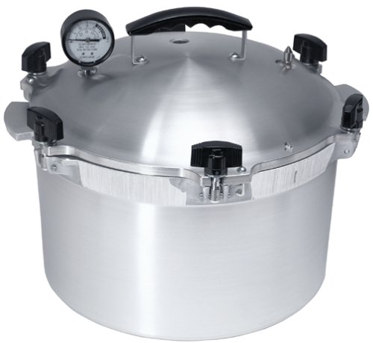
Pressure Cookers
Pressure cookers cook faster because the boiling water is hotter

Slide 84
Pressure Cookers
110ºC
1074 Torr
100ºC
760
75ºC
300
20ºC
17
0ºC
4.6

Slide 85
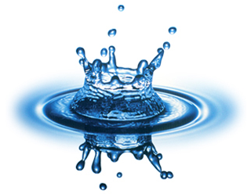
Water
Water has a low molar mass, but strong hydrogen bonding between molecules; thus it has a relatively low vapor pressure and a relatively high enthalpy of vaporization

Slide 86
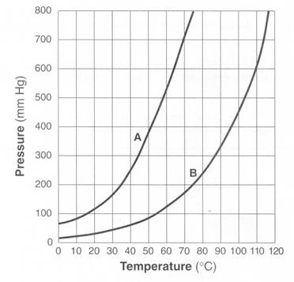
Phase Equilibrium
Which liquid has stronger intermolecular forces?
Liquid B

Slide 87
Phase Equilibrium
What is the normal boiling point of liquid A?
~72 °C

Slide 88
Phase Equilibrium
What is the normal boiling point of liquid A?
~117 °C

Slide 89
Another ex: The vapor pressure curves of water, H₂O, ethoxyethane, (C₂H₅)₂O, & ethanol, C₂H₅OH, are below (not in that order). How do we know which is which?
vapor pressure / Pa
Temperature / °C

Slide 90
Let’s consider the strength of the intermolecular forces of each…
Compound & Formula | Structure | Type of intermolecular forces
ethoxyethane(C₂H₅)₂O
ethanol C₂H₅OH
water H₂O
Increasing strength of intermolecular attraction
dipole-dipole
H-bonding
more extensive H-bonding

Slide 91
So which is which?
1.0 x 10⁵ Pa
(C₂H₅)₂O
normal b.p.
34.6 °C
C₂H₅OH
normal b.p.
78.8 °C
H₂O
normal b.p.
100 °C
dipole-dipole
H-bonding
more extensive
H-bonding
vapor pressure / Pa
Temperature / °C

Slide 92
Summary
Stronger intermolecular forces →
__________enthalpy of vaporization
__________ vapor pressure
__________ boiling point
higher
lower
higher

Slide 93
Thus,
Weaker intermolecular forces →
__________enthalpy of vaporization
__________ vapor pressure
__________ boiling point
lower
higher
lower

