Slide 1
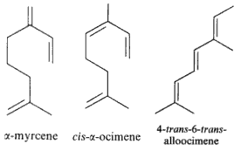
Organic Chemistry
Topics 10 & 20
Chapter 22
PART 2: Physical Properties & Isomerism

Slide 2
Homologous series
Same general formula with neighboring members of the series differing by –CH₂.
Examples:
Alkanes: C_{n}H_{2n+2}
Methane (CH₄)
Ethane (C₂H₆)
Propane (C₃H₈)
Butane (C₄H₁₀)
Alcohols: C_{n}H_{2n+1}OH
Methanol (CH₃OH)
Ethanol (C₂H₅OH)
Propanol (C₃H₇OH)
Butanol (C₄H₉OH)

Slide 3
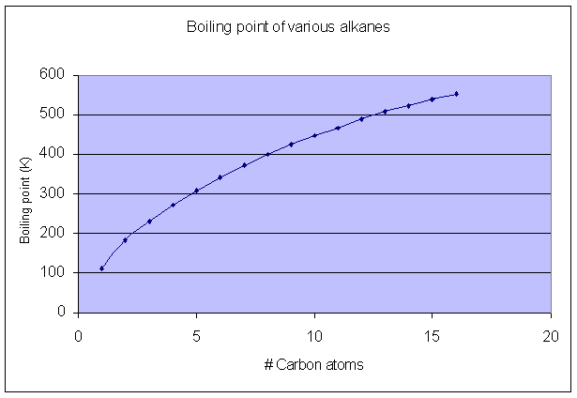
Boiling points
Length of carbon chain
The longer the chain, the higher the b.p.
(greater polarizability → stronger intermolecular forces)

Slide 4
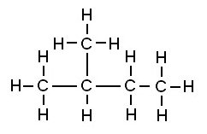
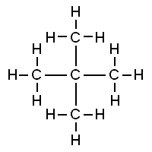
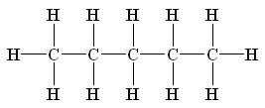
Boiling points – which is highest?
Structural isomers
pentane
2-methylbutane
2,2-dimethylpropane
b.p.=36.3°C
b.p.=27.9°C
b.p.=9.5°C

Slide 5
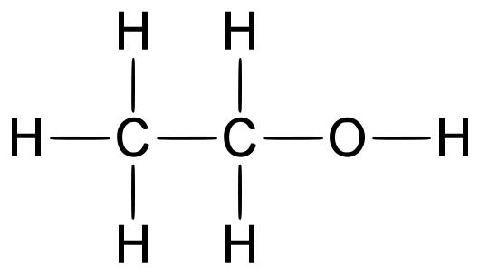
Solubility in water
Determined by polarity
Example: ethanol v. 1-hexanol (or hexan-1-ol)
higher polarity = greater solubility in water
soluble in all proportions
only slightly soluble in water
nonpolar
polar
ethanol is more soluble because a larger portion of the molecule is polar
longer C-chain of alcohol = lower solubility in water

Slide 6
Classification of alcohols & halogenoalkanes
Alcohols and halogenoalkanes may be classified according to how many R- groups and how many hydrogen atoms are bonded to the carbon atom containing the functional group.
Primary (one R-group bonded to C atom)
Secondary (two R-groups bonded to C atom)
Tertiary (three R-groups bonded to C atom)

Slide 7
Low reactivity of alkanes
C-C and C-H bonds
relatively strong
low polarity
Only readily undergo combustion rxns w/ O₂ and substitution rxns with halogens in the presence of high energy UV light

Slide 8
Structural isomerism
same molecular formula, but different structural formulas
Ex: n-butane and 2-methylpropane
Ex: 1-butene, 2-butene and methylpropene

Slide 9
Structural isomers v. stereoisomers
Structural isomers: same molecular formula, but different structural formulas
Stereoisomers: same structural formula, but differ in their spatial arrangement
Geometrical isomerism
Optical isomerism

Slide 10
Stereoisomerism
Geometrical isomerism: occurs when rotation about a bond is restricted or prevented
Example: asymmetric non-cyclic alkenes
cis-2-butene v. trans-2-butene
Example: disubstituted cycloalkanes
cis- v. trans- form of 1,2-dichlorocyclopropane

Slide 11
Stereoisomerism
Physical and chemical properties of geometrical isomers
Different physical properties: (common)
cis-1,2-dichloroethene: b.p.=60.3°C
trans-1,2-dichloroethene: b.p.=47.5°C
Difference in both physical and chemical properties: (sometimes)
Ex: heating of cis- v. trans- forms of 2-butene-1,4-dioic acid…

Slide 12
Ex: heating of cis- v. trans- forms of 2-butene-1,4-dioic acid

Slide 13
Stereoisomerism
Optical isomerism
shown by all compounds containing at least one asymmetric or chiral carbon atom within a molecule (one that contains for different atoms or groups bonded to it).
Two isomers are known as enantiomers and are mirror images of each other (like your right and left hand).
Example:
Enantiomers are optically active with plane polarized light (both rotate plane-polarized light)
Normal light consists of electromagnetic radiation vibrating in all planes – when passed through a polarizing filter the transmitted waves only vibrate in one plane and the light is said to be plane-polarized.

Slide 14
Stereoisomerism
Enantiomers
Optical activity of enantiomers can be detected and measured by an instrument called a polarimeter.
A polarimeter consists of a light source, two polarizing lenses, and between the lenses a tube to hold the sample of the enantiomer.
Diagram:

Slide 15
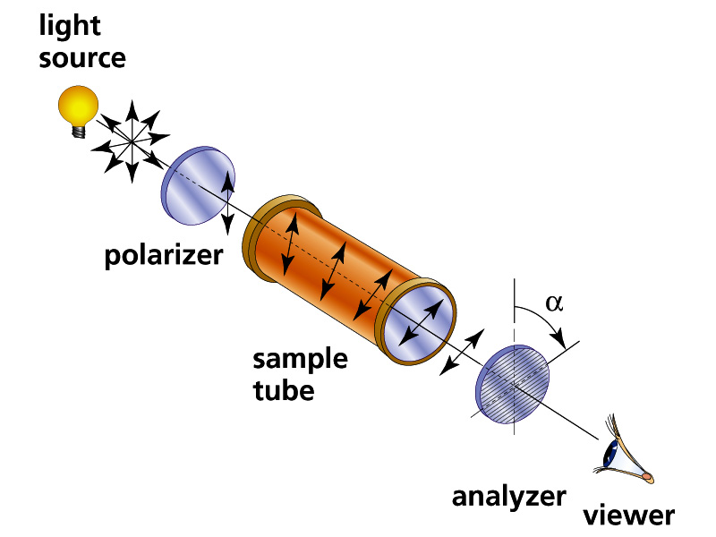
Better image of a polarimeter:

Slide 16
Stereoisomerism - Enantiomers
If the analyzer has to be rotated clockwise, the enantiomer is said to be dextrorotatory (from the Latin, dexter, meaning “right”).
If it has to be rotated counterclockwise, the enantiomer is said to be laevorotatory (from the Latin, laevus, meaning “left”).
One enantiomer is thus known as the d-form and the other is the l-form.
If both enantiomers are present in equal amounts, the two rotations cancel each other out, and the mixture appears to be optically inactive. Such a mixture is known as a racemic mixture.

Slide 17
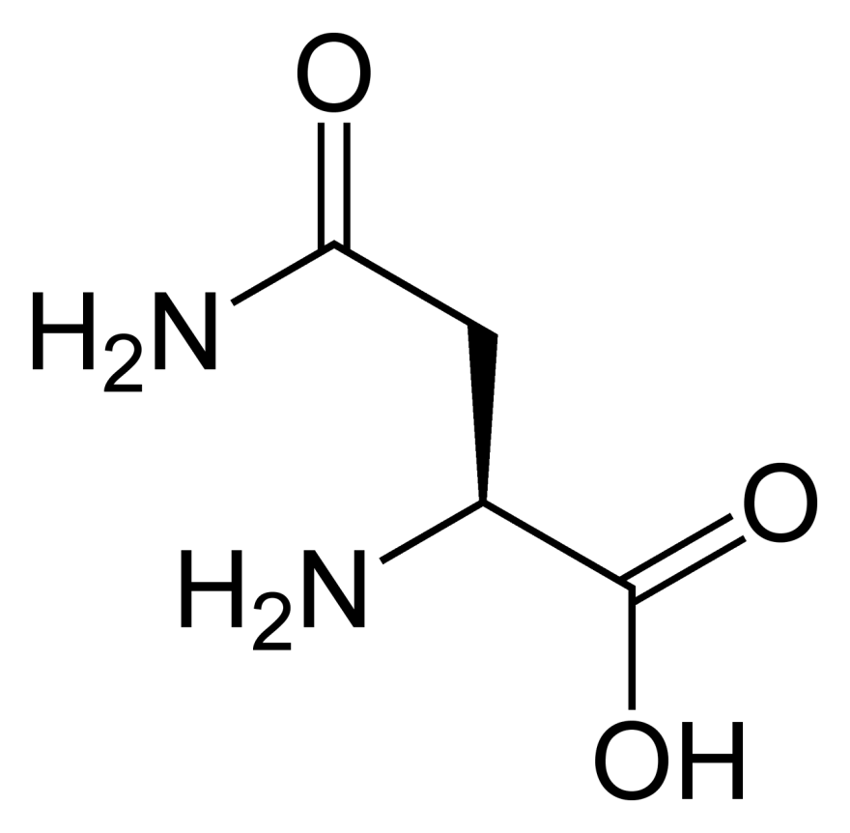
Stereoisomerism
Enantiomers
Amino acid asparagine:
H₂N-CH(CH₂CONH₂)-COOH
One enantiomer tastes bitter
Other enantiomer tastes sweet

Slide 18
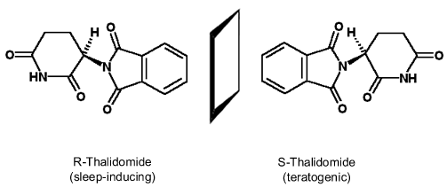
Stereoisomerism
Enantiomers: Critical considerations
Thalidomide
One enantiomer combats “morning sickness”
Other enantiomer responsible for fetal abnormalities

Slide 19
Thalidomide
Drug released in 1958 by a German pharmaceutical company (sold OTC in some countries)
Reports of severe adverse side effects began to appear in 1959
Later is was found that clinical trials revealed these problems as early as 1956, yet the company released the drug anyway
Withdrawn from market in 1961
Has since been re-released (prescription only) to treat leprosy and certain types of cancer

