Slide 1
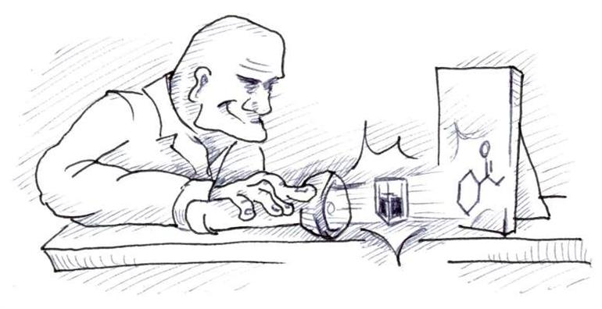
Analytical Chemistry
Option A
Part 2: Spectroscopy (IR and UV-vis)

Slide 2
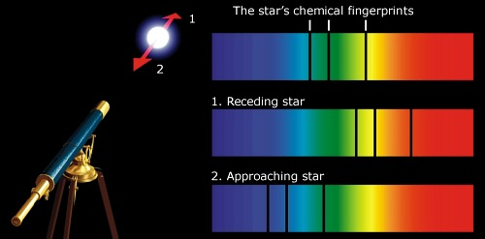
Spectroscopy is the main method we have of probing into the atom and the molecule.

Slide 3
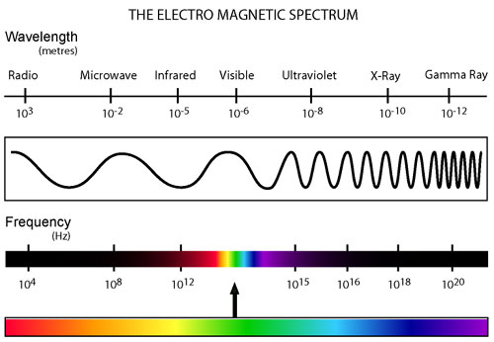

Slide 4
Energy of electromagnetic radiation is carried in discrete packets of energy called photons or quanta.
E = hf
E = energy of a single photon of radiation
h = 6.63 x 10⁻³⁴ J⋅s (Plank’s constant)
f = frequency of the radiation

Slide 5
Example: Calculate the energy of a photon of visible light with a frequency of 3.0 x 10¹⁴ s⁻¹. Express in kJ mol⁻¹.
E = hf
E = (6.63 x 10⁻³⁴ J⋅s)(3.0 x 10¹⁴ s⁻¹)
E = 1.989 x 10⁻¹⁹ J

Slide 6
Note: f x λ = c = 3.0 x 10⁸ m⋅s⁻¹
Type of em radiation | Typical f (s⁻¹) | Typical λ (m)
Radio waves (low energy) | 3 x 10⁶ | 10²
Microwaves | 3 x 10¹⁰ | 10⁻²
Infrared (IR) | 3 x 10¹² | 10⁻⁴
Visible (ROYGBIV) | 3 x 10¹⁵ | 10⁻⁷
Ultraviolet (UV) | 3 x 10¹⁶ | 10⁻⁸
X-rays | 3 x 10¹⁸ | 10⁻¹⁰
Gamma rays (high energy) | > 3 x 10²² | < 10⁻¹⁴
Thus, f = c/ λ

Slide 7
Wavenumber
In IR spectroscopy, the frequency of radiation is often measured as number of waves per centimeter (cm⁻¹), also called wavenumber.
Example: Calculate the wavenumber in cm⁻¹ for an IR wave with a frequency of 3 x 10¹³ s⁻¹.

Slide 8
Info from different em regions (you need to be able to analyze data of underlined regions)
Radio waves can be absorbed by certain nuclei causing them to reverse their spin. Used in NMR and can give info about the environment of certain atoms.
Microwaves cause molecules to increase their rotational energy. Can give info about bond lengths.
IR absorbed by certain bodies causing them to stretch or bend. Gives info about bonds in a molecule.

Slide 9
Info from different em regions
Visible and UV can produce electronic transitions and give info about energy levels within the atom or molecule.
X-rays are produced when electrons make transitions between inner energy levels. They have wavelengths of the same order of magnitude as the inter-atomic distances in crystals and produce diffraction patterns which provide direct evidence of atomic structure.
Gamma rays cause changes in the energy of atomic nuclei. Not helpful to the analytical chemist.

Slide 10
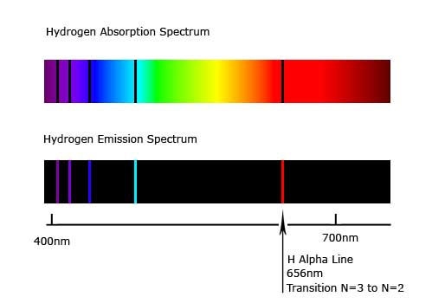
Absorption and emission spectra
Absorption: black lines where light is absorbed by sample.
Emission: bands of colored lines where light is transmitted from excited sample.

Slide 11
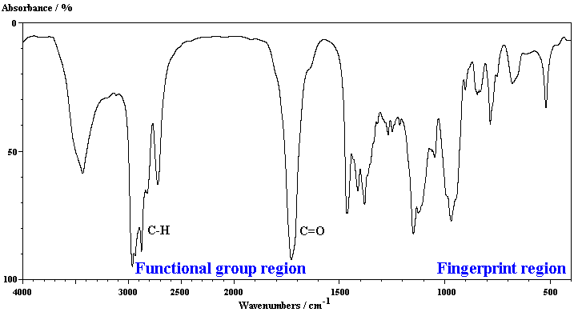
Infrared (IR) Spectroscopy

Slide 12
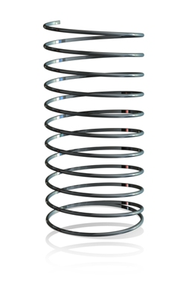
Natural frequency of a chemical bond
Chemical bonds are like springs.
Bonds vibrate and bend at a natural frequency which depends on the bond strength and the masses of the atoms.
Light atoms vibrate at higher freq. than heavier atoms
Multiple bonds vibrate at higher freq. than single bonds.

Slide 13
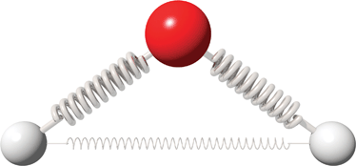
Using IR to excite molecules
Energy needed to excite the bonds in a molecule to make them vibrate with greater amplitude occurs in the IR region.
IR radiation can cause a bond to stretch or bend.

Slide 14
Stretching and bending
bending (symmetrical)
stretching (asymmetrical)
stretching (symmetrical)

Slide 15
Using IR to excite molecules
Not all vibrations absorb IR.
For absorption, there must be a change in bond polarity (dipole moment) as the vibration occurs.
Thus, diatomic gas molecules such as H₂, Cl₂ and O₂ do not absorb IR.

Slide 16
Vibrations of H₂O, SO₂ & CO₂
Molecule | Asymmetrical stretching | Symmetrical stretching | Symmetrical bending
H₂O
SO₂
CO₂
δ-
δ-
δ-
O
O
O
δ+
H
H
H
H
H
H
δ+
δ+
δ+
δ+
δ+
IR active
IR active
IR active
δ+
δ+
δ+
S
S
S
O
δ-
O
O
O
O
δ-
O
δ-
δ-
δ-
δ-
IR active
IR active
IR active
δ-
δ+
δ-
δ-
δ+
δ-
δ-
δ+
δ-
O
C
O
O
C
O
O
C
O
IR active
IR inactive
IR active

Slide 17
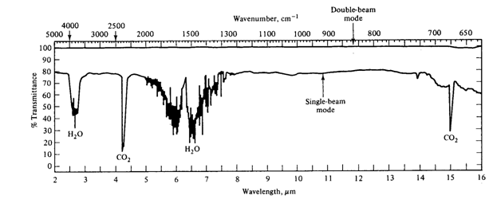
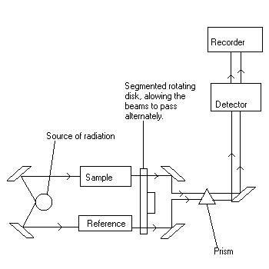
Double-beam IR spectrometer
One beam passes through sample
Second beam passes through reference
Purpose of reference: to eliminate absopions caused by CO₂ and H₂O vapor in air, or absorptions from the bonds in the solvent used.
Baseline = 100% transmittance

Slide 18
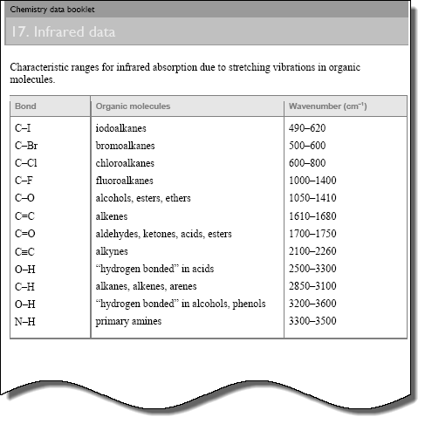
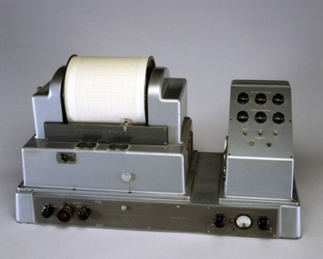
Matching wavenumbers with bonds
“fingerprint region”
lots of overlap, so not very useful
very strong
broad and strong
broad and strong
Usually sharper than OH

Slide 19
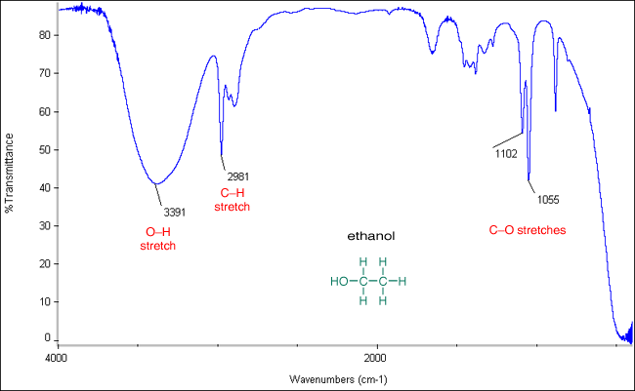
IR spectrum of ethanol, CH₃CH₂OH

Slide 20
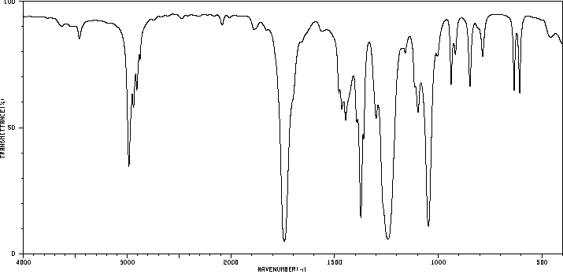
IR spectrum of ethyl ethanoate, CH₃COOCH₂CH₃
C-H
C=O
“fingerprint region”

Slide 21
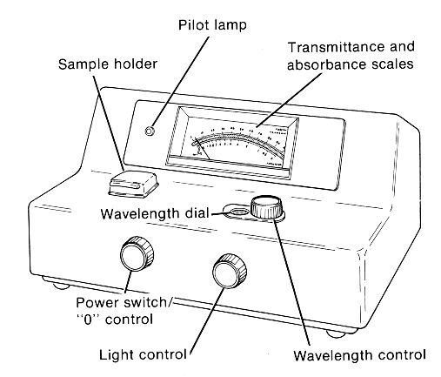
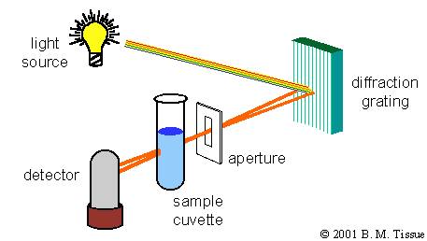
UV-vis Spectroscopy

Slide 22
UV-vis Spectroscopy
Similar to IR spectroscopy, but uses UV and visible light instead to analyze solutions of complex metal ions and organic compounds.
Horizontal axis: wavelength (not wavenumber as in IR)
Vertical axis: absorbance / intensitry of the absorption (not %transmittance as in IR)

Slide 23
UV-vis Spectroscopy
UV-vis light have sufficient energy to excite electrons in higher energy levels in complex ions and molecules.
When a full range of wavelengths of UV-vis radiation is passed through sample, an absorption spectrum is obtained.
Each characteristic absorption corresponds to an electronic transition.

Slide 24
UV-vis Spectroscopy
Substance that appear colored absorb certain wavelengths of light in the visible region and transmit the remaining wavelengths.
When the energy needed to excite an electron is in the UV region of the spectrum and all visible light is transmitted, the substance appears white.

Slide 25
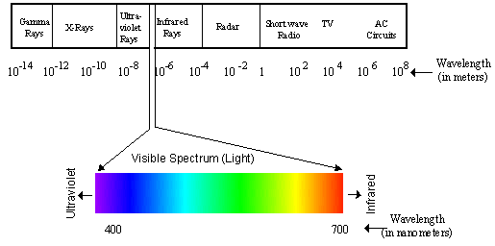
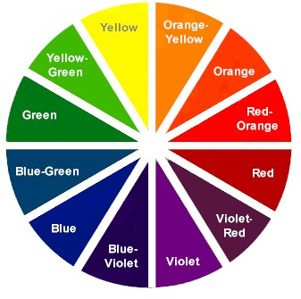

Slide 26
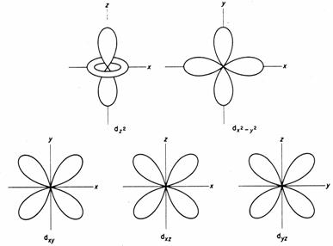
Transition metal complexes
Recall from unit 3 that d orbitals in a transition metal complex are split into two levels by the electric field created by the lone pair of electrons of the surrounding ligands.
∆E

Slide 27
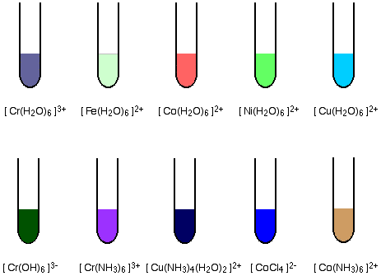
Transition metal complexes
For example, when light passes through a sol’n of [Cu(H₂O)₆]²⁺, one 3d e⁻ is excited from the lower to the higher energy sub-level.
A photon of orange light is absorbed and the light of the complementary color, blue is transmitted.

Slide 28
Recall from unit 3…

Slide 29
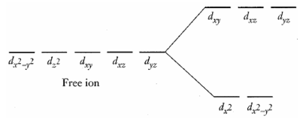
Colored Complexes
In the free ion the five d-orbitals are degenerate (of equal energy). However, in complexes the d orbitals are split into two distinct energy levels.
ΔE

Slide 30
Colored Complexes
The energy difference between the levels corresponds to a specific frequency and wavelength in the visible region of the electromagnetic spectrum.
ΔE=hf

Slide 31
Colored Complexes
When the complex is exposed to light, energy of a specific wavelength is absorbed and electrons are excited from the lower level to the higher level.
In the example above, [Ti(H₂O)₆]³⁺ contains a single d-electron in lower energy orbitals. 500 nm light absorption promotes the d-electron.

Slide 32
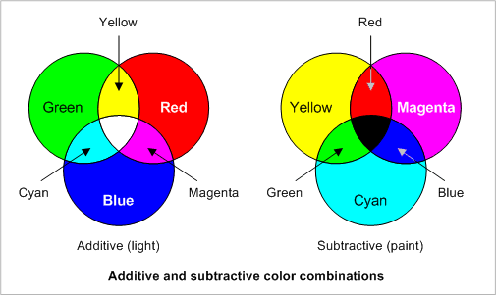
Colored Complexes
Cu²⁺(aq) appears blue because it is the complementary color to the wavelengths that have been absorbed.
When yellow light is subtracted out of white light, blue light is transmitted

Slide 33
Colored Complexes
The observed color is across the color wheel from the absorbed color.
Color Wheel
white light in
violet transmitted

Slide 34
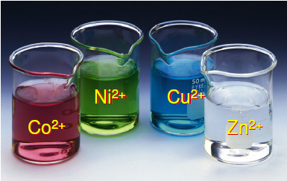
Colored Complexes
The energy separation between the orbitals and hence the color of the complex depends on the following factors:
1) Nuclear charge (based on identity of the central metal ion)

Slide 35
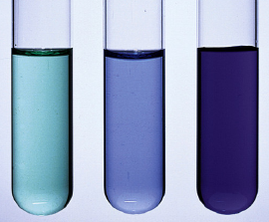
Colored Complexes
2) Charge density of the ligand
[Ni(NH₃)₆]²⁺
[Ni(H₂O)₆]²⁺
[Ni(en)₃]²⁺

Slide 36
Colored Complexes
Ex: NH₃ has a higher charge density than H₂O and so produces a larger split in the d sublevel.
[Cu(H₂O)₆]²⁺ absorbs red-orange light and appears pale blue
[Cu(NH₃)₄(H₂O)₂]²⁺ absorbs the higher energy yellow light and appears deep blue
I⁻ < Br⁻ < Cl⁻ < F⁻ < OH⁻ < H₂O < NH₃ < en < NO₂⁻ < CN⁻
Weak-field ligands
(small Δ)
Strong-field ligands
(large Δ)

Slide 37
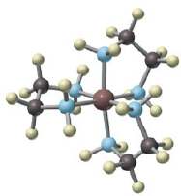
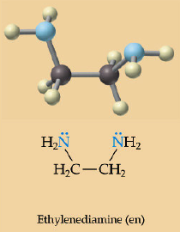
Colored Complexes
What is en?
It is part of a class of ligands called bidentate ligands (more than one atom of the ligand is involved in the bonding to the central atom… you don’t need to worry about these at this level).

Slide 38
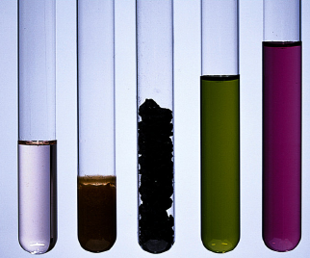
Colored Complexes
3) Number of d electrons present (and hence the oxidation # of the central ion)
Mn²⁺
Mn³⁺
Mn⁴⁺
Mn⁶⁺
Mn⁷⁺

Slide 39
Colored Complexes
4) Shape of the complex ion
Electric field created by the ligand’s lone pair of electrons depends on the geometry of the complex ion

Slide 40
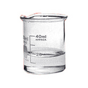
Colored Complexes
If the d sublevel is completely empty, as in Sc³⁺, or completely full, as in Cu⁺ or Zn²⁺, no transitions within the d sublevel can take place and the complexes are colorless.
Notes:
`

Slide 41
Colored Complexes
NOTE: it is important to distinguish between the words “clear” and “colorless.” Neither AP, nor IB, will give credit for use of the word clear (which means translucent) when colorless should have been used. Think about it, something can be pink and clear… colorless means something else.
Both are “clear.” Only the beaker on the left is “colorless.”

Slide 42
The Spectrochemical Series
When ligands are arranged in order of their ability to split the d orbitals:
I⁻ < Br⁻ < Cl⁻ < OH⁻ < H₂O < NH₃ < CN⁻
Iodine causes the smallest splitting
Cyanide ions cause the largest splitting

Slide 43
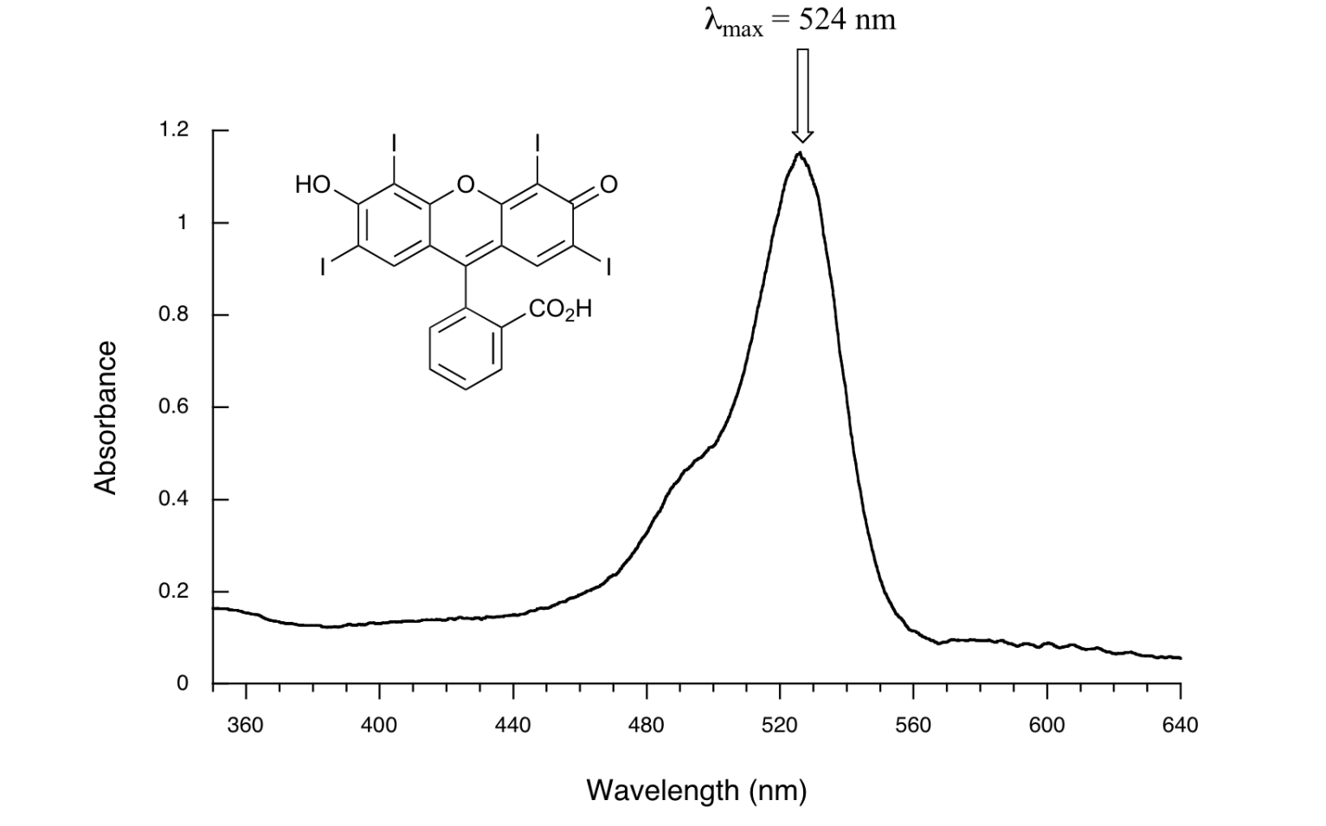
Organic Molecules
Compounds containing unsaturated groups, such as C=C, C=O, -N=N-, -NO₂ and the benzene ring can absorb in the UV or visible part of the spectrum.

Slide 44
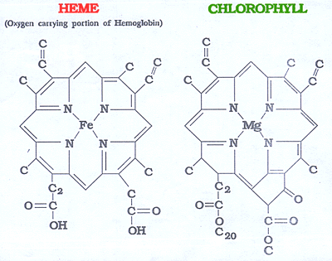
Organic Molecules
A compound is more likely to absorb visible light (and so appear colored) when it contains a conjugated system of alternate C=C and C-C bonds, with the π electrons delocalized over a larger area.

Slide 45
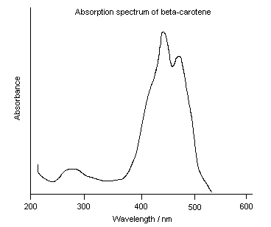
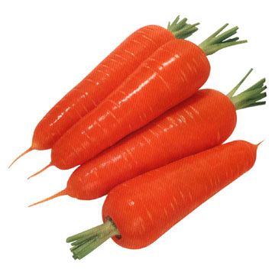
β-carotene (absorbs in the blue region; transmits orange)

Slide 46
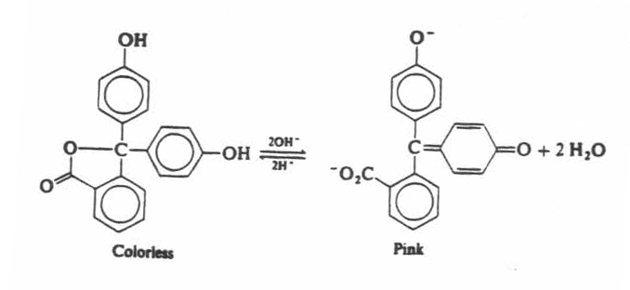
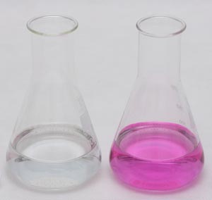
Color changes in acid-base indicators
Example: phenolphthalein
Absorbs UV light in acidic sol’n, so appears colorless (not conj). In basic solution, the pi bonds all overlap, allowing electrons to be delocalized across the entire molecule; now it absorbs green light and appears purple.

Slide 47
Using UV-vis spectroscopy and Beer-Lambert Law to determine concentration:
Concentration of metal ions in sol’n can be determined by measuring how much light, at the characteristic λ of the metal, is absorbed by the sample.
Ex: Cobalt (II) compounds are pink in sol’n (octahedral complex absorbs green light).
Monochromator selects green light of appropriate λ; pass light through sample; photocell detector measures intensity of light transmitted.

Slide 48
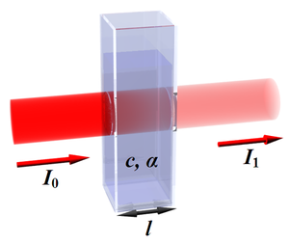
Beer-Lambert Law
Intensity of light transmitted through a sol’n falls exponentially as the path length (l) ↑.
I = intensity of light after passing through sample
I₀= intensity of light before passing through sample
k=absorbance of 1 cm pathlength sample
l = pathlength
I = I₀e^{-kt}

Slide 49
Beer-Lambert Law
Generally expressed in logarithms to base 10, with the ratio log₁₀(I₀/I) defined as the absorbance (A).
$$A=\log_{10}\frac{I_{0}}{I}=εcl$$
A = absorbance
ε = molar absorptivity coefficient
l = path length through sample cell
c = concentration

Slide 50
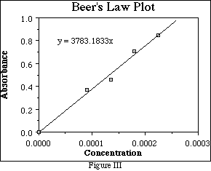
Determining the unknown concentration of a sol’n
Degree of absorption depends on concentration.

Slide 51
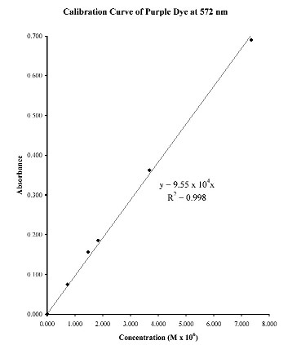
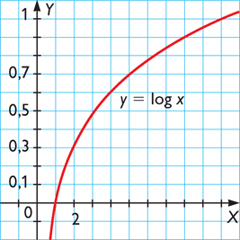
Beer-Lambert Law:
$$A=\log_{10}\frac{I_{0}}{I}=εcl$$
Relationship becomes nonlinear at higher concentrations

Slide 52
Determining the unknown concentration of a sol’n
As the Beer-Lambert Law only applies strictly to dilute sol’ns, it is not generally used directly.
Instead, the absorbance of standard solutions with a range of concentrations is measured and plotted on a graph to produce a calibration curve.
This allows the concentration of a metal in a sample to be read of once the absorbance is known.

