Slide 1
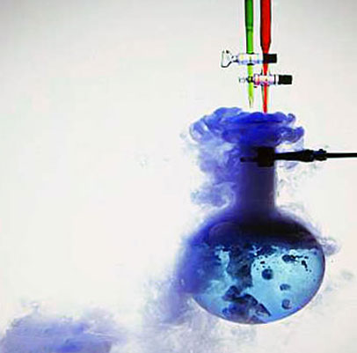
Organic Chemistry
Part 3: Reactions of
Alkanes & Alkenes

Slide 2
Reactions of Alkanes

Slide 3
Combustion of alkanes
All hydrocarbons burn in excess oxygen to give carbon dioxide and water:
C_{x}H_{y} + (x + y/4) O₂ → x CO₂ + y/2 H₂O
Although the C-C and C-H bonds (reactants) are strong, the C=O and O-H bonds (products) are stronger, so the rxn is very exothermic.

Slide 4
Combustion of alkanes
Ex: natural gas (methane)
CH₄(g) + 2O₂(g)→ CO₂(g) + 2H₂O(l)
ΔH°=-890 kJ⋅mol⁻¹
Ex: gasoline
C₈H₁₈(g) + 12½O₂(g) → 8CO₂(g) + 9H₂O(l)
ΔH°=-5512 kJ⋅mol⁻¹

Slide 5
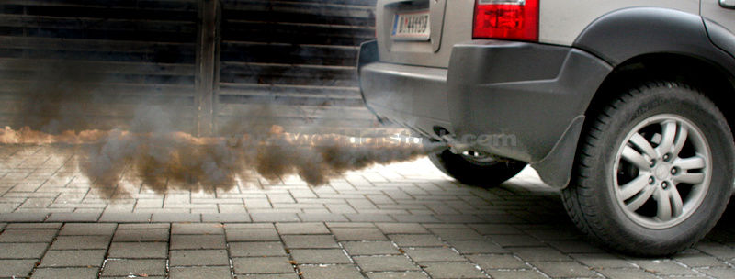
Combustion of alkanes
Incomplete Combustion:
If there is an insufficient supply of oxygen, incomplete combustion occurs and carbon monoxide and carbon are also produced as products.

Slide 6
Substitution Reactions
Alkanes can react with halogens in the presence of UV light to form an acid and a substituted alkane.
Ex:

Slide 7
Substitution Reactions
Alkanes can react with halogens in the presence of UV light to form and acid and a substituted alkane.
Ex:

Slide 8
Mechanism of chlorination of methane
The mechanism of an organic reaction describes the individual steps.
When a chemical bond breaks, it breaks heterolytically or homolytically.
Heterolytic fission: both of the shared electrons go to one atom, resulting in a negative and a positive ion.
Homolytic fission: each atoms keeps one of the shared electrons, resulting in the formation of two free radicals.

Slide 9
Mechanism of chlorination of methane
The halogen-halogen bond is weaker than the C-H and C-C bond in methane and can break homolytically in the presence of UV light.
This stage of the mechanism is called initiation:

Slide 10
Mechanism of chlorination of methane
Free radicals contain an unpaired electron and are highly reactive.
When a chlorine free radicals come into contact with a methane molecule they combine with a hydrogen atom to produce hydrogen chloride and a methyl radical.
Since a new radical is produced, this stage of the mechanism is called propagation:

Slide 11
Mechanism of chlorination of methane
The methyl free radical is also extrememly reactive and reacts with a chlorine molecule to form the product and regenerate another chlorine radical.
Another propagation step:

Slide 12
Mechanism of chlorination of methane
In theory a single chlorine radical may cause up to 10,000 molecules of chloromethane to be formed.
When two radicals react together, termination occurs:

Slide 13
Mechanism of chlorination of methane
Further substitution can occur when chlorine radicals react with the substituted products.
For example:

Slide 14
Mechanism of chlorination of methane
The substitution can continue even further to produce trichloromethane and then tetrachloromethane.
The overall mechanism is called free radical substitution.
Note that in this mechanism hydrogen radicals, H•, are not formed.

Slide 15
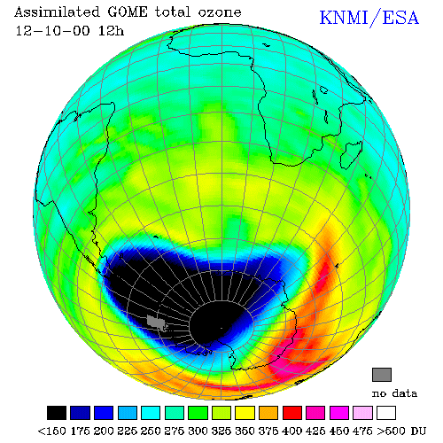
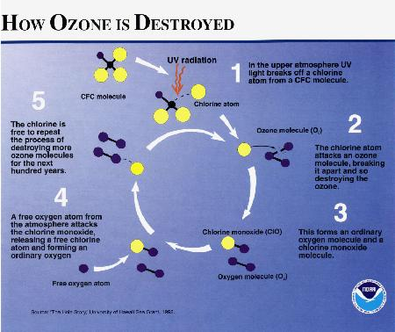
Ozone thinning

Slide 16
Reactions of Alkenes

Slide 17
Addition reactions
Bond enthalpies:
C-C 348 kJ mol⁻¹
C=C 612 kJ mol⁻¹ (less than twice C-C enthalpy)
Thus the C=C bond makes the molecule reactive.
The most important reactions of alkenes are addition reactions, where an unsaturated reactant becomes saturated.

Slide 18
Addition reactions include the addition of hydrogen, bromine, hydrogen halides and water.

Slide 19
Uses of addition reactions
Bromination
Hydration
Hydrogenation

Slide 20
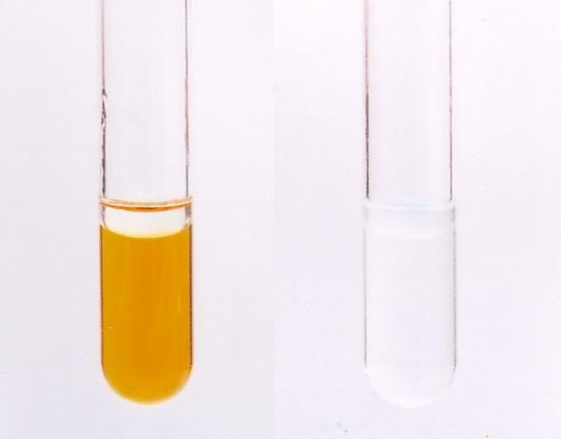
Bromination
Pure bromine is a red liquid, but has a yellow/orange color in sol’n.
When a sol’n of bromine is added to an alkene, the product is colorless.
Test for unsaturation: this decoloriation of bromine solution provides a useful test to indicate the presence of an alkene group.

Slide 21
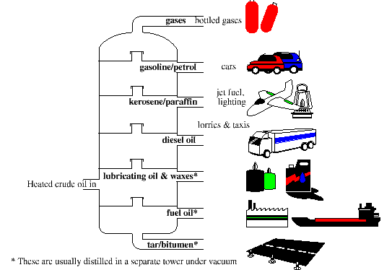
Hydration
Ethene is an important product formed during the cracking of oil.
Although ethanol can be made from the fermentation of starch and sugars, much industrial ethanol is formed from the addition of steam to ethene.

Slide 22
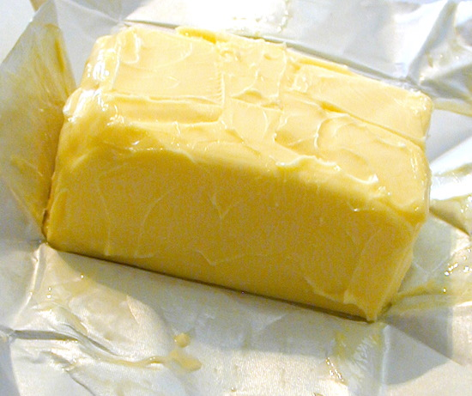
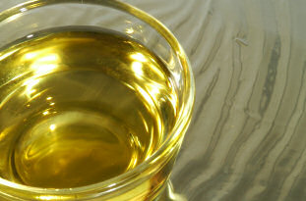
Hydrogenation
The addition of hydrogen to unsaturated vegetable oils is used industrially to make margarine.
Hydrogenation reduces the number of double bonds in the polyunsaturated vegetable oils present in the margarine, which causes it to become a solid at room temp (and have a longer shelf life).
+ H₂ →

Slide 23
Addition polymerization
Under certain conditions, ethene can also undergo addition reactions with itself to form a long chain polymer containing many thousands (typically 40,000 to 800,000) of carbon atoms.

Slide 24
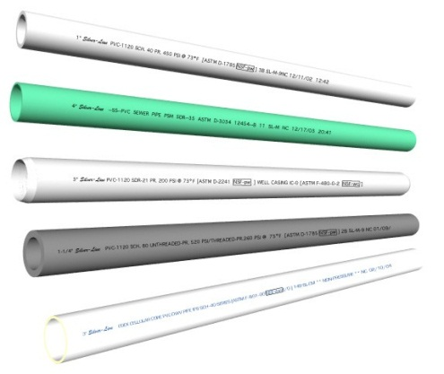
Addition polymerization
These addition reaction scan be extended to other substituted alkenes to give a wide variety of different addition polymers.
Example 1: formation of PVC

Slide 25
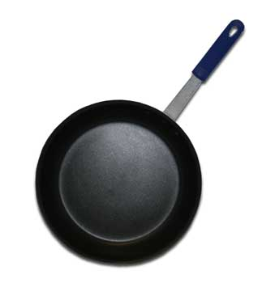
Addition polymerization
These addition reaction scan be extended to other substituted alkenes to give a wide variety of different addition polymers.
Example 2: formation of PTFE (Teflon)

