Slide 1
Motion in 2D
My website: https://scienceknowledge.webador.com/

Slide 2
Learning Objectives
Vector Components (Trigonometry)
Kinematic Equations 2D
Projectile Motion
Motion in an inclined plane
Relative Motion

Slide 3
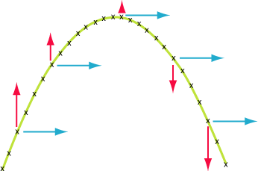
Projectile Motion
Projectile motion is a form of motion experienced by a launched object.
Affected by gravity only

Slide 5
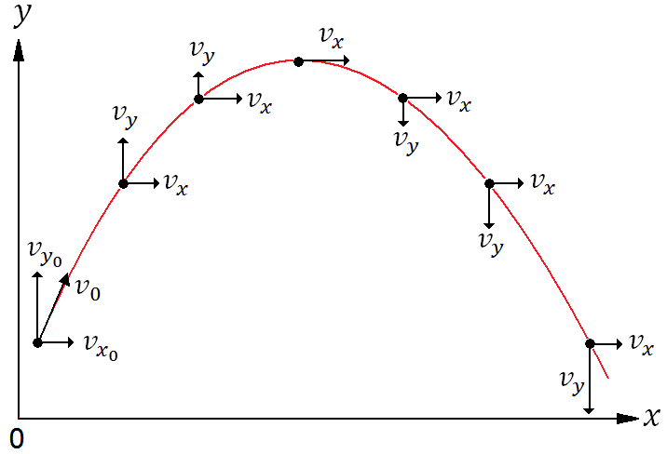
Horizontal and Vertical Velocity

Slide 7
Motion Diagram

Slide 8
Vertical and Horizontal Displacement

Slide 10
More Formulas, Maximum Height, etc

Slide 13
Trajectoty of Projectile Motion

Slide 16
Questions To Think About
Why is the trajectory of vertical component vs time is a parablic function?
Why is vertical velocity vs time a linear function?
Hint: Kinematics Equations

Slide 17
Projectile Without Fluid Resistance

Slide 18
Drag Force

Slide 19
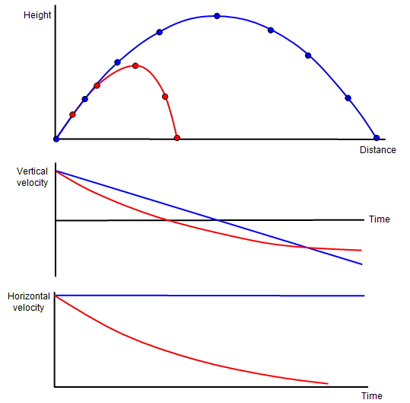
Projectile with Fluid Resistance

Slide 20
Terminal Velocity

Slide 21
Motion on An Inclined Plane

Slide 22
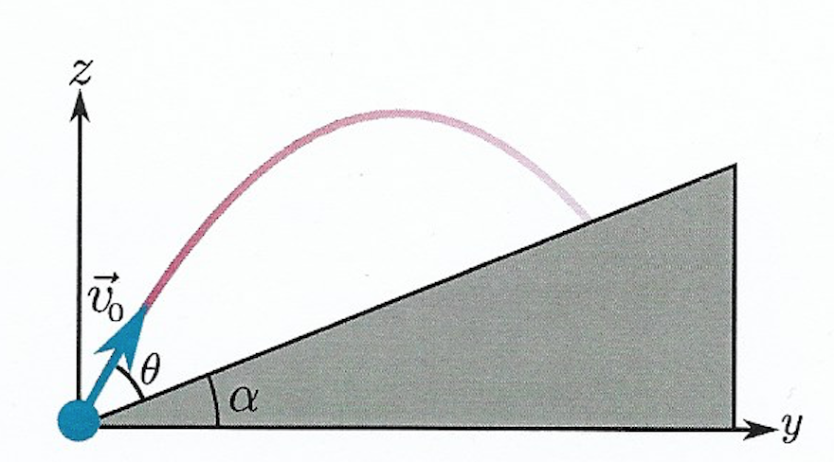
Projectile Motion on An Inclined Plane

