Slide 1
Unit 1 Review Quantitative Chemistry
AP Chapters 1-5
IB Topic 1: Quantitative Chemistry

Slide 2
What’s on our first test?
All review from H Chem (except for uncertainty and errors in measurement)
WebAssign
Summer Assignment
Uncertainty notes
Use the IB Programme Guide for Chemistry as a preparation checklist for each test
The first test (content from Ch 1-5) covers IB Topics 1 & 11 (pp. 48-50 & 68-69 of Programme Guide)

Slide 3
Quantitative Chemistry
1.1 The mole concept & Avogadro’s constant
1.2 Formulas
1.3 Chemical Equations
1.4 Mass & gaseous volume relationships in chemical reactions
1.5 Solutions
(see IB Programme Guide for details)

Slide 4
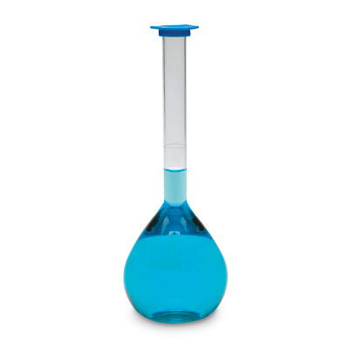
Solution concentration examples: a) Describe how you would make 100.0 cm³ of a 2.50 mol dm⁻³ solution of sodium hydroxide with the starting ingredients listed below. Back up your explanation with the appropriate calculation.
i) NaOH(s) ii) 6.0 mol dm⁻³ NaOH(aq)
Add 10.0 g of NaOH to enough water to make 100.0 mL of solution.

Slide 5
Solution concentration examples: a) Describe how you would make 100.0 cm³ of a 2.50 mol dm⁻³ solution of sodium hydroxide with the starting ingredients listed below. Back up your explanation with the appropriate calculation.
i) NaOH(s) ii) 6.0 mol dm⁻³ NaOH(aq)
Measure out 41.7 cm³ of the stock sol’n and dilute to 100.0 cm³.

Slide 6
Solution concentration examples: b) Calculate the amount of hydrochloric acid present in 2.00 dm³ of 1.50 mol dm⁻³ HCl(aq).

Slide 7
Solution concentration examples: c) What mass of potassium permanganate, KMnO₄(s), is present in 25.55 cm³ of 0.35 mol dm⁻³ KMnO₄(aq)?

Slide 8
Solution concentration examples: d) What will be the concentration of the solution formed by mixing 200 cm³ of 3.00 mol dm⁻³ HCl(aq) with 300 cm³ of 1.50 mol dm⁻³ HCl(aq)?

Slide 9
Ex.1 (IB 2005): When a small quantity of strongly smelling gas such as ammonia is released into the air, it can be detected several metres away in a short time.
Use the kinetic molecular theory to explain why this happens.
Gases are made of chaotically-moving molecules. When a new gas (e.g. ammonia) is released into a mixture of gases (e.g. air), its molecules will move rapidly from the point of release and be detectable at a distance in a short time.

Slide 10
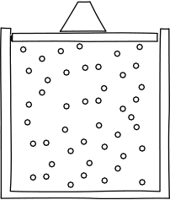
Ex.1 (IB 2005): When a small quantity of strongly smelling gas such as ammonia is released into the air, it can be detected several metres away in a short time.
b) State and explain how the time taken to detect the gas changes when the temperature is increased.
Because the kinetic energy, and hence the speed of the gas molecules, will increase as the temperature increases, the time taken to detect the gas will decrease.

Slide 11
Ex.2 (IB 2005): The percentage composition by mass of a hydrocarbon is C = 85.6% and H=14.4%. a) Calculate the empirical formula of the hydrocarbon.
 | C | H
Mass per 100 g | 85.6 g | 14.4 g
Moles per 100 g | 85.6 ÷ 12.01 = 7.13 mol | 14.4 ÷ 1.01 = 14.3 mol
Simplest ratio | 7.13 ÷ 7.13 = 1 | 14.3 ÷ 7.13 = 2
Empirical formula = CH₂

Slide 12
Ex.2 (IB 2005): The percentage composition by mass of a hydrocarbon is C = 85.6% and H=14.4%. b) A 1 g sample of the hydrocarbon at a temperature of 273 K and a pressure of 1.01 x 10⁵ Pa (1.00 atm) has a volume of 0.399 dm³.
Calculate the molar mass of the hydrocarbon.
PV = nRT so n = PV ÷ RT
n=(1.01x10⁵ Pa)(0.399x10³ m³) ÷ (8.31 J mol⁻¹ K⁻¹)(273 K)
n=0.0178 mol
Molar mass M = Mass (g) ÷ Amount (moles)
=1 g ÷ 0.0178 mol = 56.3 g mol⁻¹

Slide 13
Ex.2 (IB 2005): The percentage composition by mass of a hydrocarbon is C = 85.6% and H=14.4%. b) A 1 g sample of the hydrocarbon at a temperature of 273 K and a pressure of 1.01 x 10⁵ Pa (1.00 atm) has a volume of 0.399 dm³.
ii) Deduce the molecular formula of the hydrocarbon.
The molar mass of the empirical formula is 12.01 + (2 x 1.01) = 14.03 g mol⁻¹
The molecular mass, 56.3 g mol⁻¹, is about four times 14.03, so the molar formula must be (CH₂)₄ or C₄H₈.

Slide 14
Ex.3 (IB 2003): Sodium reacts with water as follows: 2Na(s) + H₂O → 2NaOH(aq) + H₂(g) 1.15 g of sodium is allowed to react completely with water. The resulting solution is diluted to 250 cm³. Calculate the concentration, in mol dm⁻³, of the resulting sodium hydroxide solution.
As usual, we need to convert to moles:
1.15 g of Na is 1.15 g ÷ 22.99 g mol⁻¹ = 0.0500 mol Na
From the balanced equation, we can see that 0.0500 mol of Na will produce 0.0500 mol of NaOH.
Now we know the volume of sol’n (250 cm³, 0.250 dm³) and the amount of solute (0.0500 mol of NaOH)
Concentration = amt. of solute ÷ vol. sol’n = 0.0500 mol ÷ 0.250 dm³ = 0.200 mol dm⁻³

Slide 15
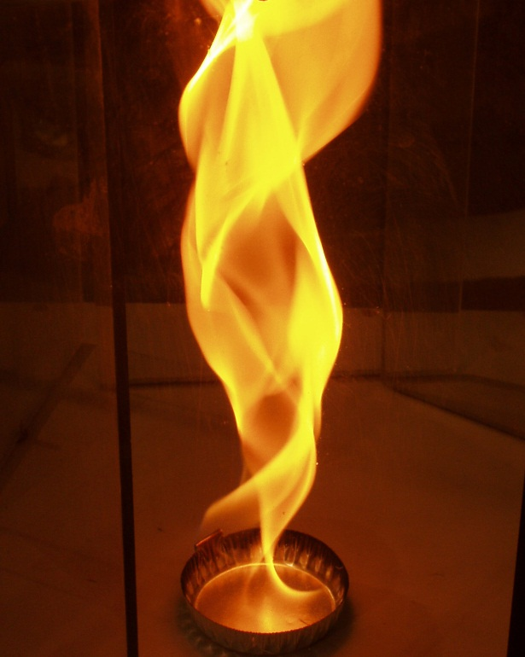
Ex.4 (IB 2004): 100 cm³ of ethane, C₂H₄, is burned in 400 cm³ of oxygen, producing carbon dioxide and some liquid water. Some oxygen remains unreacted. a) Write the equation for the complete combustion of ethane.
C₂H₄(g) + O₂(g) → CO₂(g) + H₂O(l)
3
2
2

Slide 16
Ex.4 (IB 2004): 100 cm³ of ethane, C₂H₄, is burned in 400 cm³ of oxygen, producing carbon dioxide and some liquid water. Some oxygen remains unreacted. b) Calculate the volume of carbon dioxide produced and the volume of oxygen remaining.
C₂H₄(g) + 3O₂(g) → 2CO₂(g) + 2H₂O(l)
Initially: 100 cm³ 400 cm³ 0 cm³ not a gas
Finally: 0 cm³ 100 cm³ 200 cm³
(100 cm³ of ethene would react with 300 cm³ of oxygen to produce 200 cm³ of carbon dioxide. If gas volumes are measured under the same conditions, according to Avogadro’s hypothesis)

Slide 17
Ex. 5 (IB 2004): a) Write an equation for the formation of zinc iodide from zinc and iodine.
To work out the formulae, you need to remember that iodine is diatomic (I₂), and the charges on zinc and iodide ions are +2 and -1 respectively:
Zn(s) + I₂(s) → ZnI₂(s)

Slide 18
Ex. 5 (IB 2004): b) 100.0 g of zinc is allowed to react with 100.0 g of iodine producing zinc iodide. Calculate the amount (in moles) of zinc and iodine, and hence determine which reactant is in excess.
100.0 g Zn ÷ 65.38 g mol⁻¹ = 1.530 mol Zn
100.0 g I₂ ÷ 253.80 g mol⁻¹ = 0.3940 mol I₂
According to the balanced chemical equation: Zn(s) + I₂(s) → ZnI₂(s)
1.530 mol Zn would produce 1.530 mol ZnI₂
0.3940 mol I₂ would produce 0.3940 mol ZnI₂
Iodine is the limiting reagent because the reaction will stop when the iodine has reacted and 0.3920 mol of ZnI₂ has been produced. Zinc is the reagent in excess.

Slide 19
Ex. 5 (IB 2004): c) Calculate the mass of zinc iodide that will be produced.
0.3940 mol of ZnI₂ will be produced.
0.3940 mol x 319.18 g mol⁻¹ = 125.8 g

Slide 20
Ex. 6 (IB 2004): 27.82 g of hydrated sodium carbonate crystals, Na₂CO₃⋅xH₂O, were dissolved in water and made up to 1.000 dm³. 25.00 cm³ of this solution were neutralized by 48.80 cm³ of hydrochloric acid of concentration 0.1000 mol dm⁻³. a) Write an equation for the reaction between sodium carbonate and hydrochloric acid.
Acid + carbonate → salt + water + CO₂
Hydrochloric acid produces chloride salts
Na₂CO₃(aq) + HCl(aq) → NaCl(aq) + H₂O(l) + CO₂(g)
We will learn this & more later
2
2

Slide 21
Ex. 6 (IB 2004): 27.82 g of hydrated sodium carbonate crystals, Na₂CO₃⋅xH₂O, were dissolved in water and made up to 1.000 dm³. 25.00 cm³ of this solution were neutralized by 48.80 cm³ of hydrochloric acid of concentration 0.1000 mol dm⁻³. b) Calculate the molar concentration of the sodium carbonate solution neutralized by the hydrochloric acid.
Moles HCl = 0.1mol dm⁻³ x 48.8x10⁻³dm³
= 4.88x10⁻³mol = 4.880mmol
1mol of Na₂CO₃ reacts with 2 moles of HCl, so…
2.440mmol of Na₂CO₃ react with 4.880 mmolHCl
Concentration of Na₂CO₃ = 2.440x10⁻³mol÷25x10⁻³dm³
= 0.09760 mol dm⁻³

Slide 22
Ex. 6 (IB 2004): 27.82 g of hydrated sodium carbonate crystals, Na₂CO₃⋅xH₂O, were dissolved in water and made up to 1.000 dm³. 25.00 cm³ of this solution were neutralized by 48.80 cm³ of hydrochloric acid of concentration 0.1000 mol dm⁻³. c) Determine the mass of sodium carbonate neutralized by the hydrochloric acid and hence the mass of sodium carbonate present in 1.000 dm3 of solution.
Start with answer to part b…
2.44x10⁻³ mol Na₂CO₃ x 105.99 g mol⁻¹
=0.2586 g
This is the mass in 25 cm³, so the mass in 1000 cm³ is 0.2586 g x 1000 ÷ 25 = 10.34 g

Slide 23
Ex. 6 (IB 2004): 27.82 g of hydrated sodium carbonate crystals, Na₂CO₃⋅xH₂O, were dissolved in water and made up to 1.000 dm³. 25.00 cm³ of this solution were neutralized by 48.80 cm³ of hydrochloric acid of concentration 0.1000 mol dm⁻³. d) Calculate the mass of water in the hydrated crystals and hence find the value of x.
Mass H₂O = 27.82 g – 10.34 g = 17.48 g
Moles H₂O= 17.48 g ÷ 18.02 g mol⁻¹= 0.9698 mol
Moles Na₂CO₃=10.34 g ÷ 105.99 g mol⁻¹= 0.09760 mol
x= 0.9698 mol ÷ 0.09760 mol= 10
Thus, Na₂CO₃⋅10H₂O

