Slide 1
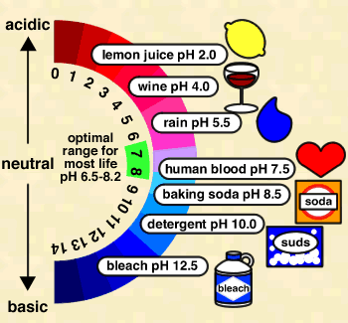
Unit 8: Acids & Bases
PART 2:
pH, pOH & pK_{w}

Slide 2
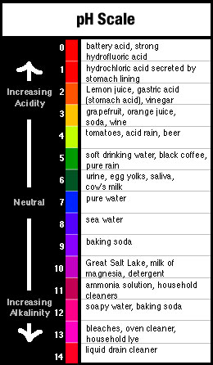
The pH Scale
pH is a value chemists use to give a measure of the acidity or alkalinity of a solution.
Used because [H⁺] is usually very small

Slide 3
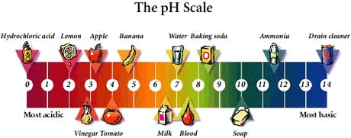
The pH Scale
pH stands for pouvoire of hydrogen.
Pouvoire is French for “power.”
The normal range of the pH scale is 0-14.
However, it is possible (if the hydronium or hydroxide concentrations get above 1 Molar) for the pH to go beyond those values.

Slide 4
pH = -log[H⁺]
Thus, [H⁺] = 10^{-pH}

Slide 5
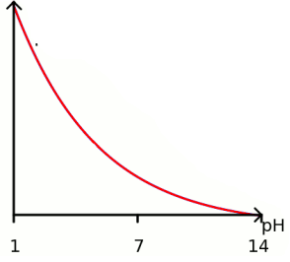
As pH decreases, [H⁺] increases exponentially (a change of one pH unit represents a 10-fold change in [H⁺]
[H⁺]

Slide 6
Example: If the pH of a solution is changed from 3 to 5, deduce how the hydrogen ion concentration changes.
pH = 3
pH = 5
pH = -log[H+]
5 = -log[H⁺]
3 = -log[H⁺]
[H+] = 10⁻⁵
-3 = log[H+]
[H+] = 10⁻³
Therefore [H+] has decreased by a factor of 100.

Slide 7
Calculations involving acids and bases
Sig figs for Logarithms (see page 631): The rule is that the number of decimal places in the log is equal to the number of significant figures in the original number.
Another way of saying this is only numbers after decimal in pH are significant.
Example: [H+] = 1.0 x 10⁻⁹ M (2 significant figures)
pH = -log(1.0 x 10⁻⁹) = 9.00 (2 decimal places)

Slide 8
Ion product constant of water, K_{w}
Recall that water autoionizes:
H₂O(l) ↔ H⁺(aq) + OH⁻(aq) (endothermic)
Therefore K_{c} =

Slide 9
Ion product constant of water, K_{w}
The concentration of water can be considered to be constant because so little of it ionizes, and it can therefore be combined with K_{c} to produce a modified equilibrium constant known as k_{w}. In fact, liquids and solids never appear in equilibrium expressions for this reason.
K_{c}[H₂O] = [H⁺][OH⁻]
K_{w}

Slide 10
Ion product constant of water, K_{w}
Therefore, K_{w} =

Slide 11
Ion product constant of water, K_{w}
At 25°C, K_{w} = 1.00 x 10⁻¹⁴
In pure water, because [H⁺]=[OH⁻], it follows that [H+] =
So at 25°C, [H⁺] = 1.0 x 10⁻⁷, which gives pH = 7.00

Slide 12
K_{w} is temperature dependent
Since the dissociation of water reaction in endothermic (bonds breaking), an increase in temperature will shift the equilibrium to the RIGHT, thus INCREASING the value of K_{w}.
H₂O(l) ↔ H⁺(aq) + OH⁻(aq) (endothermic)

Slide 13
K_{w} is temperature dependent
As K_{w} increases, so do the concentrations of H⁺(aq) and OH⁻(aq) → pH decreases
However, since hydronium and hydroxide concentrations remain equal, water does not become acidic or basic as temperature changes, but the measure of its pH does change.

Slide 14
K_{w} is temperature dependent
Temp (°C) | K_{w} | [H⁺] in pure water | pH of pure water
0 | 1.5 x 10⁻¹⁵ | 0.39 x 10⁻⁷ | 7.47
10 | 3.0 x 10⁻¹⁵
20 | 6.8 x 10⁻¹⁵ | 0.82 x 10⁻⁷ | 7.08
25 | 1.0 x 10⁻¹⁴
30 | 1.5 x 10⁻¹⁴ | 1.22 x 10⁻⁷ | 6.92
40 | 3.0 x 10⁻¹⁴ | 1.73 x 10⁻⁷ | 6.77
50 | 5.5 x 10⁻¹⁴
0.55 x 10⁻⁷
7.27
1.00 x 10⁻⁷
7.00
2.35 x 10⁻⁷
6.63

Slide 15
H⁺ and OH⁻ are inversely related
Because the product [H⁺] x [OH⁻] is constant at a given temperature, it follows that as one goes up, the other must go down (since K_{w} = [H⁺][OH⁻])
Type of sol’n | Relative concentrations | pH at 25°C
Acid
Neutral
Alkaline
[H⁺] > [OH⁻]
pH < 7
[H⁺] = [OH⁻]
pH = 7
[H⁺] < [OH⁻]
pH > 7

Slide 16
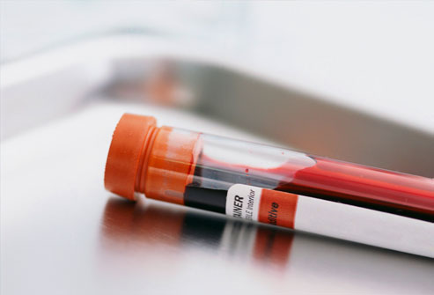
Example: A sample of blood at 25°C has [H⁺]=4.60 x 10⁻⁸ mol dm⁻³. Calculate the concentration of OH- and state whether the blood is acidic, neutral or basic.
K_{w} = [OH⁻][H⁺]
1.00 x 10⁻¹⁴ = [OH⁻][4.60 x 10⁻⁸]
[OH⁻] = 2.17 x 10⁻⁷ M
Since [OH⁻] > [H⁺],
the sample is basic.

Slide 17
Example: A sample of blood at 25°C has [H⁺]=4.60 x 10⁻⁸ mol dm⁻³. Calculate the concentration of OH- and state whether the blood is acidic, neutral or basic.
How would you expect its pH to be altered at body temperature (37°C)?
As temp. ↑, K_{w} and [H+] ↑ ∴pH ↓

Slide 18
pH and pOH scales are inter-related
pOH= -log[OH⁻]

Slide 19
pH and pOH scales are inter-related
From the relationship:
K_{W} = [H⁺][OH⁻]
-log K_{W} = -log([H⁺][OH⁻])
-log K_{W} = (-log[H⁺]) + (-log[OH⁻])
pK_{W} = pH + pOH
at 25°C, K_{W} = 1.0 x10⁻¹⁴, thus
14.00 = pH + pOH at 25°C

Slide 20
Given any one of the following we can find the other three: [H⁺],[OH⁻],pH and pOH
[H⁺]
10⁰
10⁻¹
10⁻³
10⁻⁵
10⁻⁷
10⁻⁹
10⁻¹¹
10⁻¹³
10⁻¹⁴
pH
0
1
3
5
7
9
11
13
14
Acidic
Neutral
Basic
14
13
11
9
7
5
3
1
0
pOH
10⁻¹⁴
10⁻¹³
10⁻¹¹
10⁻⁹
Basic
10⁻⁷
10⁻⁵
10⁻³
10⁻¹
10⁰
[OH⁻]

Slide 21
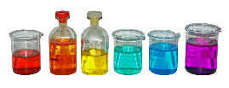
Summary of Key Equations
pOH= -log[OH⁻]
pH= -log[H⁺]
K_{W} = [H⁺][OH⁻]
pK_{W} = pH + pOH, and thus
14.00 = pH + pOH (at 25°C)
NOTE:
These equations apply
to all aqueous solutions
(not just to pure water)

Slide 22
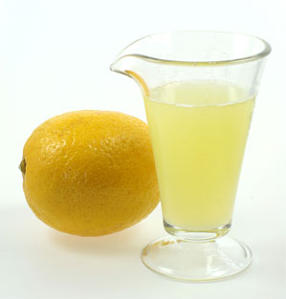
Example: Lemon juice has a pH of 2.90 at 25°C. Calculate its [H⁺],[OH⁻], and pOH.
pOH:
pOH= 14.00 – 2.90 = 11.10
[H⁺]:
pH = -log[H⁺]
2.90 = -log[H⁺]
[H⁺] = 10^{-2.90} = 1.3 x 10⁻³ mol dm⁻³
[OH⁻]:
[OH⁻] = 10^{-11.10} = 7.9 x 10⁻¹²mol dm⁻³

