Slide 1
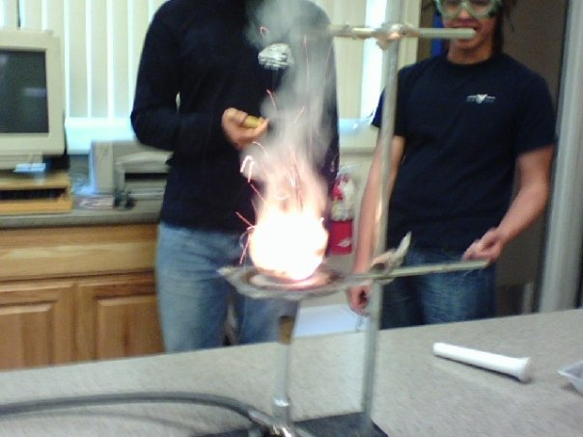
Energetics
IB Topics 5 & 15
PART 1: Heat and Calorimetry
Above: thermit rxn

Slide 2
Energy: a measure of the ability to do work.
Work: to move an object against an opposing force.
Energy (J) = Force (N) x Distance (m)
Forms of energy include: heat, light, sound, electricity, and chemical energy (energy released or absorbed during chemical rxns)

Slide 3
Enthalpy (H): a measure of internal energy stored in a substance.
Absolute value of enthalpy of reactants cannot be known, nor can enthalpy of products in a rxn.
Enthalpy change (ΔH) in a rxn can be measured (difference between reactants and products).
Standard enthalpy change of a rxn (ΔH^{ϴ}): measured at pressure = 1 atm; temp = 298 K

Slide 4
EXOTHERMIC & ENDOTHERMIC RXNS
Exothermic rxns: release energy in the form of heat (because bonds in the products are stronger than the bonds in the reactants); decreasing enthalpy has neg. sign (ΔH < 0)
Diagram:
reactants
Enthalpy, H
ΔH = negative
products
extent of rxn

Slide 5
EXOTHERMIC & ENDOTHERMIC RXNS
Endothermic rxns: absorb energy in the form of heat; increasing enthalpy, positive value (ΔH > 0)
Diagram:
products
Enthalpy, H
ΔH = positive
reactants
extent of rxn

Slide 6
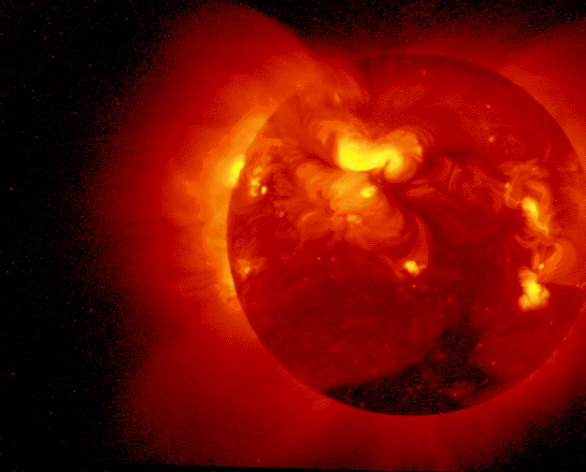
TEMPERATURE AND HEAT
Heat: a measure of the total energy in a given amount of a substance (and therefore depends on the amount of substance present).

Slide 7
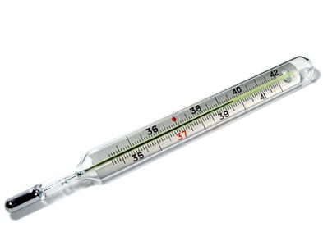
TEMPERATURE AND HEAT
Temperature: a measure of the “hotness” of a substance. It represents the average kinetic energy of the substance (but is independent of the amount of substance present).

Slide 8
TEMPERATURE AND HEAT
Example: Two beakers of water. Both have same temperature, but a beaker with 100 cm³ of water contains twice as much heat as a beaker containing 50 cm³.
Same temp, but MORE HEAT

Slide 9
TEMPERATURE AND HEAT
The increase in temp. when an object is heated depends on
The mass of the object
The heat added
The nature of the substance (different substances have different “specific heat” values)

Slide 10
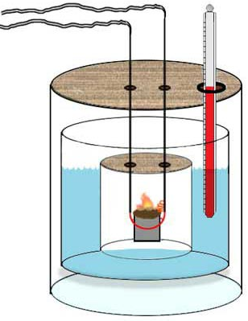
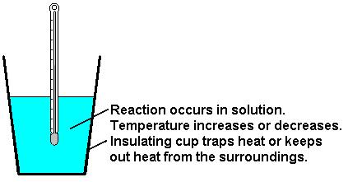
CALORIMETRY
The enthalpy change for a rxn can be measured experimentally by using a calorimeter.
simple calorimeter
(a.k.a. “coffee cup calorimeter”)
bomb calorimeter

Slide 11
CALORIMETRY
In a simple “coffee cup” calorimeter, all heat evolved by an exothermic rxn is used to raise temp. of a known mass of H₂O.
For endothermic rxns, heat transferred from the H₂O to the rxn can be calculated by measuring the lowering of the temperature of a known mass of water.

Slide 12
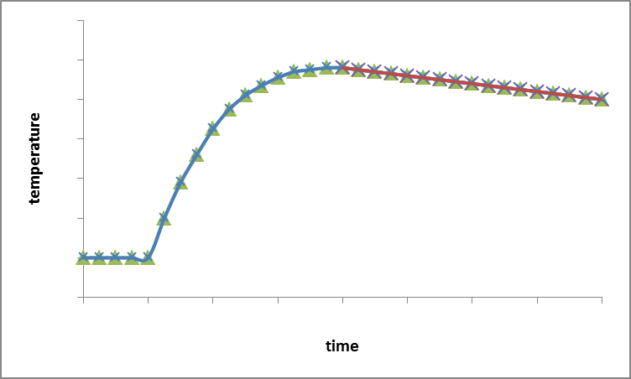
Compensating for heat loss:
Graph temp. v. time
T₃
cooling trendline
T₂
ΔT
T₁ = initial temp.
T₂ = max temp. measured
T₃ = max temp. if no heat loss
T₁
ΔT = T₃ - T₁
By extrapolating the graph, the temp rise that would have taken place had the rxn been instantaneous can be calculated.

Slide 13
CALCULATION OF ENTHALPY CHANGES (ΔH)
The heat involved in changing the temperature of any substance can be calculated as follows:
Heat energy = mass (m) x specific heat capacity (c) x temperature change (ΔT)
(Remember q = mcΔT from H Chem?)

Slide 14
CALCULATION OF ENTHALPY CHANGES (ΔH)
Specific heat capacity of H₂O = 4.18 kJ kg⁻¹ K⁻¹
Thus, 4.18 kJ of energy are required to raise the temp of 1 kg of water by one Kelvin.
Note that this is effectively the same as the complex unit J/g⋅°C (from Honors Chem)

Slide 15
CALCULATION OF ENTHALPY CHANGES (ΔH)
Enthalpy changes are normally quoted in kJ mol⁻¹ for either a reactant or product, so it is also necessary to work out the number of moles involved in the reaction which produces the heat change in the water.

Slide 16
Example 1: 50.0 cm³ of 1.00 mol dm⁻³ hydrochloric acid solution was added to 50.0 cm³ of 1.00 mol dm⁻³ sodium hydroxide solution in a polystyrene beaker. The initial temperature of both solutions was 16.7 °C. After stirring and accounting for heat loss the highest temperature reached was 23.5 °C. Calculate the enthalpy change for this reaction.
Step 1: Write the equation for reaction
HCl(aq) + NaOH(aq) → NaCl(aq) + H₂O(l)

Slide 17
Example 1: 50.0 cm³ of 1.00 mol dm⁻³ hydrochloric acid solution was added to 50.0 cm³ of 1.00 mol dm⁻³ sodium hydroxide solution in a polystyrene beaker. The initial temperature of both solutions was 16.7 °C. After stirring and accounting for heat loss the highest temperature reached was 23.5 °C. Calculate the enthalpy change for this reaction.
Step 2: Calculate molar quantities
∴heat evolved will be for 0.0500 mol

Slide 18
Example 1: 50.0 cm³ of 1.00 mol dm⁻³ hydrochloric acid solution was added to 50.0 cm³ of 1.00 mol dm⁻³ sodium hydroxide solution in a polystyrene beaker. The initial temperature of both solutions was 16.7 °C. After stirring and accounting for heat loss the highest temperature reached was 23.5 °C. Calculate the enthalpy change for this reaction.
Step 3: Calculate heat evolved
Total vol. sol’n = 50.0 + 50.0 = 100.0 mL
Assume sol’n has same density and specific heat capacity as water, then…
Mass of “water” = 100.0 g
ΔT = 23.5 – 16.7 = 6.8 °C
heat evolved = 100.0g x 4.18J/g°C x 6.8 °C
= 2.84 kJ/mol (for 0.0500 mol)
neg. value = exothermic

Slide 19
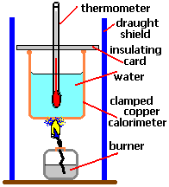
Example 2: A student uses a simple calorimeter to determine the enthalpy change for the combustion of ethanol (C₂H₅OH). When 0.690 g of ethanol was burned it produced a temperature rise of 13.2 K in 250 g of water.
Calculate ΔH for the reaction
C₂H₅OH(l) + 3O₂(g) → 2CO₂(g) + 3H₂O(l)
Heat evolved = 250g x 4.18J/g°C x 13.2°C
Heat evolved = 13.79 kJ (for 0.015 mol ethanol)
neg. value = exothermic

Slide 20
Example 2: A student uses a simple calorimeter to determine the enthalpy change for the combustion of ethanol (C₂H₅OH). When 0.690 g of ethanol was burned it produced a temperature rise of 13.2 K in 250 g of water.
b) The IB Data Book value is -1371 kJ mol⁻¹. Provide reasons for any discrepancy between this and the calculated value above.
Not all heat produced is transferred to the water
Water loses some heat to surroundings
Incomplete combustion of ethanol

Slide 21
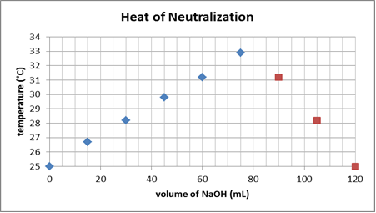
Example 3:The neutralization reaction between solutions of NaOH and H₂SO₄ was studied by measuring the temperature changes when different volumes of the two solutions were mixed (hint: just like your molar ratio lab). The total volume was kept constant at 120.0 cm³ and the concentrations of the two solutions were both 1.00 mol dm⁻³ (Figure 5.2).
Linear trend of increasing temp
Linear trend of decreasing temp
Figure 5.2: Temperature changes produced when different volumes of NaOH and H₂SO₄ are mixed.
a) Annotate Fig. 1 appropriately and determine the volumes of the solutions which produce the largest increase in temperature.
From the graph: V_{NaOH} = 80 mL
V_{H2SO4} = 120 mL - 80 mL = 40 mL

Slide 22
Example 3:The neutralization reaction between solutions of NaOH and H₂SO₄ was studied by measuring the temperature changes when different volumes of the two solutions were mixed (hint: just like your molar ratio lab). The total volume was kept constant at 120.0 cm³ and the concentrations of the two solutions were both 1.00 mol dm⁻³ (Figure 5.2).
Figure 5.2: Temperature changes produced when different volumes of NaOH and H₂SO₄ are mixed.
b) Calculate the heat produced by the reaction when the maximum temperature was produced.
heat produced = m_{H2O} x c_{H2O} x ΔT_{H2O}

Slide 23
Example 3:The neutralization reaction between solutions of NaOH and H₂SO₄ was studied by measuring the temperature changes when different volumes of the two solutions were mixed (hint: just like your molar ratio lab). The total volume was kept constant at 120.0 cm³ and the concentrations of the two solutions were both 1.00 mol dm⁻³ (Figure 5.2).
T_{f}
T_{i}
Figure 5.2: Temperature changes produced when different volumes of NaOH and H₂SO₄ are mixed.
b) Calculate the heat produced by the reaction when the maximum temperature was produced.
ΔT_{H2O} = T_{f} - T_{i} = (33.5 – 25.0) = 8.5 °C

Slide 24
Example 3:The neutralization reaction between solutions of NaOH and H₂SO₄ was studied by measuring the temperature changes when different volumes of the two solutions were mixed (hint: just like your molar ratio lab). The total volume was kept constant at 120.0 cm³ and the concentrations of the two solutions were both 1.00 mol dm⁻³ (Figure 5.2).
Remember that significant figures for temperatures are always based on the Kelvin temp… thus 8.5 °C is really
8.5°C + 273.15 = 281.2 K (4 sig figs)
T_{f}
T_{i}
Figure 5.2: Temperature changes produced when different volumes of NaOH and H₂SO₄ are mixed.
b) Calculate the heat produced by the reaction when the maximum temperature was produced.
heat produced = 120.0g x 4.18 J/g°C x 8.5 °C = 4264 J
heat produced ≈ 4260 J

Slide 25
Example 3:The neutralization reaction between solutions of NaOH and H₂SO₄ was studied by measuring the temperature changes when different volumes of the two solutions were mixed (hint: just like your molar ratio lab). The total volume was kept constant at 120.0 cm³ and the concentrations of the two solutions were both 1.00 mol dm⁻³ (Figure 5.2).
c) Calculate the heat produced for one mole of NaOH.

Slide 26
Example 3:The neutralization reaction between solutions of NaOH and H₂SO₄ was studied by measuring the temperature changes when different volumes of the two solutions were mixed (hint: just like your molar ratio lab). The total volume was kept constant at 120.0 cm³ and the concentrations of the two solutions were both 1.00 mol dm⁻³ (Figure 5.2).
d) The literature value for the enthalpy of neutralization is -57.5 kJ mol⁻¹. Calculate the percentage error value and suggest a reason for the discrepancy between the experimental and literature values.

Slide 27
Example 3:The neutralization reaction between solutions of NaOH and H₂SO₄ was studied by measuring the temperature changes when different volumes of the two solutions were mixed (hint: just like your molar ratio lab). The total volume was kept constant at 120.0 cm³ and the concentrations of the two solutions were both 1.00 mol dm⁻³ (Figure 5.2).
d) The literature value for the enthalpy of neutralization is -57.5 kJ mol⁻¹. Calculate the percentage error value and suggest a reason for the discrepancy between the experimental and literature values.
1)The calculated value assumes:
No heat loss from the system
All heat is transferred to the water
The sol’ns contain 120 g of water
2) Uncertainties in the temp., vol. and concentration measurements.
3) Literature value assumes standard conditions.

Slide 28
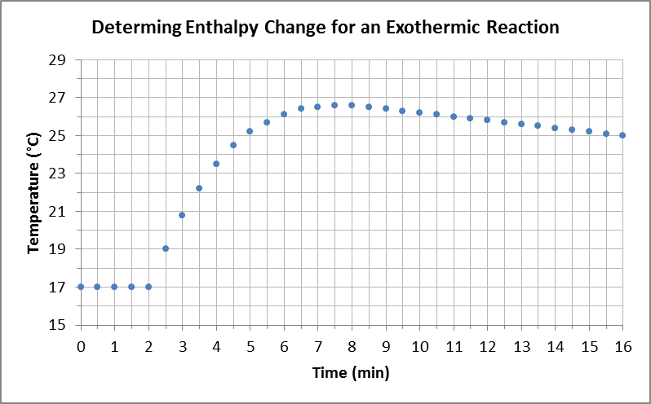
Example 4: 50.0 cm³ of 0.200 mol dm⁻³ copper (II) sulfate solution was placed in a polystyrene cup. After two minutes, 1.20 g of powdered zinc was added. The temperature was taken every 30 seconds and the following graph obtained. Calculate the enthalpy change for the reaction taking place (Figure 5.3).
Figure 5.3: Compensating for heat lost in an experiment measuring temperature changes in an exothermic reaction.
Step 1: Write the equation for the reaction.
Cu²⁺(aq) + Zn(s) → Cu(s) + Zn²⁺(aq)

Slide 29
Example 4: 50.0 cm³ of 0.200 mol dm⁻³ copper (II) sulfate solution was placed in a polystyrene cup. After two minutes, 1.20 g of powdered zinc was added. The temperature was taken every 30 seconds and the following graph obtained. Calculate the enthalpy change for the reaction taking place (Figure 5.3).
Figure 5.3: Compensating for heat lost in an experiment measuring temperature changes in an exothermic reaction.
Step 2: Determine the limiting reagent.
∴ Cu²⁺(aq) is the limiting reactant

Slide 30
ΔT
Figure 5.3: Compensating for heat lost in an experiment measuring temperature changes in an exothermic reaction.
Step 3: Extrapolate the graph to compensate for heat loss and determine ΔT.
ΔT = 27.4 – 17.0 = 10.4 °C

Slide 31
Example 4: 50.0 cm³ of 0.200 mol dm⁻³ copper (II) sulfate solution was placed in a polystyrene cup. After two minutes, 1.20 g of powdered zinc was added. The temperature was taken every 30 seconds and the following graph obtained. Calculate the enthalpy change for the reaction taking place (Figure 5.3).
Step 4: Calculate the heat evolved in the experiment for 0.0100 mol of reactants.
Assume sol’n mass is approx.= mass of 50.0 mL of water
Heat evolved = 0.0500g x 4.18J/g°C x 10.4°C
Heat evolved = 2.17 kJ

Slide 32
Example 4: 50.0 cm³ of 0.200 mol dm⁻³ copper (II) sulfate solution was placed in a polystyrene cup. After two minutes, 1.20 g of powdered zinc was added. The temperature was taken every 30 seconds and the following graph obtained. Calculate the enthalpy change for the reaction taking place (Figure 5.3).
Step 5: Express this as the enthalpy change for the reaction (ΔH).
neg. value = exothermic

